Slide 1
INTRODUCTION:
WAMPANOAG LAND
QUAKER REFUGE
ERICA H. ADAMS
West Falmouth Quaker Meeting
Legacy Grant (2019) + (2017)
Faculty (retired) Tufts University

Slide 2
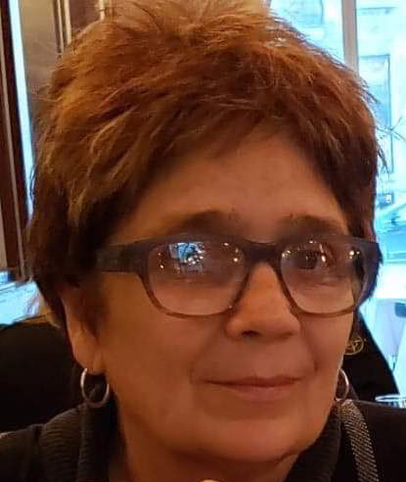
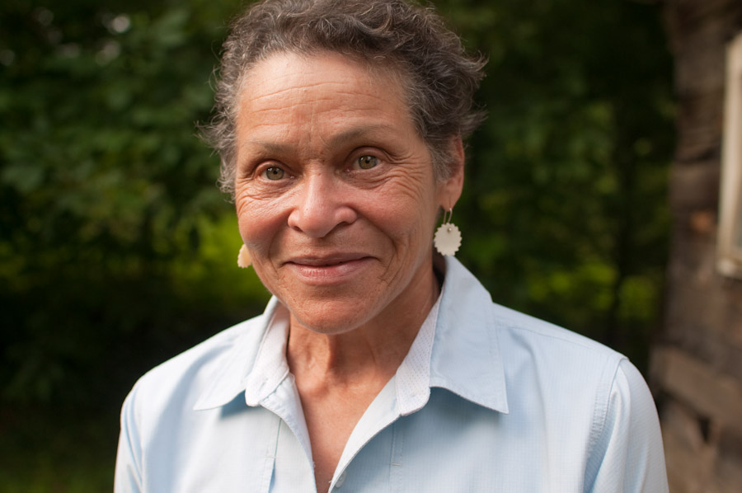
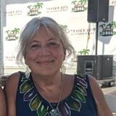
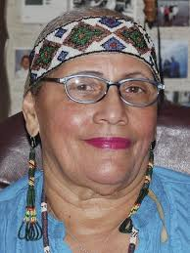
INTRO: WAMPANOAG LAND + QUAKER REFUGE
ERICA H ADAMS www.EricaHAdams.com
  WEST FALMOUTH QUAKER + MASHPEE resident
  ARTIST + WRITER + CURATOR + Retired FACULTY of Fine Arts at Tufts University
  West Falmouth Library Grant RESEARCH + ORAL HISTORIES including Wampanoag
  QUAKER: (2) LEGACY GRANTS (2019 + 2017) to create dialogues about diversity + peace:
    Respeto/Respect a CHIAPAS PHOTOGRAPHY PROJECT traveling exhibition
WAMPANOAG SPIRITUALITY
RAMONA/Nosapocket PETERS
  MASHPEE WAMPANOAG ----BEAR CLAN Member
  PRESIDENT + FOUNDER: NATIVE LAND CONSERVANCY, INC a Mashpee Wampanoag non-profit
QUAKERS + WAMPANOAGS
GAIL MELIX
  MANOMET WAMPANOAG
  QUAKER: SANDWICH MONTHLY MEETING + NEYM EARTH CARE MINISTRY COMMITTEE
  Retired RN – Falmouth Hospital + Cape Cod Hospital
WAMPANOAG FOOD
JOAN TAVARES AVANT aka “GRANNY SQUANNIT”
  MASHPEE WAMPANOAG DEER CLAN MOTHER + HISTORIAN + TRIBAL PRESIDENT (3 terms)
  DIRECTOR of INDIAN EDUCATION (25 YEARS) in the MASHPEE PUBLIC SCHOOLS created curriculum for natives + non-natives
  AUTHOR People of the First Light (2010) + COLUMNIST Mashpee Enterprise + EDITOR National League of American Pen Women
  QUOTE: "I am honored to serve as a founding trustee for the WLRP project to open a K-3 immersion charter school in the fall of 2015.
It has been my forever passion to not only preserve the culture but to assist making wise pedagogic decisions for our children and families in their own public recognized tribal school".^{[2]} Wôpanâak Language Reclamation Project.
  WIKIPEDIA: https://en.wikipedia.org/wiki/Joan_Tavares_Avant

Slide 3
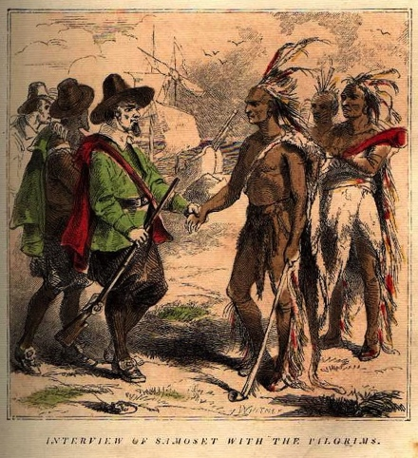
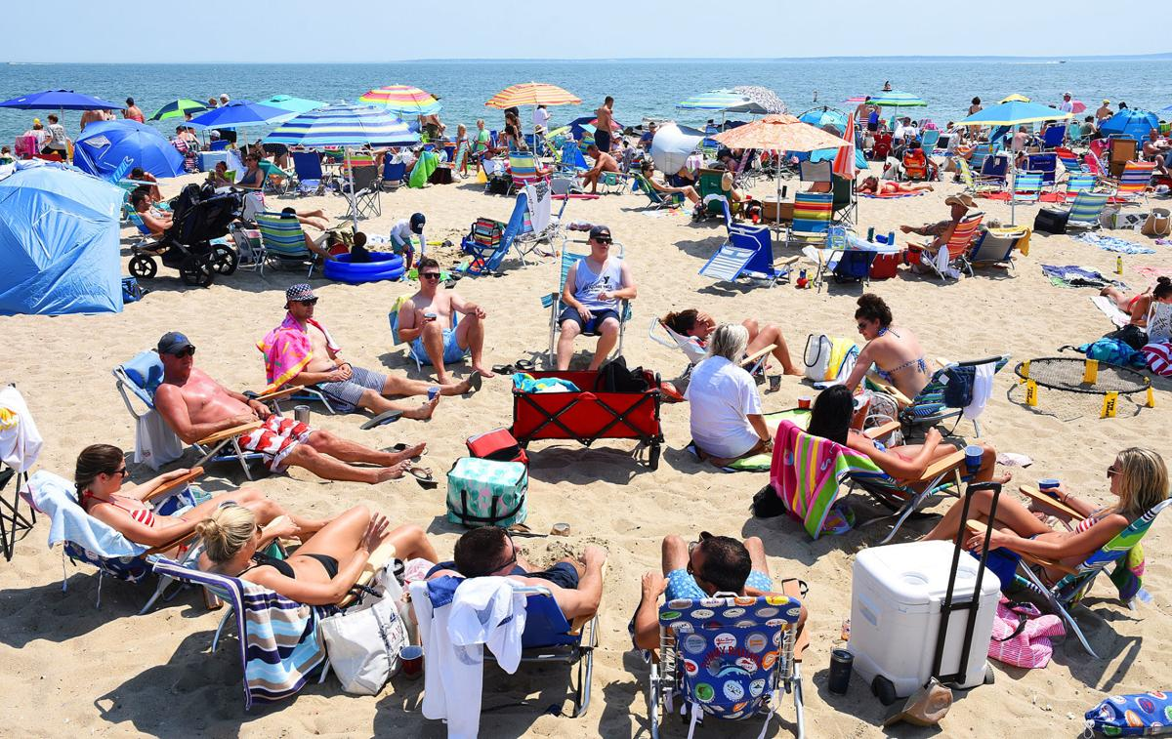
WEST FALMOUTH QUAKERS + MASHPEE WAMPANOAG
(Religious Society of Friends) + (“People of the First Light”)
400 YEARS:
FROM HERE TO THERE
WAMPANOAGS GREET PILGRIMS
RESORT LIFE
ERICA H. ADAMS
QUAKER: WEST FALMOUTH PREPARATIVE MEETING (MA)
Quaker LEGACY GRANTS (2019) + (2017)
U.S. COORDINATOR: CHIAPAS PHOTOGRAPHY PROJECT (México)

Slide 4
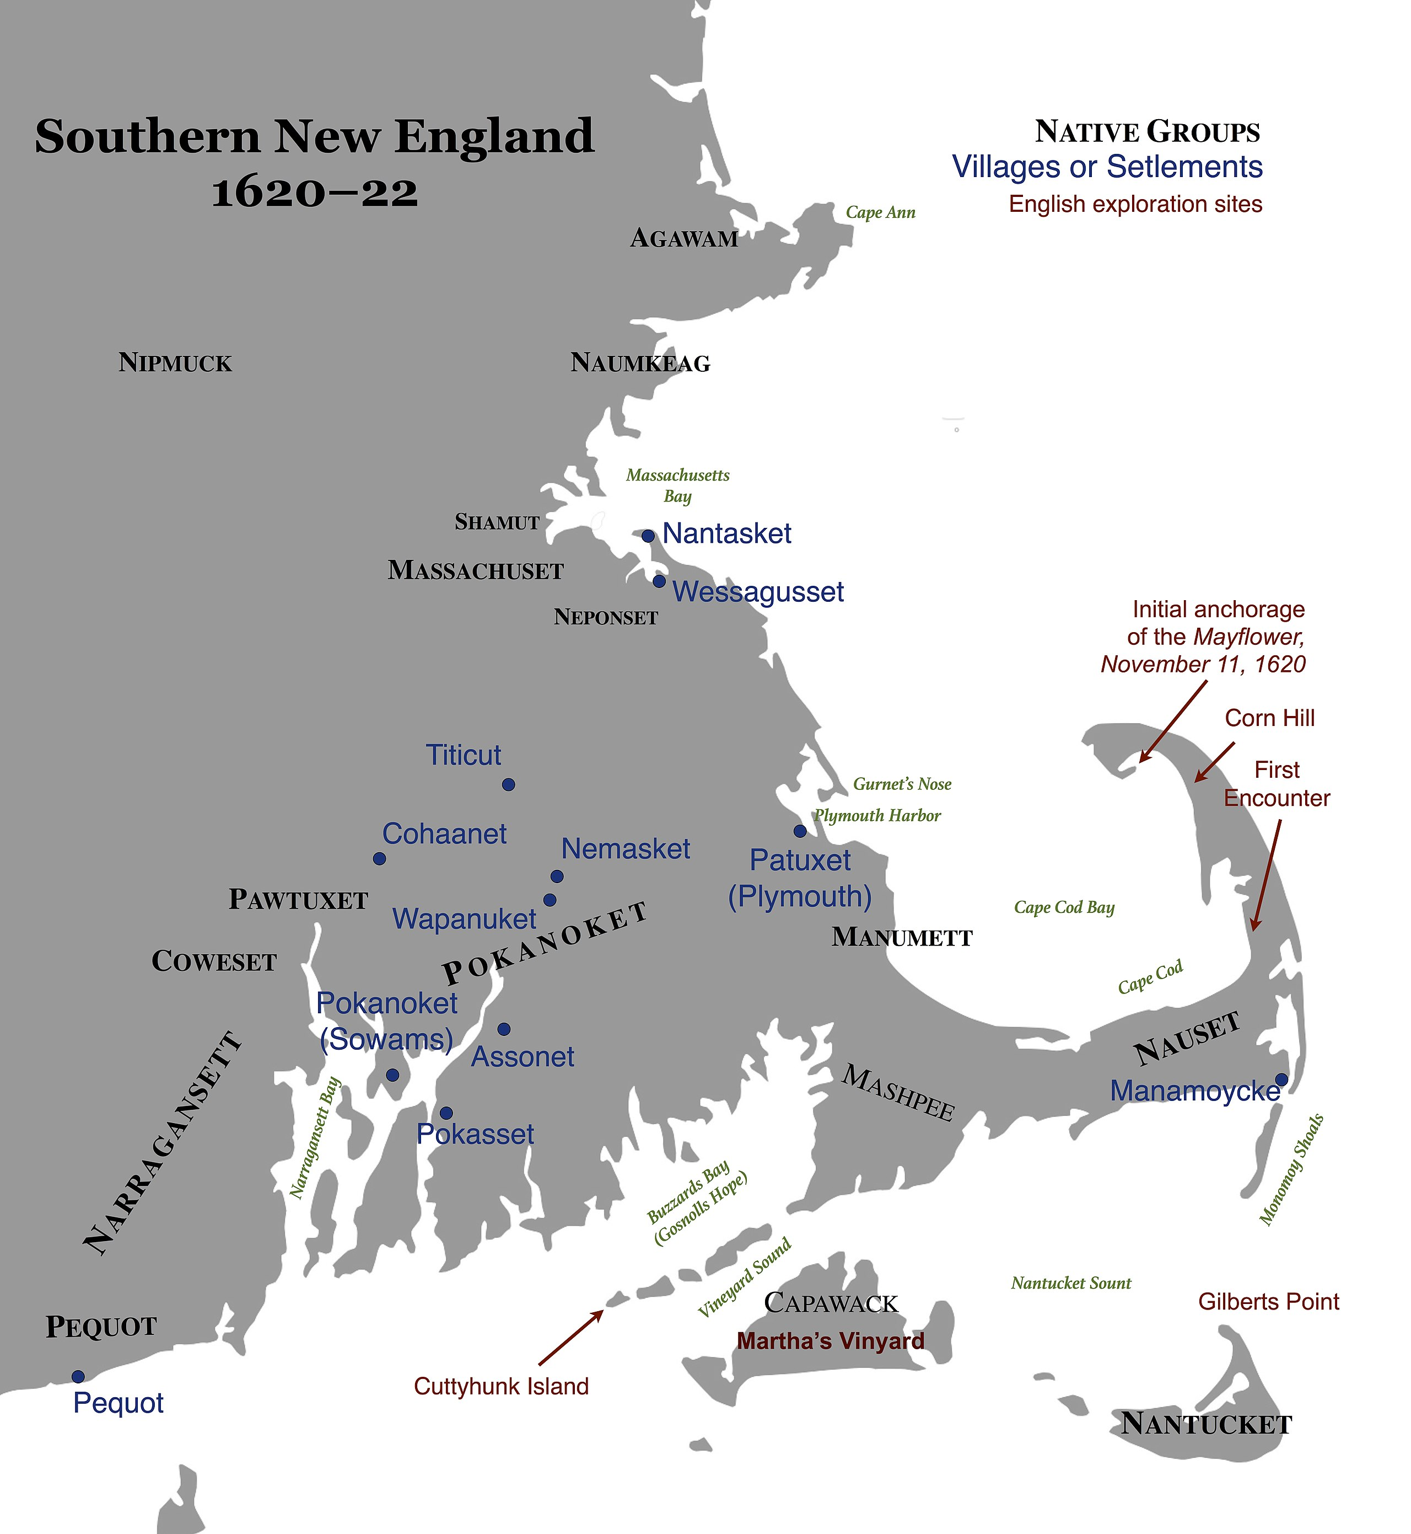
More than
12,000 years
MASHPEE
WAMPANOAG
Inhabited
Present day
MASSACHUSETTS
+
EASTERN
RHODE
ISLAND

Slide 5
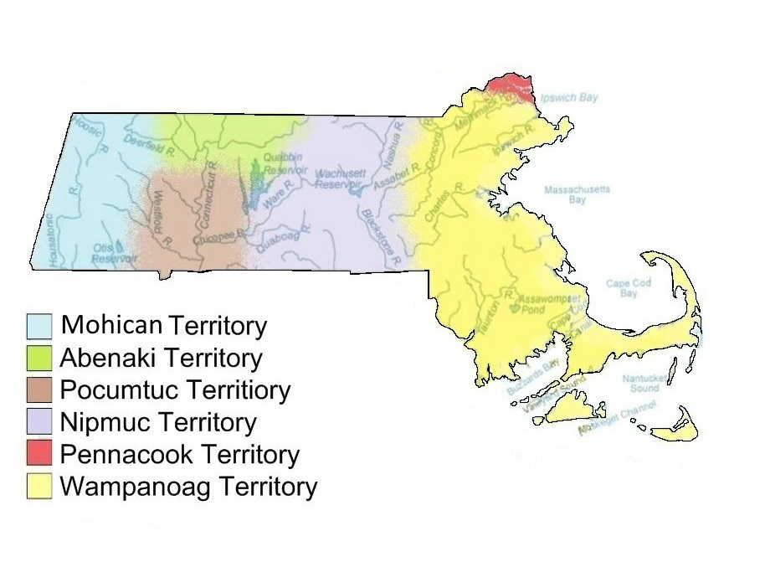
WAMPANOAG POPULATION from 1600 (12,000) to 2020 (2,600)
1600 12,000 with 40 villages
                8,000 mainland + 4,000 islands -Martha’s Vineyard + Nantucket
1614-20 3 EPIDEMICS New England + Canadian Maritimes
paved way for Puritans and Pilgrims
1675 2,000 mainland + 3,000 islands –Martha’s Vineyard + Nantucket
1,000
1675 -1676 400 survived King Philip’s War (27 went, 4 returned)
  FEVER killed 2/3 of Nantucket
2020 2,600 enrolled in MASHPEE WAMPANOAG TRIBE

Slide 6
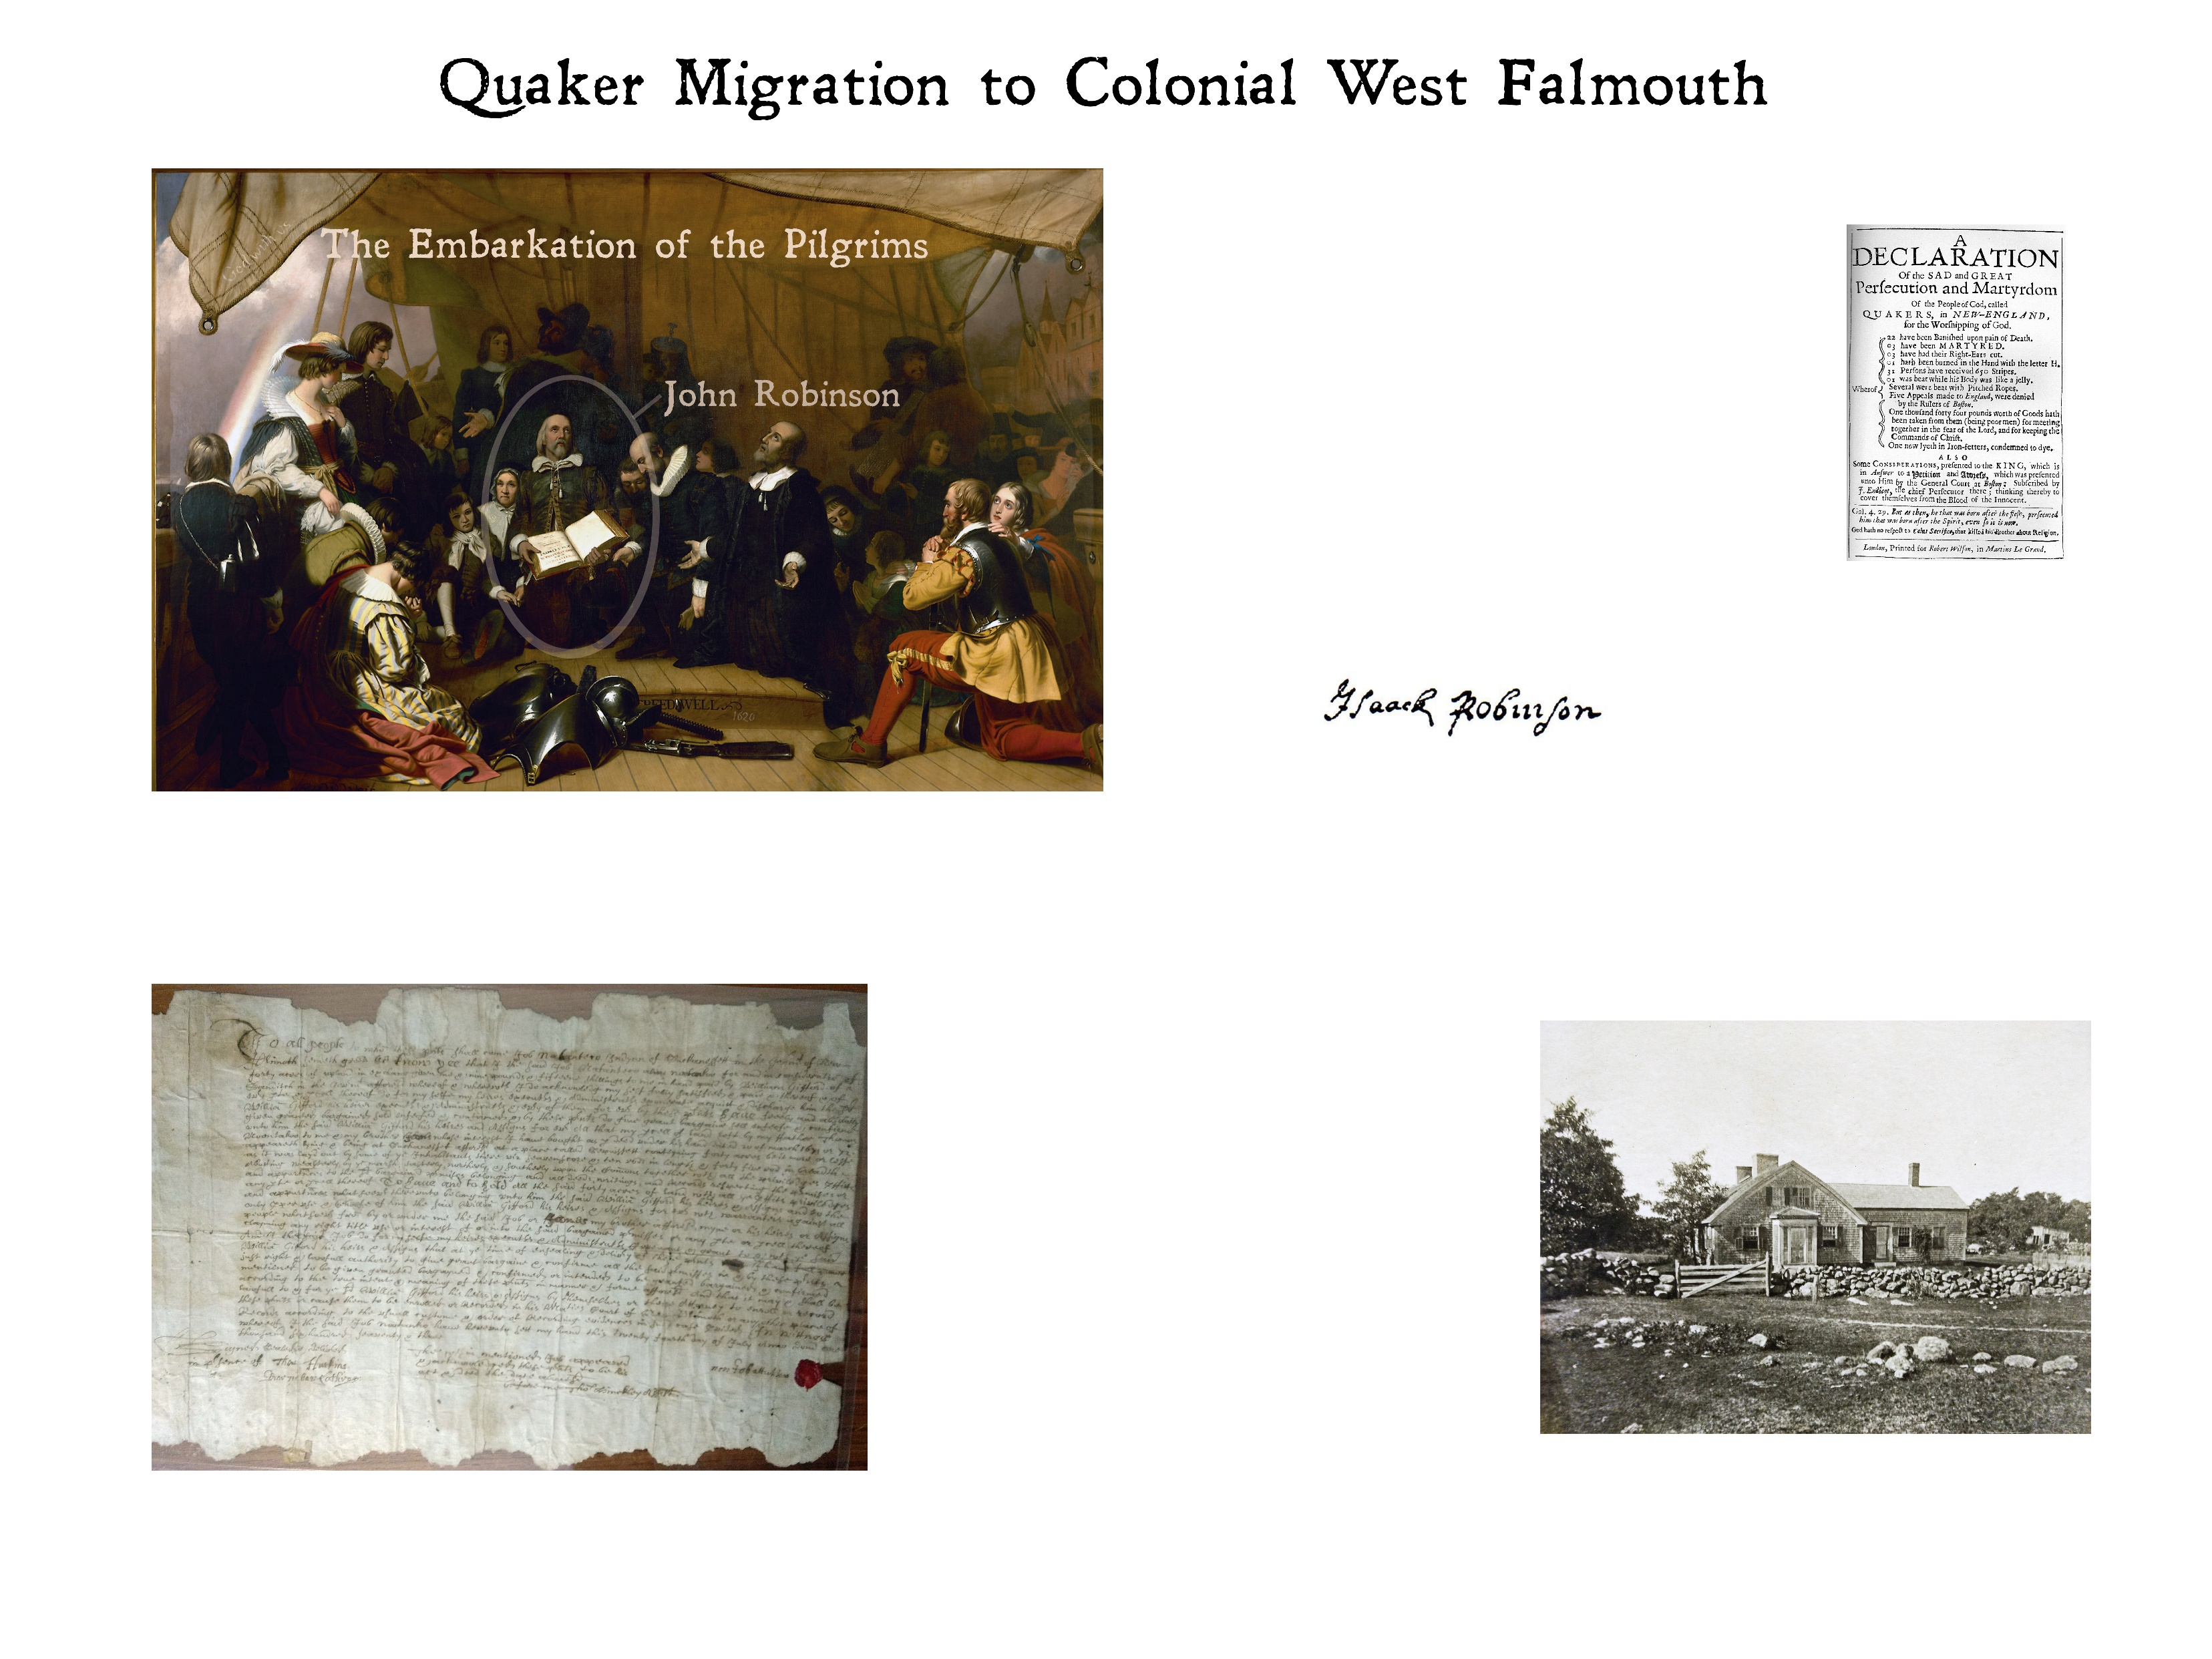
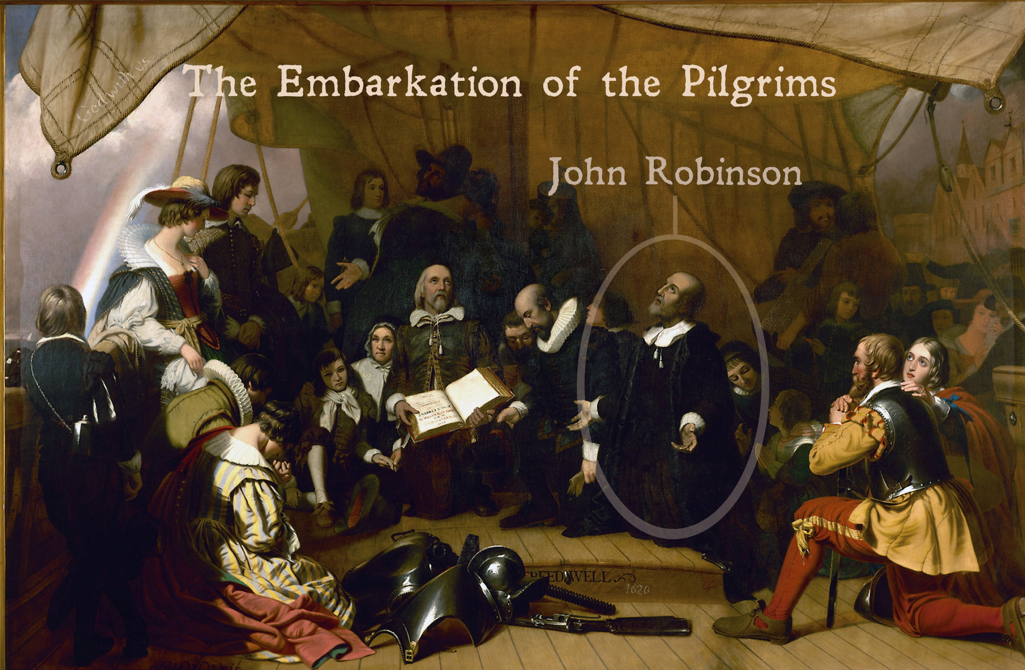
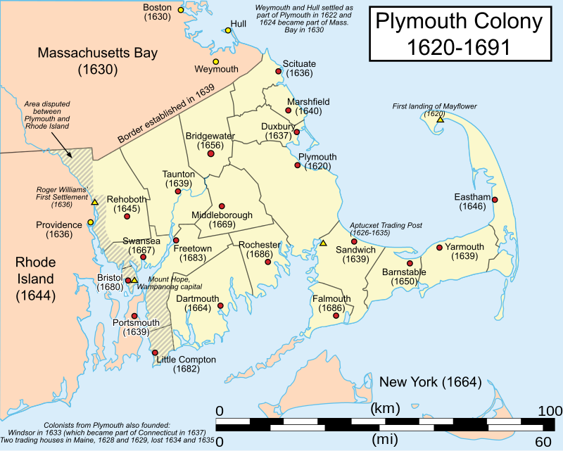
John Robinson (England 1575-1625 Netherlands) was the beloved pastor of the “Pilgrim Fathers” in Leiden.
Shown here praying with them before their departure on the Speedwell, the sister ship of the Mayflower, he remained in the Netherlands with part of his flock.
In 1631, his son Isaac Robinson sailed to the Plymouth Colony.
Isaac Robinson was esteemed in Plymouth and was one of four men chosen by the General Court in 1659 to attend Quaker meetings in Sandwich to try to understand these heretics and “reduce them from the error of their ways.”
Robert Walter Weir, 1843, U.S. Capitol Rotunda
In fact, Robinson found the Quakers congenial and, though he did not join them, he wrote to the governor suggesting they should not be persecuted. For this, the General Court found him a “manifest opposer of the laws” and disenfranchised him.
Even while he was disenfranchised, the Plymouth General Court permitted Robinson and others to form and settle the Town of Falmouth—known as Suckanesset until the 1690s.
The political reasons for this are murky, but it seems clear that both the General Court and Robinson were happy to maximize the distance separating them.
Given Robinson’s support for Quakers, this was a clear signal to them that life in FALMOUTH would be far preferable to the persecution they faced in Sandwich.
Wikipedia
Source: WEST FALMOUTH QUAKER INFORMATION CENTER 2019

Slide 7
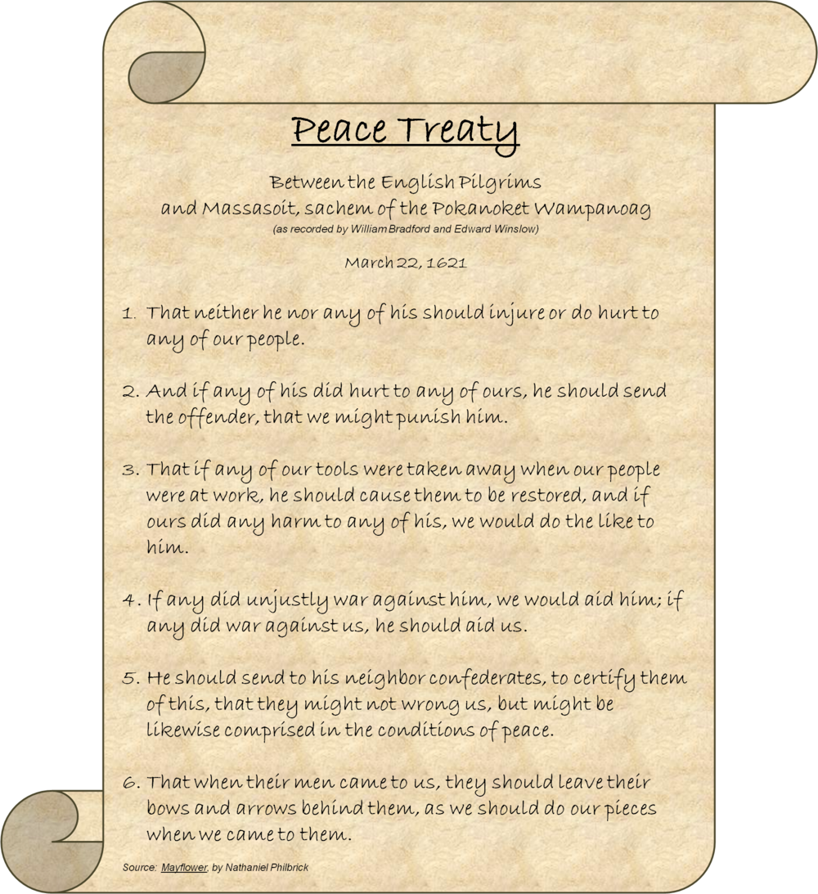
1621 WAMPANOAG Samoset (Abenaki/Maine 1590 -1653) : “WELCOME ENGLISHMEN”
+ English speaking Squanto (Tisquatum) (Pautuxet: PLymouth 1590-1622 Chatham)
HELPED PILGRIMS + PLYMOUTH COLONY
                ESTABLISH GOOD RELATIONSHIP WITH WAMPANOAG CHIEF MASSASOIT
    GROW CORN, FISH, and SURVIVAL SKILLS
    SIGNED TREATY OF FRIENDSHIP with MASSASOIT sachem of Pokanoket WAMPANOG
Engraving 1853

Slide 8
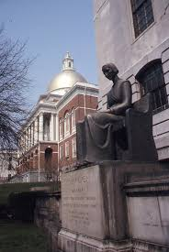
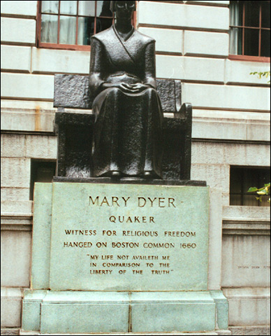
EARLY QUAKERS
MARY DYER
  QUAKER
HUNG on BOSTON COMMON
PURITAN response
JAILED + HUNG
SENT TO
    UK
    PILGRIMS in PLYMOUTH
    QUAKERS in SANDWICH
    FLED Sandwich to RHODE ISLAND or WEST FALMOUTH

Slide 9
“ALL YOU NEED TO KNOW
ABOUT
THE FOUNDING of the U.S.
IS
THE PURITANS WERE THROWN OUT OF LEIDEN”
THE MOST TOLERANT PLACE IN EUROPE.
1/2020 Pasquale G. Tatò, PhD Linguistics, Harvard University

Slide 10

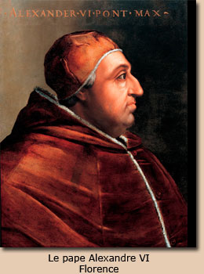
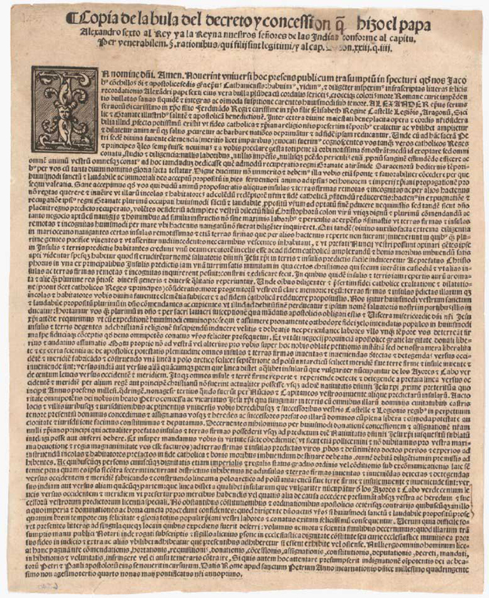
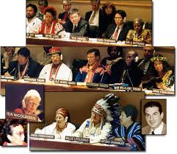
DOCTRINE of DISCOVERY (1493)
www.neym.org
Justified European Seizure of Land
From Native Americans
  The Doctrine of Discovery (1493)
  * “ESTABLISHED a spiritual, political, and legal justification for colonization and seizure of land not inhabited by Christians …invoked since Pope Alexander VI issued a Papal Bull ”Inter Caetera in 1493”.
  Demarcation Bull Granting Spain
  Possession of Lands Discovered by Columbus.
  (Rome, May 4, 1493 Pope Alexander VI)
United Nations (2012) PERMANENT FORUM
on INDIGENOUS ISSUES (UNPFII):
THE DOCTRINE of DISCOVERY has been severely condemned as socially unjust, racist and in violation of basic and fundamental human rights. And noted the THE DOCTRINE of DISCOVERY “as the foundation of the violation of their (indigenous people) human rights
  SAUL VICENTE VASQUEZ,
    Permanent Forum expert from Mexico, said:
    “Large multinational corporations continued to implement the Discovery Doctrine today, with “conquests” that included seizure of land and the erasing of fragile indigenous cultures”.
*
https://upstanderproject.org/firstlight/doctrine

Slide 11
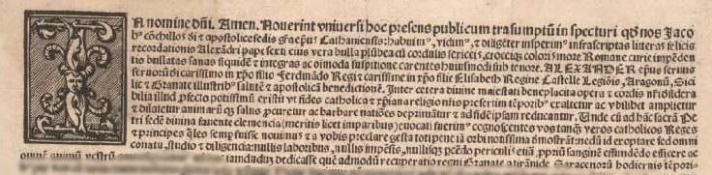
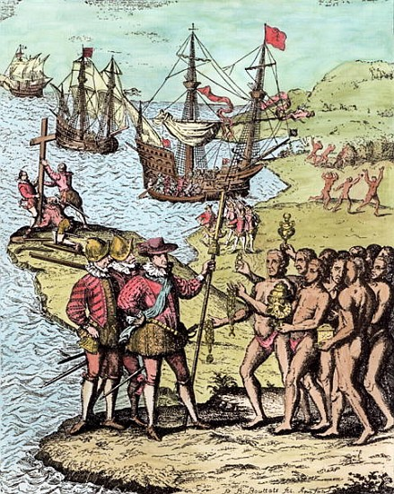
The significance of the Doctrine continues to be debated.
According to David Wilkins, “it is more complicated than just saying the Pope gave European Catholics the rights to colonize and convert.
In reality, the absolute denial of Native land rights was replaced less than fifty years later when Charles V… sought the advice of Francisco de Vitoria … as to what the Spanish could legally and morally claim in the New World. Vitoria, in a clear rebuttal to the Pope and the discovery notion, declared that Native peoples were the true owners of their lands.”
THE DOCTRINE of DISCOVERY
1800s INSPIRATION for MONROE DOCTRINE, which declared
U.S. hegemony over the Western Hemisphere, and
MANIFEST DESTINY justified American expansion westward by propagating belief that the U.S. was destined to control all land from the Atlantic to the Pacific and beyond.
1823 Supreme Court case, Johnson v. M'Intosh, the
Doctrine of Discovery became part of U.S. FEDERAL LAW and
was used to DISPOSSES Native peoples of their land.
In a unanimous decision, Chief Justice John Marshall writes,
“that the principle of discovery gave European nations an absolute right to New World lands”[1] and Native peoples certain rights of occupancy.
We study the Doctrine of Discovery to listen to voices that have been silenced and disregarded for centuries. These voices tell a frequently overlooked story about the origins of the United States.
https://upstanderproject.org/firstlight/doctrine

Slide 12
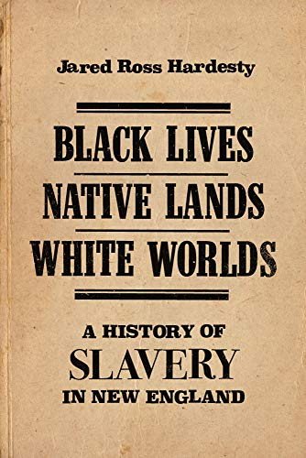
“Although religion inspired the settlement of New England
Colonists believed that to glorify God
and
do God’s errand in the wilderness
meant creating economically viable settlements …
yet these enterprises required considerable land and labor.
To develop both required an insidious system
where they would
dispossess local Indians from their land
through war and debt,
capture them, and exchange them,
usually in the Caribbean,
where New Englanders already had deep economic connections,
for African slaves. This human trafficking laid the foundation
for slavery in New England”.
Chapter 1, page 23: Black Lives, Native Lands, White Worlds -A History of Slavery in New England
Jared Ross Hardesty©2019, U Mass Amherst Press

Slide 13
Colonial New England: Land was plentiful and workers scarce
Downing’s letter is important to understanding the original nature of slavery in colonial New England.
Colonial expansion depended on two inter-related factors: displacement of the indigenous population and labor.
“1645 August, leading Salem MA resident and attorney Emmanuel Downing wrote to his brother-in-law and former Massachusetts governor John Winthrop about a war with the Narragansett Indians of modern Rhode Island.
Concerned about the spiritual well-being of the young colony,
Downing believed the conflict to be good and just.
Waging war on those who “mayneyne the wo[rshi]p of the devil” like the Narragansett would allow God to “deliver” Indian captives “into our hands.”
These prisoners in turn could be exchanged for African slaves which would be more useful than “wee conceive.”
Chapter 1: Black Lives, Native Lands, White Worlds -A History of Slavery in New England
Jared Ross Hardesty©2019, U Mass Amherst Press

Slide 14
“We name ourselves after the land we live with.
Because, not only are we breathing in, we are also drinking from the water that is flavored by that very land.
Whatever is deposited in the soil is in that water is in us.
So we are all one thing, and we name ourselves after the place that is our nurturing. That sustains our life.”
--- Ramona/Nosapocket Peters

Slide 15
NAMES
WAMPANOAG means "eastern people” – “People of the First Light”
Also called: Massasoit, Philip's Indians + very commonly in the early records, Pokanoket (Poncakanet).
Town of MASHPEE is an Anglicization of native name
mass-nippe: mass = “great” or “greater” (eg: Massachusetts) nippe = “water”
Translated as greater cove or great pond or land near great cove, referencing Wakeby Lake which is greater at one end.
LANGUAGE
Algonquin. N-dialect like the Massachuset, Nauset, and Narragansett.
Sub-tribes
WAMPANOAG CONFEDERACY
Agawam, Annawon, Assameekg, Assawompset, Assonet, Betty's Neck, Coaxet, Cohannet, Coneconarn (Cawnacome), Cooxissett, Cowsumpsit, Jones River, Loquasquseit, Mattakest (Mattakees, Mattakesset), Mattapoiset, Munponset, Nukkehkummeess, Namasket, Patuxet, Piowant (Piant), Pocasset (Corbitant, Caunbatant, Weetamoo), Pokanoket (Montaup, Sowam), Saltwater Pond, Shawomet (Shanomet), Shimmoah, Tispaquin (Tuspaquin), Totoson, Tyasks (Tyashk), and Wauchimoqut.
Nantucket:
Miacomit, Nantucket, Polpis, Sasacackeh, Shaukimmo, Siasconsit, Squam (Pennacook), Talhanio, and Tetaukimmo.
                Martha's Vineyard:
Capawack (Capawake), Cheesehahchamuk, Chaubaqueduck, Gay Head, Mankutquet, Nashamoiess, Nashanekammuck, Nohtooksaet, Nunnepoag, Onkonkemme, Pahkepunnasso, Sanchecantacket, Seconchqut, Tewanticut, Toohtoowee, and Warnpamag (Sanchakankachet).
WAMPANOAG PRAYING TOWNS before 1675:
Acushnet, Herring Pond (Comassakumkanit), Kitteaumut, Manomet, Pachade, Quittaub, Sakonnet, and Wawayontat. Also Toikiming on Nantucket and Gay Head on Martha's Vineyard
                PRAYING TOWNS in 1680:
Acushnet, Chappaquidgick, Coatuit, Cotuhikut, Gay Head, Meeshawn (Nauset), Mashpee (Marshpee), Matakees, Natick, Punkapog, Sakonnet, Toikiming, and Weequaket.
              Mainland Settlements in 1847:
Assonet, Chipaquadie, Christiantown, Dartmouth, Herring Pond, Mashpee, Mamatakesett Pond, Natick-Dudley-Grafton, Punkapog, Sakonnet, Tumpum Pond, and Yarmouth.

Slide 16
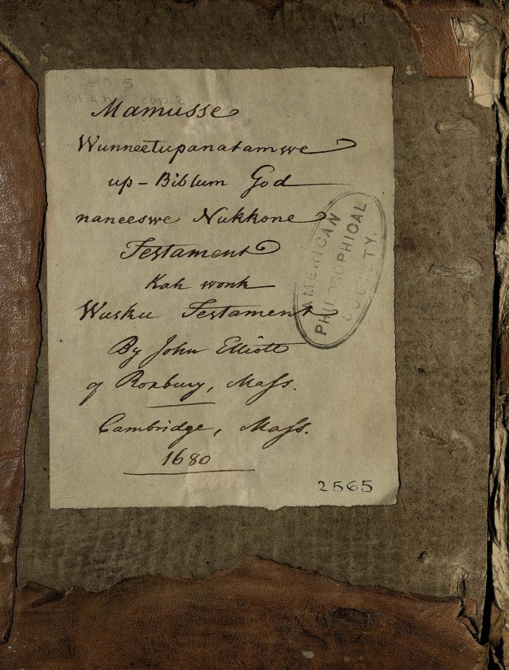
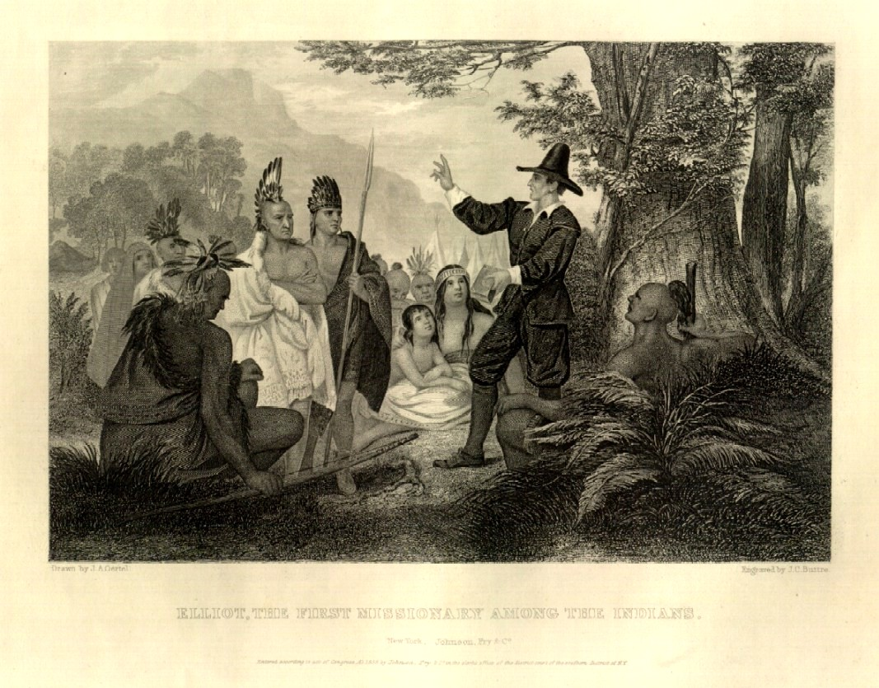
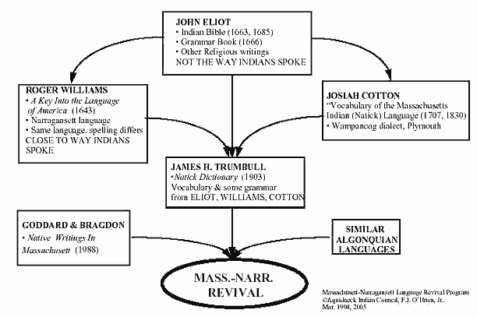
JOHN ELIOT 1663 1st BIBLE published in “America” in WAMPANOAG /Algonquin LANGUAGE
by what became HARVARD PRESS

Slide 17
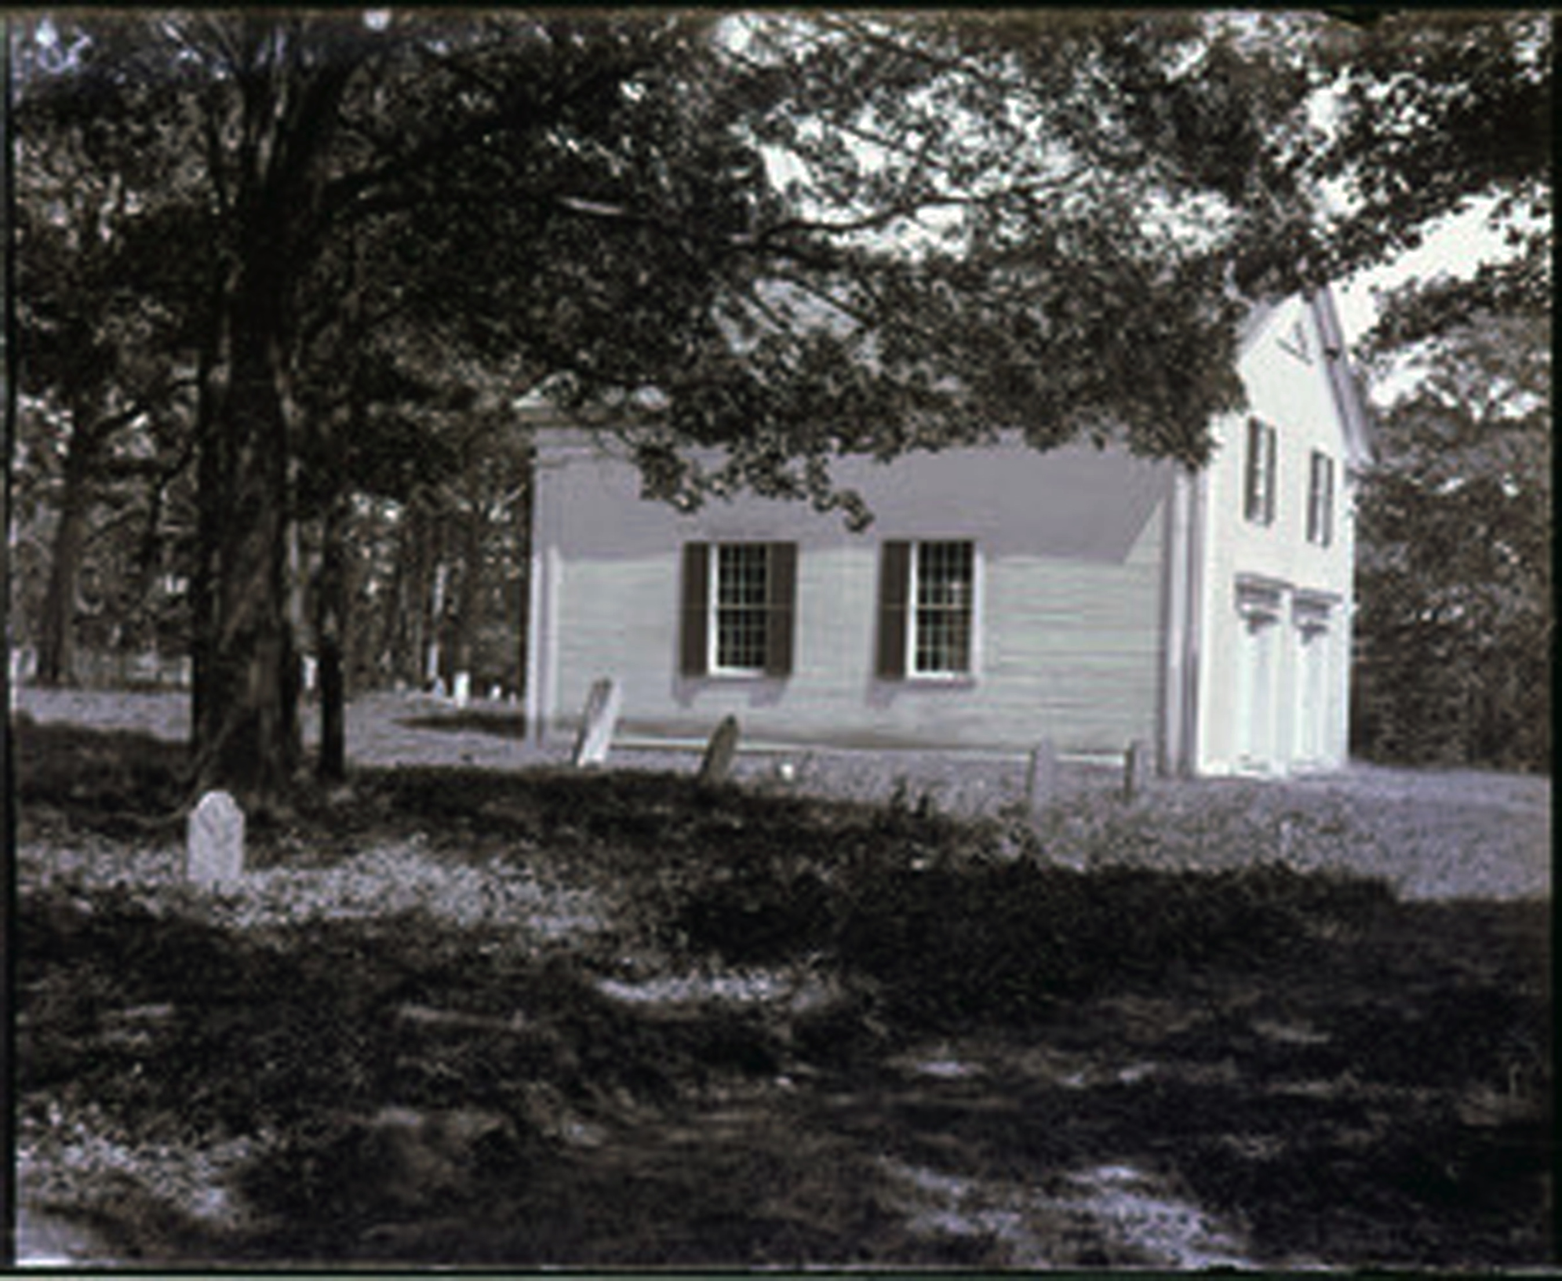
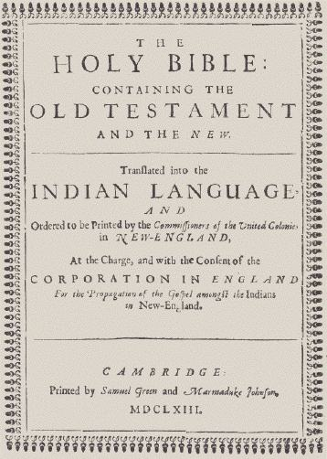
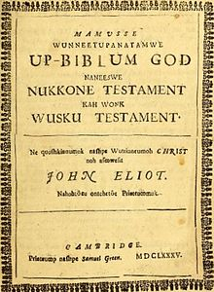
“PRAYING INDIANS”: OLD INDIAN MEETINGHOUSE, Mashpee, MA
1684 oldest Native American church in United States
  1663 1st Bible printed in America
  was in Wampanoag/Algonquin language
in Cambridge, MA -later Harvard University Press
Ministers appointed by Harvard College
“The Whole Holy His-Bible God, both Old Testament and also New Testament. This turned by the-servant-of-Christ, who is called John Eliot”
Mashpee’s Indian pastors + preachers:
  Richard Bourne, 1670 - 1685
  Simon Popmonet, 1685 - 1729
  Joseph Bourne, 1729 - 1742
  Gideon Hawley, 1758 - 1807
  Phineas Fish, 1808 -1833
  “Blind Joe” Amos, 1810 -1836
  William Apes, 1833 -1835
Old Indian Meetinghouse, Mashpee MA
PHOTO: 1898 -1905
  First Church
  1684 2nd built on site of 1st by Deacon John Hinckley
  1717 Moved to another site in Mashpee
1758 Described as being on present site

Slide 18
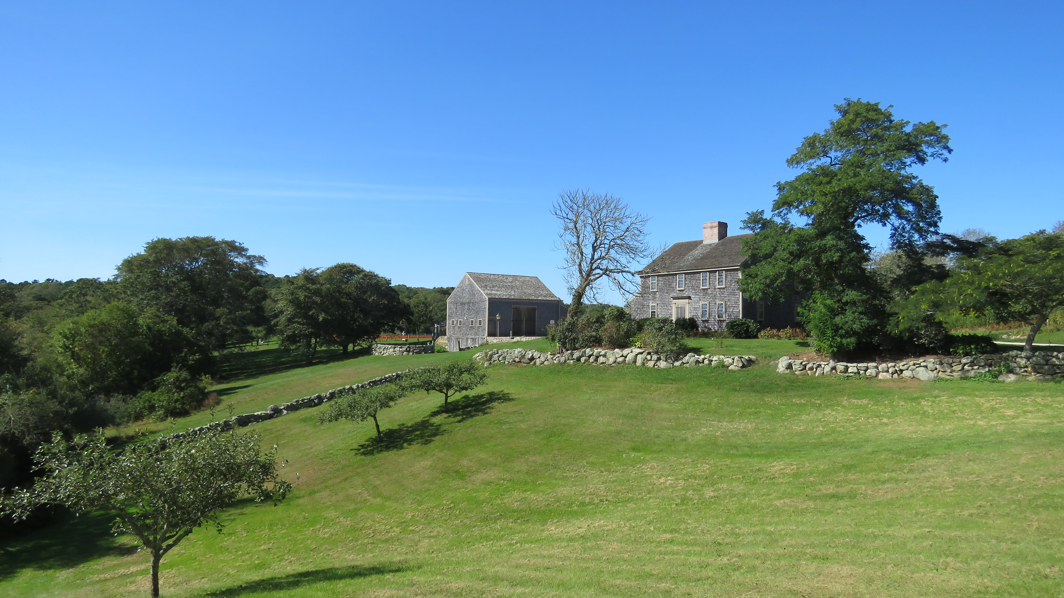
Rev. Richard Bourne (England 1610 – 1685 Sandwich MA at 73)
Mashpee Indian missionary, teacher, politician, missionary
Ordained by John Eliot; Learned + preached in Wampanoag language
  The court house ordered that Mr. Thomas Hinckley (last governor of Plymouth)
  Richard Bourne, & Marshall Bacon shall purchase all the land that they can of
  the Indians ; in those parts towards Sosoneessett.
1665 Bourne purchased a large tract of land for Government.
1667 Bourne purchased at Pocasset (West Falmouth) large tract.)
                https://archive.org/stream/historyofrichard00dyke/historyofrichard00dyke_djvu.txt

Slide 19
“PRAYING INDIANS”
English colonists began to settle the area of present-day Mashpee (MA) With assistance of HARVARD COLLEGE APPOINTED missionary RICHARD BOURNE (ENGLAND 1600 - 1682 USA) from Sandwich:
        BOURNE preached in WAMPANOAG, taught MASHPEES to read and write native tongue,
          HIS GOAL? Autonomy for Wampanoag, manage their own affairs, own land + have self respect. Worked 20 years to obtain land for at Mashpee for a Reservation.
              Plymouth Colony Records, Vol. 6, p.159 1 Mass. Historical Society Collections, Vol. 3 p 188:
          “THE ORIGINAL GRANT: unable to find either in the State Archives or at Barnstable, but it is said to have been obtained through the efforts of Richard Bourne, after 1600. In 1672, this grant was confirmed before John Alden by Quachetasset* https://archive.org/stream/richardbournemis00aye/richardbournemis00aye_djvu.txt
Colonists “allowed” Wampanoag converts to Christianity about 50 squares miles (130
km) in English settlement.
PRAYING INDIANS: Wampanoag governed themselves with a court of law and trials according to English custom.
1670-85 REV. BOURNE at Old Indian Meetinghouse, Mashpee MA
1675-76 KING PHILIP’S WAR MASHPEE WAMPANOAG + CAPE COD were geographically isolated
Following Wampanoag defeat in KING PHILIP’S WAR those on mainland were
      resettled with the Sakonnet in present-day Rhode Island.
      Other Wampanoag were forced to settle in praying towns, such as Mashpee, in Barnstable County on Cape Cod.
  Colonists
          SOLD many Wampanoag men into slavery in the Caribbean + enslaved women
  and children in New England.
          DESIGNATED Mashpee on Cape Cod, as largest Native American reservation in Massachusetts.

Slide 20
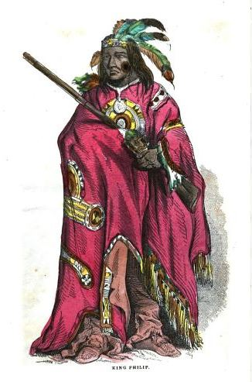
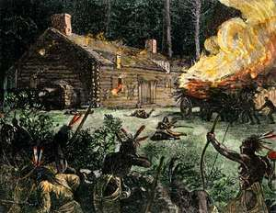
1675-76 KING PHILIP’S WAR (Metcomet)
Pan Indian War
against encroaching English
West Falmouth Quaker Samuel Boreman Bowman (1651 -1676: AGE 25)
The Indians of the Cape remained neutral during King Phillip’s War
and were considered a defense to Sandwich and the towns below.
In 1676 one reverse at Rehoboth, early in the war, cost the Cape 20 men
– Barnstable (6), Yarmouth and Sandwich (5) each, and Eastham (4).
Almost entire command of Captain Pierce of Scituate –(50) men
and (2) Indians –was massacred, including the captain himself.
Names of the Barnstable men lost were:
Samuel Child Linnet and Samuel Boreman or Bowman.
Unable to find the list from the other towns.
The Indians lost were Cape Indians
and only one was permitted to return.
Otis, Amos, 1801-1875, and Charles Francis Swift.
Geneological Note of Barnstable Families. Published in Barnstable, MA 1888

Slide 21


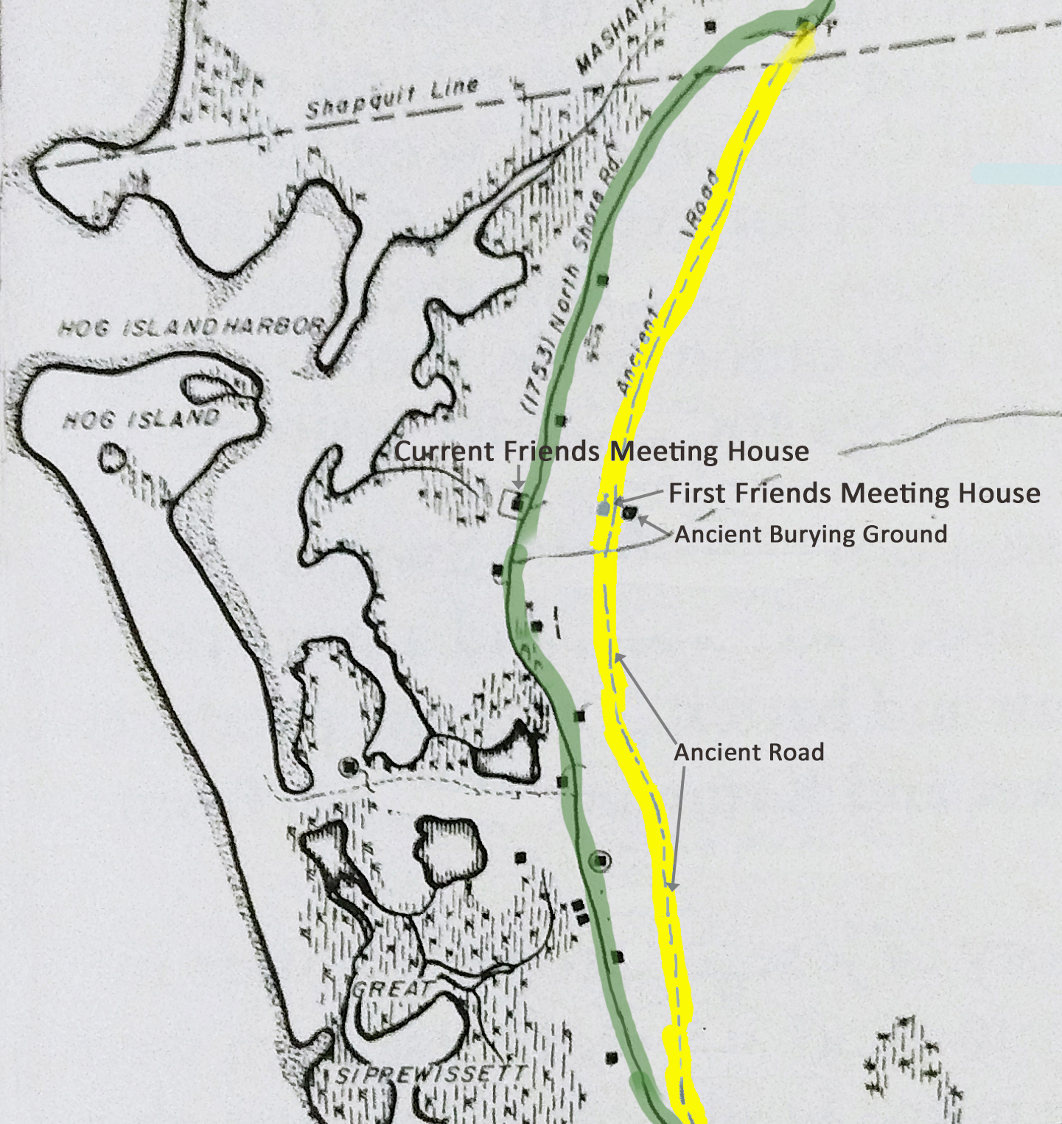
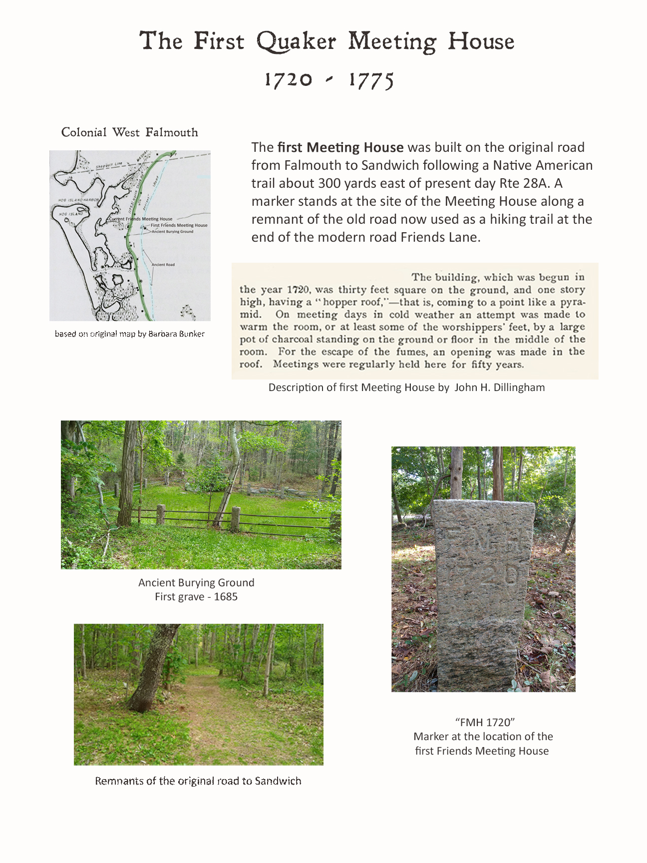
In the Town of Falmouth, Quakers were allowed to vote, despite not being members of the official church. They voted against paying Congregational ministers, lost the votes, and were granted exemptions in 1731, a century before Massachusetts separated church and state.
Thomas Bowerman III was jailed for failing to pay the “priest’s rate”—while his father, also a Quaker, was a selectman. Indeed, during the century after the American Revolution, one of the three selectman was usually a Quaker.
1673 DEED: WEST FALMOUTH
NATIVE AMERICAN SOLD TO QUAKER
West Falmouth Village (often called Sippewissett) was where most Quakers chose to live, and it was a Quaker enclave until the first half of the nineteenth century.
Thomas Bowerman I built a house in 1678 which remained in his family until 1981 (left), and
William Gifford bought 40 acres from JOB NATICO, the son of the last local sachem (1673 deed above).
After the North Shore Road (now Route 28A) was built farther down the hill in 1753, a new meetinghouse and cemetery were built there.
This second meetinghouse was replaced on the same site by the current building in 1842.
The first Meetinghouse was built along
the Native American path to Sandwich,
with a cemetery on the other side.
Source: WEST FALMOUTH QUAKER INFORMATION CENTER 2019

Slide 22
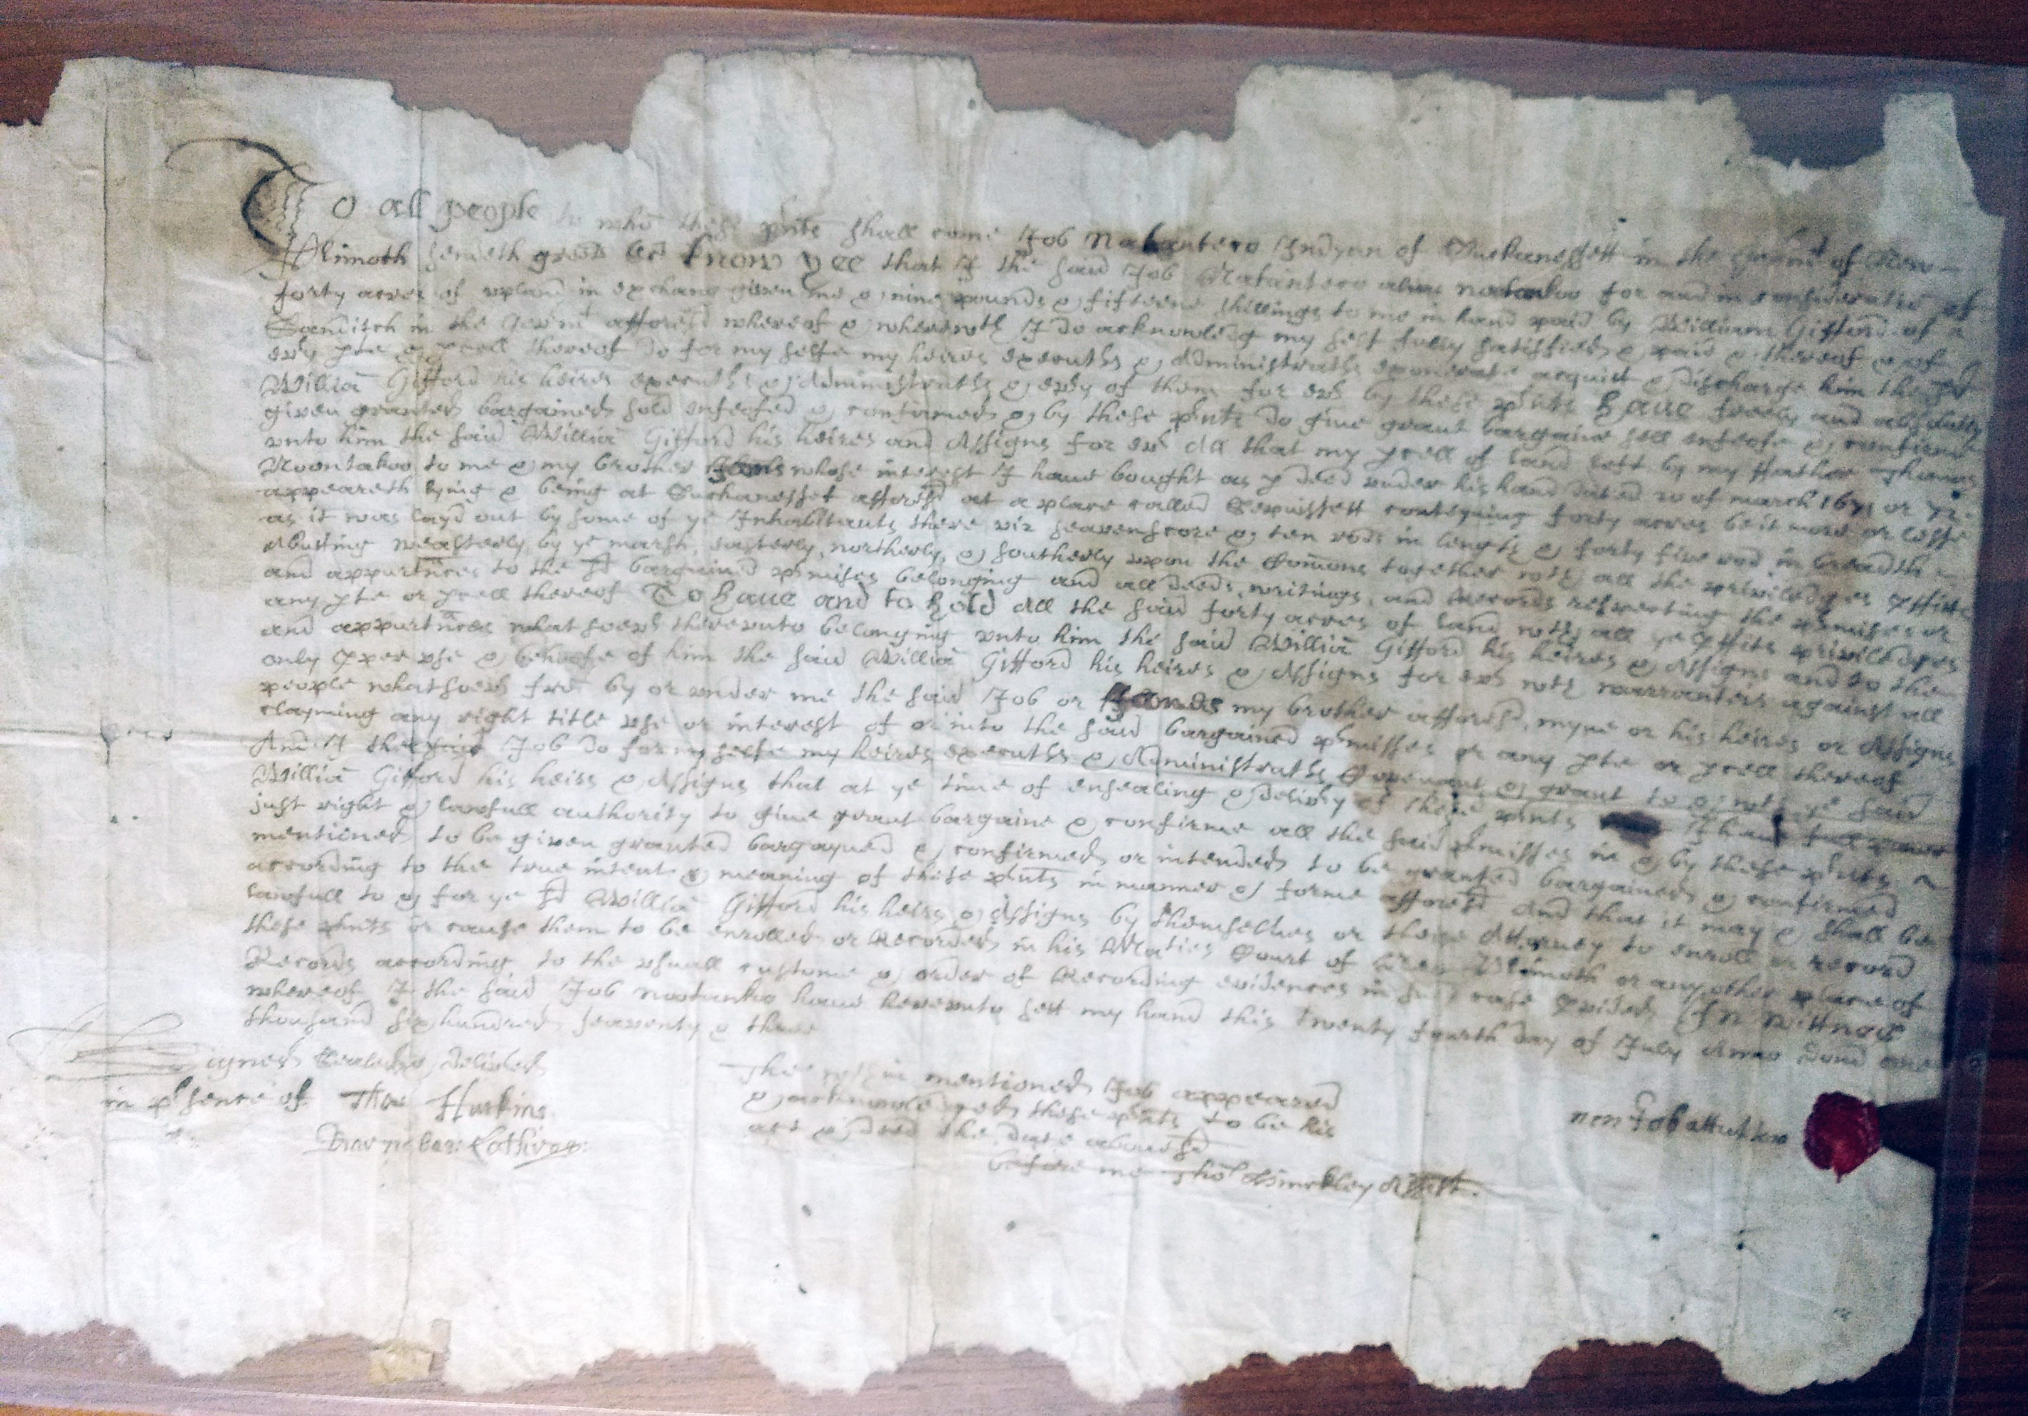
LAND
  1673 DEED 40 ACRES “WEST FALMOUTH” aka SIPPEWISSET
      JOB NANTICO last son of local sachem
      SOLD to WILLIAM GIFFORD 1st Quaker of West Falmouth
      CONCEPT of LAND: COMMUNAL vs PRIVATE PROPERTY
      DEED in ARCHIVES West Falmouth Library

Slide 23
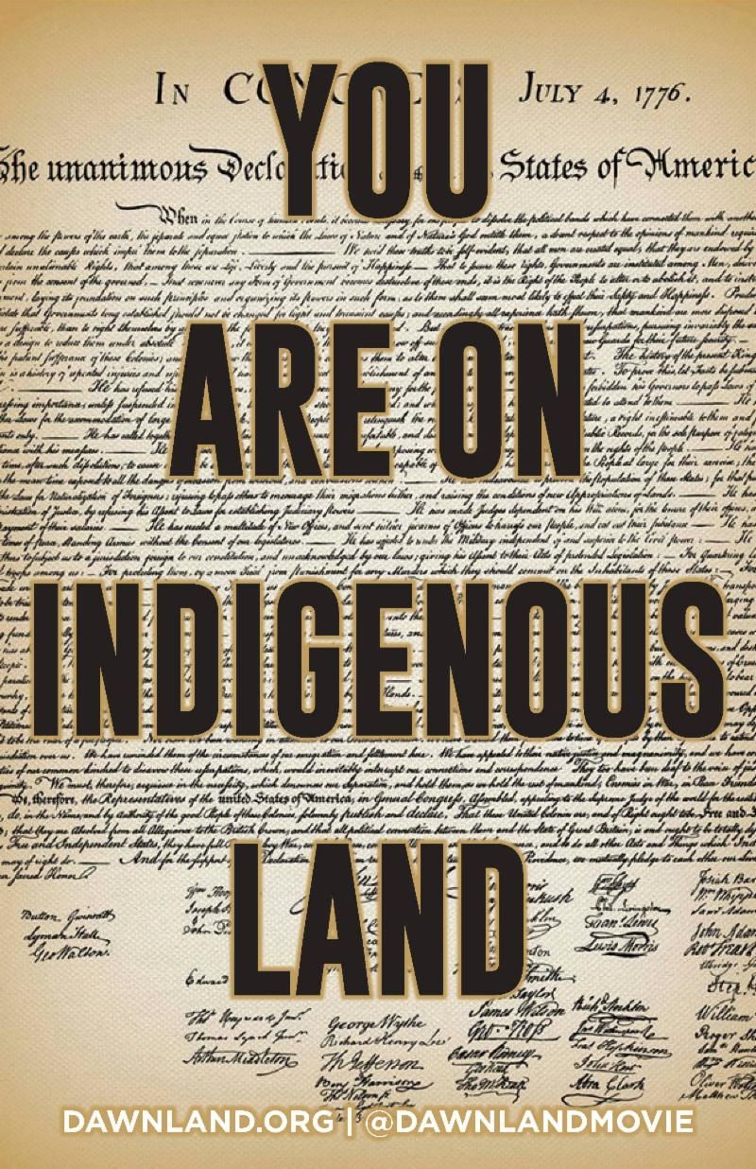

Slide 24
LAND 18th + 19th c HOW MASHPEE WAMPANOAG LOST THEIR LAND
FEDERAL NONINTERCOURSE ACT prohibits sale of INDIAN LANDS
without the express APPROVAL of CONGRESS
to protect Indians from land grabbers:
  “ No sale of lands made by any Indians,
  or any nation or tribe of Indians within the United States,
  shall be valid to any person or persons, or to any state,
  whether having the right of preëmption to such lands or not,
  unless the same shall be made and duly executed at some public treaty held
  under the authority of the United States”.
STATE returned a certain level of SELF-GOVERNMENT to Wampanoag, although they were
not completely autonomous.
With the idea that emulating European-American farming would encourage assimilation.
1842 COMMONWEALTH of MASSACHUSETTS divided ancestral land Wampanoag held in common
      and PARCELLED them out to MASHPEES individually:
        Distributed 2,000 acres (8.1 km²) of WAMPANOAG’S 13,000-acre (53 km²) property into 60-acre PARCELS (240,000 m²) to heads of households, so that each family could have individual ownership for subsistence farming.
1870 LEGISLATURE adopted laws changing old Mashpee INDIAN DISTRICT into an ORDINARY TOWN and conveying the remaining TRIBAL LANDS to the TOWN.
STATE approved the incorporation of MASHPEE as a town:
ultimately, Wampanoag lost control of most of their LAND + SELF GOVERNMENT.

Slide 25
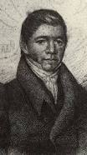
LAND OPPRESSION + RESISTANCE
1752 Excerpt from a letter to the Governor about the overseers, June 11, 1752
"We poor Indians in Mashpee, in Barnstable county,
we truly are much troubled by these English neighbors of ours being on this land of ours, and in our marsh and trees.
Against our will these Englishmen take away from us what was our land.
They parcel it out to each other, and the marsh along with it against our will.
And as for our streams, they do not allow us peacefully to be when we peacefully go fishing. They beat us greatly, and they have houses on our land against our will."
Late 19th c
"The land of my fathers was gone; and their characters were not known as human beings but as beasts of prey.
We were represented as having no souls to save, or to lose, but as partridges upon the mountains. All these degrading titles were heaped upon us. Thus, you see, we had to bear all this tide of degradation.
preacher WILLIAM APESS (1798--1839) Pequot
(So loved that he was officially adopted by the Wampanoag)
http://www.manyhoops.com/introduction.html
Author: A Native of the Forest, (republished 1990)
    considered one of the most important pieces of literature by a native writer.

Slide 26
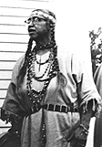
WAMPANOAG LITERACY ----in DECLINE AFTER 1674 – 1800s
September 1, 1674 (the year before King Philip's War),
he (BOURNE) names 22 places where Indian meetings were held, with an attendance of about 500.Of these,
142 could read Indian, and so read Eliot's Bible ;
72 could write, + 9 could read English.
These praying Indians increased in the 11 years following to 1,014, and there were in his limits 600 warriors.
REV. RICHARD BOURNE
https://archive.org/stream/historyofrichard00dyke/historyofrichard00dyke_djvu.txt
"It was a legislative act that kept the Mashpee Indians from
learning to read and write.
Act of 1789, Sec 5, the Regulations of the Plantation.
Prohibiting instruction of a Mashpee in reading and writing
under the pain of death.
      My grandmother, she did know how to read and write but there were so many that didn't because it wasn't allowed. After a while they did vote for a certain amount of money to go to schools in Mashpee, in later years."
-- Mable L. Avant Mashpee Wampanoag + historian (1892 –1964)
http://www.manyhoops.com/introduction.html
Mable L. Avant
(1892-1964)

Slide 27
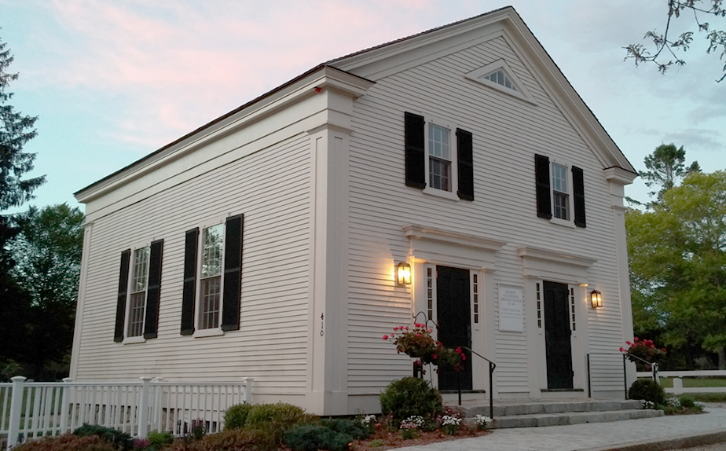
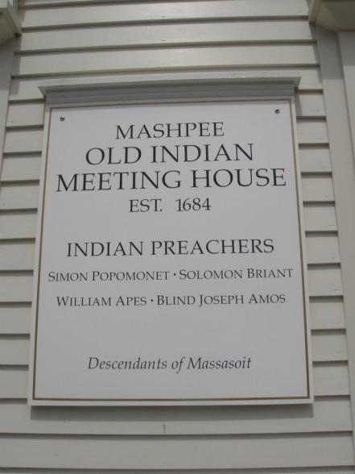
Old Indian Meetinghouse
Circa 1634-35 /1684
oldest church on Cape Cod
oldest Native American church
in United States
The Indian pastors + preachers of Mashpee were:
  Richard Bourne, 1670 - 1685
  Simon Popmonet, 1685 - 1729
  Joseph Bourne, 1729 - 1742
  Gideon Hawley, 1758 - 1807
  Phineas Fish, 1808-1833
  “Blind Joe” Amos, 1810-1836
  William Apes, 1833-1835

Slide 28

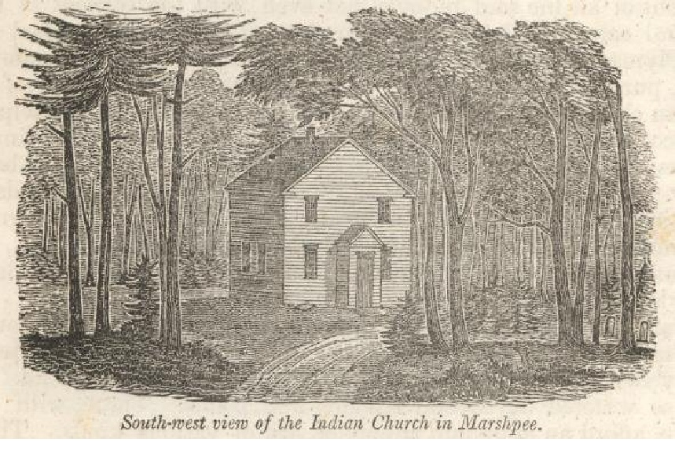
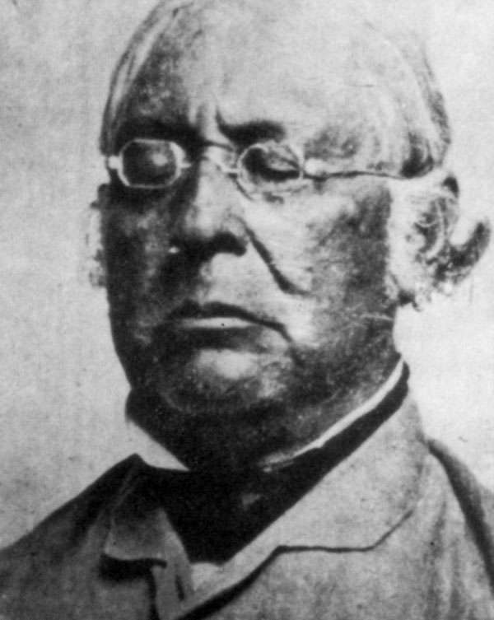
Why
Mashpee Wampanoag
celebrate
“Blind Joe” Amos
Wampanoag
Baptist Minister
every
July 21st
“Old Indian Church”
In Marshpee
“Blind Joe” Amos
(1806- 1869)

Slide 29
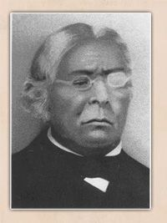
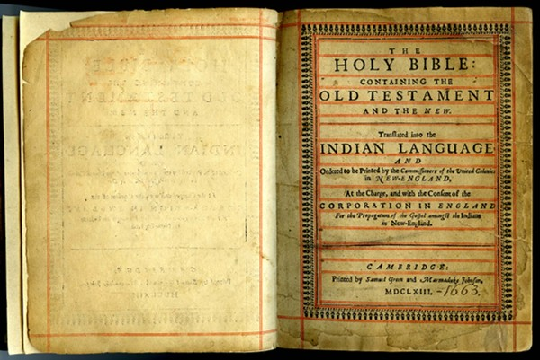
BLIND JOE AMOS:
“To prepare for the ministry,
he had his mother read
long passages from the Bible, which he committed to memory”
Joan Tavares Avant, People of the First Light, 2010.
“Blind Joe” Amos (1806- 1869)
“knew the entire King James Bible by heart
and could recite it
in both English and Wampanoag”
Quote: Mwalim Peters research

Slide 30


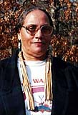
“YEARS LATER
Joe would ‘read’
complete chapters
to his congregations
In this manner.
FIRST TO HEAR HIS SERMONS,
however,
were the BIRDS + the ANIMALS of the FOREST,
for his ALTER was constructed from
STONES + DRIFTWOOD
in a REMOTE COVE upon THE LAKESHORE.
HERE he PRACTICED PREACHING
In the SOLITUDE of
GOD’S NATURAL CHAPEL,
the GREAT OUTDOORS”.
Joan Tavares Avant, People of the First Light, Wampanoag Historian

Slide 31
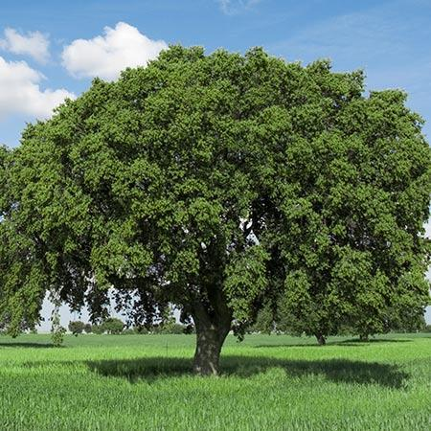
As a minister, “Blind” Joe Amos
“preached under the shade of a large oak tree every Sunday throughout the seasons”
1832: he left his indigenous Mashpee
to assist Indian brethren
in Gay Head/Aquinnah, Martha’s Vineyard
Established a 2nd Baptist congregation
among Wampanoag.

Slide 32
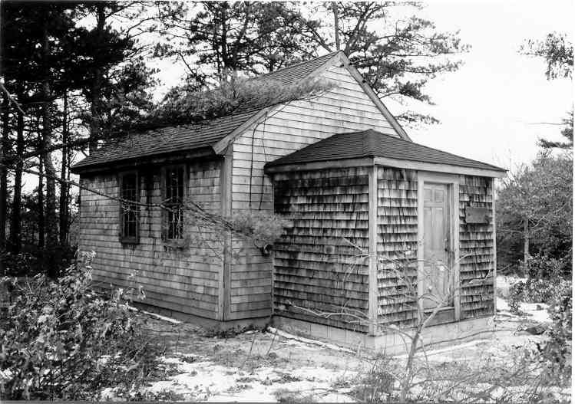
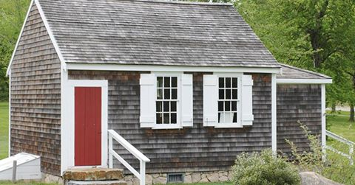
Rev. Blind Joe returned to Mashpee
Held meetings in a one-room schoolhouse
Where in 1833 he heard visiting Pequot preacher William Apess
“Conditions among the Indians were deplorable
and the Mashpee headmen
had employed Rev. Apess (1833-35)
to stay on and help them seek redress
from the State authorities,
as they were under State wardship.
Apess found a valuable and willing ally in
their own Blind Joe, who was despite his handicap,
ever ready to serve his people in a way, civil or spiritual,
if it lay within his power.
Indeed the coming of Rev. Apess
he considered an answer to his prayers.”
Joan Tavares Avant, People of the First Light, 2010
Wampanoag and historian
South Mashpee One Room School House
(1831 – 1901)
2019: Restored

Slide 33
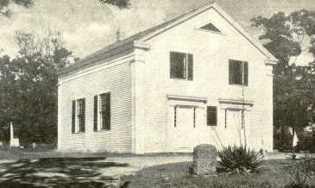
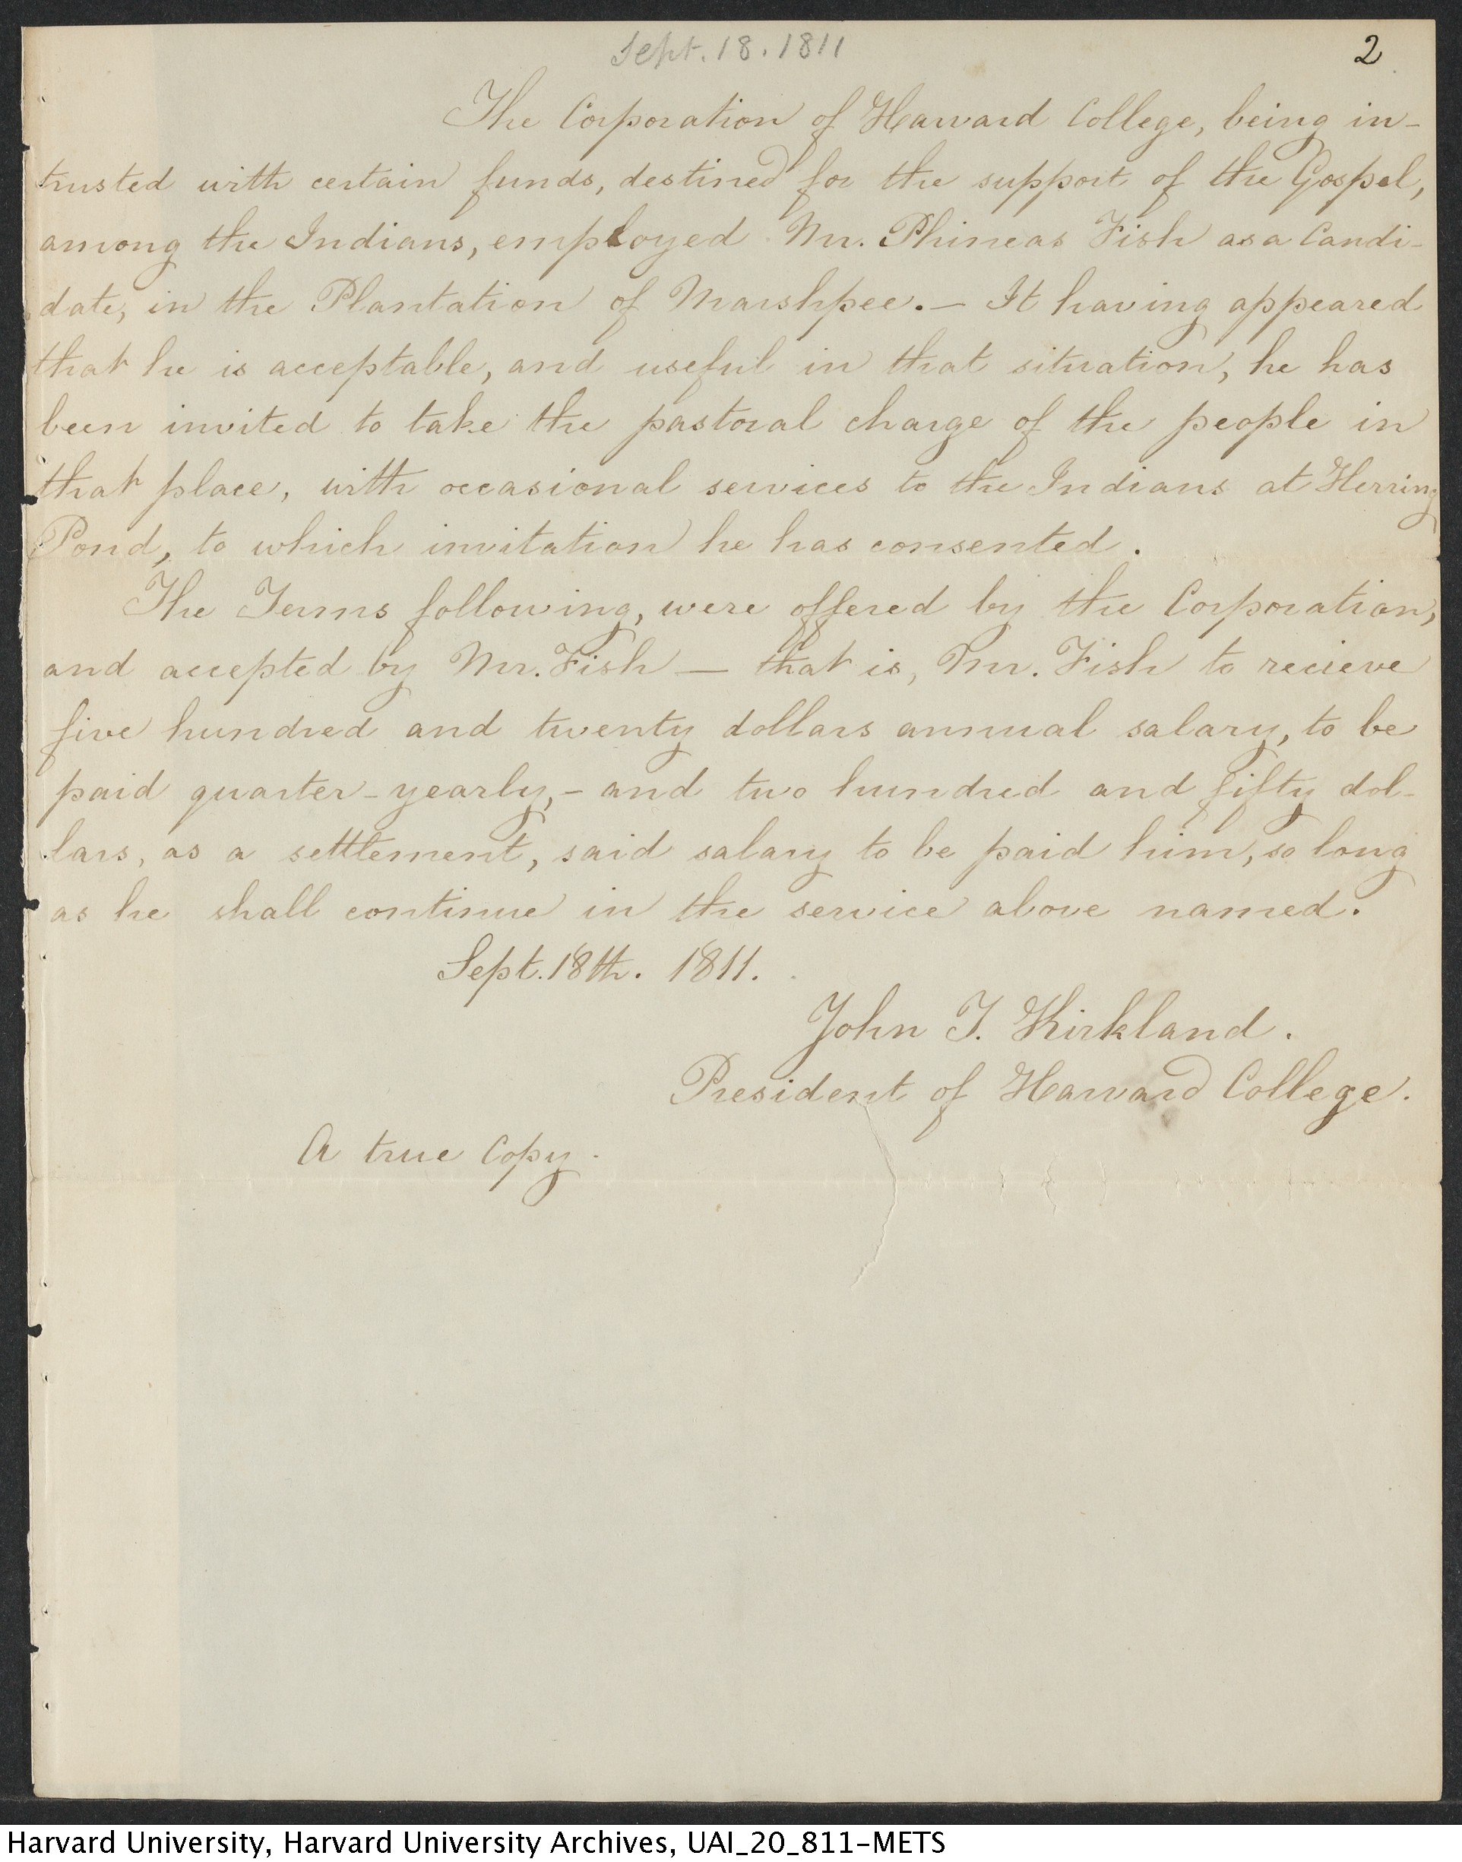
“In 1820 Baptist movement gained a foothold on Cape Cod
Blind Joe Amos embraced the denomination as his own,
becoming, at once its foremost champion and organizer
among the Indians.
First, though, he had to be ordained.
His people sought the use of their Old Indian Church
(built for them in 1684) for this purpose.
The autocratic Rev. Fish, its pastor, refused,
and they (Indians) were forced to hold the ordination
of their own beloved Blind Joe in a private home instead.
This was in 1830 and was organized under his leadership,
The first Baptist Congregation among the Indian descendants
on Cape Cod, Blind Joe, at last, had found his special calling . . .”
Joan Tavares Avant, People of the First Light, 2010
Wampanoag and historian
“Blind Joe” Amos
(1806- 1869)
Reverend Phineas Fish
(1808 -1833)
HARVARD COLLEGE CONTRACT SEPT 18, 1811

Slide 34
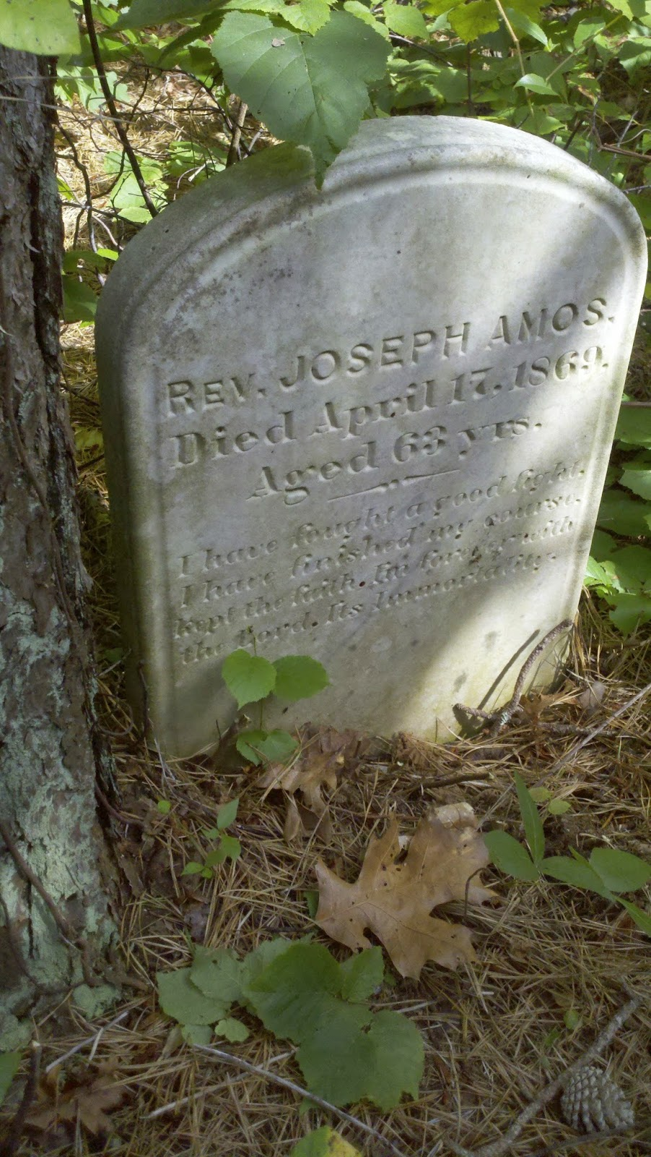
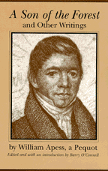
Famous Baptist preacher
Rev. “Blind Joe” AMOS preached (1810-1836)
Honored because of all this and these deeds in 1833:
  1833 Ousted Rev. Phineas Fish (1808-1833)
  the Harvard appointed minister to Mashpee church
  who was so unpopular that he was locked out by his parishioners
  Led by Reverend Joe Amos
  2. 1833 Led the “WOODLOT REVOLT”* of Indian independence
  in an act of civil disobedience
  by dumping wagon loads of wood which had been cut by white men.
      *Considered by historians (eg: Quaker-historian Jim Gould) and held up in recent years as
      the 1st significant expression of sovereign rights by a native tribe
      since contact with the colonists occurred more than 200 years before.
    William Apess A Native of the Forest, (republished 1990)
    considered one of the most important pieces of literature by a native writer.

Slide 35
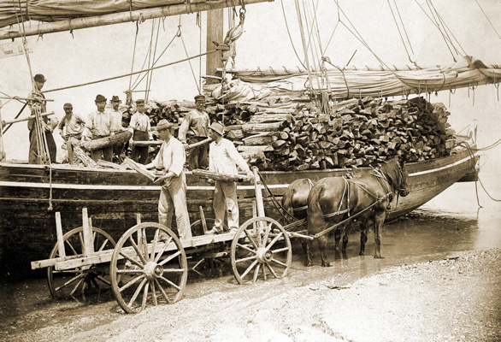
Reverend Fish’s religious differences and take over of the meetinghouse was only one reason his presence caused the tribe to resent him. A particularly sore point was his decision to lease logging rights of woodlot to two Cotuit brothers, the Sampsons.
Deforestation by 19th Century on Cape Cod
to fuel Sandwich Glass factory,
speed evaporation of sea water for sea salt and
sparse sandy soil made trees a premium.
Fire wood was at a premium.
The Mashpee Woodlot Revolt of 1833 by David C. Churbuck
https://churbuck.com/wp-content/uploads/2014/01/the-mashpee-woodlot-revolt-of-1833.pdf

Slide 36



POLITICAL MAP (1833) from SCHOOLBOOK of QUAKER MARY ABBY SWIFT (1837-1913)
Doc: Falmouth Historical Society
Uncivilized & civilized, non-Christian & Christian locations
Moral + Political Chart (MAP) of the Inhabited World
Exhibiting the Prevailing Religion. Form of Government and Degree of Civilization and Population of each Country

Slide 37



FALMOUTH 1858
QUAKERS
MARSHPEE DISTRICT 1858
WAMPANOAG

Slide 38


1861 WEST FALMOUTH QUAKER MEETING
BUILT
CARRIAGE SHEDS

Slide 39

THE CURRENT (THIRD) MEETINGHOUSE
572 WEST FALMOUTH HIGHWAY
Photo: Erica H. Adams
THE FIRST MEETING HOUSE AND CEMETERY
(left) “FMH 1720,” marking the site of the first Friends Meeting House
(right) “ancient cemetery,” used 1685– 1770
Photos: David and Abigail Young
These lie on opposite sides of the Native American path to Sandwich, now a woods trail at the end of the modern road Friends Way
Source: WEST FALMOUTH QUAKER INFORMATION CENTER 2019

Slide 40
TimeLine: West Falmouth
  1657 1st Quaker Meeting in Wm. Allen’s house
  1671: 1st Land Purchase in West Falmouth: William Gifford buys 40 acres around -1st Quaker of Sandwich
  Sippewissett marshes from last Native American in area Job Nootenko
  1685 Religious Meeting of Friends established at West Falmouth
  Richard Landers’ in public records for 1st time: descendents say ownership established by a ROYAL GRANT.
  1720 Funded 1st meetinghouse: R. Landers, Th. Bowerman, Jos Landers, Bj Bowerman Wing, Wm Gifford,
  Steph. Harper, Benj Swift and Dan Allen
  1725 1st West Falmouth Quaker Meeting House completed on Friends Way
  1753 West Falmouth Highway rerouted from hills east of village
  1755 Women Friends of Falmouth requested a preparative meeting – a women’s meeting separate from men
  1771 2nd West Falmouth Quaker Meeting House built on current site –stood for nearly 70 years until (1841)
            Benjamin Swift & his wife Mary were the first to be laid in the new lot.
  1778 1st village blacksmith shop established about this time by Richard Lake
Gristmill built on Windmill Lane, saving 4 mile trip to Dexter’s Mill
26 houses present in village note on list by John Hoag Dillingham in 1909 includes
Village formally christened West Falmouth + establishes 1st Post Office by Federal government
  1841- 42 3rd Old Quaker Meeting House replaced for 3rd time; current house constructed by Moses Swift.
  1846-47 Quaker Schism: Wilbur/ Gurney
  1850 Transferred Quarterly Meeting from Nantucket to West Falmouth due to whaling industry
  1850’s West Falmouth Harbor greatly reduced when winds reduce tall dunes of Black Beach
1st West Falmouth Methodist Church built by Alvin Crowell
Capt. John Hamblin leaves on last whaling voyage
1872 Cape Cod Branch Railroad opened line to Woods Hole to serve Pacific Guano Works on Penzance Point; makes Buzzard’s Bay accessible to outsiders
  1872 1st summer houses in West Falmouth built by families Howland, Fowles, Cutter and Russel
on the harbor at Old Dock Road and Nashawena Street
1888 Quaker cemetary and meetinghouse improvements via Daniel Wheeler Swift begins

Slide 41



WETU –early Mashpee dwelling
Late 19th c
HOME: MABEL AVANT (1892-1964)
Wampanoag historian
Late 20th c MUSEUM:
MASHPEE WAMPANOG

Slide 42
1890s SUMMER HOUSES
Richard Bowman transcript and background info:
At one time Richard's grandfather, Edward and grandmother, Mary Annie Dimmick,
owned two houses across from the current West Falmouth gas station and
all the land (100 acres) from current Route 28A all the way down to Old Silver Beach and Bay Shores.
This tract was referred to as The King's Grant Land.
Richard's father, Warren O. Bowman and mother Mary Jane McKenzie inherited the land.
Wealthy residents from the cities began buying up large tracts of land in Falmouth in the 1900s.
Falmouth began assessing farm land as lots in 1931.
"Most local residents did not have the funds to compete with the investors.
Those that did made out OK.
There was a lot of land that disappeared for this reason.
My father thought he was doing us a favor by selling the land, in the 1930s.. I don't regret it.
I wouldn't want to invest in other people's misfortune.”
Falmouth Massachusetts Problems of A Resort Community, Millard C. Faught, 1945, NY: Columbia University Press

Slide 43




THE SWIFT BROTHERS
Daniel Wheeler Swift (1840-1910) on left, and his brother Henry D. Swift (1833-1916) on right, were from West Falmouth but made their fortunes as inventors in Worcester in an envelope business.
Both maintained their connections with West Falmouth and the Meeting; they built summer/retirement homes on each side of the Meetinghouse, shown below their respective portraits.
Henry Swift, drafted in the Civil War, was willing to wear the uniform but refused to fight or drill, instead helping in the medical tent. He was saved from execution only when influential Quakers met with President Lincoln and obtained a furlough for him.
Daniel Wheeler Swift (1840-1910)
Henry D. Swift (1833-1916)
Falmouth Historical Society
RESHAPING THE MEETING
Falmouth Historical Society
D. Wheeler Swift, in retirement, focused on revitalizing West Falmouth Meeting, whose numbers were dwindling. Favoring assimilation of the Meeting towards mainstream
Protestantism, he paid for Meetinghouse renovations such as replacing plain benches with carved pews, installing a lectern on a raised platform, and hired a Quaker minister, Dr. Elam Henderson.
After Dr. Henderson’s departure in 1918, however, it became clear that the Meeting had lost its ability to go forward without professional leadership.
Worship took place only during the summer when visitors would fill the pews, and silent worship was not the norm:
instead, visiting ministers of various Protestant groups would usually lead services in their own fashion. 1918 -1964
MEETINGS in SUMMER only
Summer Home: Daniel Wheeler Swift (1840-1910)
Photo: Erica H. Adams
Summer Home: Henry D. Swift (1833-1916)
Photo: Erica H. Adams
Source: WEST FALMOUTH QUAKER INFORMATION CENTER 2019

Slide 44


LATE 19th c SWIFT BROTHERS RENOVATIONS: PROTESTANT STYLE
QUAKERS: WEST FALMOUTH PREPARATIVE MEETING
PHOTO: JEANNE SCHNELL
BENCHES
PIANO
LECTERN
WAINSCOTTING
PHOTO: JEANNE SCHNELL

Slide 45

PROPERTY TAXES were hardship on MASHPEES as well as for WEST FALMOUTH”S QUAKER FAMILIES

Slide 46
Early 1900s few residents remained in South Mashpee
land accumulators + speculators like
Est. 1917 THE GREATER COTUIT SHORE COMPANY
purchased much of Mashpee’s shores
known today as POPPONESSET + NEW SEABURY
From 1929 MALCOLM G. CHACE, an industrialist from Rhode Island
BOUGHT LANDS of GREATER COTUIT SHORE COMPANY
+ CRANBERRY GROWERS + LOCAL RESIDENCES
CHACE CREATED NEW BUSINESSES:
Popponesset Beach, Inc., Popponesset Corporation, Realty Operators, Fields Point Manufacturing Company, and finally the New Seabury Corporation.
1960 -82
CHACE’S SONS created NEW SEABURY RESORT
https://peninsulacouncil.com/the-peninsuala-council/history/

Slide 47




1970 -1980s LAND of MASHPEES

Slide 48
1970s HOW MASHPEE WAMPANOAG LOST THEIR LAND --
Russell Peters, president of the Mashpee Wampanoag Indian Tribal Council,
called the verdict unfair shortly after was returned at 1:50 P.M.
“What we are dealing with is 200 years of injustice toward the Indians,” he said.
“This is just another example of that injustice cloaked in the halls of justice.”
BOSTON, Jan.6—A Federal jury decided today
that the Wampanoag Indians of the Cape Cod town of Mashpee were not a tribe on key legal dates of their history, thus balking the Indians’ claim to a vast tract of land in the town…
JAN 6
New York Times
NOT a TRIBE:
1870
1976
WAS a TRIBE
1834
1842
NO TRIBE EXISTED
1790
1869
1870
1976
21 Hours of Deliberations
The jury of eight men and four women, all whites, had deliberated more than 21 hours. They found that the Indian group was not a tribe in 1870, when, the Indians charged, their lands were taken from them, or in August 1976, when they filed their lawsuit in Federal District Court, seeking all of the town's undeveloped land.
The jury did find that the group was a tribe on two of the six dates in question, in 1834, when it succeeded in having a plantation declared an “Indian district” by the Massachusetts Legislature, and in 1842, when each Indian in Mashpee was alloted 60 acres of land that they had formerly held in common.
But the jury found that no tribe existed in 1790, 1869, 1870 or 1976, and that no tribe existed continuously.

Slide 49






1970s ARCHIVES from WEST FALMOUTH QUAKERS

Slide 50
1979 Mashpee Tribe v. New Seabury Corp.
first litigation of the
Nonintercourse Act (Congress must approve sale of Indian land)
            to go to a jury
1834 + 1870 The Mashpee lands sold without federal consent.
              The Mashpee claim implicated
                11,000 acres, worth approximately $30,000,000 at the time of trial. The Mashpee's attempts to settle the claim were rebuffed.
40-day trial, the jury decided
the Mashpee Tribe was NOT a TRIBE at several relevant dates for the litigation

Slide 51

DEPARTMENT of the INTERIOR
granted
FEDERAL RECOGNITION
to the MASHPEE
2,600
enrolled
Citizens
AFTER 3 DECADES of FIGHTING
to be re-acknowledged as a tribe

Slide 52


  MASHPEE WAMPANOAG
First Light Shellfish Farm
Funded by a U.S. Fish and Wildlife Grant, the Mashpee Wampanoag Shellfish Farm began operations in 2009 and our first oysters were sold to our wholesaler in September 2010.
Through shellfish cultivation, the Mashpee Wampanoag Tribe improves the water quality of the Popponesset Bay by reducing the nitrogen composites.

Slide 53


JESSE “LITTLE DOE” BAIRD REVIVED WOPANNAK
– language of MASHPEE WAMPANOAG TRIBE
2010 McARTHUR FELLOW
Genius” Grant
Noam Chomsky once said he would have considered your work “impossible.” What drives you?
I feel I was born to do this. There’s a burning desire in me to reclaim what is Wampanoag.
Boston Globe 2011 July 31
JESSE “LITTLE DOE” BAIRD
LINGUIST
AQUINNAH WAMPANOAG TRIBE
Martha’s Vineyard

Slide 54
2009 IT ALL STARTS WITH LANGUAGE
The Mashpee Wampanoag Tribal Language Department was established in cooperation with the Wôpanâak Language Reclamation Project (WLRP) by Council Ordinance 2009-ORD-005 on June 10, 2009
to recognize the role of language as “central to the protection of the customs, culture, and spiritual well-being of the people,” and to acknowledge the “critical state of the newly reclaimed Wampanoag language, and the need to secure its survival for the benefit of future generations.”
The Tribal Council reaffirmed its commitment to language revitalization in resolution 2011-RES-025 to recognize the inherent “birth right of each Wampanoag child adult to speak his or her language given by Creator”, and the decades of work by WLRP to return language home to Wampanoag families.

Slide 55
2009 Wampanoag Language Reclamation Project
Per longstanding memoranda of understanding and WLRP’s by-laws, the Tribal Language Department is staffed by the community-run intertribal non-profit organization, the Wôpanâak Language and Cultural Weety8, Inc., also known as the Wôpanâak Language Reclamation Project (WLRP). WLRP is governed by a Board of Directors and Language Committee drawn from all tribal household members who enroll as language students. WLRP’s Language Committee members and Board of Directors meet monthly to review project activities, progress, policies, and funding.
Founded more than twenty years ago with the key objective of reclaiming Wôpanâôt8âôk (Wampanoag language) as the principal means of expression within the Wampanoag Tribal Nation, WLRP’s efforts have gained international recognition for becoming the first American Indian community to reclaim and revitalize a sleeping tribal language after many generations without living speakers.
This unprecedented effort was made possible through formal linguistics training in Algonquian languages, and by working with the largest Native-written corpus of 17th and 18th century documents in North America translated and written by Wampanoag people—including the King James Bibles of 1663 and 1680, and hundreds of personal letters, wills, deeds, and land transactions written in Wôpanâôt8âôk.
Wampanoag people were also the first American Indians to develop and use an alphabetic writing system. Read more at wlrp.org

Slide 56

About 2013 MASHPEE WAMPANOAG
TRIBAL COUNCIL BUILDING
complete

Slide 57
2015
federal government declared
150 acres of land in Mashpee
and
170 acres of land in Taunton
as the Tribe’s initial reservation,
on which the Tribe can exercise
its full tribal sovereignty rights
https://mashpeewampanoagtribe-nsn.gov

Slide 58

2018
Chairman Cedric Cromwell of the Mashpee Wampanoag Tribe addresses
the #StandWithMashpee rally at the U.S. Capitol on November 14, 2018.
Photo by Indianz.Com (CC BY-NC-SA 4.0)
        Mashpee Wampanoag Tribe defeats bid to move homelands lawsuit to another court
        Tuesday, June 25, 2019
Leaders of the Mashpee Wampanoag Tribe are welcoming a judge's decision that keeps their homelands lawsuit against the Trump administration in a more favorable court.
In a June 21 ruling, Judge Rosemary M. Collyer said the tribe's case belongs in Washington, D.C., because of its many connections to the nation's capital. Besides possibly raising "national policy implications," she noted that the defendants are officials who are based in the D.C. headquarters of the Department of the Interior and the Bureau of Indian Affairs
“The significance of this victory and its importance to our tribe cannot be understated," Chairman Cedric Cromwell said in a press release posted on Native News Online. "Judge Collyer agreed with every single argument that we advanced and showed, as a Reagan-appointed judge that our issue is a bi-partisan plight with ‘national policy implications’ for the rights of tribes across the U.S. She was also right to point out that the tribe has received support from pan-tribal organizations representing more than 250 tribes across the U.S. who all agree that the Interior was unlawfully arbitrary and capricious."

Slide 59
H.R.312 - Mashpee Wampanoag Tribe Reservation Reaffirmation Act
116th Congress (2019-2020)
Sponsor: | Rep. Keating, William R. [D-MA-9] (Introduced 01/08/2019)
Committees: | House - Natural Resources
Committee Meetings: | 06/05/19 2:00PM 05/01/19 10:00AM
Committee Reports: | H. Rept. 116-54
Latest Action: | Senate - 05/20/2019 Read the second time. Placed on Senate Legislative Calendar under General Orders. Calendar No. 92. (All Actions)
Roll Call Votes: | There has been 1 roll call vote
Shown Here:
Passed House (05/15/2019)
Mashpee Wampanoag Tribe Reservation Reaffirmation Act
This bill reaffirms the Mashpee Wampanoag Tribe reservation as trust land in Massachusetts.
In addition, the bill requires actions, including actions pending in federal court, relating to the land to be dismissed.

Slide 60
In September 7, 2018, the Department of the Interior
issued the first Carcieri decision
in which it refused to reaffirm its own authority to confirm the status of the Mashpee Wampanoag Tribe’s reservation.
The decision opens the door for the Mashpee Wampanoag Tribe’s reservation
to be taken out of trust and disestablished
and follows on the heels of the federal government’s refusal to continue
to defend the status of the Tribe’s reservation in court.
The Department rejected the clear evidence of federal jurisdiction
provided in multiple federal reports (some commissioned by Congress),
Mashpee children attending federal Indian schools, federal representative of the Tribe,
and other evidence accepted as sufficient in prior decisions.
HR 312, The Mashpee Reservation Reaffirmation Act, is a bipartisan bill that reaffirms the status of Mashpee’s reservation that and has widespread support from Indian country.
Passage of HR 312 will prevent Interior from disestablishing the Tribe’s reservation.
The Mashpee Wampanoag Tribe’s citizens are
currently suffering a massive loss of resources and services
due to the uncertainty of the trust status of the Reservation.
Millions of dollars of funding are being lost or delayed for
our clean water program,
our children’s education through our Mukayuhsak Weekuw immersion pre-school and kindergarten and critical community service programs.
It’s also a direct threat to our emergency services, housing and substance abuse program that’s desperately needed to combat the opioid epidemic. These are just a few of the ways this negative ruling is impacting our community and our children.
Please consider ways that you can help correct this injustice.
https://mashpeewampanoagtribe-nsn.gov/standwithmashpee

Slide 61


2018 WAMPANOAG LANGUAGE in MASHPEE HIGH SCHOOL
MASHPEE HIGH SCHOOL OFFERS
FIRST-EVER NATIVE AMERICAN LANGUAGE COURSE
Learning a new language has long been a requirement at most American high schools. While the typical offerings include Spanish, French, and Latin, in Mashpee, a small group of students is taking on a language that hasn’t been spoken fluently in centuries. WCAI’s Kathryn Eident has more on the Wôpanâak Language class at
Mashpee High School.
MUKAYUHSAK WEEKUW:
THE CHILDREN’S HOUSE

Slide 62


MASHPEE WAMPANOAG
AFFORDABLE HOUSING

Slide 63
2019 June Tribe Gets Grant For
Cultural Education Efforts
The Mashpee Wampanoag Tribe recently received a nearly $20,000 grant from the First Nations Development Institute, a Colorado-based non-profit that assists tribes across the country.
The award will support a new project: We Are The Seventh Generation.
Seventh Generation was designed to help youth retain and perpetuate the cultural integrity of Wampanoag community values through participation in seasonally dictated activities and ceremonial gatherings.
The idea is to leverage knowledge and skills of culture-keepers and elders by fostering connections with youth, as they strengthen identity, assume responsibility, and develop pride.
“The grant supports a dedicated focus on an age group often overlooked for specific inclusion in cultural activities.”
The grant is for a total of $19,100.
Thirty Wampanoag youth ages 10 to 14 will engage in a 12-month science, technology, engineering, art and mathematics (STEAM) based cultural project.
The idea behind STEAM is that it fosters children’s curiosity, creativity, and learning as they try things and explore the world around them. Tribal youth from Mashpee and the Wampanoag community beyond will participate.

Slide 64

MASHPEE SELECTMAN: DAVID WEEDEN,
MASHPEE WAMPANOAG
Serves as:
Interim Tribal Historic Preservation Officer
Council Member for the Mashpee Wampanoag Tribe
Formerly on town of Mashpee’s Planning Board

Slide 65



NEW ENERGY AND REVIVAL
The Meeting got a lifeline in 1962 when the Unitarian Fellowship of Falmouth made arrangements to use the building each week and to replace the old wood-burning furnace with a gas model. They remained with us until 1995, when they built their own building next to the Falmouth Jewish Congregation.
In 1964, a small influx of Quakers from other areas, both year-round and summer-only, allowed us to return to traditional silent meetings all year. (And to install running water in the Meetinghouse!) There were a few survivors from Dr. Henderson’s days, notably Cecilia Bowerman Fuglister, to witness this return.
The Meeting entered a new era of activism and social justice, often the fruits of Quaker faith: draft counseling and other opposition to the endemic wars of the “post-war” era, working for equal justice and equal opportunities for every person, and climate crisis activism.
(left above) The gravestone of Samuel Lamar Jordan, the first African-American known to be buried in our cemetery.
(left below) Some of the Meeting children (and assistants) plant a regenerative garden, designed to increase the amount of carbon in the soil. They have chosen to name it Friend’s Garden in memory of Martin Fido, a recently deceased and beloved Meeting stalwart who worked tirelessly with and for the children.
(right) A projection from NOAA/ the National Oceanographic and Atmospheric Administration showing the result of a seven-foot sea level rise, with the location of the Meetinghouse marked in red. The melting of only 40% of the glaciers in West Antarctica (the smaller side of that continent) would bring about such a seven-foot rise.
Son of Larry + Carolyne Lamar Jordan
Source: WEST FALMOUTH QUAKER INFORMATION CENTER 2019

Slide 66

1958 -1965 WEST FALMOUTH MEETING
TRANSITIONAL YEARS
1948 - 1951, several winters building was rented to the Seventh Day Adventists
      group which needed a meeting place until they could acquire their own.
1962 - 1984 shared the building with Unitarian Fellowship
  1965 renewed Quaker patterns with year-round unprogrammed meetings
and active committees.
Meeting prospers with growing membership and renewed vitality
http://www.capecodquakers.org/wfmemories.html

Slide 67








21st c ACTIVISTS WEST FALMOUTH MEETING
CLIMATE CHANGE
CLIMATE CHANGE
CLIMATE CHANGE
JAY O’HARA
LEGACY GRANT 2017
STEVE GATES
LEGACY GRANT 2019
LARRY JORDAN
QUAKER INSTITUTE
For the FUTURE 2019
RESTORATIVE JUSTICE
GRANDMOTHERS
AGAINST GUNS
PEACE + DIVERSITY+
INDIGENOUS RIGHTS
QUNO / QUAKER
UNITED NATIONS OFFICE
BRENDA NOLAN
+ PAULA BLUMENTHAL
NAN GARRETT LOGAN
STATE HOUSE AWARD 2019
ERICA H. ADAMS
LEGACY GRANT 2019 +2017
CAROLYNE LAMAR JORDAN

Slide 69
2018 PRESS MASHPEE ENTERPRISE
2019 PRESS ARTS FUSE Boston

Slide 70
INTRO: WAMPANOAG LAND + QUAKER REFUGE
ERICA H ADAMS www.EricaHAdams.com
  WEST FALMOUTH QUAKER + MASHPEE resident
  ARTIST + WRITER + CURATOR + Retired FACULTY of Fine Arts at Tufts University
  West Falmouth Library Grant RESEARCH + ORAL HISTORIES including Wampanoag
  QUAKER: (2) LEGACY GRANTS (2019 + 2017) to create dialogues about diversity + peace:
    Respeto/Respect a CHIAPAS PHOTOGRAPHY PROJECT traveling exhibition
WAMPANOAG SPIRITUALITY
RAMONA/Nosapocket PETERS
  MASHPEE WAMPANOAG ----BEAR CLAN Member
  President + Founder: NATIVE LAND CONSERVANCY, INC a Mashpee Wampanoag non-profit
QUAKERS + WAMPANOAGS
GAIL MELIX
  MANOMET WAMPANOAG
  QUAKER: SANDWICH MONTHLY MEETING + NEYM EARTH CARE MINISTRY COMMITTEE
  Retired RN – Falmouth Hospital + Cape Cod Hospital
WAMPANOAG FOOD
JOAN TAVARES AVANT aka “GRANNY SQUANNIT”
  MASHPEE WAMPANOAG DEER CLAN MOTHER + HISTORIAN + TRIBAL PRESIDENT (3 terms)
  DIRECTOR of INDIAN EDUCATION (25 YEARS) in the MASHPEE PUBLIC SCHOOLS created curriculum for natives + non-natives
  AUTHOR People of the First Light (2010) + COLUMNIST Mashpee Enterprise + EDITOR National League of American Pen Women
  QUOTE: "I am honored to serve as a founding trustee for the WLRP project to open a K-3 immersion charter school in the fall of 2015.
It has been my forever passion to not only preserve the culture but to assist making wise pedagogic decisions for our children and families in their own public recognized tribal school".^{[2]} Wôpanâak Language Reclamation Project.
  WIKIPEDIA: https://en.wikipedia.org/wiki/Joan_Tavares_Avant

Slide 71
“We name ourselves after the land we live with.
Because, not only are we breathing in, we are also drinking from the water that is flavored by that very land.
Whatever is deposited in the soil is in that water is in us.
So we are all one thing, and we name ourselves after the place that is our nurturing. That sustains our life.”
--- Ramona/Nosapocket Peters

Slide 72


