Slide 1
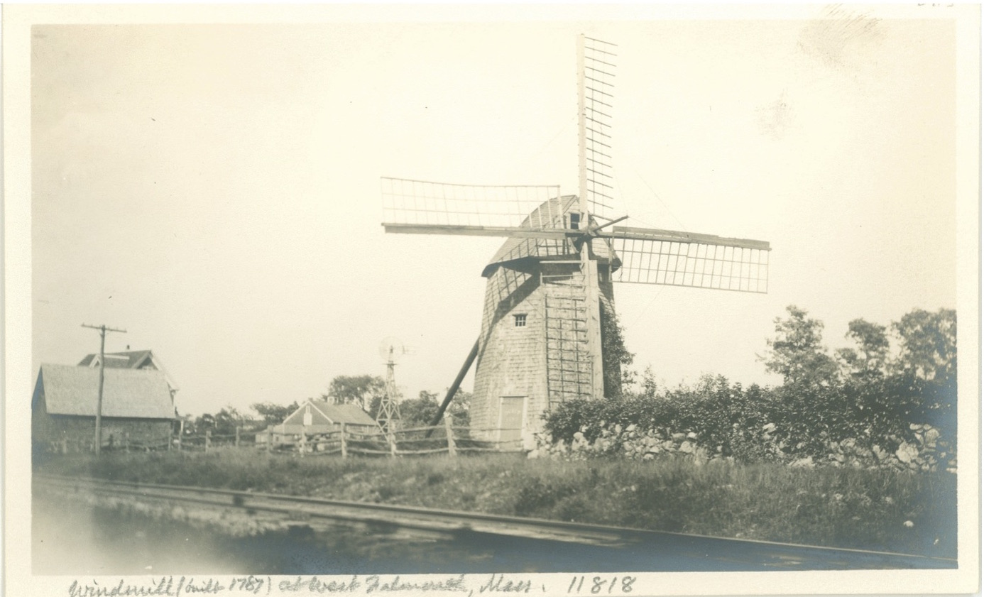
West Falmouth QUAKER WOMEN
Suconesset, Suckinesset and Saconessett - Falmouth

Slide 2
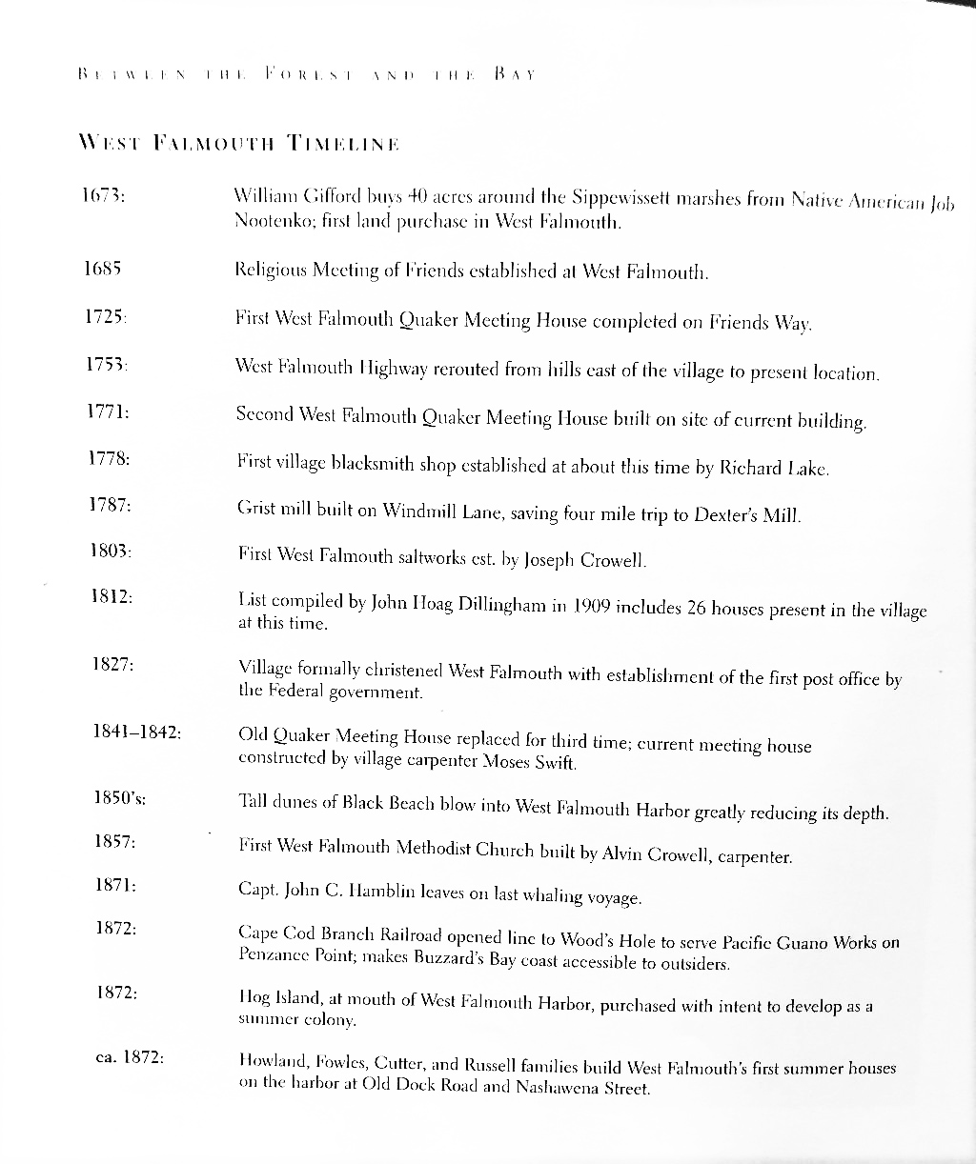

Slide 3
QUAKERS in WEST FALMOUTH
Mary Mangelsdorf
“In New England Quakers were punished with particular severity,
because the Puritans and Pilgrims had come here to establish not freedom of religion
--an idea whose time had not yet come –but a theocracy. Quakers endangered the system”.
The first two Quakers to reach New England,
Mary Fischer and Ann Austin, landed in Boston in July, 1656.
They were kept closely guarded in jail and deported after 4 weeks …
One citizen of the town, an older man named Nicholas Upsall, gave the jailer money
for their food which, in that time, was not provided to prisoners automatically.
For this and no doubt, for his sympathy with Quaker ideas,
he was banished from Boston and spent the winter of 1656 in Sandwich
… when Spring came, the magistrates ordered him off to Newport,
the traditional place for heretics since the time of Anne Hutchinson and Roger Williams.
Among the early landowners in Falmouth, we can glean several names which appear on the list of Quakers persecuted in Sandwich … for a century after the Revolutionary War in 1789, one of three selectmen was almost always a Quaker.

Slide 4
Is this Quaker Run described October 2017 by Mother Bear (to Paula Palmer and Buffy Curtis) where Wampanoags protected Quakers from Puritans, etc?
“The Society in Sandwich 1657,
No less than 18 families met for worship in houses of William Allen, William Newland and Ralph Allen and, as tradition has it in Christopher’s Hollow – a spot believed to have been so named from the preaching of Christopher Holder ----approached by the road which passes the alms—house into the woods.
Described in the Falmouth Local, 12th mo., 1887:
About a mile southeasterly of the village of Sandwhich is a deep sequestered glen or hollow in the wood. There is no spot in the county of Barnstable more secluded or lonely. It is even now as primeval in appearance as it was on the day the Pilgrims first set foot on Plymouth rock. This quiet glen is surrounded by a ridge of hills, covered in part by trees and it is some 125 feet deep. At the bottom are to be seen a few straggling red-cedar trees. In the spring and summer a small stream of water runs into this glen, which keeps up a perpetual murmur For over two centuries this lonely spot has been called ‘Christopher’s Hollow,’ in memory of Christopher Holder ….”
History of Barnstable County, Chapter X: Society of Friends page 168 by John Dillingham

Slide 5
WEST FALMOUTH
“Before the end of the 18th century a small community of religious dissidents had taken root on the uplands to the west and north of the settlement of Suckanesset sections then designated as the “Back Shore” and or the “North Shore”. To the east of these areas stood the wooded hills of the glacial moraine, and to their west beyond the rich sheltered marshlands of Little and Great Sippewissett lay the open waters of Monument Bay, now Buzzards Bay”.
“These lands had been settled by families who were or who would shortly become Quakers. They had been attracted to Suckanesset by the climate of religious tolerance that had prevailed in that town since its settlement in 1661”.
“About 1685 a Religious Meeting of Friends was officially established there by the Sandwich Monthly Meeting”.
“Most of the families in the area for the first century and a half were to be members of that meeting”.
“It is this early religious foundation of the village now known as West Falmouth that establishes a place for it in history. However, it is its location that has shaped its destiny through the shifting fortunes of three centuries”
Book of West Falmouth, Barbara Bunker page 428.

Slide 6
Colonial period
William Gifford, Quaker of Sandwich + 1st landholder of colonial West Falmouth: on 1673, he purchased 40 acres of upland at Sippewisset from Job Nootenko probably the last native inhabitant in the area.
During the following decades others bought land and settled _Bowerman, Harper, Weeks and Robinson Jr. Successful farms developed and Quaker faith became firmly established.
By the time of the Revolution (1776) there had evolved the configuration upon which the future development would be built.
1704 Richard Landers’ in public records for first time …
  his descendents say his ownership was established by a royal grant.
Voted in 1712 that new lands be laid out:
1771 a new meetinghouse was built: Benjamin Swift and his wife Mary were the first to be laid in the new lot.

Slide 7
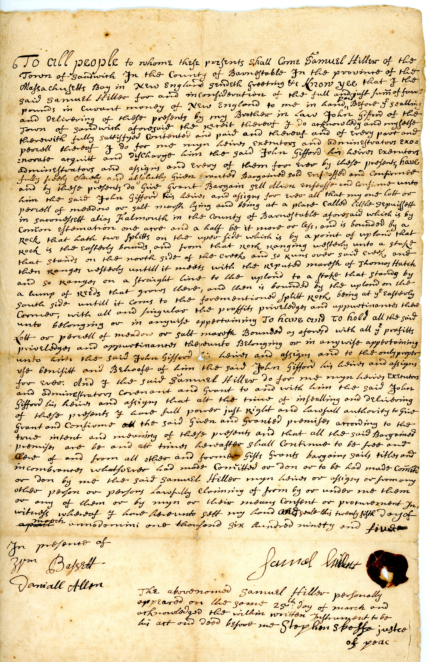
DEED: 1695 Little Sippewisset (alias Falmouth) deed with red seal, signed Samuel Hillew
“To all the people to whom they presents shall come Samuel Hillew of the Town of Sandwich for the County of Barnstable for the province of that Massachusetts Bay in New England sendeth geeting + know yee that I that said Samuel Hillew for and in confi(?)ovation of that full and just sum of four pounds in current mondy of New England to (-) in hand paid before ye goalling and delivering of those (???)by my brother in law John Gifford of the town of Sandwich aforesaid the _____”

Slide 8
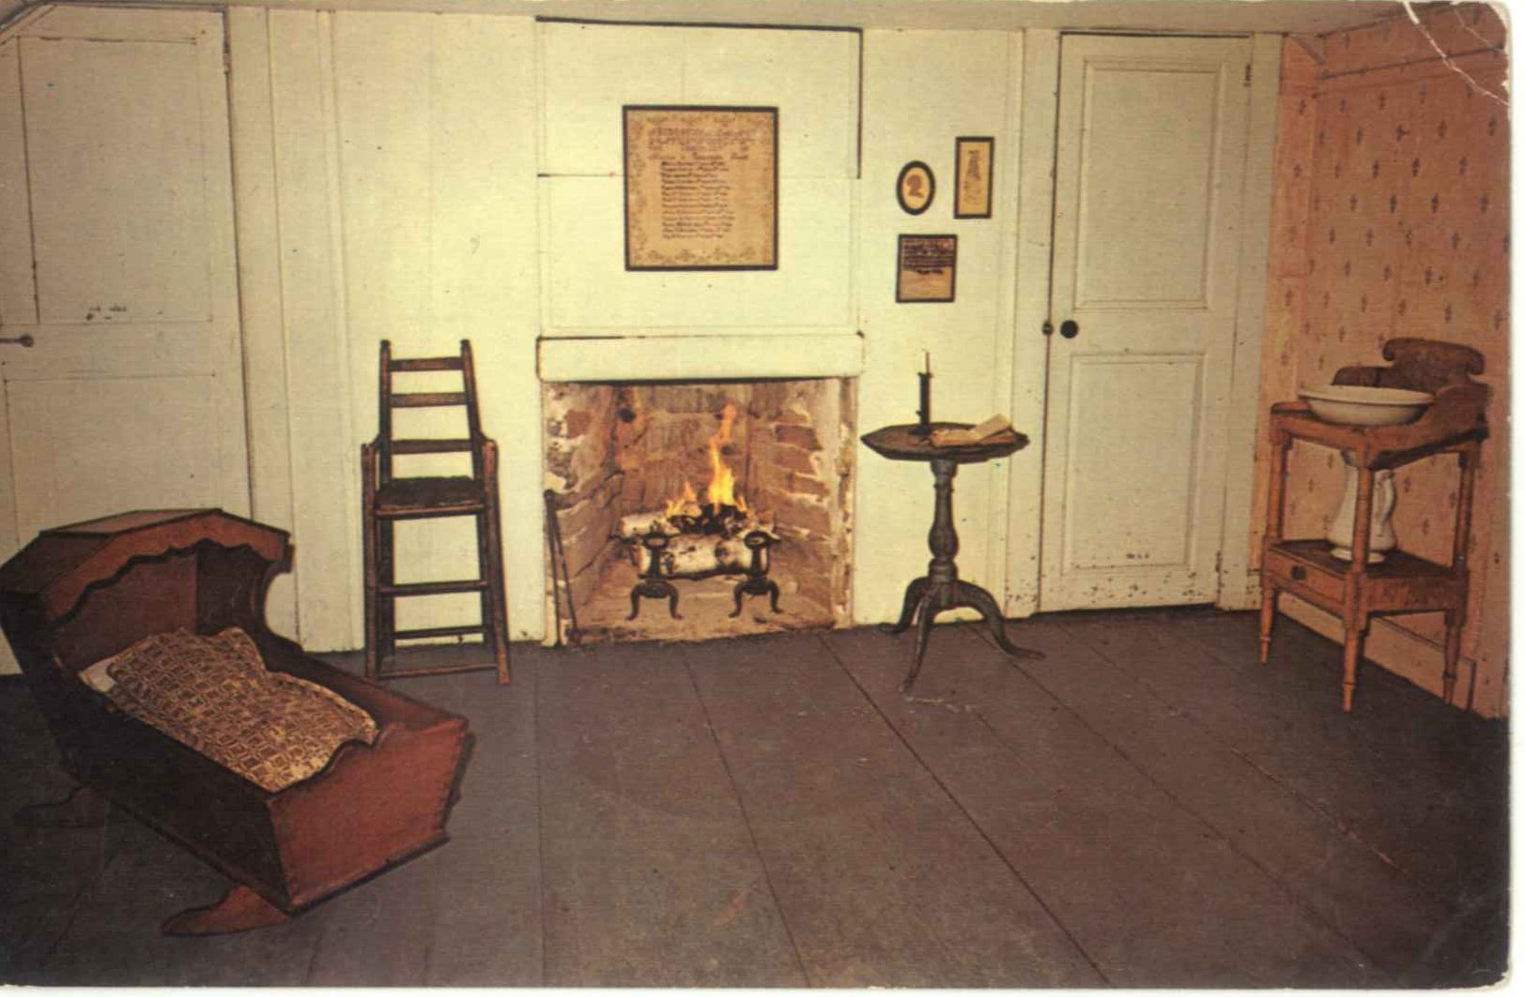
Bowerman Homestead original bedroom

Slide 9
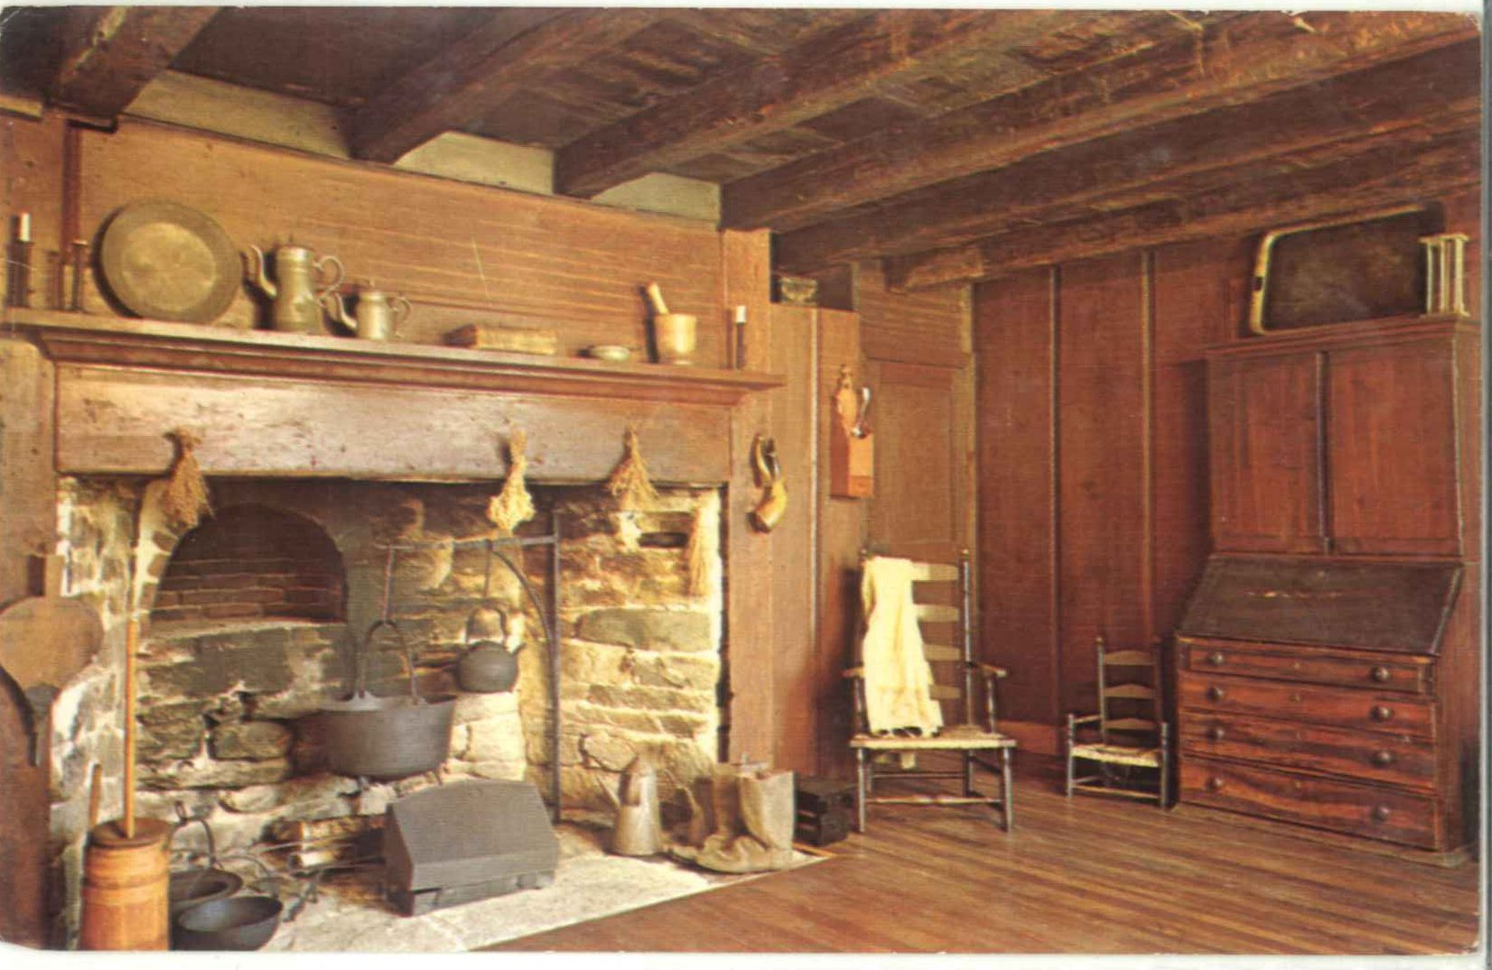
Bowerman homestead original kitchen

Slide 10
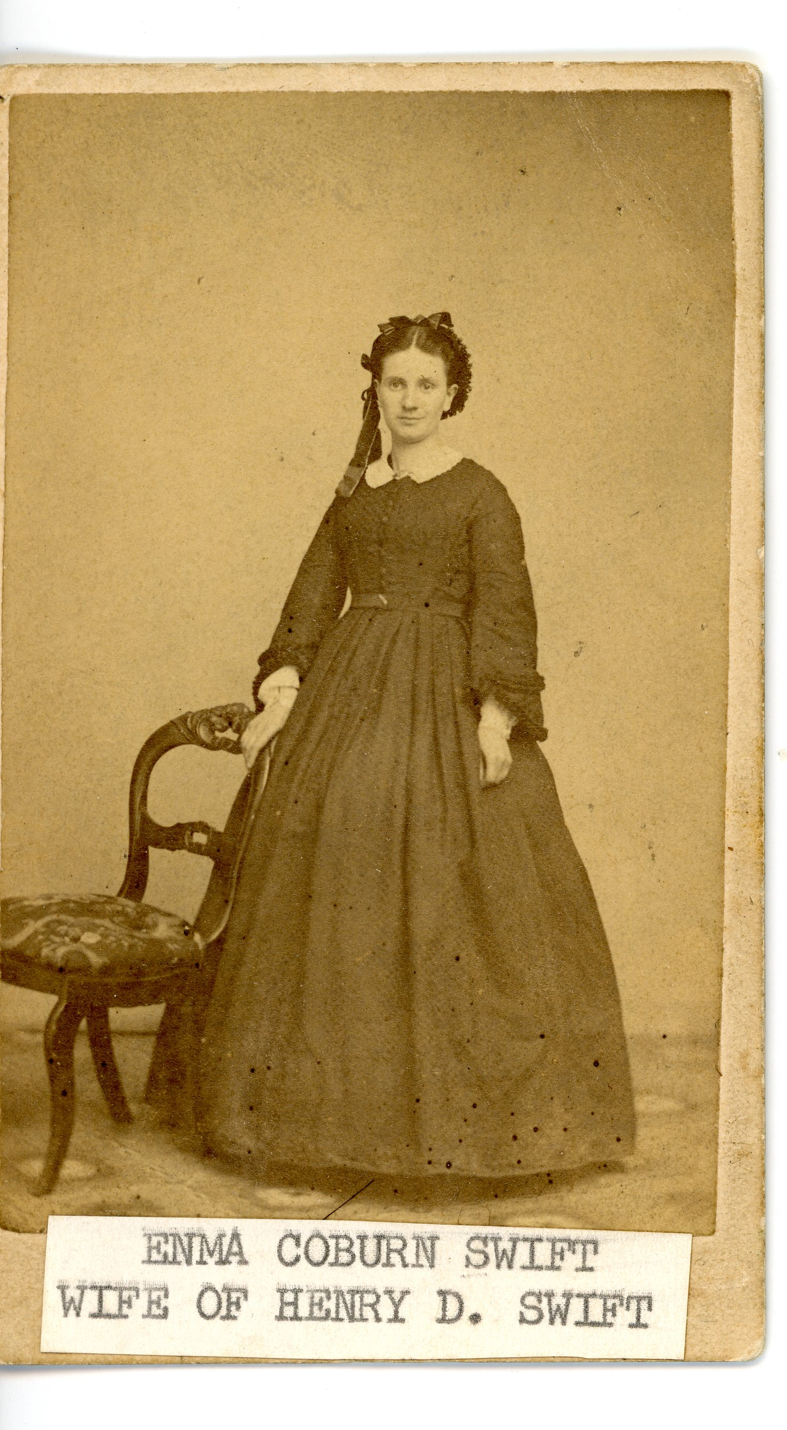
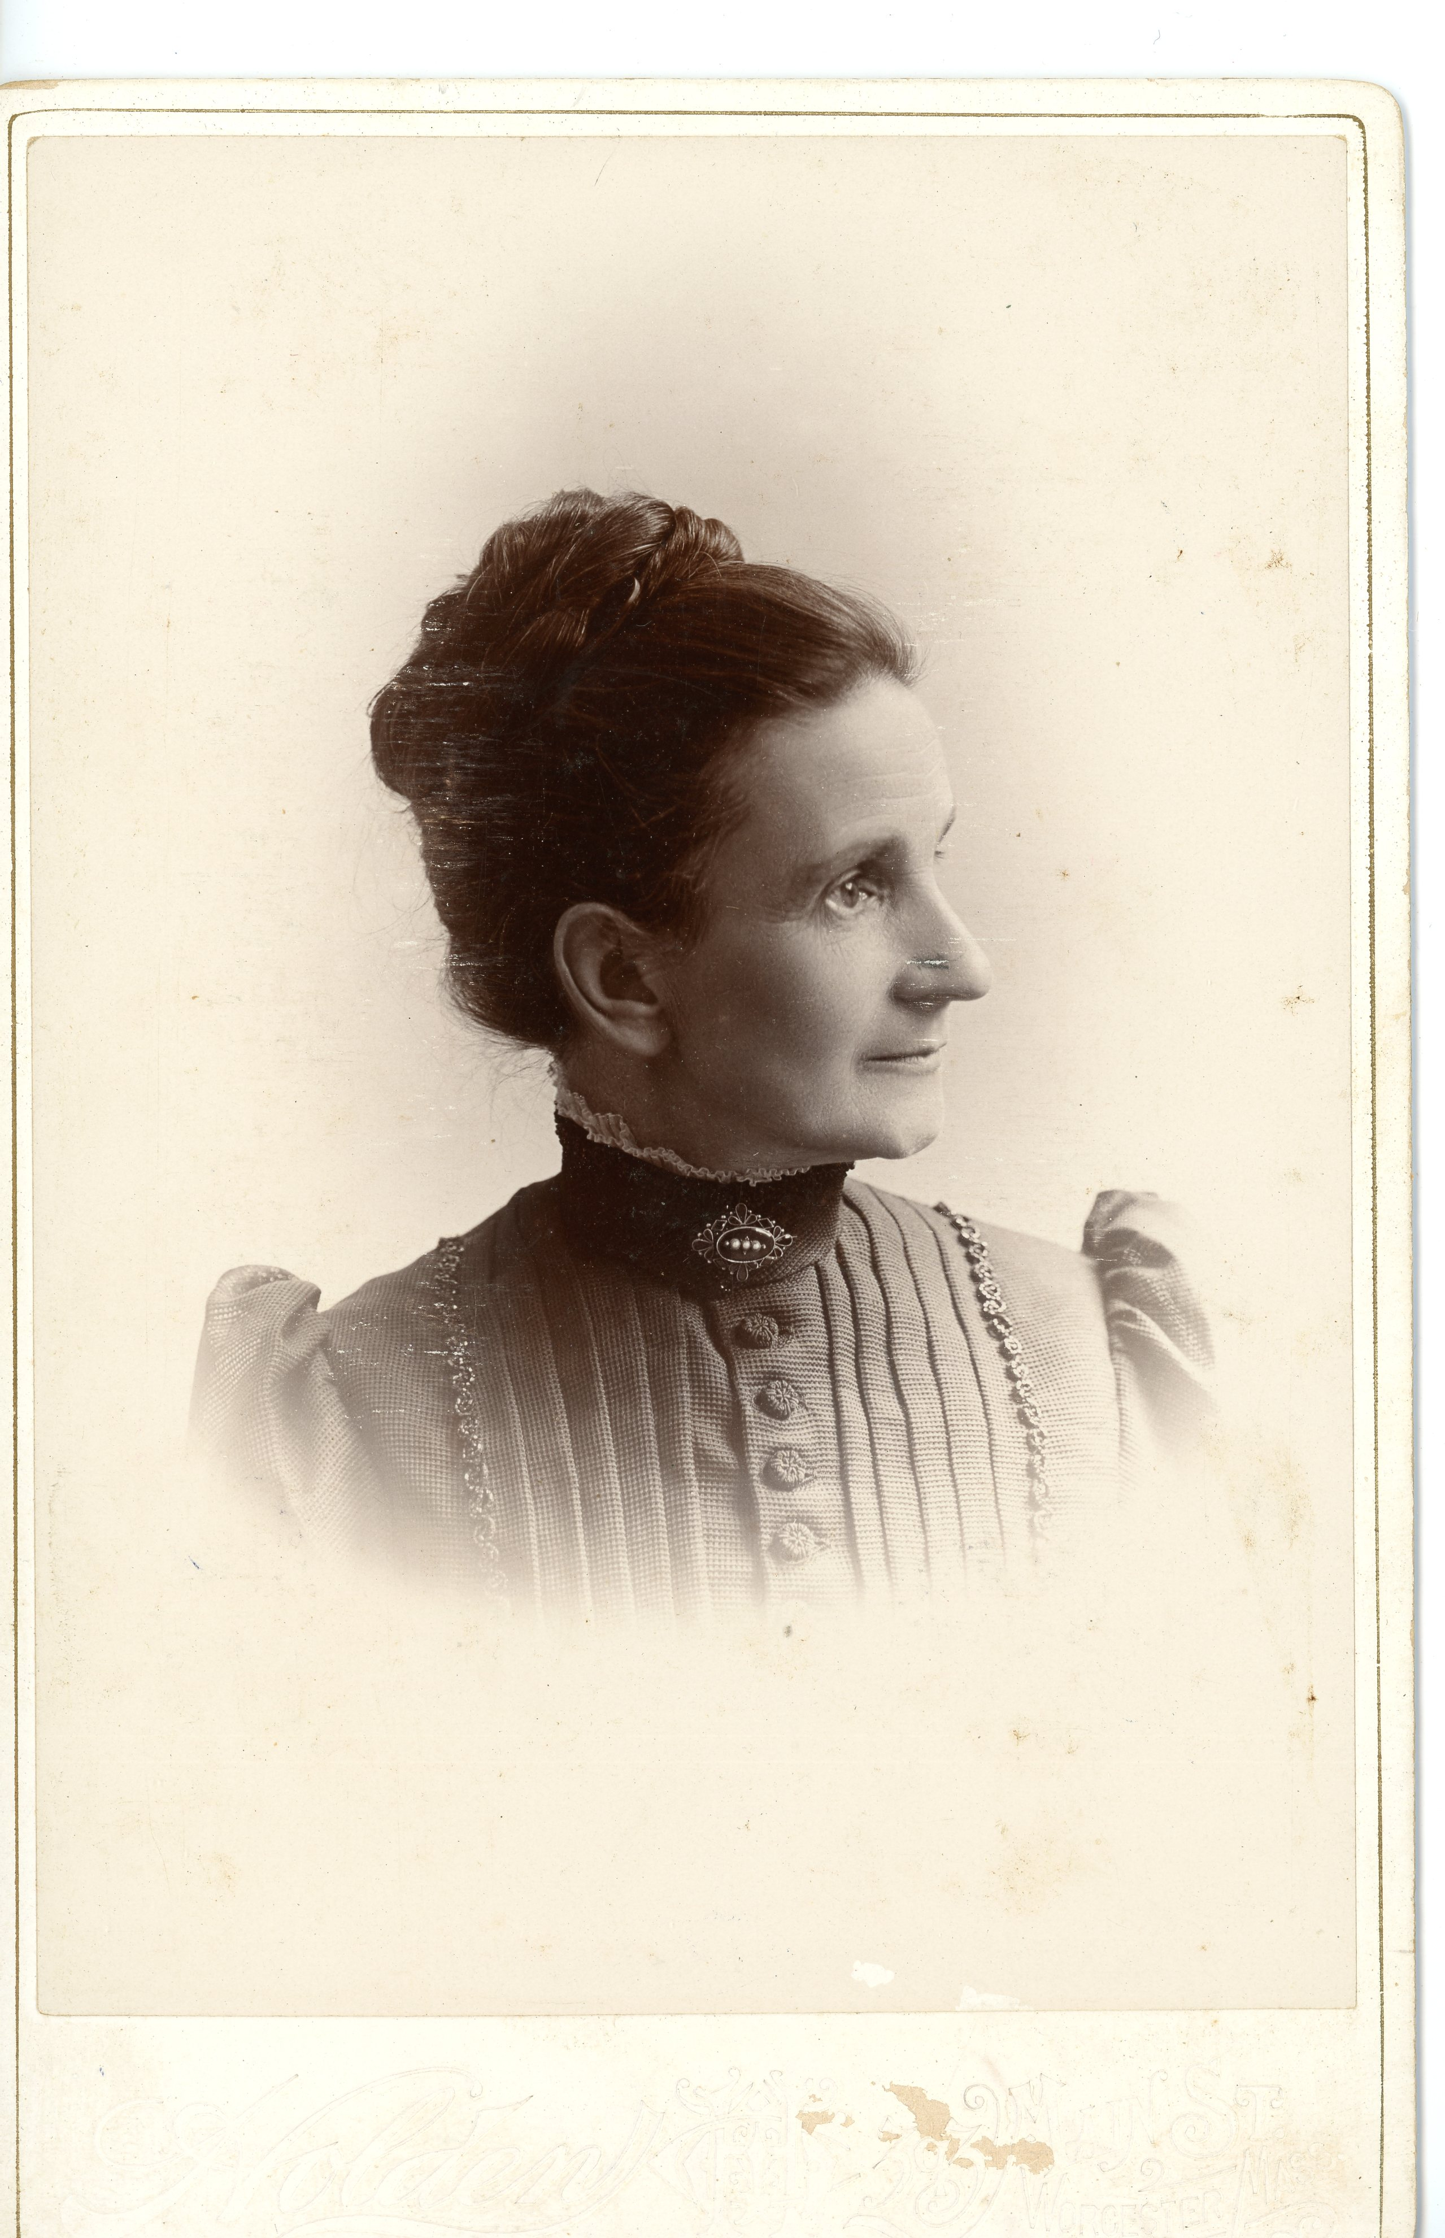
Emma Coburn Swift

Slide 11
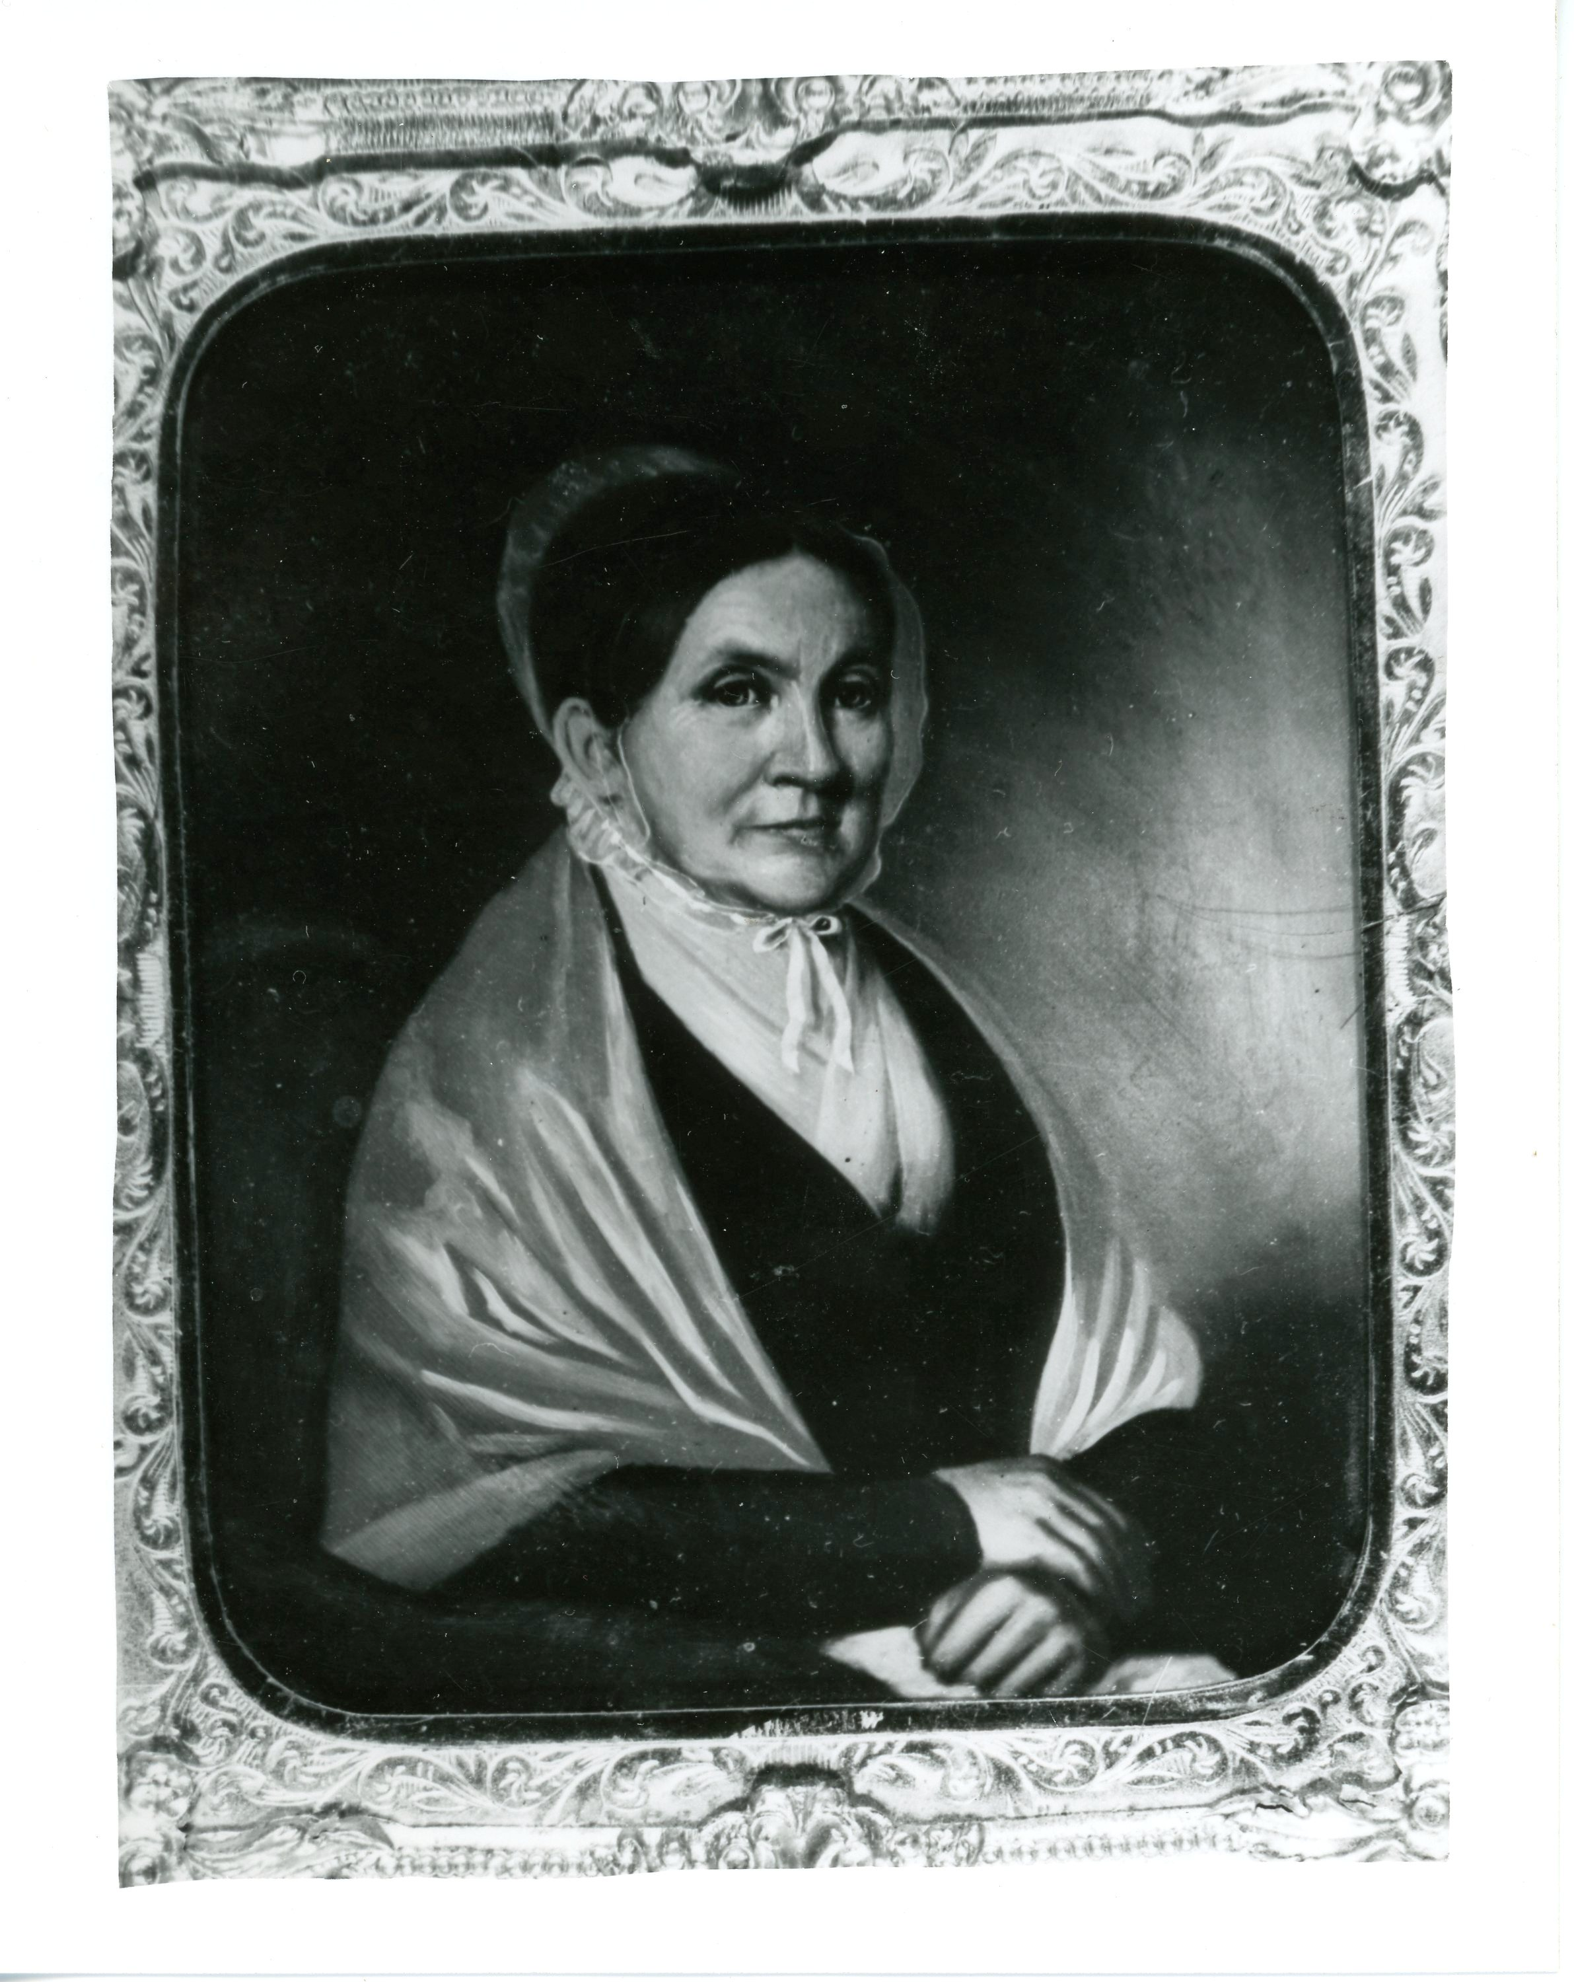
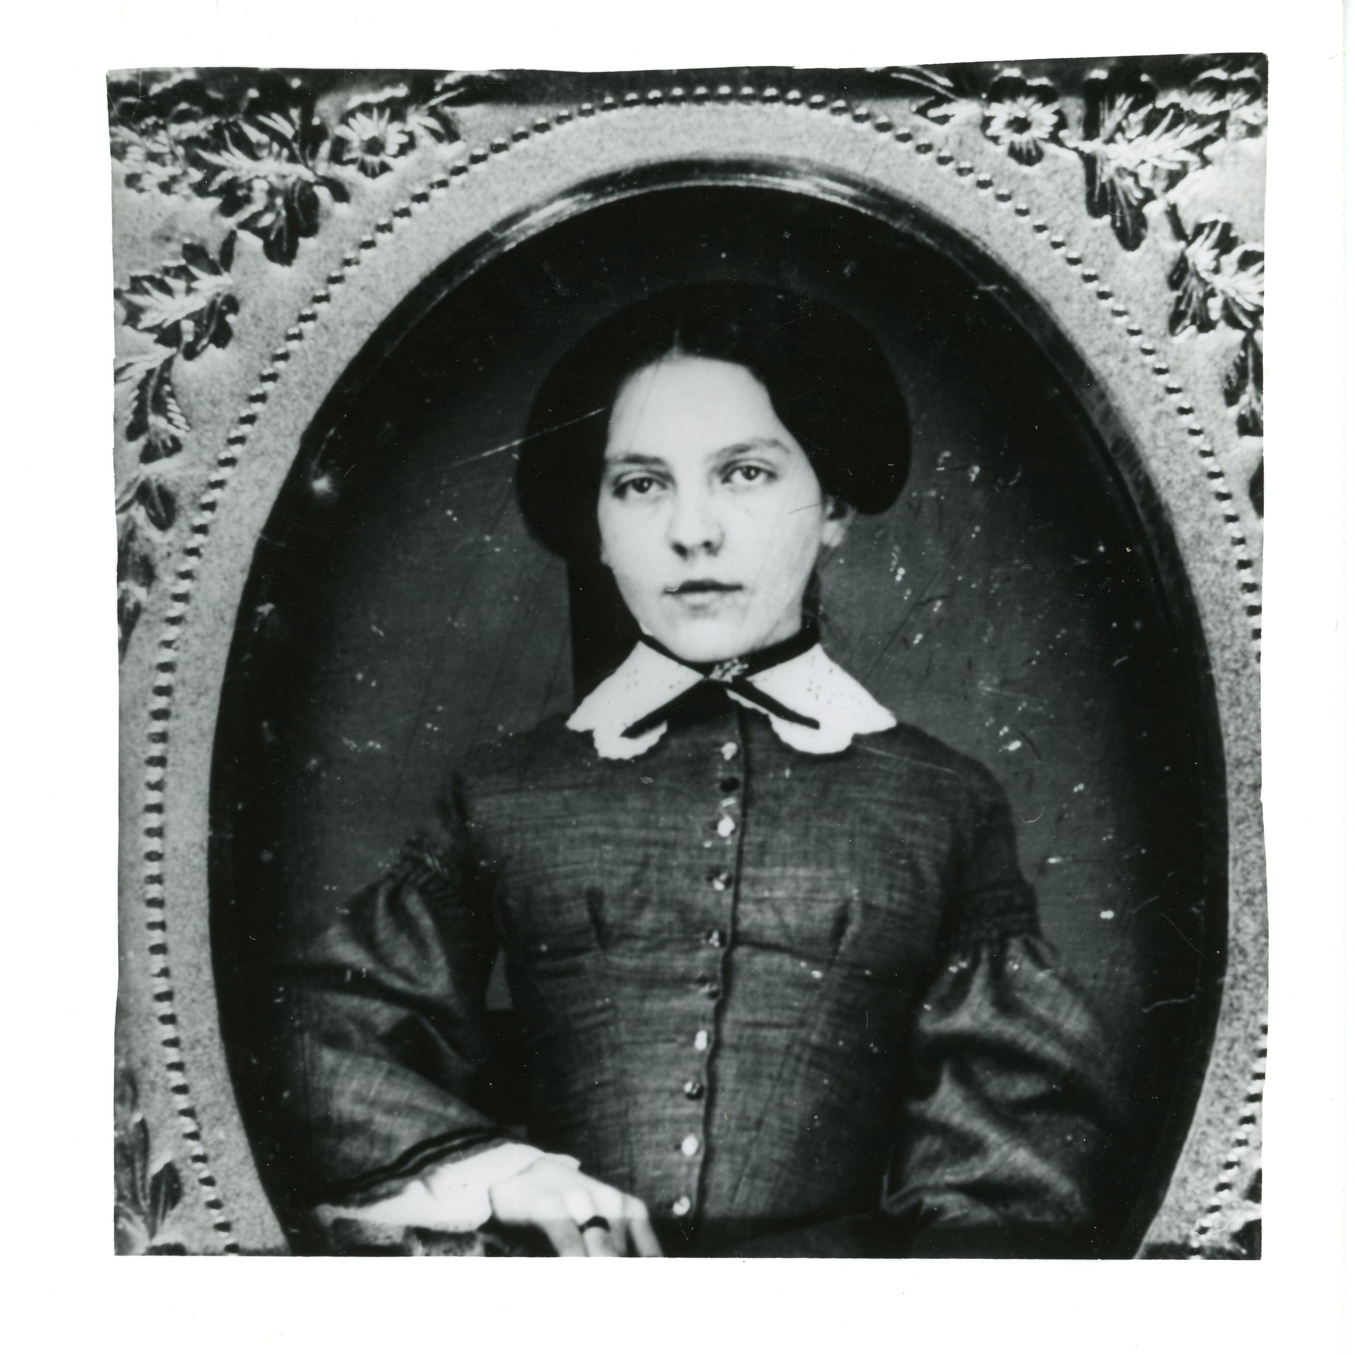
Hepzibah (Hoxie) Swift
Mary Abby Swift

Slide 12
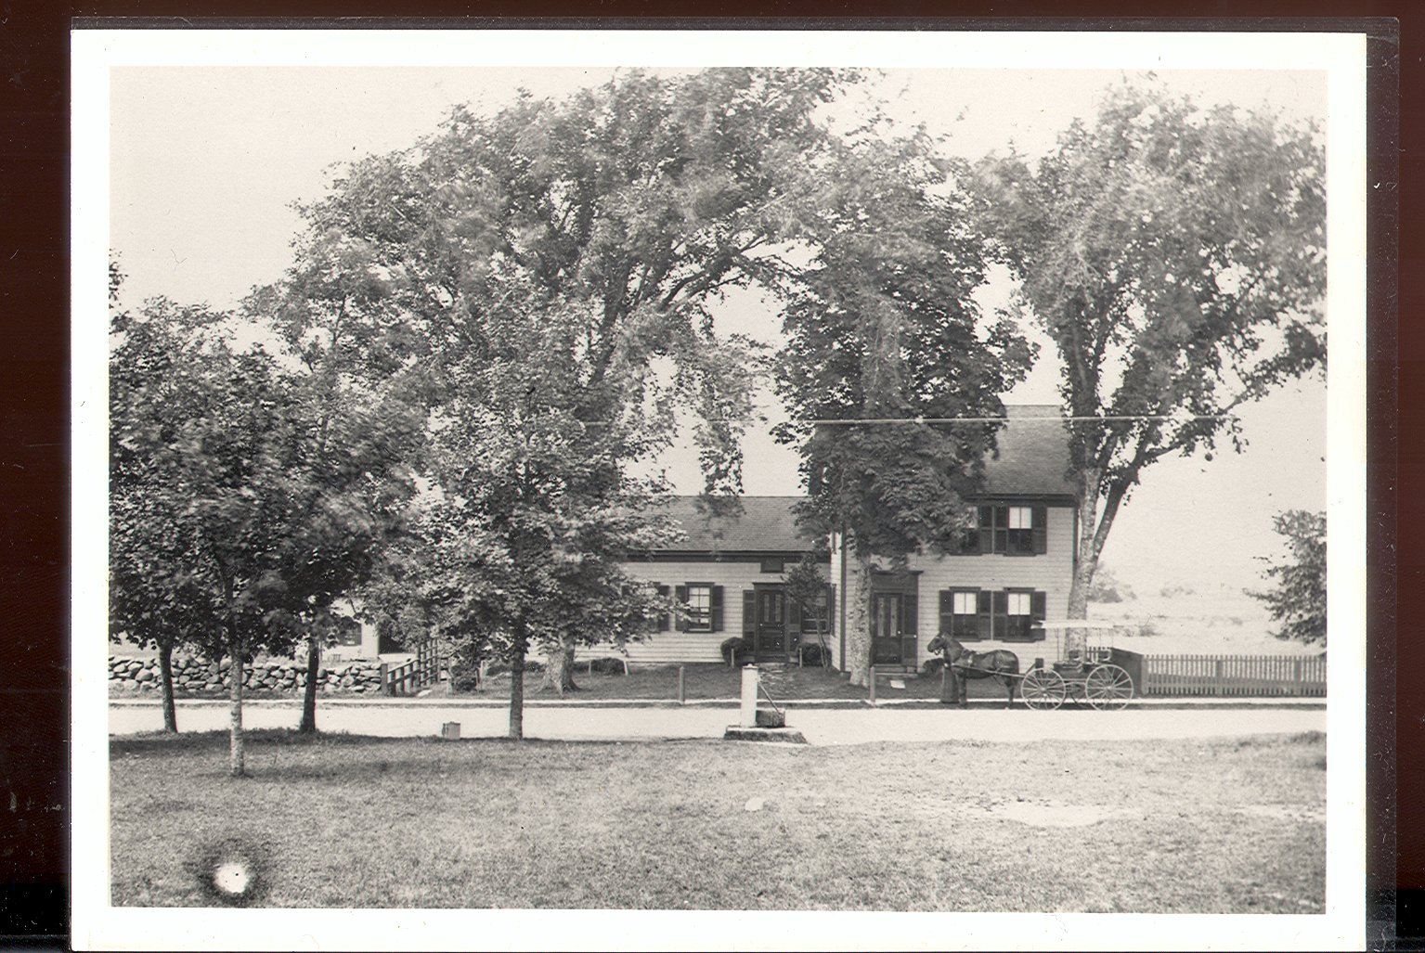
Abiel Swift f-in law of Hepz Swift’s Homestead

Slide 13
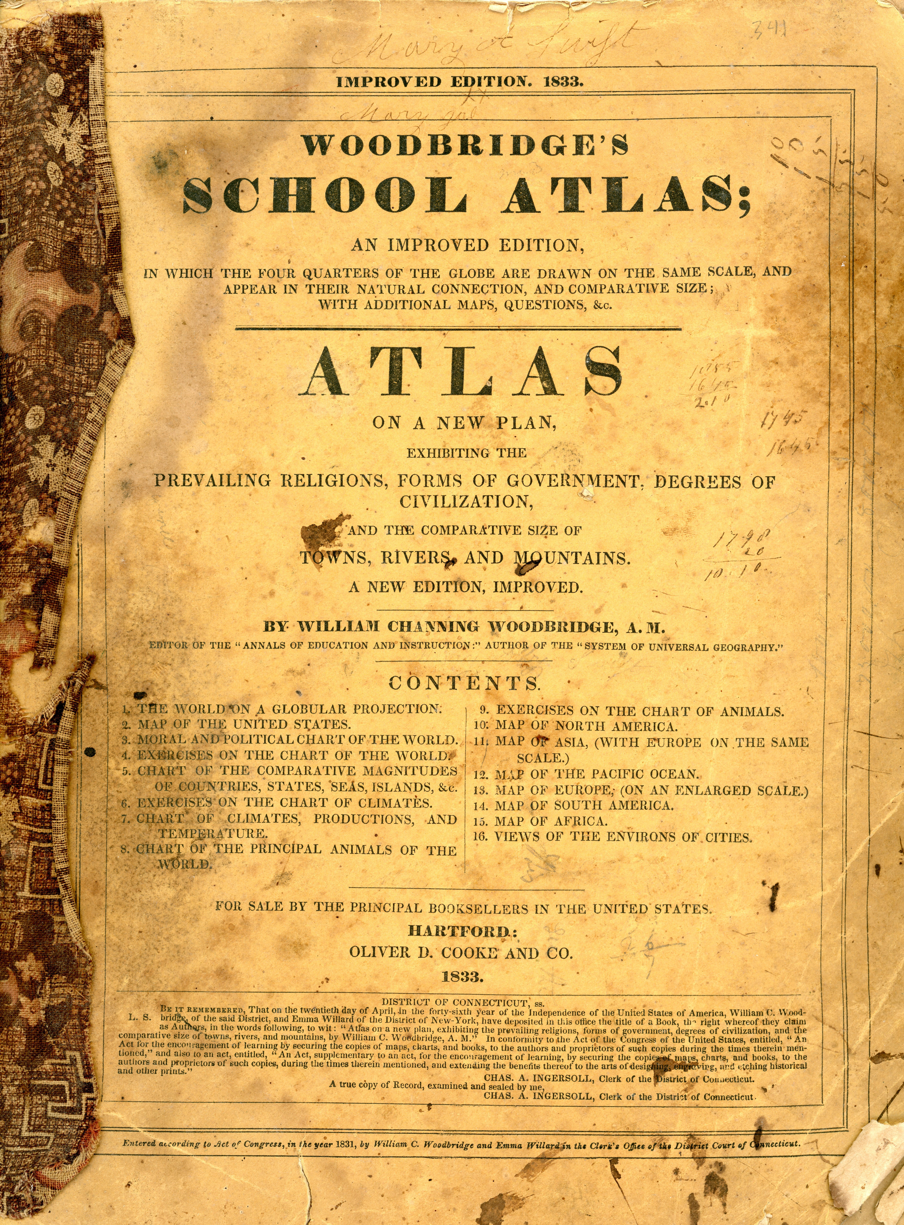
Mary Abby Swift
Her school book

Slide 14
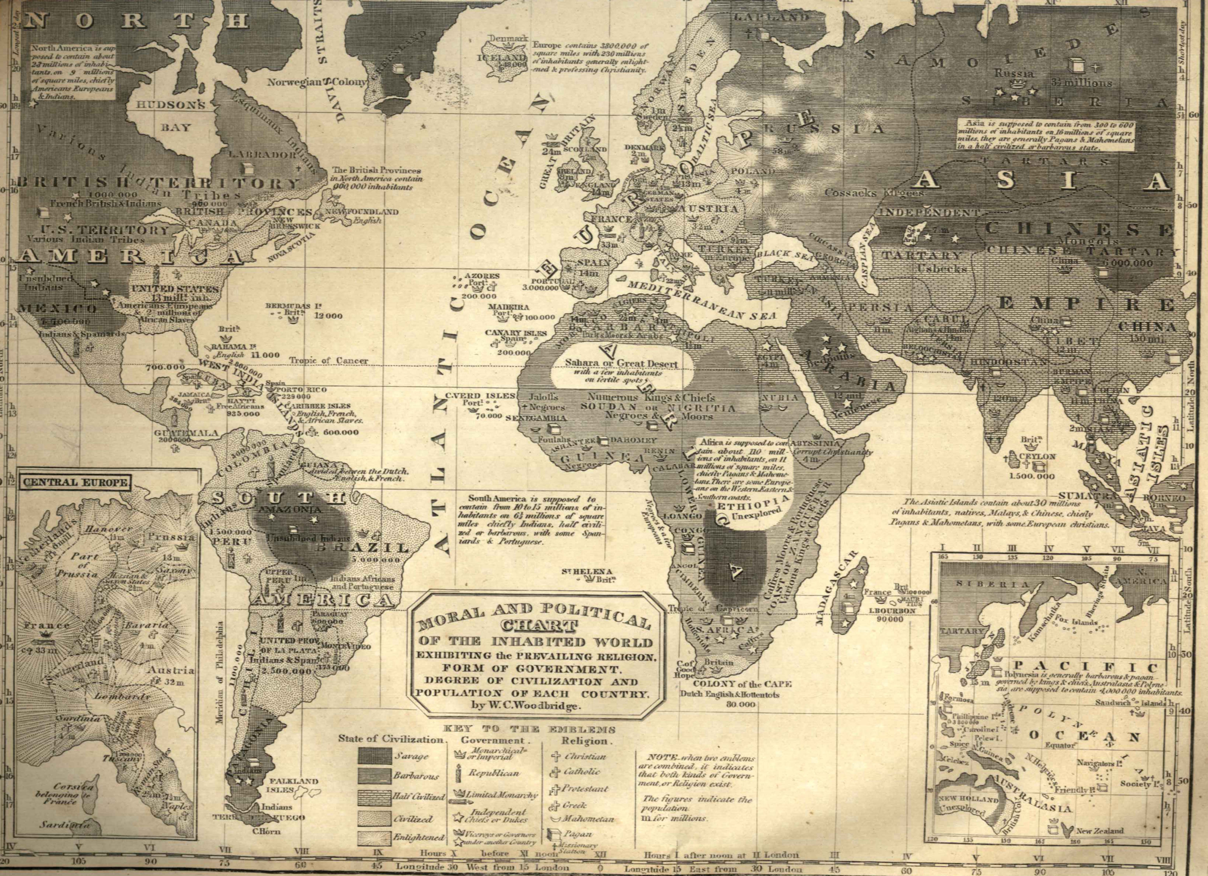
Political Map in school book of Mary Abby Swift shows
uncivilized and civilized, non-Christian and Christian locations

Slide 15
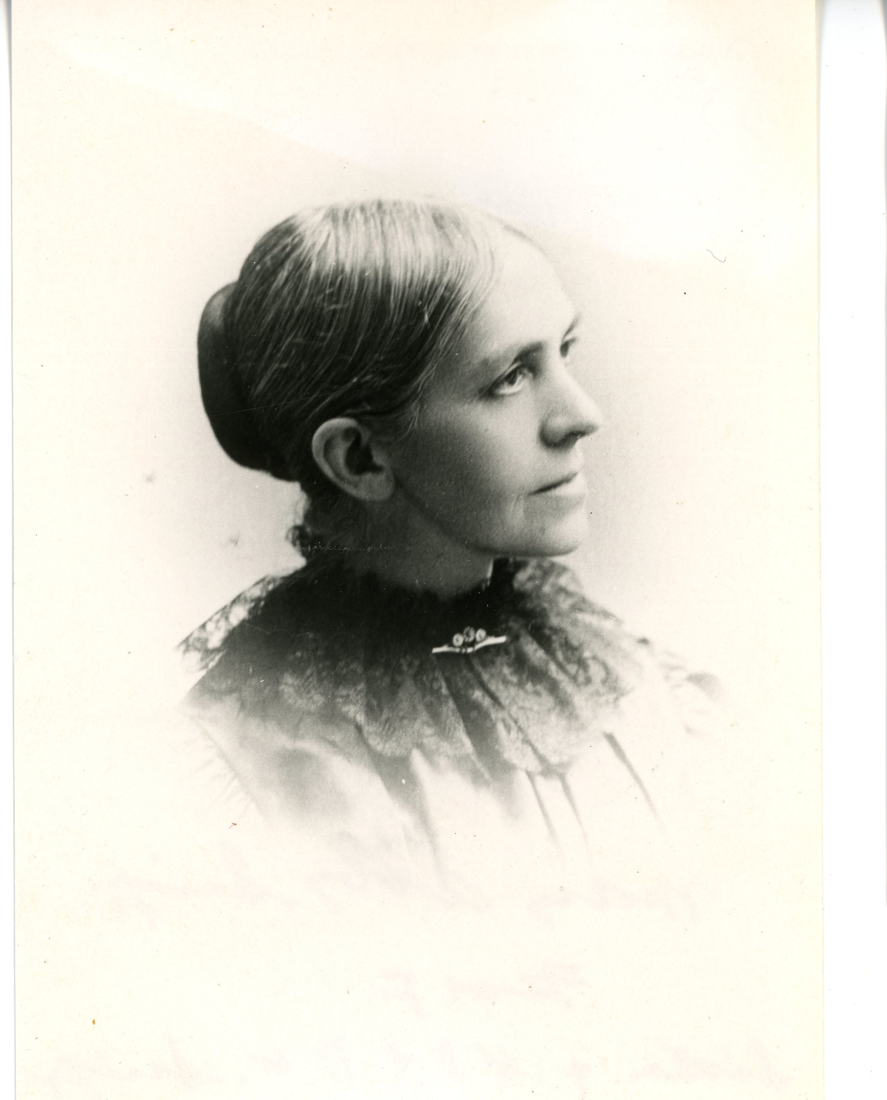
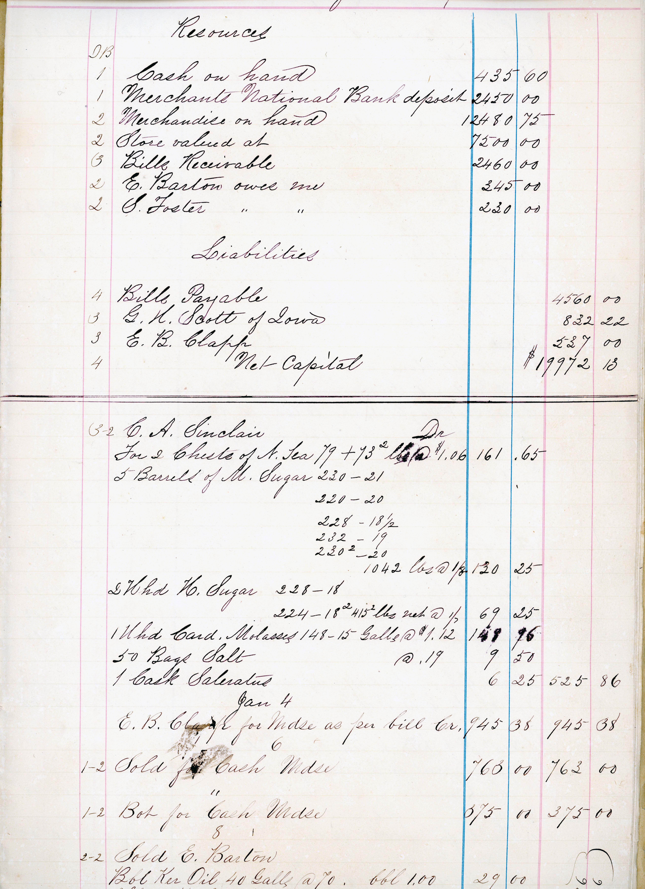
Mary Abby Swift and her ledger for her business in Falmouth

Slide 16
1718 Miss Hannah Sargent chosen for town’s school mistress at town meeting
1724 town voted school mistress salary:
  12 pounds and suitable diet with use of a horse twice a year to visit friends.
1725 Line drawn between town of Falmouth + ‘the South Sea Indians’ or district of Marshpee
1771 West Falmouth built new meetinghouse
By 1789 Falmouth’s church and town records in Falmouth are distinct and separately kept
1794 Meetinghouse englarged
1831 West Falmouth Friends established an elementary school for their children where
West Falmouth Library now stands.
1755 Women’s Meeting for Business begun in West Falmouth continued through 1880s
when congregation became too small to support two separate groups -
  Women encouraged to concentrate on family life and charity
and other matters assumed to be their expertise.
In the 18th century, it was radical to assume women could conduct business alone and preach during worship–both practices Quakers encouraged from the first.
  The moveable partitions in many old Friends Meeting Houses
Were put there to divide the men’s and women’s business meetings.
These were raised during worship.
1841 the 3^{rd –}and present - West Falmouth Meetinghouse was constructed and
Friends worshipped in the school house,
“It was here,” says John Dillingham “that Elizabeth Dillingham (wife of Stephen)
and Elizabeth Gifford (wife of William) first appeared as preachers

Slide 17
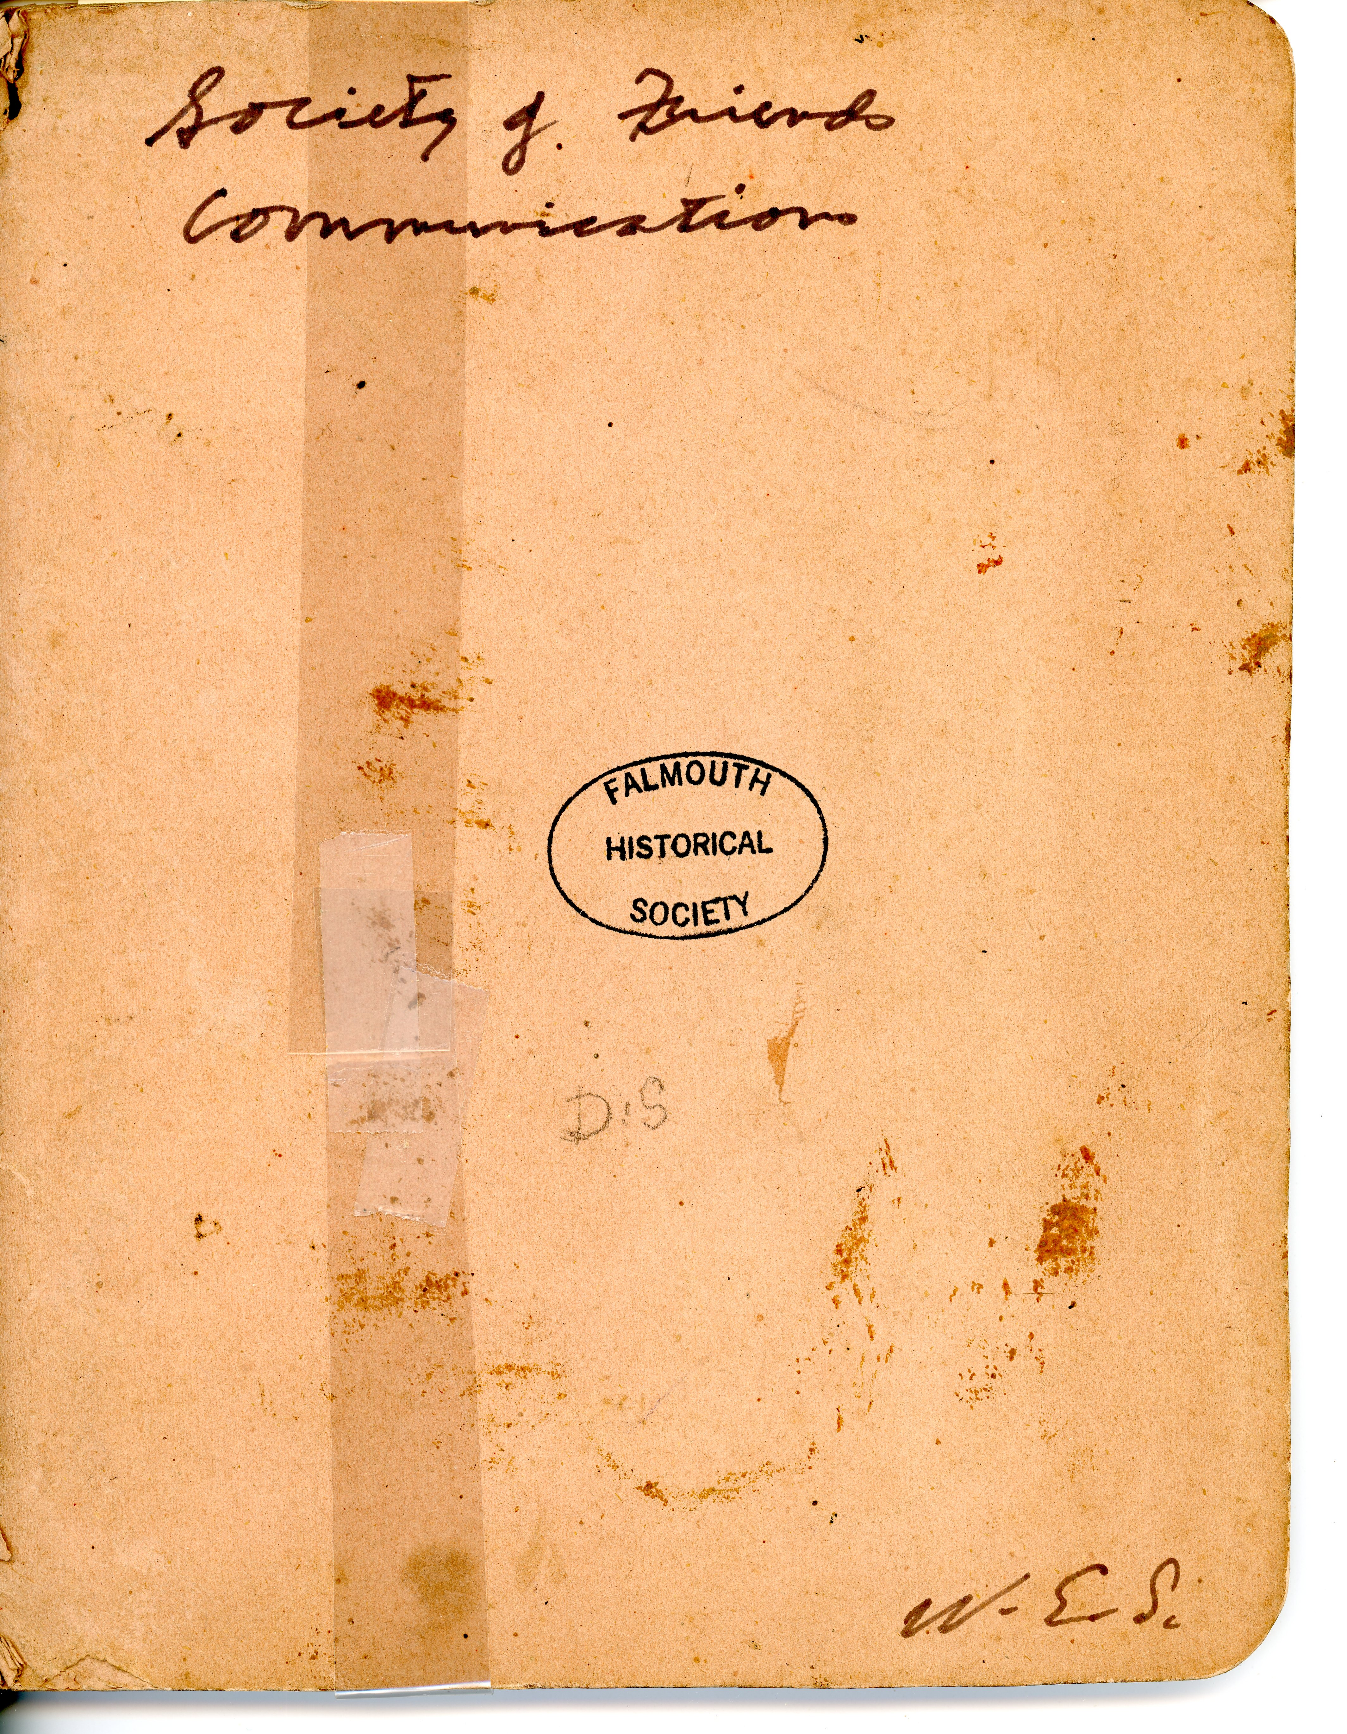
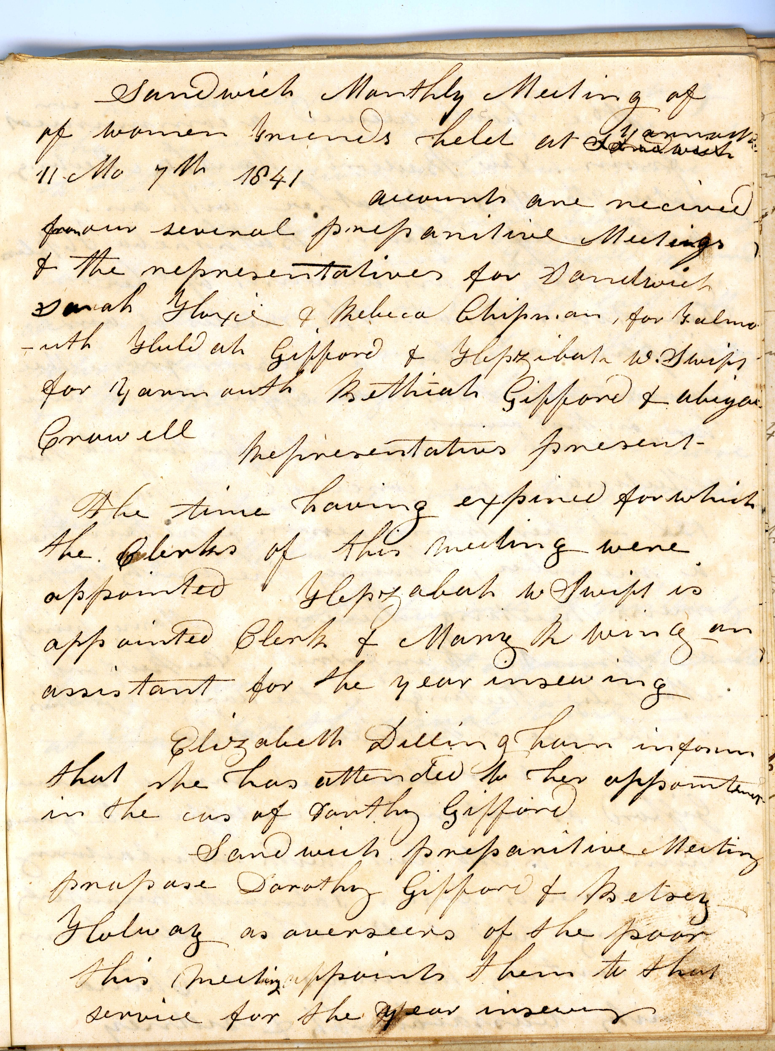
1841 Sandwich Monthly Meeting of
Women Friends

Slide 18
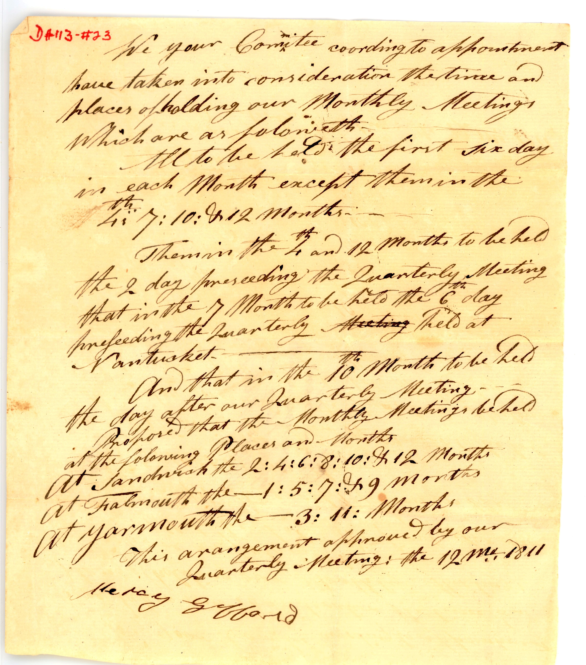
We your Committee coording to appointment
have taken into consideration the time and
places of holding our Monthly Meetings
Which are as foloweth
All to be held the first Sixday/Friday
in each Month except them in the
th
4 : 7: 10: & 12 & 12 months
Them in the 4th and 12th months to be held
the 2 day preceeding the Quarterly Meeting
that in the 7th Month to be held the 6 day
preseeding the Quarterly Meeting held at
Nantucket.
And that in the 10th Month to be held
the day after our Quarterly Meeting - - -
Proposed that the Monthly Meetings beheld
at the following Places and Months
At Sandwich the 2: 4: 6:8: 10 & 12 Months
At Falmouth the 1: 5: 7 & 9 Months
At Yarmouth the 3:11: Months
This arrangement approved by our
Quarterly Meeting: the 12 Mo 1811
(signed)
Mercy Gifford
Note: in 1657 the Sixth month is now considered August
Mercy Gifford
1811 Agreement

Slide 19
April 20, 1775
Gentlemen: --The barbarous murders committee on our innocent brethren
on Wednesday the 19th inst, (referring to the battle at Lexington)
have made it absoutely necessary that we immediately
raise an army to defend our wives and children
From the butchering hands of an inhuman soldiery ...
The Committee of Safety, Concord, Mass.
April 1779 English fleet short of provisions docked at Woods Hole (Holl)
Manassah Swift’s wife a helpless woman with her children’ (and no man at home)
told the English she had no cheese to sell, and besides they
Shouldn’t have a crumb …
They bayonetted her cheeses
She called them a valient sets indeed—fitted for just two things,
to rob hen roosts and make hen-pecked husbands.
Page 88 History of Falmouth

Slide 20
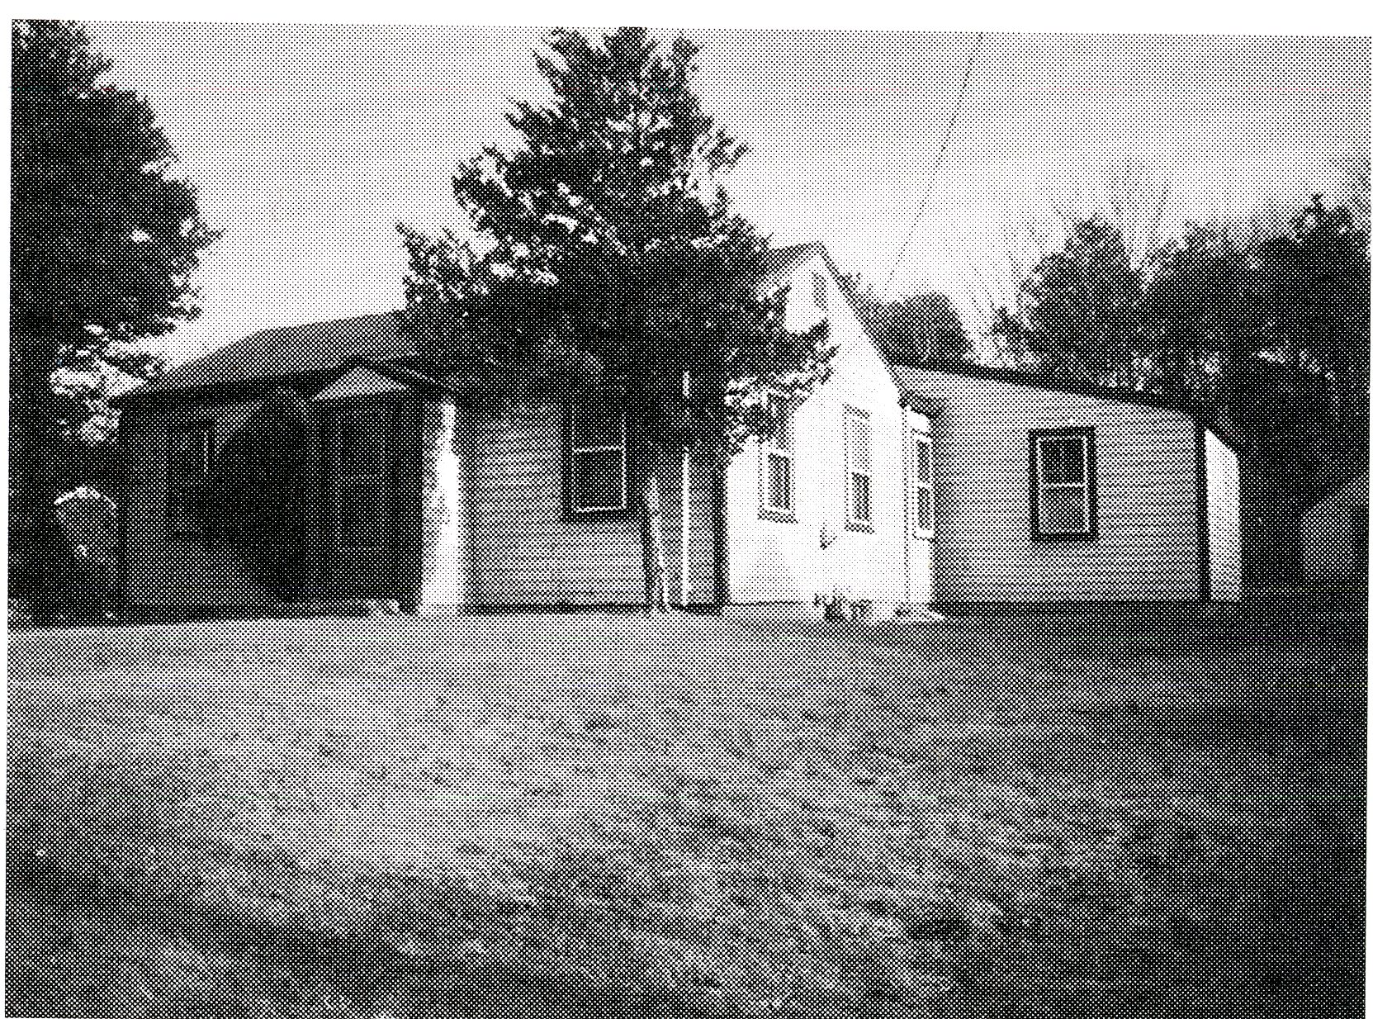
Post Revolutionary decades
Changes is customs of worship occurred throughout America
Calvinism suffered from divisiveness in the 18th century, was assailed by liberalism following the war.
West Falmouth Friends at first resisted the changing climate
  by providing a separate education for their children in 1831 built their own schoolhouse but gave it up in 1847 to attend Schoolhouse No. 5 north of Brick Kiln Road.

Slide 21
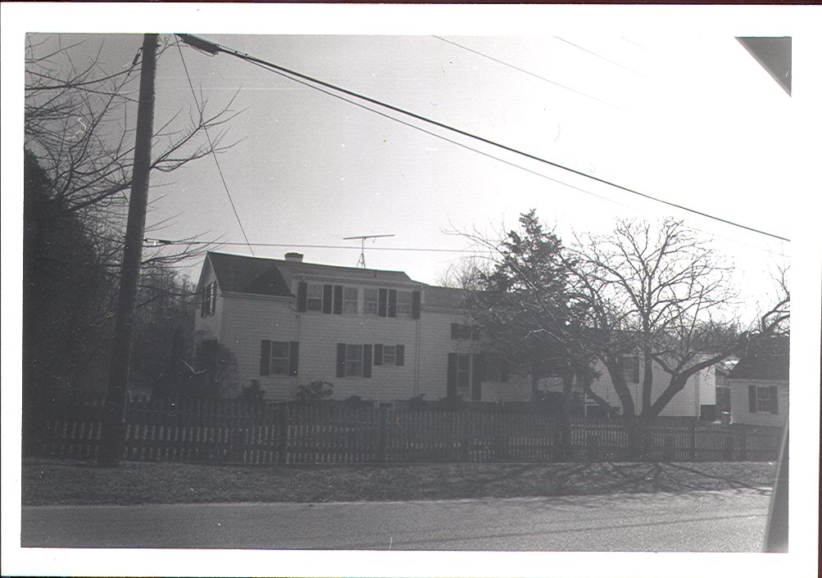
quaker school now 536 w falmouth hwy

Slide 22
West Falmouth Friends
List of preachers recorded as ministers
1816 Browning Swift
1818 Susan Swift
1827 Joshua Swift
1827 William Gifford
1801 John R. Davis (he came from New Bedford Monthly Meeting)
1829 Huldah Gifford
1846 Newell Hoxie (originally Sandwich)
1849 Elizabeth Gifford
1851 Mary Hoag
1851 Elizabeth G, Dillingham
1867 Lois B. Gifford
1867 Charity G. Dillingham (now Chace)
1870 Daniel Swift
Clerks of Sandwich monthly Meeting who were Falmouth residents:
Benjamin Swift (1745-47); Daniel Bowman (1796-98) + (1810-11); Prince Gifford (1798-1801); William Gifford (1811-14) + (1817-23); Prince Gifford, jr (1814-17); Daniel Swift (1823-31): Stephen Dillingham (1831-35); Newell Hoxie (1835-49); Arnold Gifford (1861-72); Meltiah Gifford (1872-84); James E Gifford (1884 to present time.)
Page 194 History of Barnstable County (Falmouth Library)
The only Clerks of the women’s monthly meeting, from Falmouth since 1849:
1849-50 + 1852-54 Hepza Swift
1869-76 Huldah Gifford

Slide 23
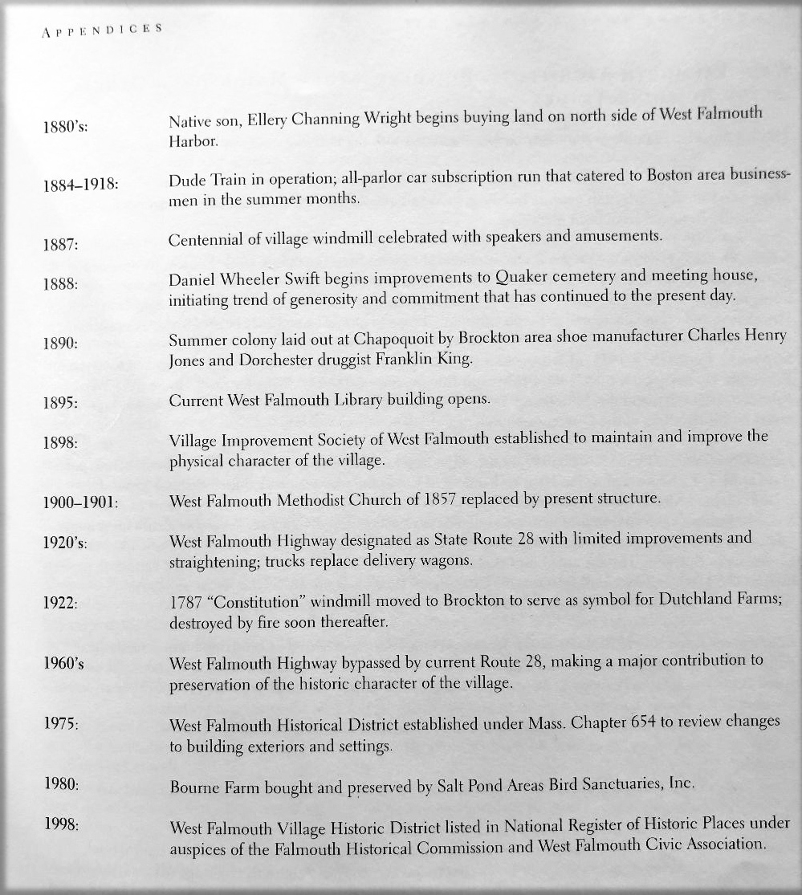

Slide 24
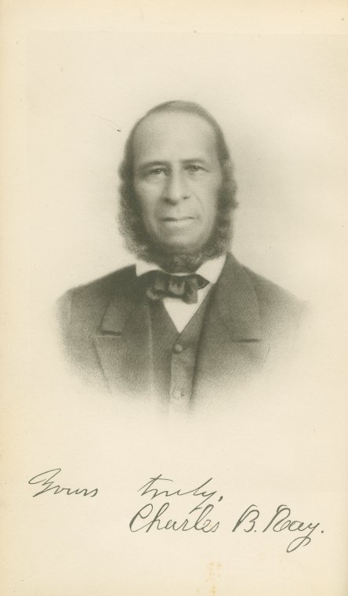
ACCURACY QUESTIONABLE re: not Annes but her mother
ABOLITIONISTS about 1839-1840, 73 Falmouth women signed a petition for the abolition of slavery. 2 signers were free black women: Rhoda Hammond + Annes Ray. Little is known about Rhoda, but Annes raised a distinguished family. Her son was a hero of the underground railroad, and she lived to see the ratification of the 13th amendment abolishing slavery. She also inspired a local legend.
A story has been passed down in Falmouth that the young Annes was a slave, brought to town on a sailing trip with her souther “master”. While he conducted business with Squire Palmer, whose home served as the post office, Annes went to the kitchen and was hidden inside a barrel by the Palmer women. The southerner couldn’t find her before the tide turned, so he left her behind to start a new life in Falmouth.
Though this story may have a grain of truth, some of the details just don’t add up. What we know about Annes is far more interesting. Annes lived in Falmouth with a black family named Harrington. She was probably related to them by blood or adoption. She got married her on March 30, 1806, to Joseph Ray of Westerly, Rhode Island. Joseph’s fathers, Thomas has been noted on the 1790 Census as an “Indian”. The Ray family history tells us that Thomas has African ancestry as well. Joseph and Annes settled in a house on Main Street, about where Eastman’s/Ace Hardware is today. Joseph worked as a mail carrier. Among their seven children, Charles Bennet Ray (12.24.1806) became a big name in the Underground Railroad; he moved to NY City, became a reverend involved with the anti-slavery movement (1833) forming the American Anti-Slavery Society. Took in escaped slaves into his home and by 1939 the sole editor of The Colored American suspended in 1842.

