Slide 1
THE SWIFTS – WEST FALMOUTH FOUNDING FAMILY
August 7, 2019
WEST FALMOUTH LIBRARY IN COOPERATION WITH OUR
FRIENDS FROM THE QUAKER MEETINGHOUSE INVITE
YOU TO A TALK, TOUR, AND RECEPTION
CELEBRATING THE SWIFT FAMILIES
6:00-7:00 TALK AND SLIDES OF ARCHIVAL DOCUMENTS
7:00-8:00 TOUR OF THE FRIENDS QUAKER MEETING HOUSE
8:00-9:30 RECEPTION (FOOD AND DRINK) AT THE LIBRARY AND OPPORTUNITY TO MINGLE AND VIEW ARCHIVE DISPLAYS
BONUS: FRIDAY 8/9/2019 at 9:00 AM GUIDED WALK TO THE OLD QUAKER CEMETERY AND FIRST MEETINGHOUSE SITE
Meet in Library Parking Lot. We will walk up the hill and turn left at Friends Way
.4 miles (10 minutes each way). Easy walk once you get up the hill.
Funded in part with a grant from the institute for museum and library services administered by the Massachusetts board of library commissioners

Slide 2
My sincere thanks goes to: Susan Meyers for her extensive research; Falmouth Museums on the Green archive collections; David Young, Abigail Young, and Erica Adams for assisting with research for this and other presentations; June Swift Atwood for contributing research and sharing family history; the entire library staff for covering the circulation desk while I chased down facts and scoured the archives; the Friends of the Quaker Meetinghouse who have graciously invited you all for a guided tour of the Meetinghouse tonight and a walking tour to the site of the first meeting house and the ancient cemetery Friday morning, and to the Tim Jackson family for taping this presentation.
How important were the Swifts to the history and heritage of West Falmouth? Two cemeteries give us clues:
The West Falmouth Friends Cemetery: 341 total Memorials…
62 Swift (38 Bowman, 33 Bowerman and 76 Gifford)
The Oak Grove Cemetery: 5,258 Memorials…
117 Swift (66 Bowman,1 Bowerman and 81 Gifford)
Totals for both cemeteries:
179 Swift
157 Gifford
104 Bowman
34 Bowerman

Slide 3
VILLAGE SWIFTS | SUMMER SWIFTS
ABIAL (ABIEL) PAUL MOSES SILAS F. | D. WHEELER & SARAH HENRY D. & EMMA ABBY SWIFT MENDENHALL

Slide 4
Quakers Abial (b.1765) and Paul Swift (b.1753) were cousins who settled in Sandwich. Abial came to West Falmouth to apprentice as a blacksmith. In 1790 he purchased the shop from blacksmith, Richard Lake, and established a smith and chandlery (candle) business. Abiel’s sons Daniel (b.1792) and (Seth b.1801) worked as blacksmiths, mechanics, and shopkeepers; and Daniel served as the village school teacher. Daniel and Seth managed their father’s business as a village commerce center which included ship building, coastal trade with Nantucket and Maine, and a village store.
Henry D. (b.1833) and D. Wheeler (b.1840) were sons of
Daniel and Hepzibah Hoxie Swift.
Paul Swift found an opportunity to buy land when Seth and Thomas Bowerman sold their inheritance and moved to New York state. Paul and his son, Moses (b.1786) purchased Seth’s farm and the village windmill in 1816, In 1854 Moses Swift (age 68) with others organized the Union Store as a cooperative.
The store also housed the Post Office.

Slide 5
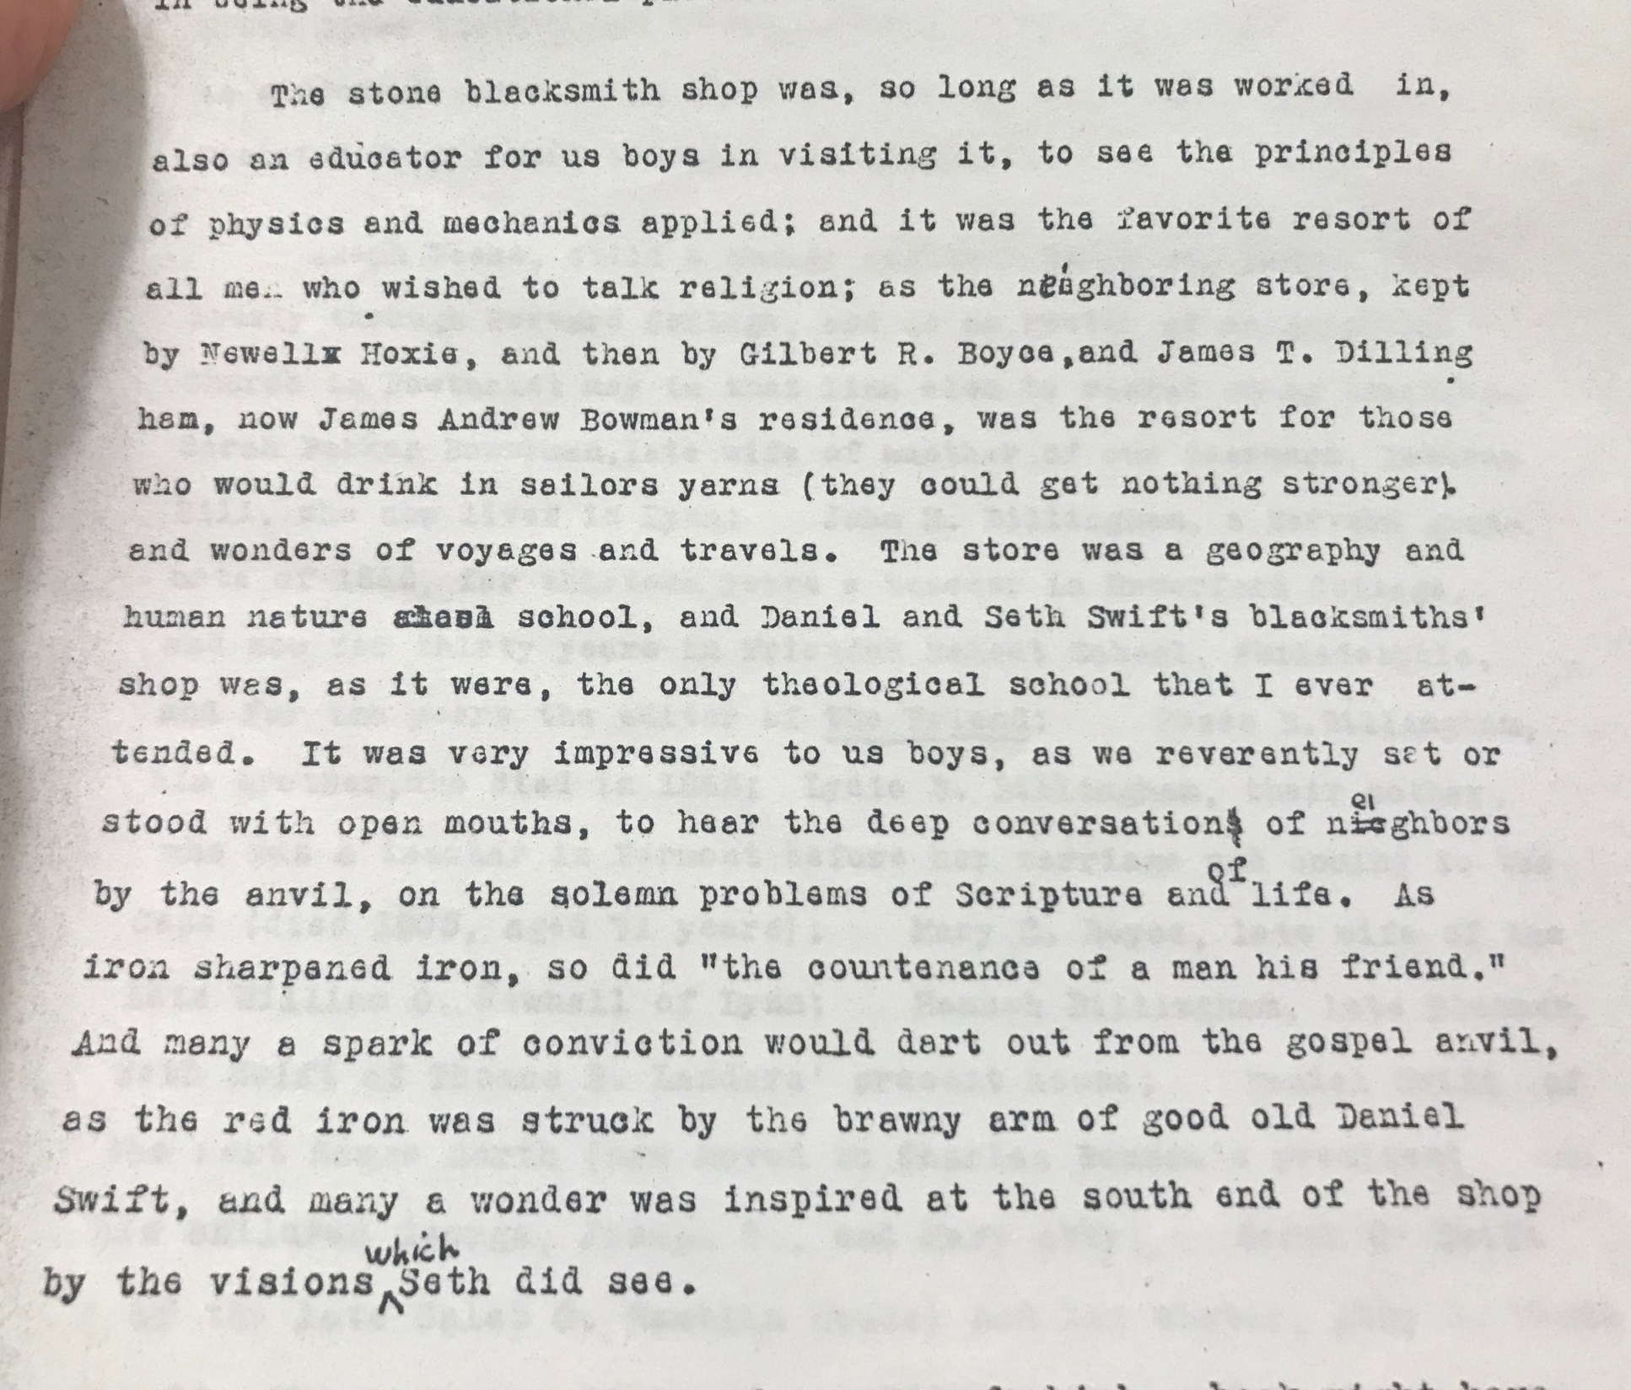
Notes:
The store was a geography and human nature school, and Daniel and Seth Swift’s blacksmiths’ shop was, as it were, the only theological school that I ever attended. Author not identified.

Slide 6
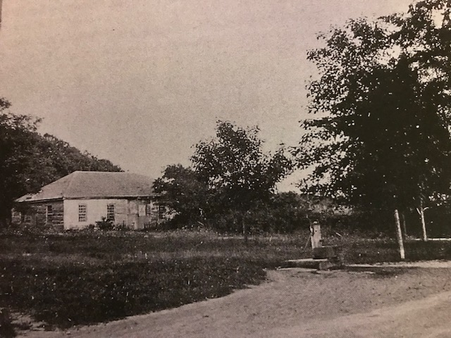
Historic View of the Blacksmith Shop on
Blacksmith Shop Road
Photograph ca.1897 by H.G. Curless
Notes:
Richard Lake established the Blacksmith Shop ca 1778. He was a Quaker from Rhode Island who was probably encouraged to move to West Falmouth. Daniel Wheeler Swift asked that I find an old photograph of the building which still stands. The outside of the building is built of pink granite. It was one of the first permanent structures built specifically for business in West Falmouth.

Slide 7
We begin our history with Silas F. Swift (b.1835 and son of Moses)
Falmouth Enterprise Saturday, October 22, 1904
The death of Silas F. Swift after a severe illness of about three weeks, has left a vacancy in the life of West Falmouth that many, especially the summer residents, will find hard to reconcile. He was born at the old homestead on the third of January, 1835, where he has since made his home, and as the successor to his father, Moses Swift, became the owner of the "Old Wind Mill." For twenty years he was the station agent at West Falmouth and as such was the first to welcome the new comer and the last to speed him on his homeward way. He was the last owner of the "Old Salt Works" in operation in this section of the state, having purchased the plant of Nathaniel Eldred. He was a birthright member of the Society of Friends at West Falmouth. His familiar figure, will be missed by many, for it will seem unnatural not to see him hurrying to and from the station. His first wife was the daughter of Barnabas and Virtue Bowerman; his second the daughter of Thomas and Rebecca Gifford. At their death he filled the mother's place as well as the father's for his children. The third wife, Matilda, is the daughter of the late George and Matilda Gamans. She, with the children, Horace E. Swift, Virtue E. Holman, Charles H. Swift, Georgiana M. Swift and Paul G. Swift, remain to mourn his loss.
Notes:
We actually begin with his obituary, which speaks so fondly of his work in the village. Until the late 1940s a person who was born to a Quaker family automatically became a member of the Society by right of birth, hence birthright.

Slide 8
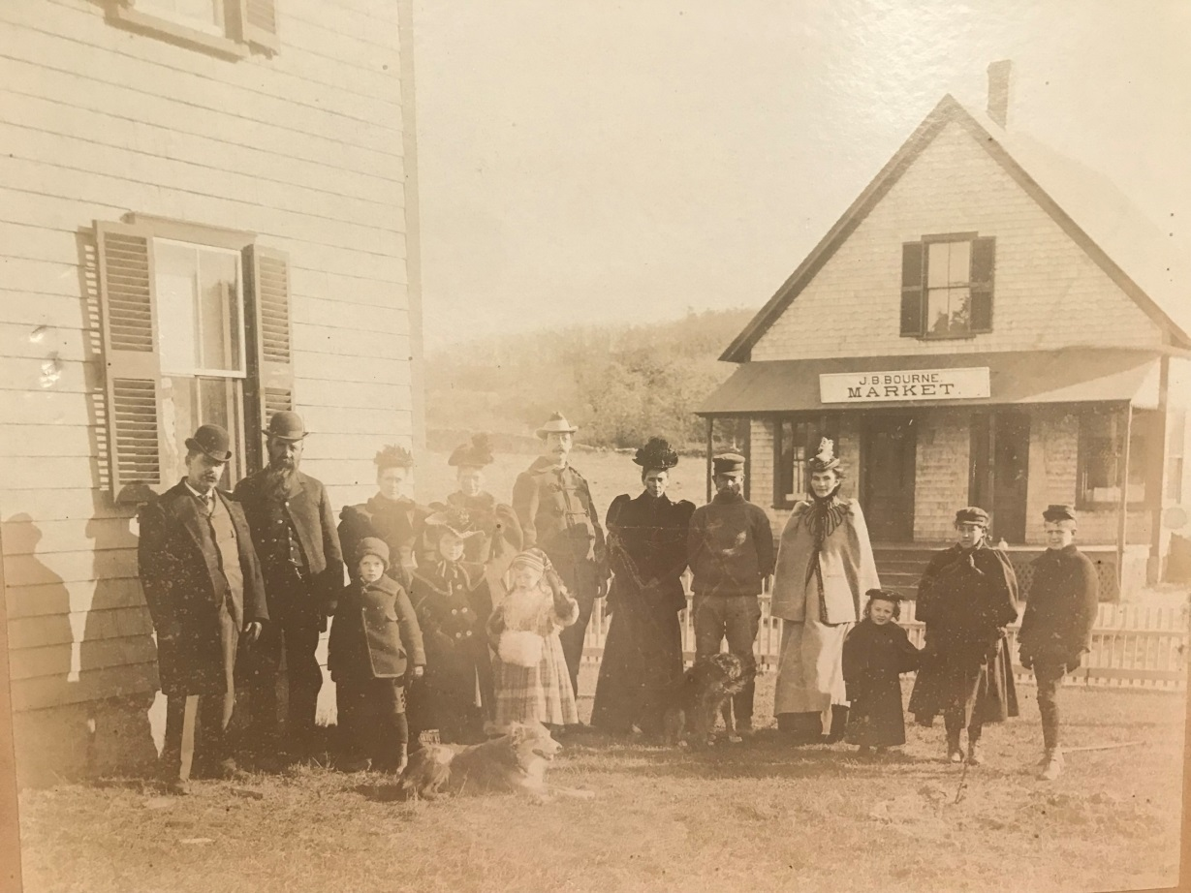
The railroad station also served as a telegraph office. The telegraph name for West Falmouth was Longview. Silas F. was the first station agent and telegraph operator.
Right: The Silas F. Swift family c.1898
“The enterprising Silas F. Swift proved to be more astute than any other West Falmouth native in his ability to recognize and exploit a new opportunity. Taking on the role of railroad station agent and telegraph operator, was just the beginning. Regional promoter and real estate agent Ezra G. Perry, noted that Silas also offered meals and lodgings to travelers, thus filling all of the gaps identified by Perry in his 1898 book entitled A Trip Around Cape Cod.”

Slide 9
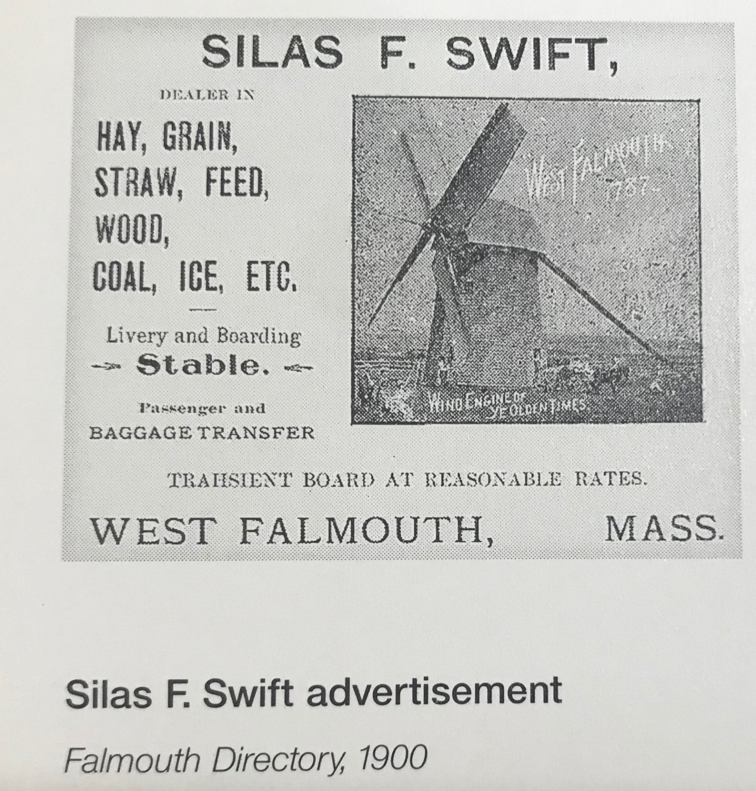

Slide 10
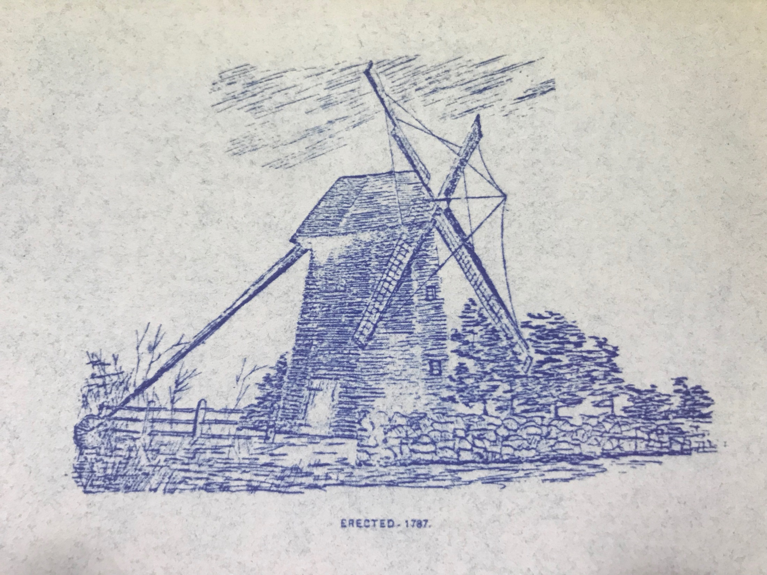

Slide 11
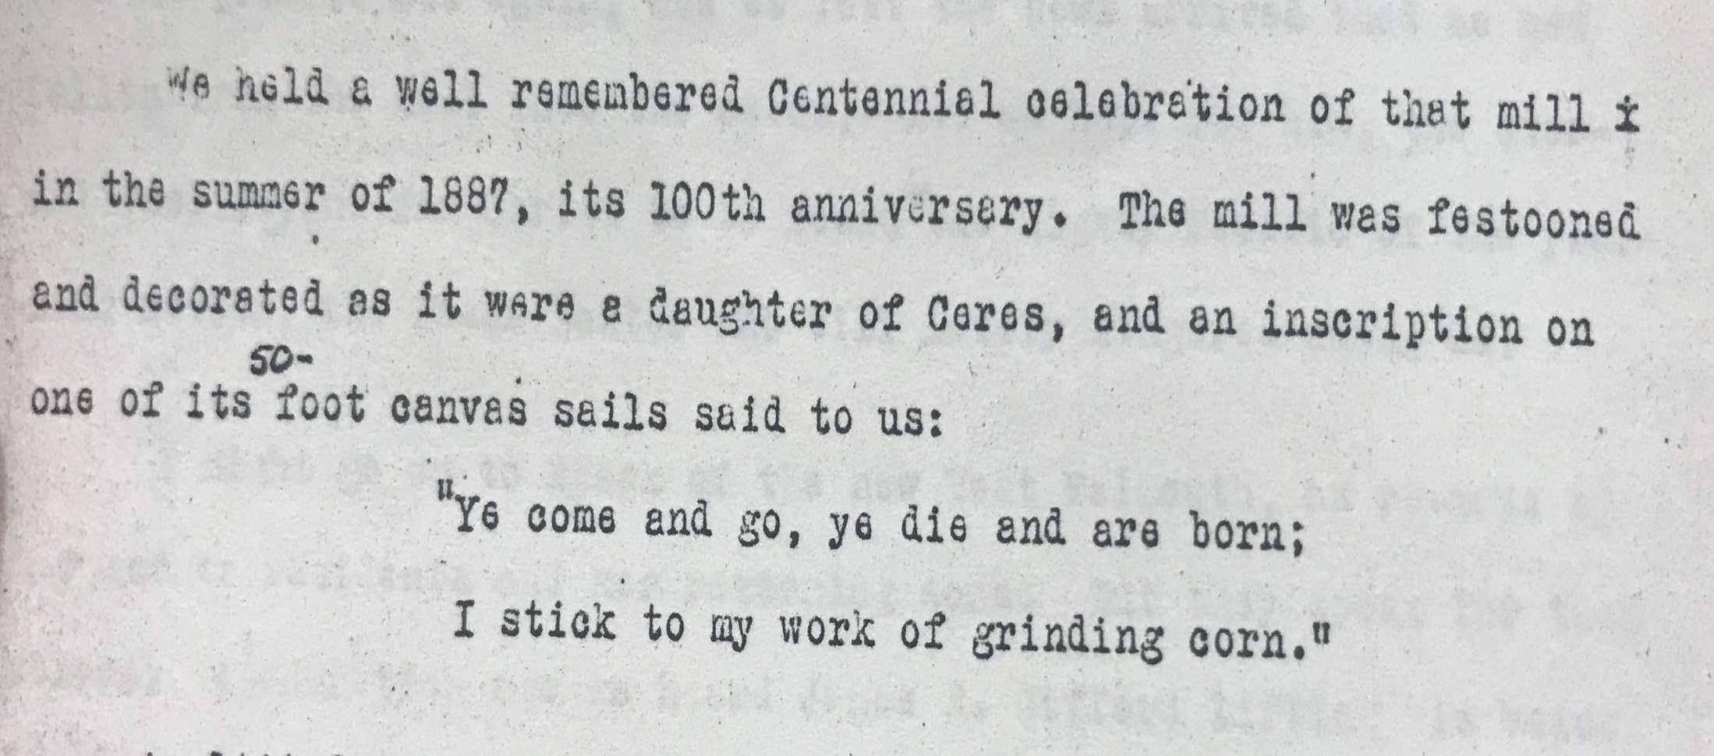
Ceres was the Roman Goddess of agriculture and grain.

Slide 12
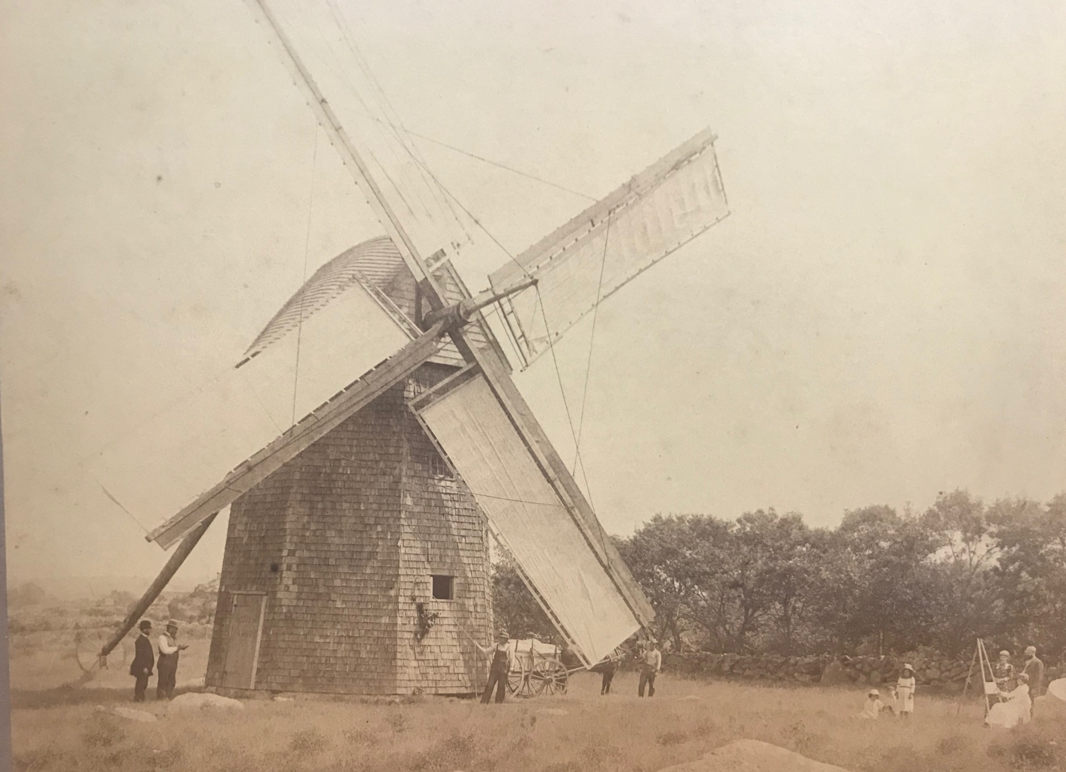
The windmill was located at the end of Old Windmill Lane on the Village side of The Old Colony Railroad tracks (now the bike path).

Slide 13
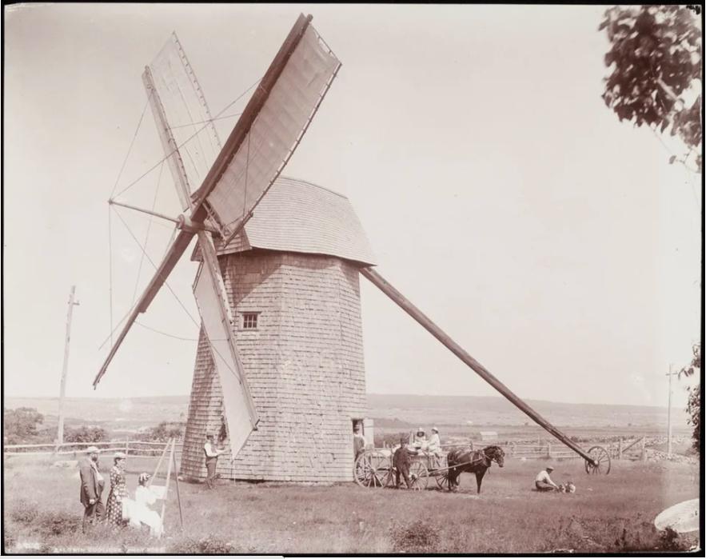
Notes:
Note the absence of trees and the view to the water.

Slide 14
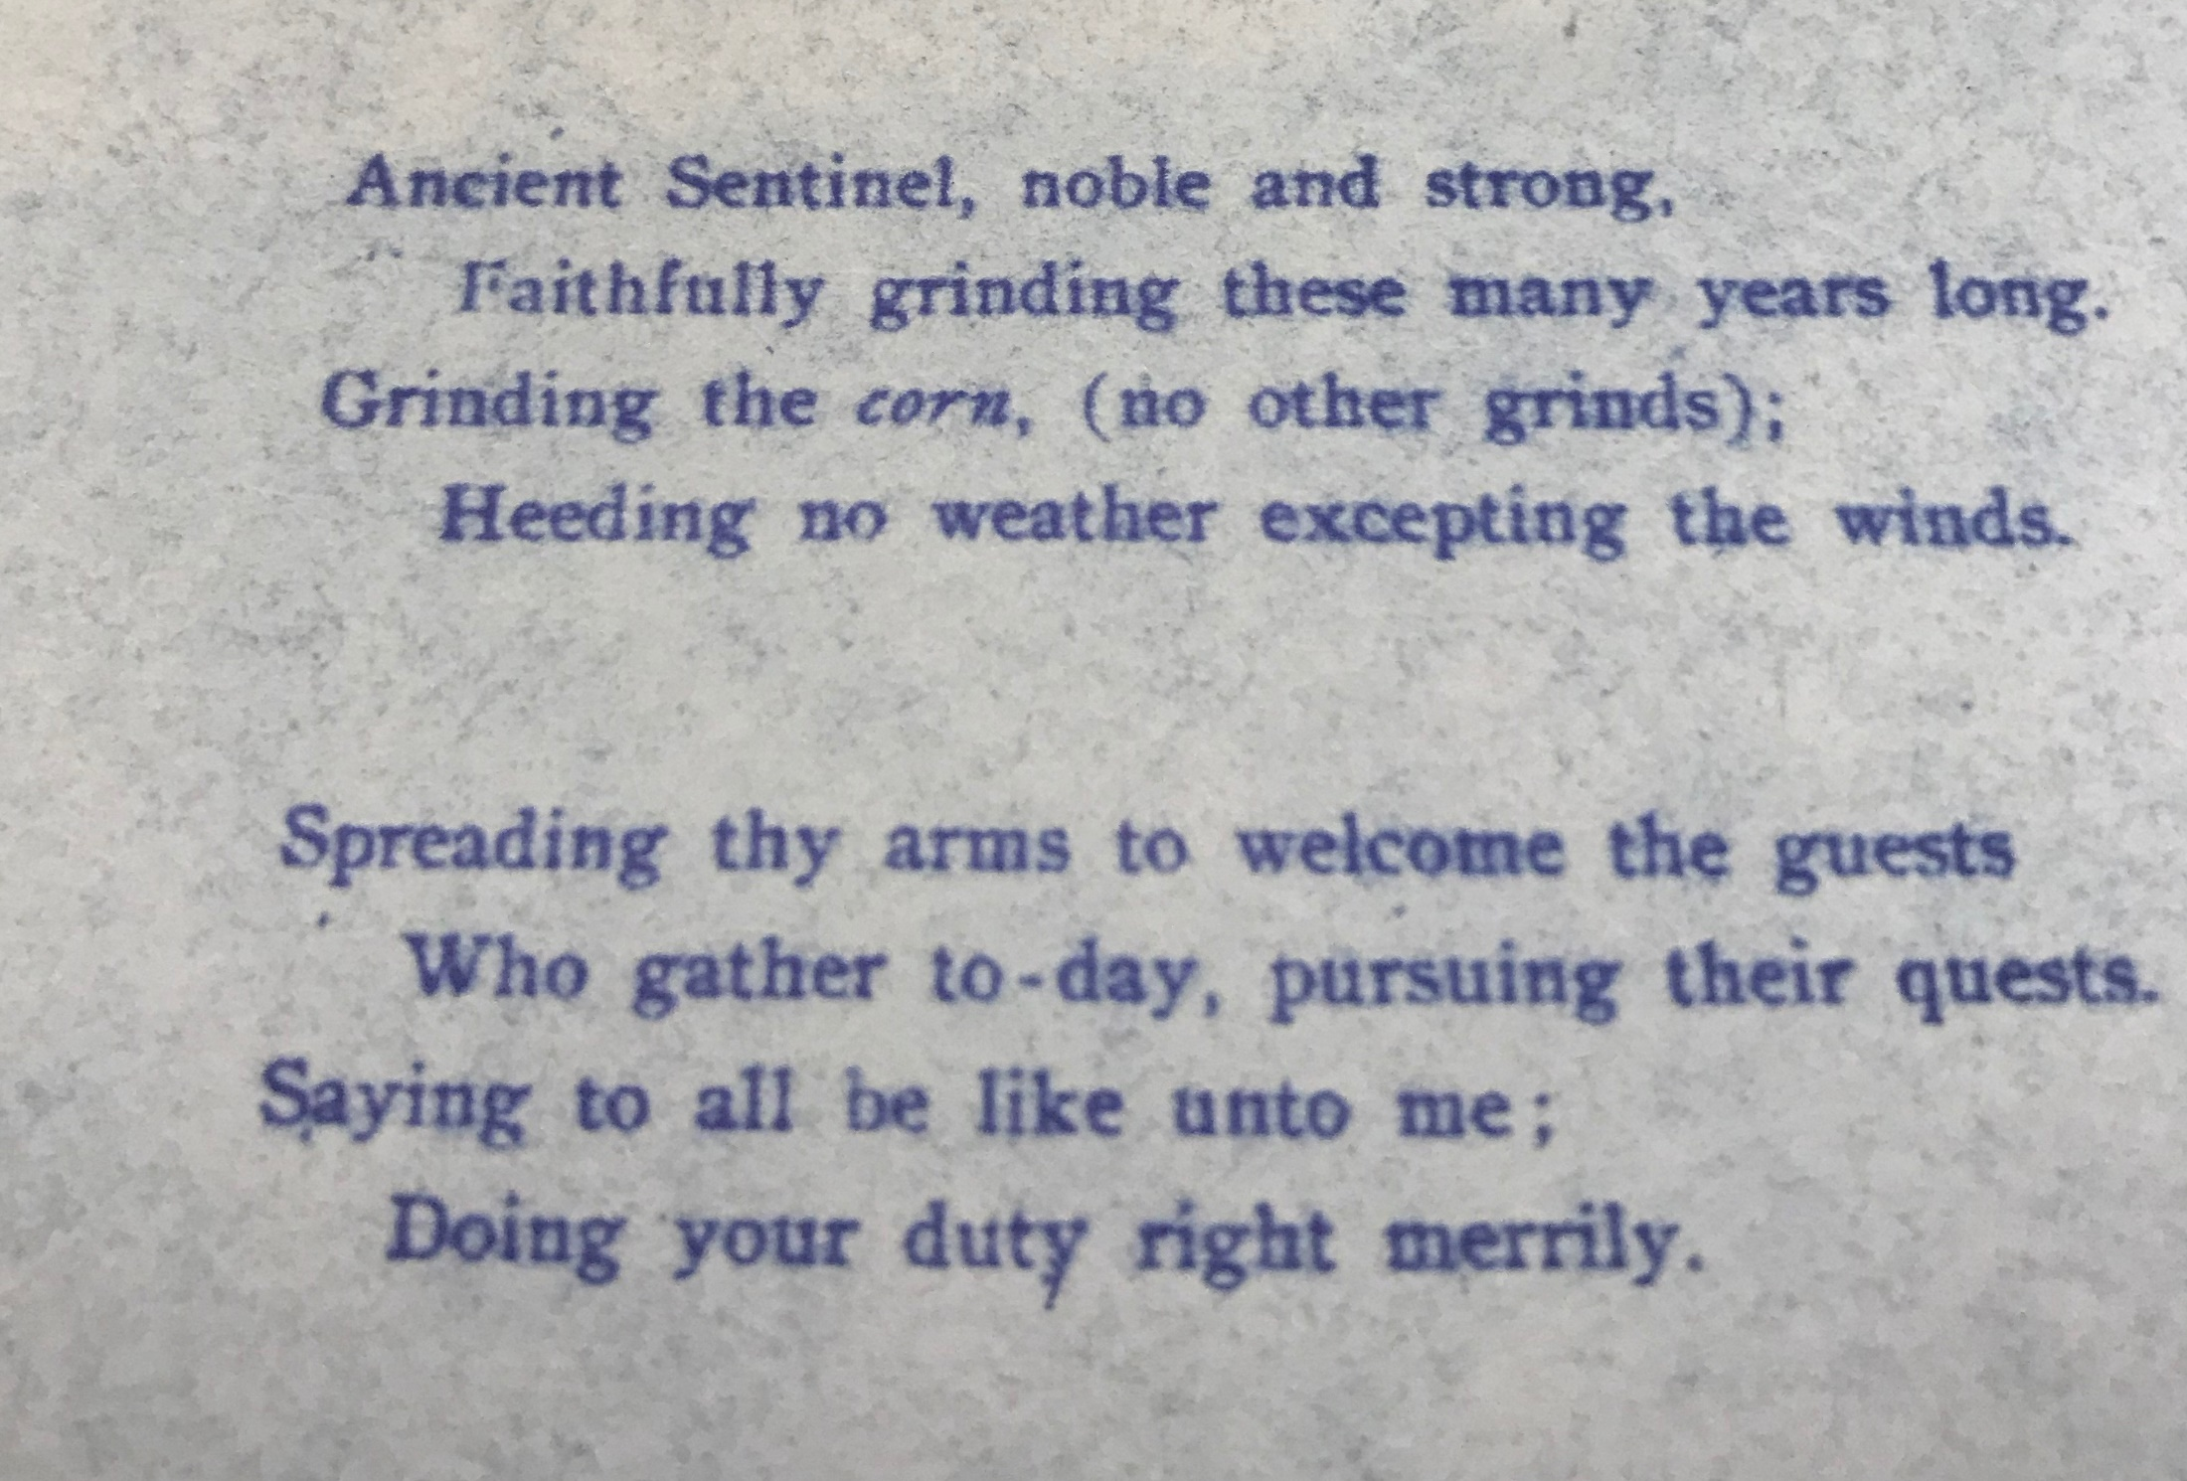

Slide 15
The Swift Lots
“Silas F. owned much of the land between his house at 666 West Falmouth Highway and the harbor, including upland between Mill and Spring Coves. The northern half of that neck was subdivided and christened the “Swift Lots” according to an 1881 land plan.
Silas F. was undoubtedly influenced by the purchase of Hog Island for summer development in the early 1870s, and by the ongoing land acquisitions by Ellery Channing Wright on the north side of West Falmouth Harbor.
Silas was an enterprising man who descended from an old and important village family. His father Moses and his grandfather Paul acquired the village windmill from the Bowerman family in 1816 establishing a family dynasty that endured throughout the 19th century. Moses organized the Union Store as a cooperative. He was also a skilled carpenter, who constructed the Quaker Meetinghouse in 1841.”* *(Between the Forest and the Bay)

Slide 16
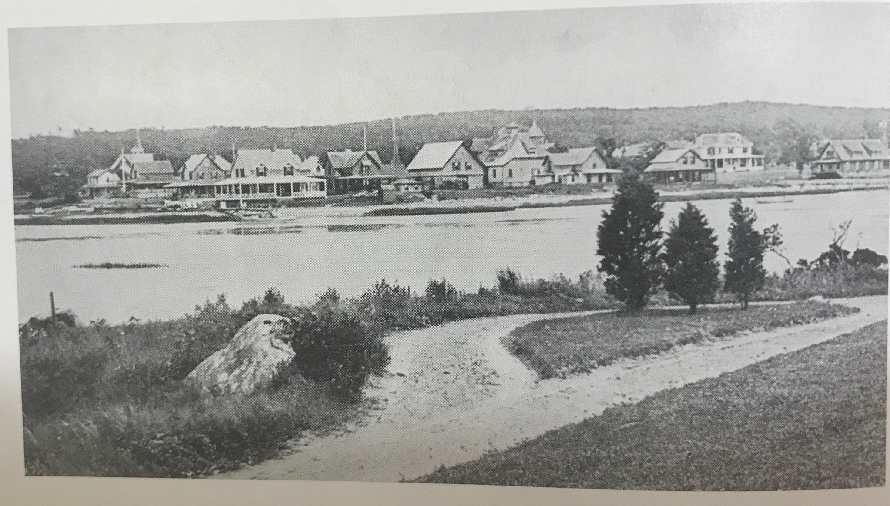
The view across Mill Cove looking south ca. 1920

Slide 17
By 1908 ten of the eleven “Swift Lot” houses had been built on a grid of streets that included Swift Street, Gifford Place, and Burgess Place,
The harbor front lots were developed first, and houses were oriented in that direction, underscoring the purpose of the development. All of these houses are comfortable shingle clad structures, enlivened with understated Queen Anne and Shingle Style detail.
Most rise 2 and ½ stories to gable roofs and are surrounded by bracketed verandahs. They are clearly designed for casual summer living and enjoyment of the outdoors.*
*(Between the Forest and the Bay).

Slide 18
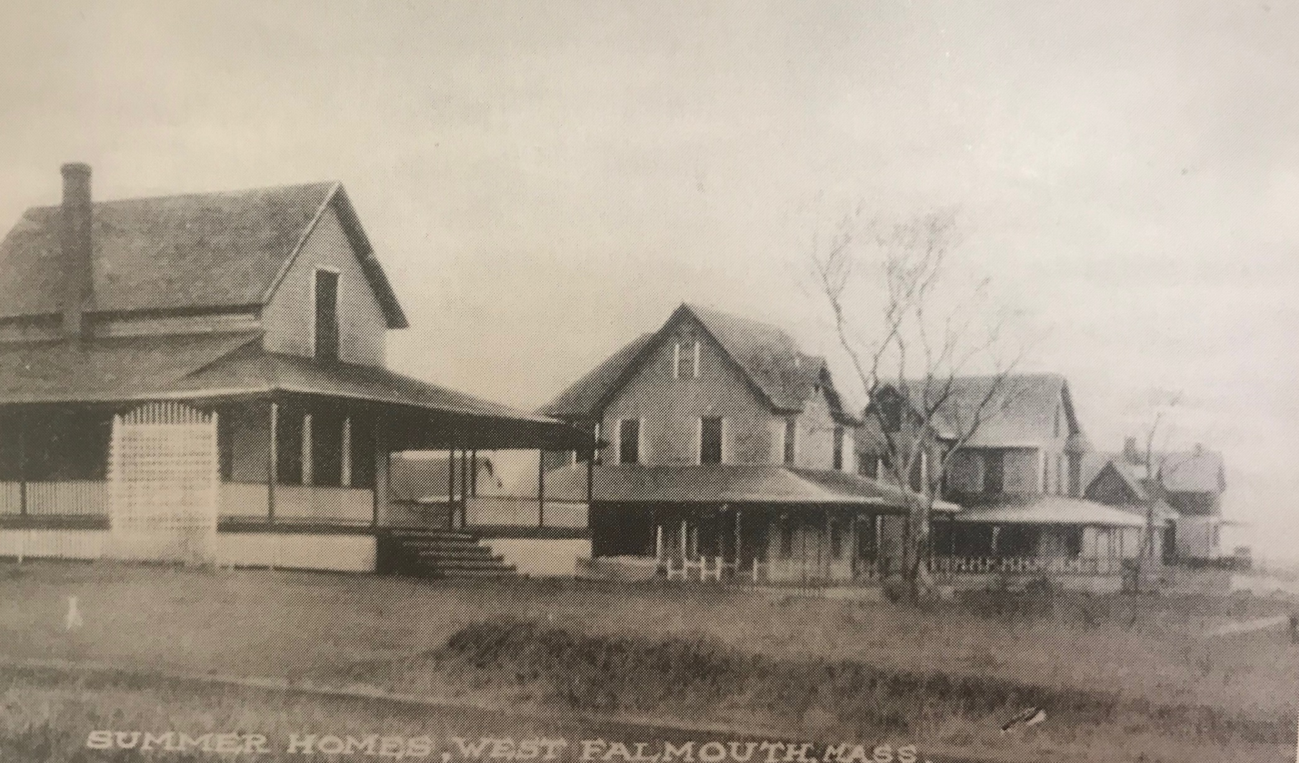
Early Summer Homes on the Swift Lots
Many of the original homes are recognizable today. Some appear to resemble the “gingerbread houses” of the Vineyard.
*Vineyard Methodist Camp Cottages were Built 1859-1880.
Notes:
Fred Bowman built over 1,000 homes in Falmouth and on the Vineyard during his lifetime, so this may also have influenced the design of these homes. Fred Bowman also built the summer homes for Henry and D. Wheeler.

Slide 19
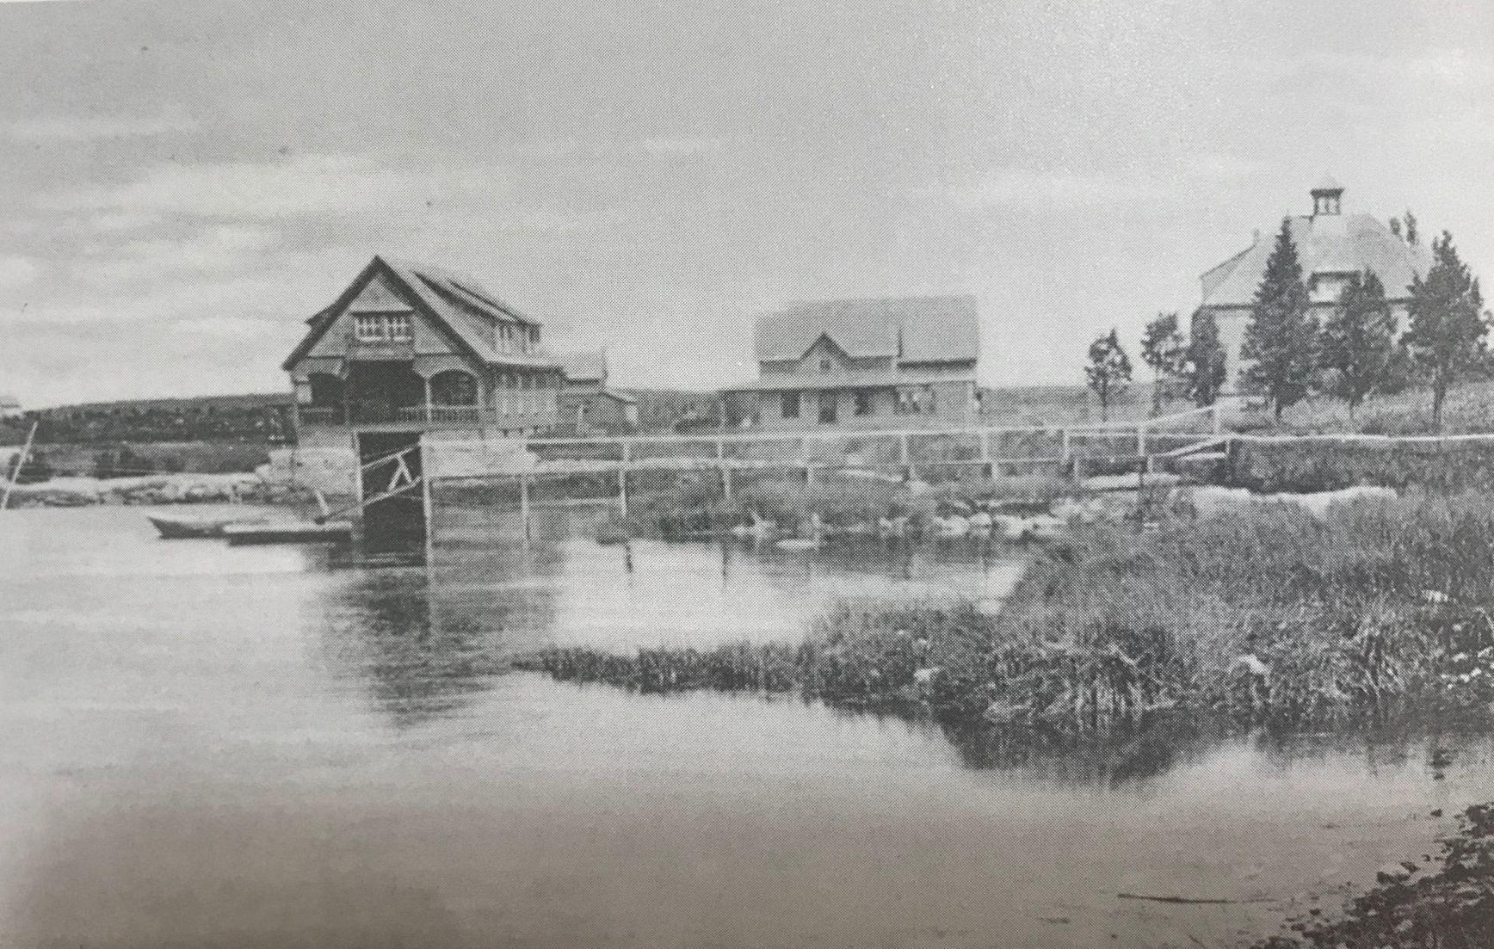
Henry M Kingman Estate
“Henry Kingman, a Brockton shoe manufacturer, built an imposing example of a Queen Anne style home at 22 Nashawena Street in the early 1890s. The matching carriage house and boathouse seen to the rear were originally part of this extensive summer estate, with the latter taking full advantage of its site on Spring Cove. Kingman bought the land from Silas F. Swift”. *
*(Between the Forest and the Bay).

Slide 20
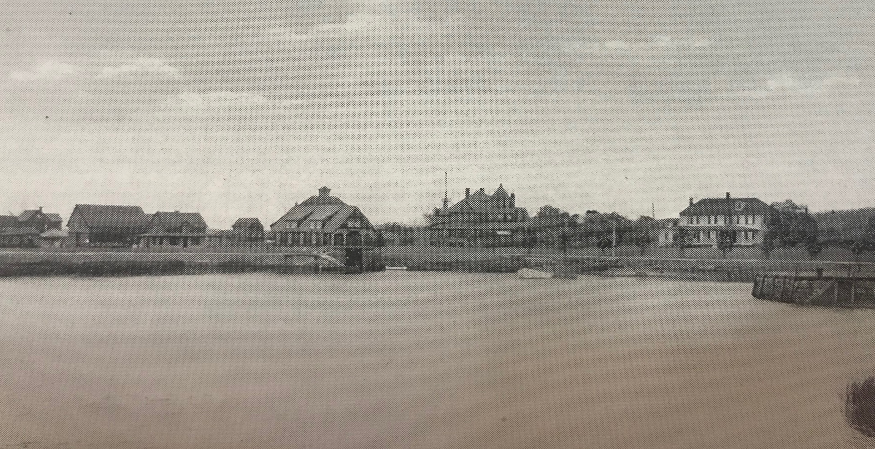
Historic Postcard View of Spring Cove

Slide 21
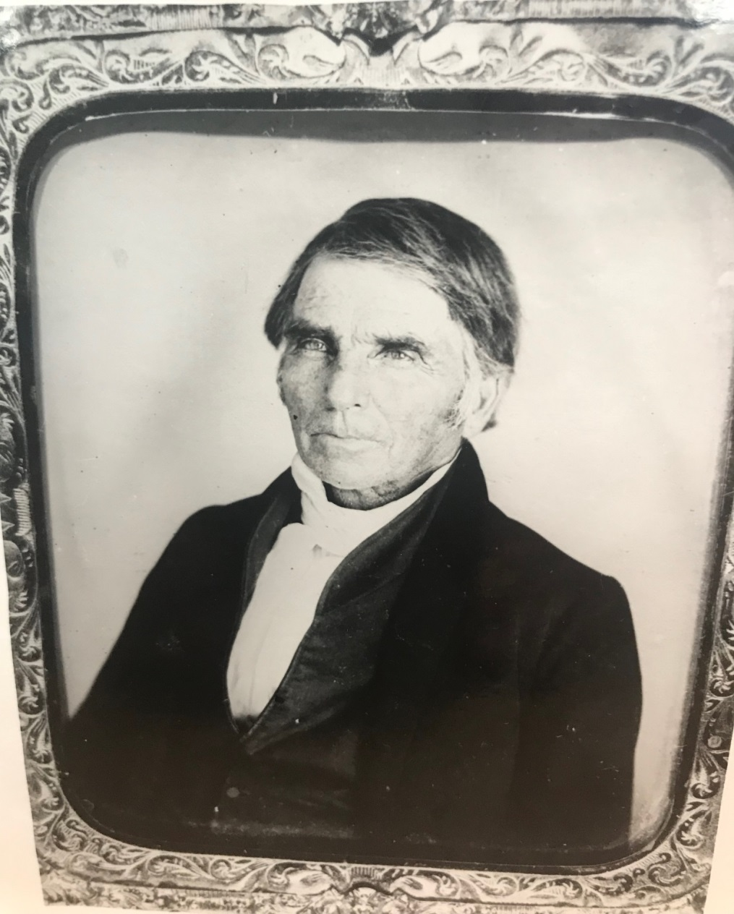
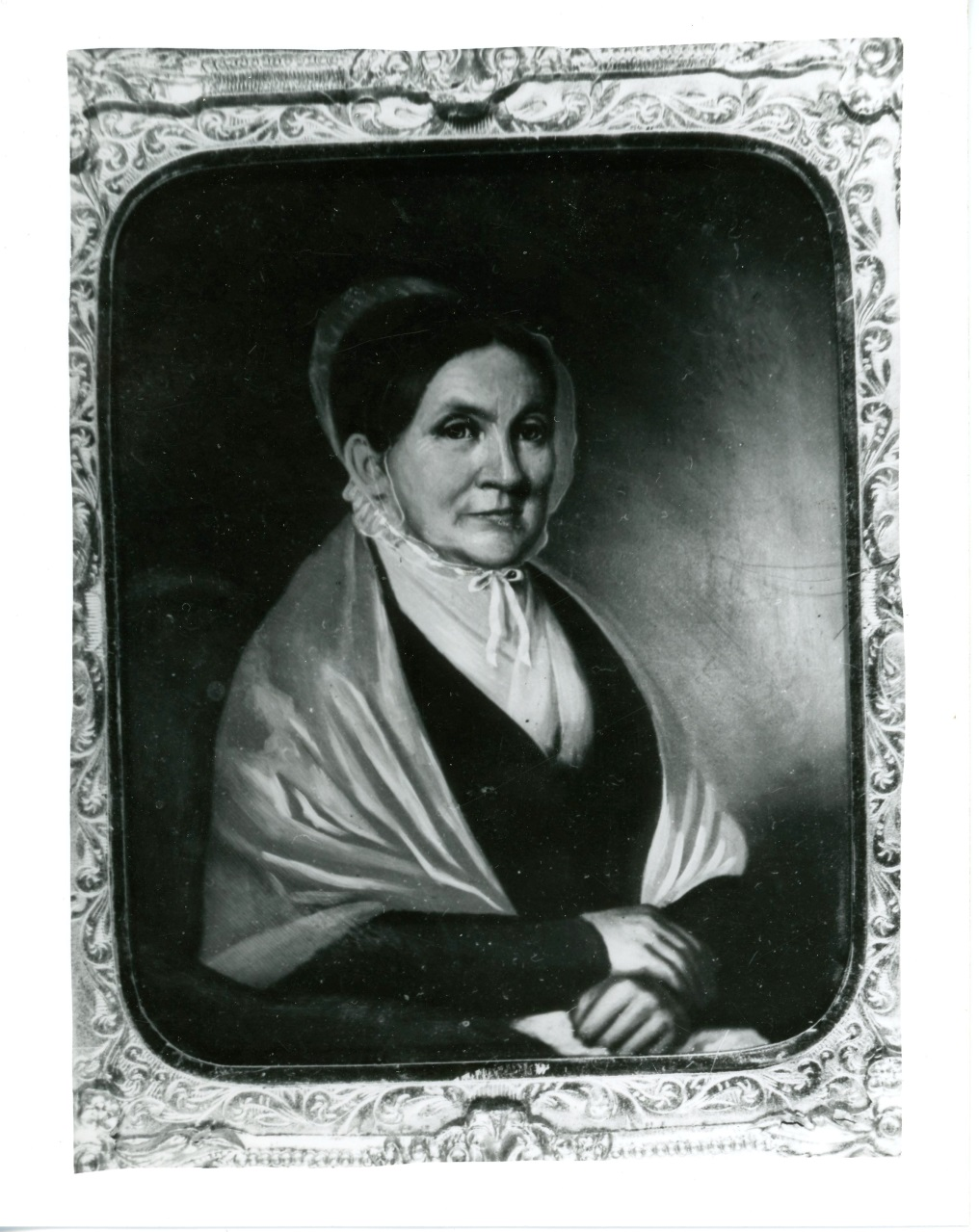
Daniel Swift (b.1792)
Hepzibah (Hoxie) Swift b.1796
Daniel’s first wife, Rebeccah A. Akin Swift died in 1820 at age 24.
Notes:
Hepzibah was mother to Joseph Newell, Henry, Mary Abby, and D. Wheeler.

Slide 22
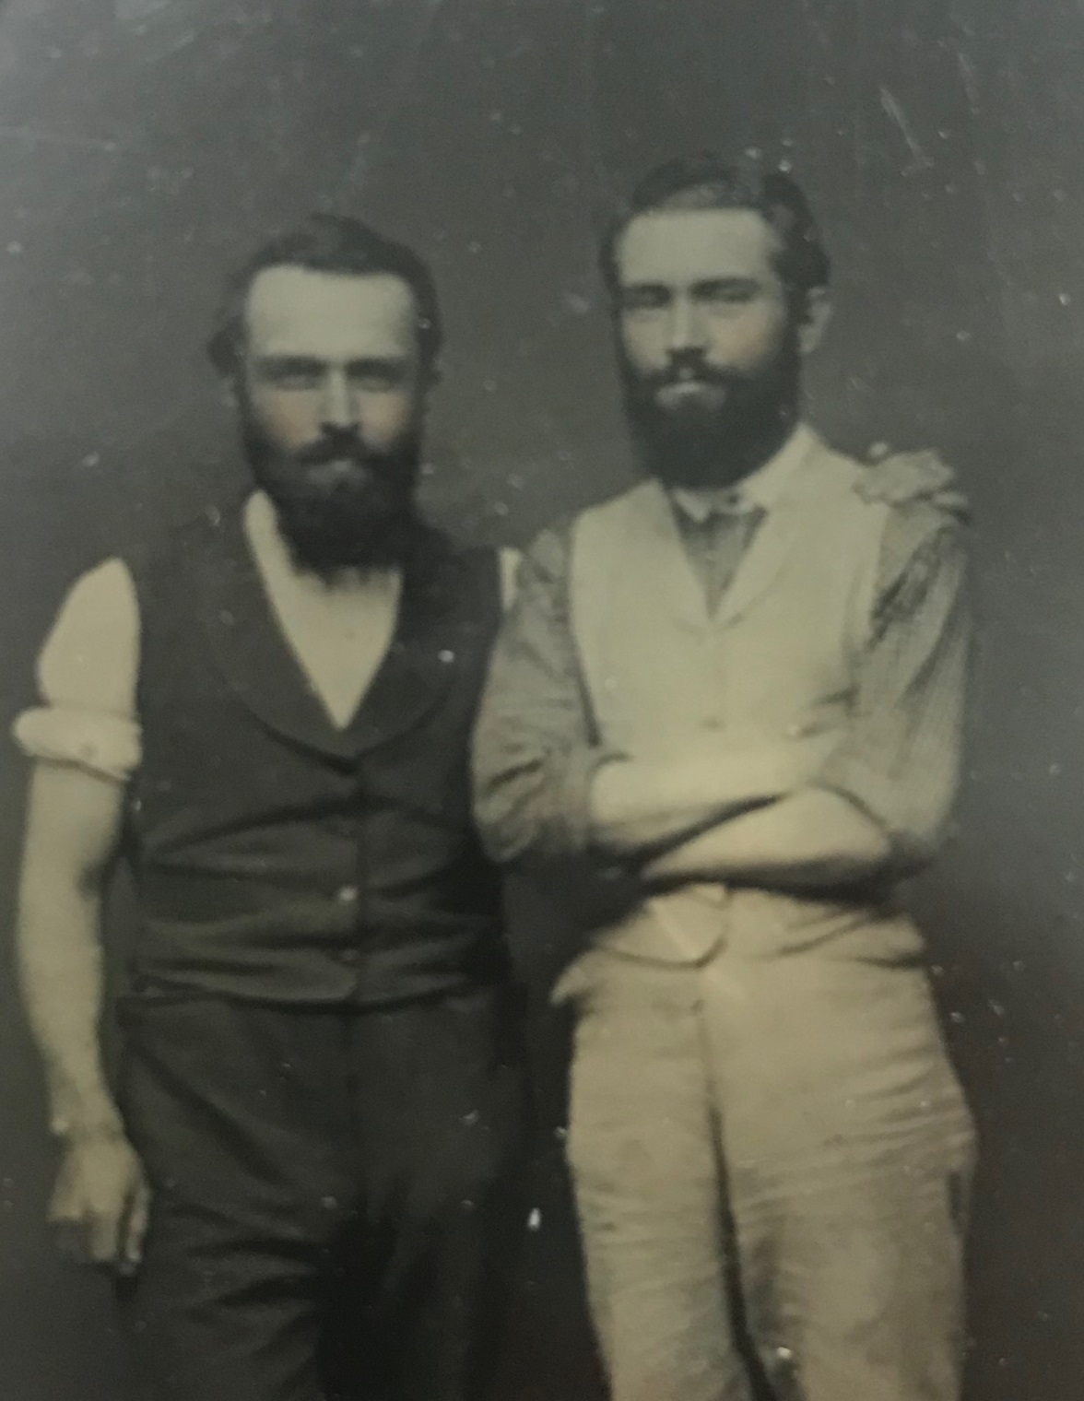
Brothers:
D. Wheeler-
Left
Henry Wheeler-
Right
The Swift families funded the cost of the West Falmouth Library in 1897 and funded the renovation of the third Quaker Meetinghouse. The families continue to support both institutions and other
institutions and organizations in the communities where they live or have lived.

Slide 23
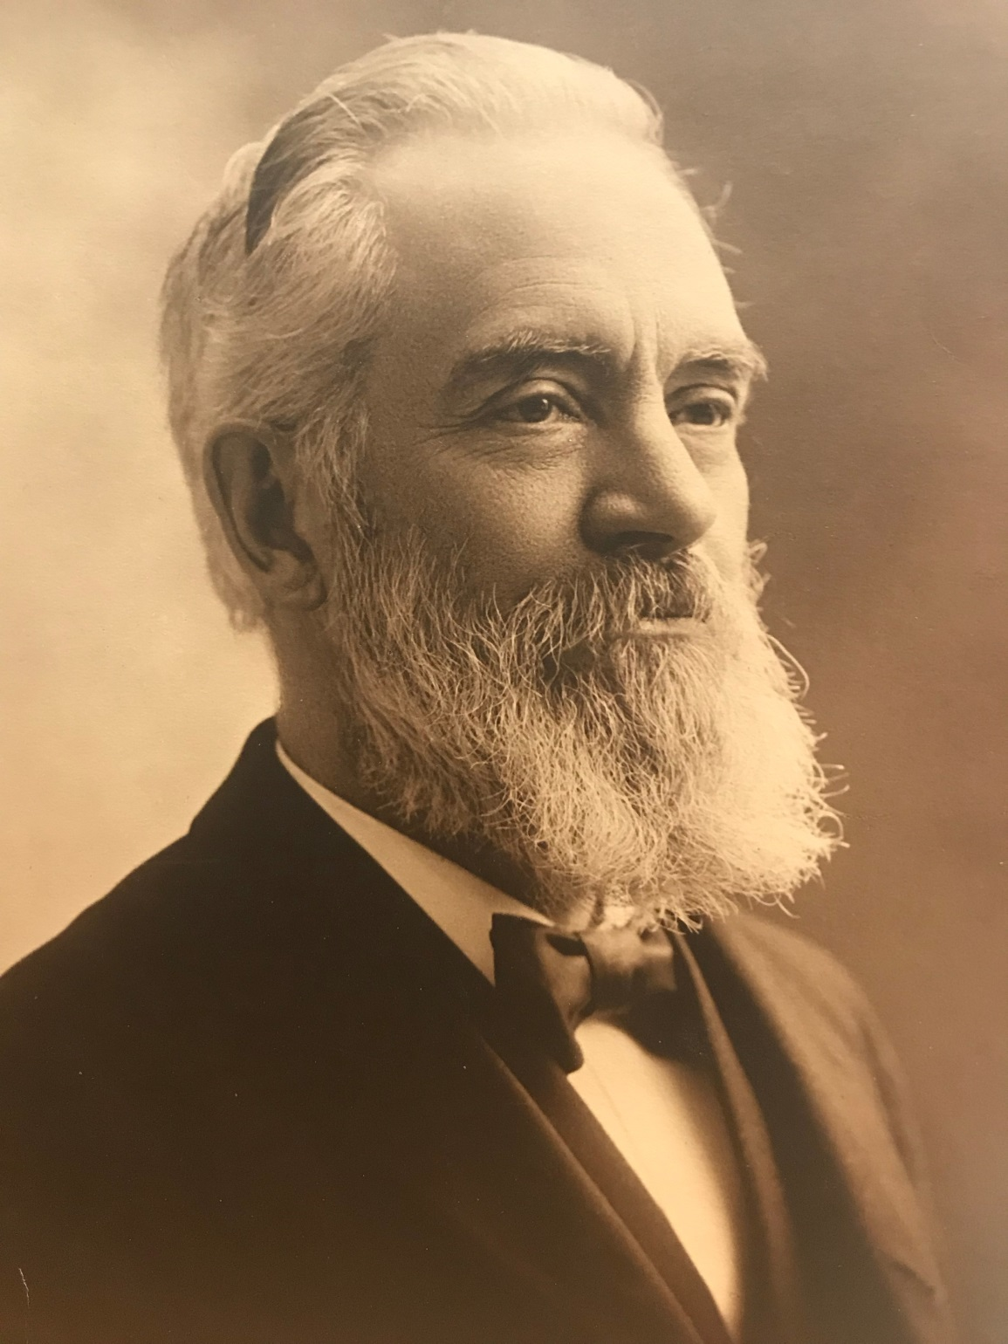
Henry D. Swift
b.1833

Slide 24
Henry D. Swift
Falmouth Enterprise, Saturday, March 04, 1916; Page: 7
DEATH OF HENRY D. SWIFT End Comes From Weakness of Heart at His Summer Home at West Falmouth. Henry D. Swift. 16 Channing St., Worcester, mechanical superintendent of the Logan, Swift & Brigham Envelope Co. for many years up to the time of its consolidation with the United States Envelope Co., in 1898, since which time he had lived in retirement, died at his summer home, West Falmouth, his birthplace, at 2.30 o'clock Tuesday afternoon, from weakening of the heart, due to age. Mr. Swift was 82 years old in May and, with the exception of ex-Mayor James Logan, was the last survivor of the pioneer envelope manufacturers of Worcester, outliving G. Henry Whitcomb,
one of the number, by 16 days.

Slide 25
Despite his advanced years, Mr. Swift had been active until a year ago, this having been the first winter he had passed at his summer home. It was his custom to pass the winters at his Channing-street residence, and it was kept in readiness, for him this winter, but he preferred to remain at West Falmouth rather than take any chances of the journey to Worcester. Mr. Swift's last illness was of ten days' duration, and was the culmination of a gradual breaking down of the human system. He had the best of medical attention and care, and was made as comfortable as if he was at his Worcester home. Mrs. Swift and their son, Willard E. Swift, assistant superintendent of the Grove-street plant, were; with him as much as possible, though- at, the time of his death the son was on his way from Boston to Falmouth. Following the last wishes of Mr. Swift the funeral and burial were held in his native town. He expressed a. wish to die there, and to be buried with his ancestors. The funeral was held at the Friends’ church, West Falmouth, Friday morning at 11 o'clock, and burial was in the Friends' burial ground. Mr. Swift was a life-long Quaker and during his many years' residence in Worcester was active in the Society of Friends, as the church denomination is known.

Slide 26
Falmouth Enterprise, Saturday, March 04, 1916; Page: 7 DEATH OF HENRY D. SWIFT End Comes From Weakness of Heart at His Summer Home at West Falmouth. Henry D. Swift. 16 Channing St., Worcester, mechanical superintendent of the Logan, Swift & Brigham Envelope Co. for many years up to the time of its consolidation with the United States Envelope Co., in 1898, since which time he had lived in retirement, died at his summer home, West Falmouth, his birthplace, at 2.30 o'clock Tuesday afternoon, from weakening of the heart, due to age. Mr. Swift was 82 years old in May and, with the exception of ex-Mayor James Logan, was the last survivor of the pioneer envelope manufacturers of Worcester, outliving G. Henry Whitcomb, one of the number, by 16 days. Despite his advanced years, Mr. Swift had been active until a year ago, this having been the first winter he had passed at his summer home. It was his custom to pass the winters at his Channing-street residence, and it was kept in readiness, for him this winter, but he preferred to remain at West Falmouth rather than take any chances of the journey to Worcester. . Mr. Swift's last illness was of ten days' duration, and was the culmination of a gradual breaking down of the human system. He had the best of medical attention and care, and was made as comfortable as if he was at his Worcester home. Mrs. Swift and their son, Willard E. Swift, assistant superintendent of the Grove-street plant, were; with him as much as possible, though- at, the time of his death the son was on his way from Boston to Falmouth. Following the last wishes of Mr. Swift the funeral and burial were held in his native town. He expressed a. wish to die there, and to be buried with his ancestors. The funeral was held at the Friends’ church, West Falmouth, Friday morning at 11 o'clock, and burial was in the Friends' burial ground. Mr. Swift was a life-long Quaker and during his many years' residence in Worcester was active in the Society of Friends, as the church denomination is known. An incident in the life of Mr. Swift was that during the Civil War he was tried by court-martial and sentenced to be shot because of his refusal to serve in the army, claiming exception on the ground of being a Quaker, whose principles are that it is wrong, to take human life under any circumstances. He was paroled by President Abraham Lincoln and returned to his West Falmouth home. Henry D. Swift was born at West Falmouth, May 21, 1833. He was the son of Daniel and Hepsabah Swift. His father was the mechanic of the village and ran a shop which, beside catering to the mechanical needs of the town, did an active business fitting out whaling vessels and other ships which were built at West Falmouth. Mr. Swift's boyhood days were passed in the village with his brothers, George, Joseph and Wheeler, and his sister, Mary Abbie, all of whom are dead. His schooling was obtained entirely in the village schools, which were open only three months in the winter season, and although his opportunities for learning were very limited, he .showed early in life that rare ability which distinguished him later as a brilliant inventor.
An incident in the life of Mr. Swift was that during the Civil War he was tried by court-martial and sentenced to be shot because of his refusal to serve in the army, claiming exception on the ground of being a Quaker, whose principles are that it is wrong, to take human life under any circumstances. He was paroled by President Abraham Lincoln and returned to his West Falmouth home.
(More details follow at the end of the obituary). Henry D. Swift was born at West Falmouth, May 21, 1833. He was the son of Daniel and Hepsabah (Hepzibah) Swift. His father was the mechanic of the village and ran a shop which, besides catering to the mechanical needs of the town, did an active business fitting out whaling vessels and other ships which were built at West Falmouth. Mr. Swift's boyhood days were passed in the village with his brothers, George, Joseph and Wheeler, and his sister, Mary Abbie, all of whom are dead. His schooling was obtained entirely in the village schools, which were open only three months in the winter season, and although his opportunities for learning were very limited. He showed early in life that rare ability which distinguished him later as a brilliant inventor.
Notes:
This is the only reference of George as a brother. I was unable to determine the lineage.

Slide 27
As a mere boy he built a windmill in the fields near his home, constructed from rude lathe materials he found at hand, and this accomplished, he and his brother Wheeler set about making furniture of various kinds. These pieces of his handiwork were sold about the neighborhood. When 15 years old, he sailed alone across Buzzards bay in a small open boat and sought the employ of Gideon Wood, a cabinet maker of New Bedford. He worked for Gideon Wood three years, learning the cabinet trade. He then returned to West Falmouth and devoted his time to caring for the place. Mr. Swift when 21 years old went to South Dedham and entered the employ of Willard Everett, a cabinet maker. He was married to Emma Colburn Fuller, South Dedham, May 14, 1861. The next winter the cabinet mill burned, and Mr. Swift returned with his wife to West Falmouth. There with his brother, D. Wheeler, they developed the first practical clothes wringer ever constructed. Prior to this all clothes had been rung by hand.

Slide 28
The first ringer had wooden rolls, but it was found in practice that these warped and split so badly as to make the ringers practically useless. The Swifts with great difficulty secured a small supply of rubber, which they had made especially for this purpose. This was all that was required to make the clothes wringer a practical success. A wringer was patented in the name of D. W. Swift, Jan. 28, 1862. Mr. Henry Swift's first son, Lucius, was born March 11, 1862. The next summer Mr. Swift moved to South Dedham, and with his brother, Wheeler, began the manufacturing of wringers on a larger scale in the top floor of George Morrill's ink mill. This mill is standing, and is a part of the present factory of the George Morrill Co. The Swift Brothers placed the sale of their wringers in the hands of a Boston agent, and as a result of his trickery, their business was wrecked. However, they had succeeded in producing the first practical wringer, and this is still manufactured in a modified form. In the summer of 1863, while in South Dedham Mr. Swift was drafted into the army. Mrs. Swift came back to West Falmouth after Mr. Swift had gone to Concord where troops were being mobilized. Mr. Swift was a birthright member of the Society of Friends, and thoroughly believed their principles, that it was wrong; under all circumstances, to take human life.

Slide 29
While at Concord he was ordered to take part in military drills. This he resolutely refused to do, it being contrary to the dictates of his conscience. He was put into the guardhouse, but he adhered to his determination, and refrained from all military activity at Concord as well as later on, when sent to Long Island and In Boston harbor, From there troops, were being constantly sent South to replenish armies in the field. While at Long Island he gladly helped in hospital services, but refused all remuneration for his services. He was “bucked down" and was finally told by officers he would be shot for refusal to obey orders. He was taken from the guardhouse and made to witness an execution, and was told that would be his fate if he persisted in his insubordination, but he still remained firm. He was tried by court-martial and was sentenced to be shot. During Mr. Swift's stay at Long Island he was visited by Stephen A. Chase, Lynn, and Charles R. Tucker, New Bedford, both prominent, members of the Society of Friends. They went to Washington and stated the facts of Mr. Swift's case to President Abraham Lincoln and Secretary of war Edwin M. Stanton. When, the matter was considered by the president he directed that an honorable parole be made out. This was done and delivered to him shortly before the time he had been informed his execution was to take place. This was in the fall of 1863, and upon his parole he at once joined his wife at West Falmouth.

Slide 30
Through Mr. Swift's attendance of Friends' meetings he met James Greene Arnold, a patent attorney. Mr. Arnold was developing an envelope machine for G. Henry Whitcomb, a pioneer envelope manufacturer of Worcester. Mr. Arnold suggested that Mr. Swift enter the employ of Mr. Whitcomb to assist in the development of the envelope machine. Mr. Swift felt that this would be leaving a certainty for an uncertainty, declined to do so and sent for his brother, D. Wheeler Swift, who was still at West Falmouth and unemployed. His brother came, entered Mr. Whitcomb's employ, and Henry Swift followed him about a year later. The Arnold machine had to be abandoned and the Swift brothers began the development of envelope folding and printing machinery which made possible the commercial success which soon characterized the Whitcomb factory. Henry Swift in 1884, with his brother, left the employ of the Whitcombs, and in company with James Logan and
John S. Brigham, started an envelope business of their
own at 16 Union street (in Worcester)

Slide 31
Mr. Swift felt it incumbent to develop new machinery which would not in any way interfere with the rights already in the possession of their former employers. This seeming difficulty proved a stepping stone to even greater success than before. The new machinery was far superior to the old, and coupled with the executive ability of Mr. Logan and Mr. Brigham, led to the rapid success of the new company of Logan, Swift & Brigham. The business grew until new quarters were necessary, and in 1889 a new factory was built at 75 Grove street. When the Logan, Swift & Brigham Co. was bought by the United States Envelope Co. in 1898, Mr. Swift retired from active business life. Since then he has passed most of his time at his old home, West Falmouth. Ever since his boyhood he has been a lover of nature and has devoted much time to the study of astronomy. He had a well-equipped astronomical observatory at West Falmouth and spent much effort in making observations. From these he made models of some of the larger lunar mountains and craters, and made other charts of his work. He was dearly loved by all who knew him, and his chief joy was in helping others to live uprightly and cherish the things worth loving. His whole life was one of persistent righteousness, and his decease will be regretted most by those who knew him best.*(Falmouth Enterprise 3/4/1916)

Slide 32
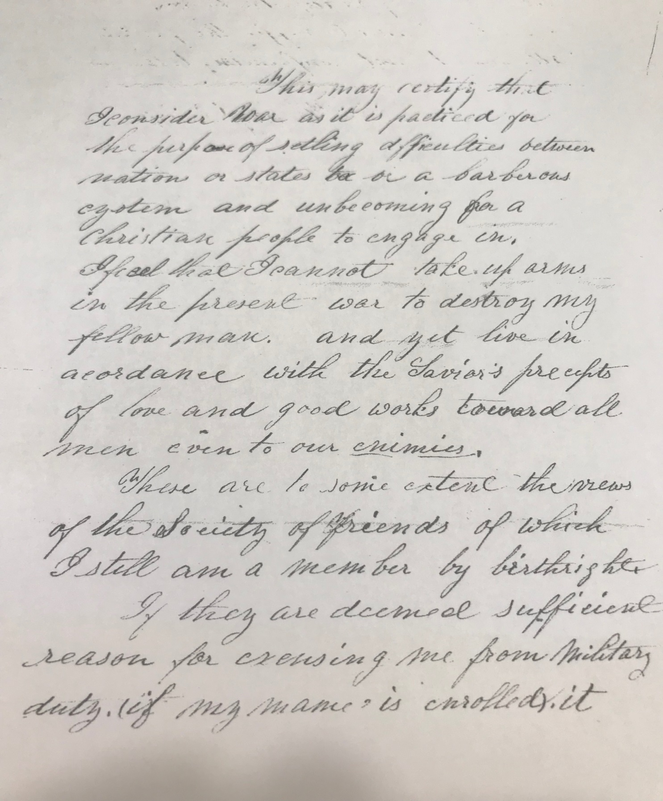
Henry’s request for war exemption citing his birthright as a member of the Society of Friends

Slide 33
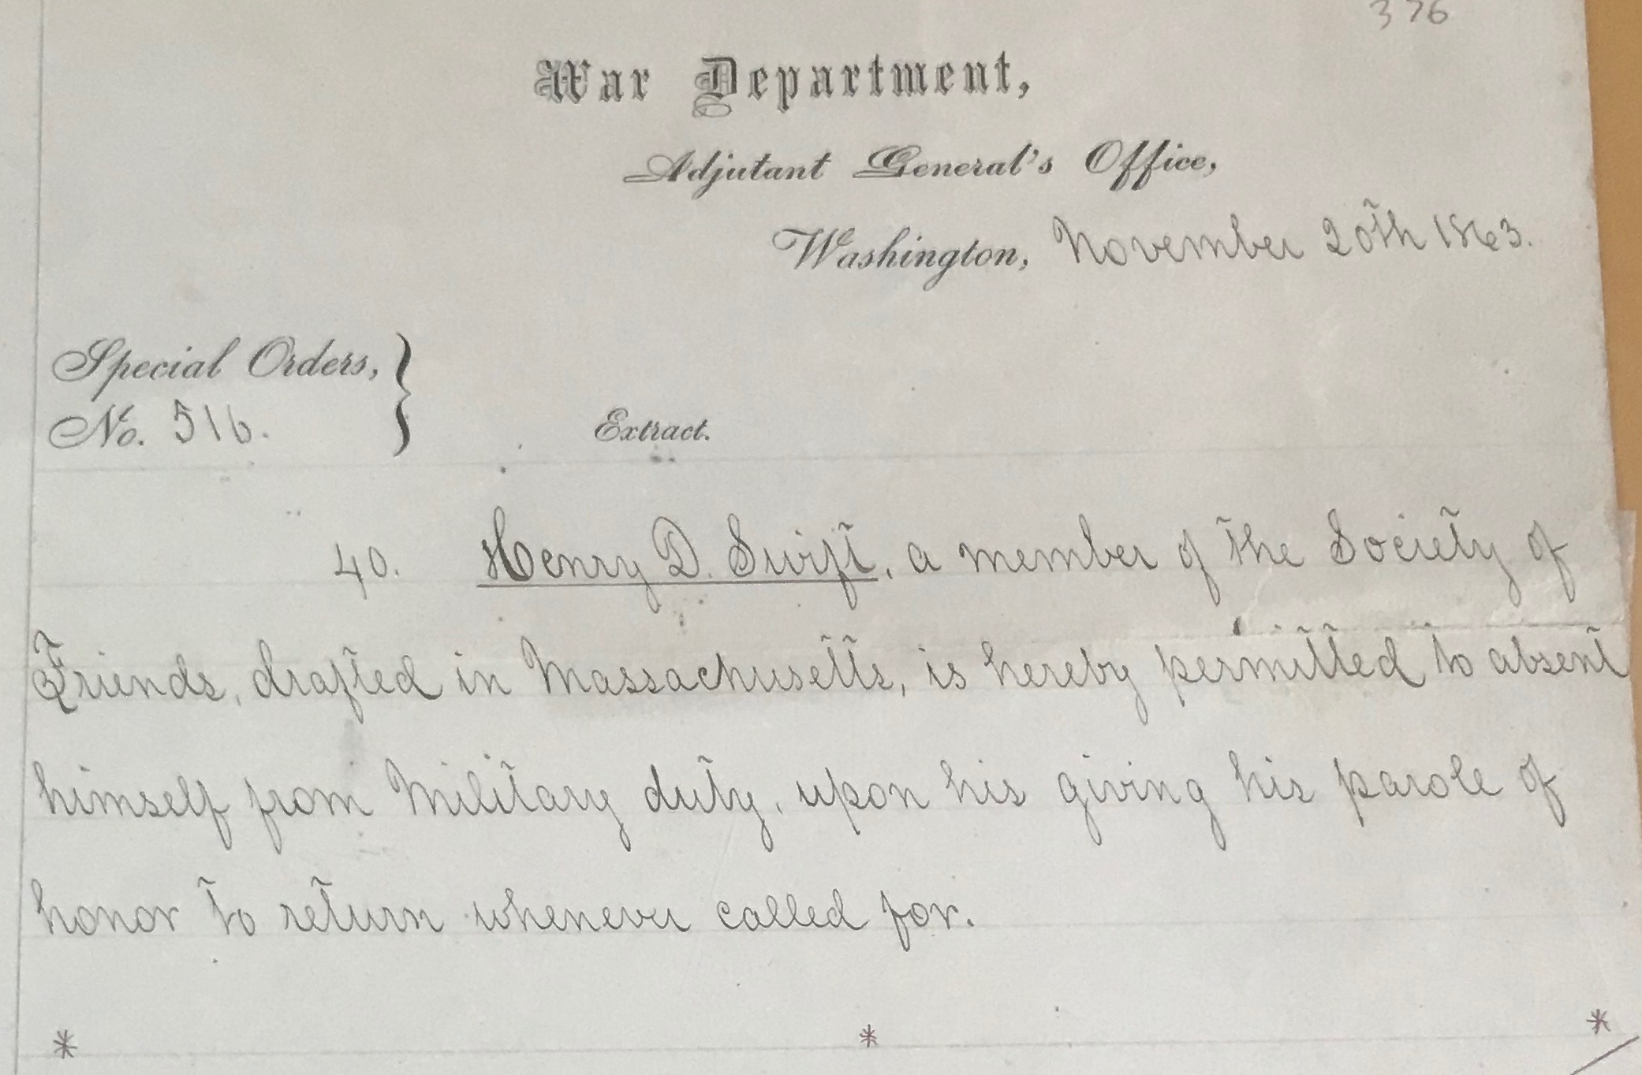
Permission to absent himself from Military duty-authorized by President Lincoln.

Slide 34
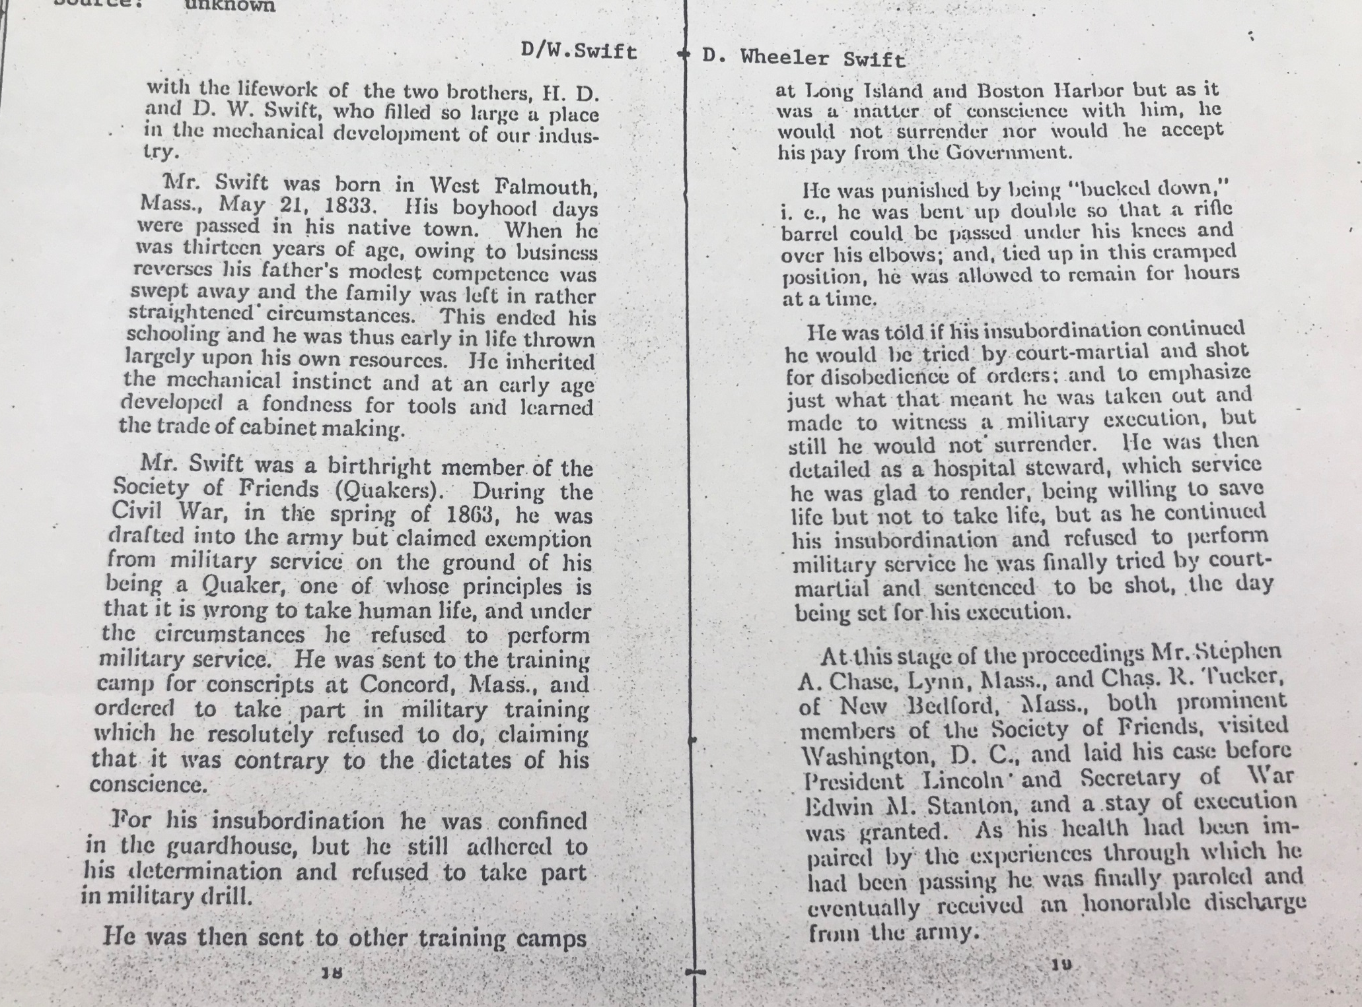
Notes:
The Mr. Swift here-although the text is labeled D. W. Swift is Henry who was born in 1833. D. Wheeler was born in 1840.

Slide 35
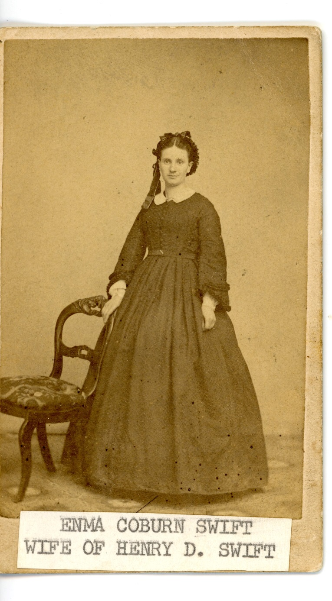
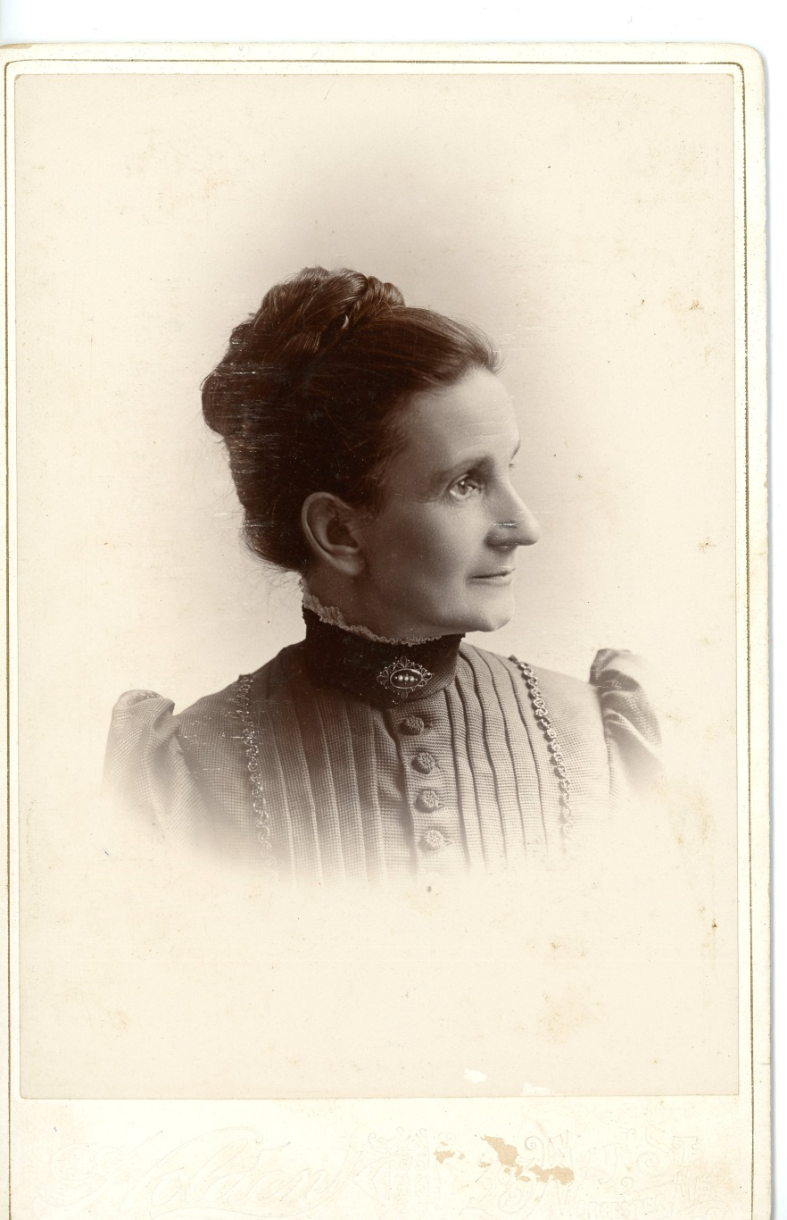
b. 1843

Slide 36
Falmouth Enterprise, Saturday, December 21, 1918, page 2 EMMA C. SWIFT Emma C. Swift who has made her home in West Falmouth, Mass., for the last few years, died on Saturday, Dec. 14. The end came unexpectedly, for while she had been in frail health for some time, she had been able to be up and about the house until the last. She was born in Boston in 1840, daughter of Daniel and Mary Colburn. Her parents dying while she was still a child, she was adopted by a Mr. L. N. Fuller, of Dedham in whose home she received every possible advantage. In 1861 she married Henry D. Swift of West Falmouth living for a short time in Dedham where Mr. Swift was employed.
After a few years they moved to Worcester, where the greater part of her life was spent.
In 1898 Mr. and Mrs. Swift built a house in West Falmouth, near Mr. Swift's boyhood home, which they occupied for the greater part of the past few years.

Slide 37
Mrs. Swift survived her husband by nearly three years. The news of her death will bring sorrow to many who knew her. She was well known and loved in Old Orchard, Maine, where she enjoyed many summers among religious workers, who came from all over the world for missionary conferences, and mission work in many lands received inspiration and help from her work in their behalf. Although handicapped by frail health, her influence for good was felt in every community that she came in contact with. She leaves one son, Willard E. Swift of Worcester. The remains of Mrs. Emma C. Swift who died in Worcester Saturday, Dec. 14, were brought to West Falmouth for interment in the Friends cemetery.

Slide 38
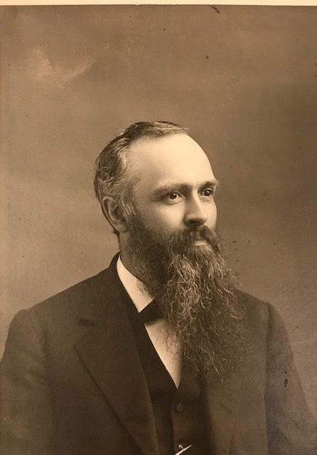
D. Wheeler
Swift
b. 1840

Slide 39
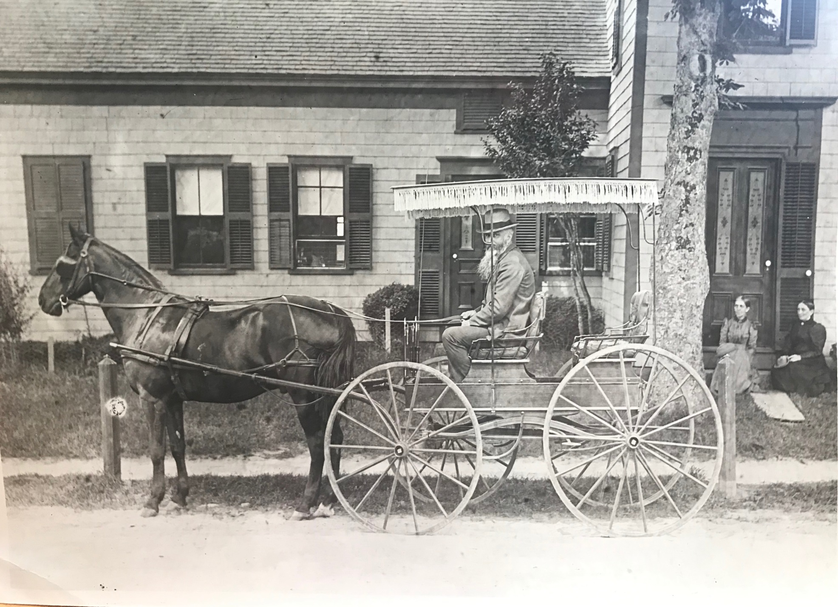
Daniel Wheeler Swift at the family Homestead.

Slide 40
D. Wheeler Swift
Falmouth Enterprise, Saturday, June 18, 1910; Page: 3
SUCCUMBED TO SHOCK Death of D. Wheeler Swift of Worcester Worcester, June 14 - D. Wheeler Swift, aged 70, inventor of machinery that folds and gums envelopes and a director in the U. S. Envelope Co., died shortly after midnight this morning at his home, 22 Oak avenue, from a paralytic shock that he suffered last November at his summer home in West Falmouth. Mr. Swift was one of the men who helped build up the big envelope business of Worcester, and he also had a hand in the formation of the big combination which practically controls that industry in the United States, being superintendent of mechanical construction as well as a director since the big concern was formed. Mr. Swift was a native of West Falmouth and began his business career in a cabinet shop in New Bedford.
In 1862 he engaged in the manufacture of wringers in Dedham with his brothers, Henry and Joseph, and he had the credit of producing the first practical spring wringer ever made.

Slide 41
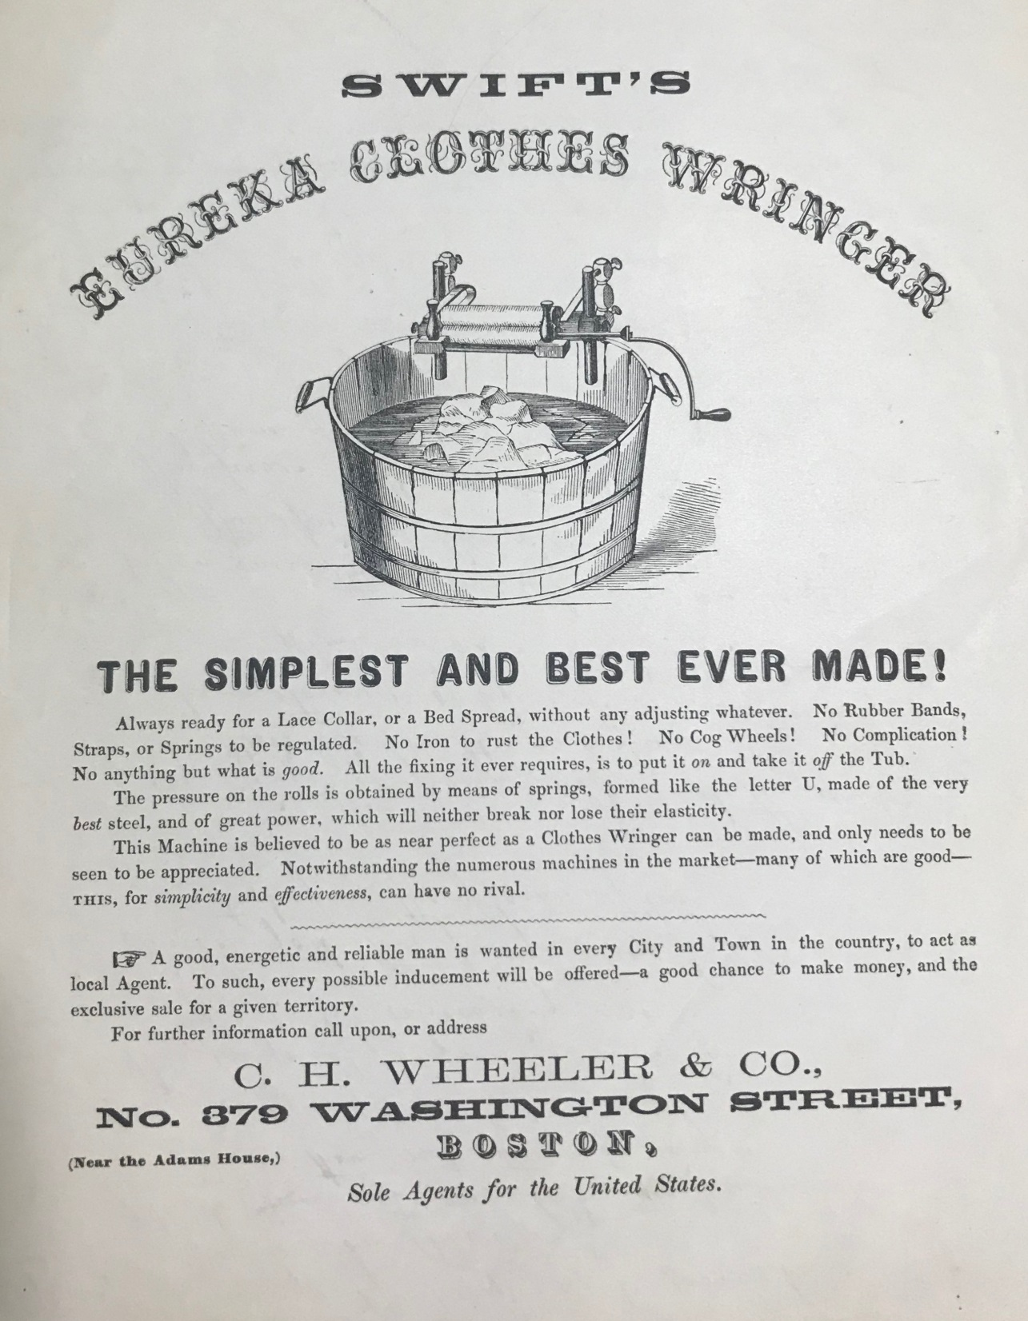
About 1861 the brothers invented the Eureka Clothes Squeezer and after over forty years it is still being manufactured. They moved to South Dedham and hired space in the factory of Seth E. Merrill & Co., manufacture of printing inks, and began the manufacture of the Eureka Clothes Wringer.

Slide 42
He came to Worcester in 1864 and entered the employ of David Whitcomb who was just starting the envelope industry, and while interested in the early days of that line, he made the first machines that folded and gummed envelopes successfully. When the Logan, Swift & Brigham envelope company was formed in 1884, Mr. Swift was made president and his inventive genius gave the concern many of the practical machines now in use all over the oodntry.
When the U. 8. envelope company was formed in 1898, Mr. Swift was elected to the directorate and made superintendent of mechanical construction, and in this capaoity he invented new automatic and folding machines that reduced the cost of production materially.
Mr. Swift was a member of the society of Friends, to whose work he was a generous contributor, and the new house of worship at Chatham and Oxford streets was made possible through his gifts.
He married Sarah J. Gifford of North Dartmouth in 1871 and she survives him, as do a sister, Miss Mary Abbie Swift, and a brother, Henry D. Swift.
D. Wheeler came to Worcester in 1864 and entered the employ of David Whitcomb who was just starting the envelope industry, and while interested in the early days of that line, he made the first machines that folded and gummed envelopes successfully. When the Logan, Swift & Brigham envelope company was formed in 1884, Mr. Swift was made president and his inventive genius gave the foundation for many of the practical machines now in use all over the country. When the U. S. envelope company was formed in 1898, Mr. Swift was elected to the directorate and made superintendent of mechanical construction, and in this capacity he invented new automatic and folding machines that reduced the cost of production materially.
Mr. Swift was a member of the society of Friends, to whose work he was a generous contributor, and the new house of worship at Chatham and Oxford streets (in Worcester) was made possible through his gifts.
He married Sarah J. Gifford of North Dartmouth in 1871 and she survives him, as do a sister, Miss Mary Abbie Swift, and a brother, Henry D. Swift.*
*(Falmouth Enterprise June 18, 1910)

Slide 43
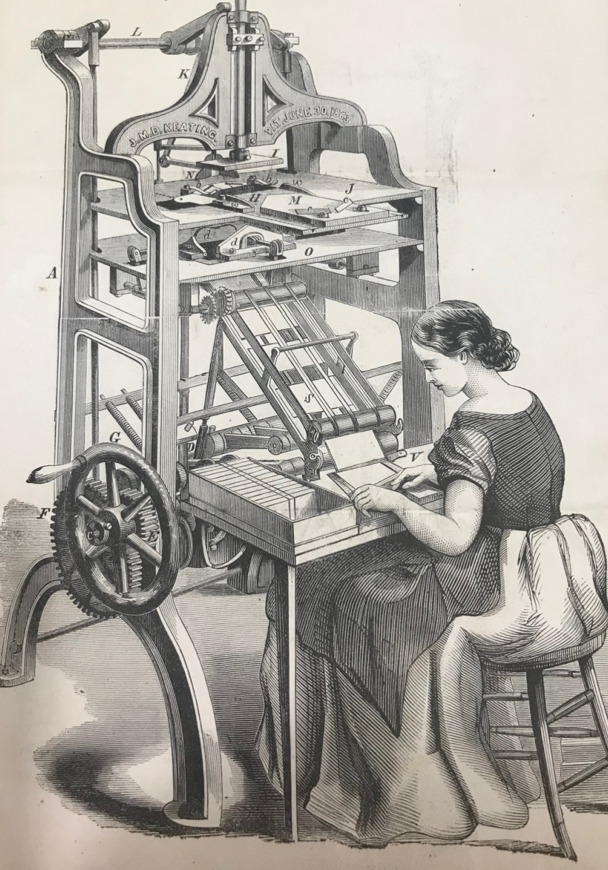
This is a drawing of an envelope folding machine. It is not the machine the Swift Brothers patented.
To see the actual patent for the envelope folding machine invented and perfected by Henry and D. Wheeler Swift, follow the link at the bottom on the page.
https://patentimages.storage.googleapis.com/2c/28/ed/f5b54c3baf1ffb/US115382.pdf
Notes:
An example of an envelope folding machine of the 1800s.

Slide 44
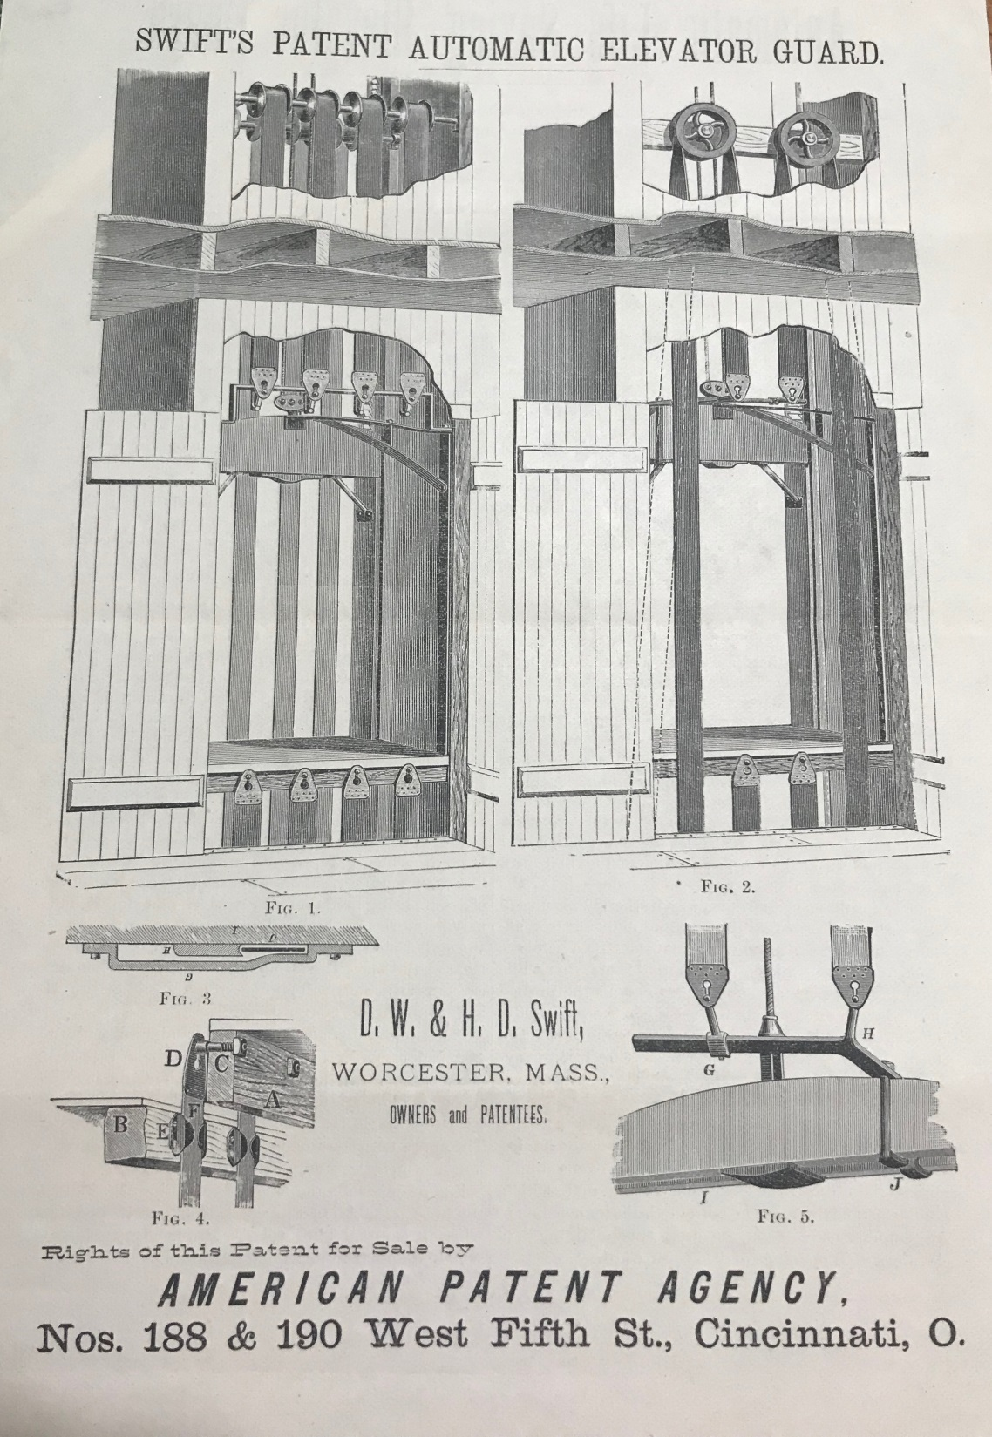
This is the actual drawing of the Automatic Elevator Guard invented by Henry and D. Wheeler Swift submitted to the American Patent Agency.

Slide 45
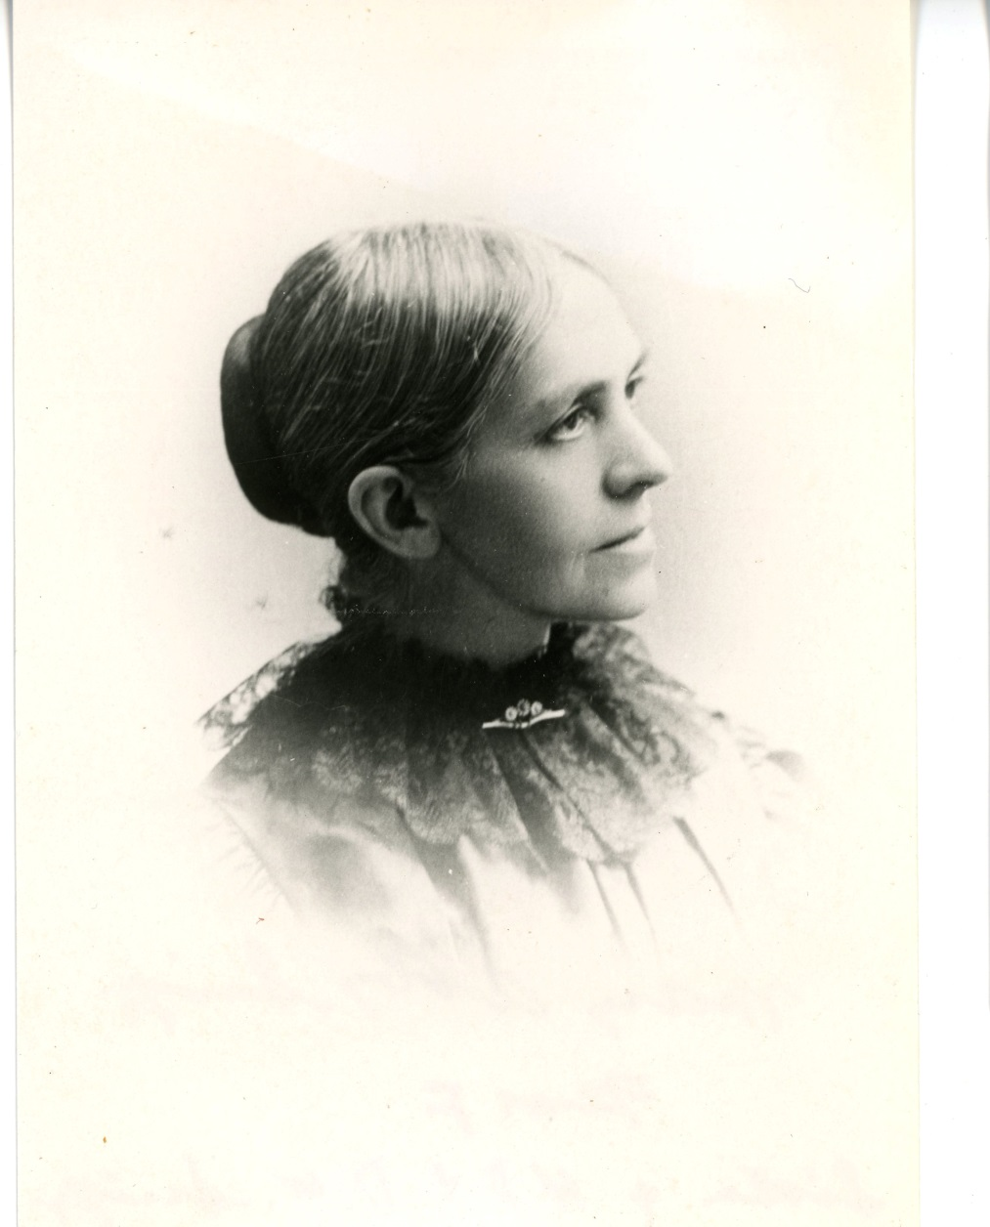
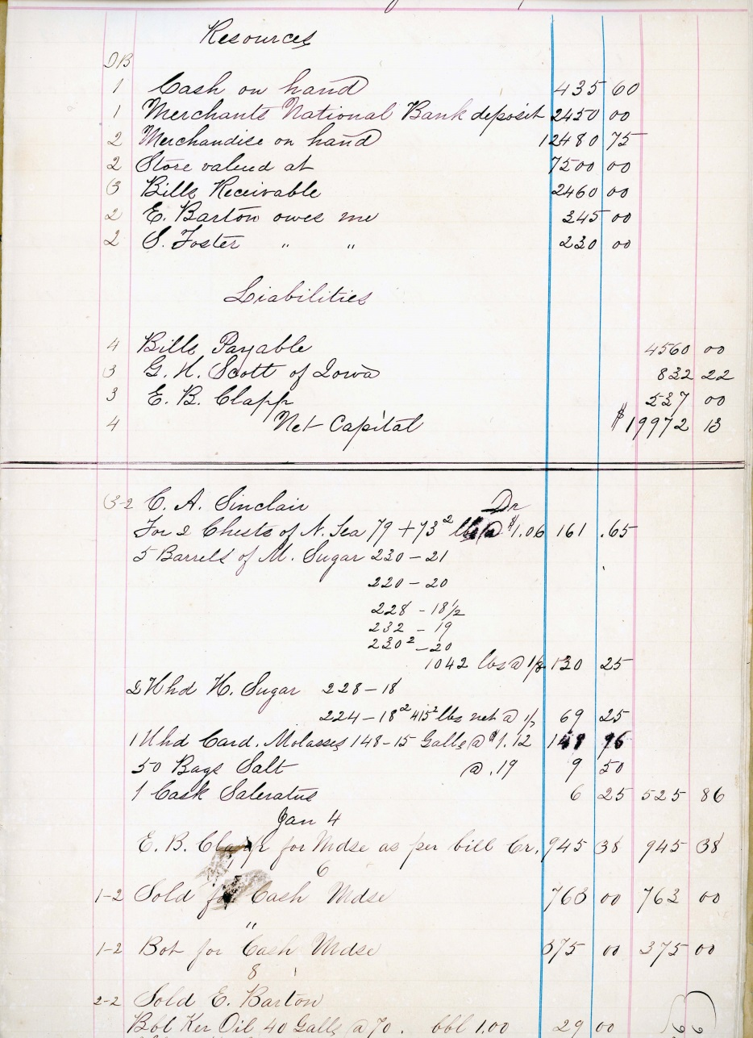
Henry and D. Wheeker’s sister, Mary Abby Swift
b.1837
Mary Abby Swift and her ledger for her business in Falmouth
Notes:
Abby is the correct spelling.

Slide 46
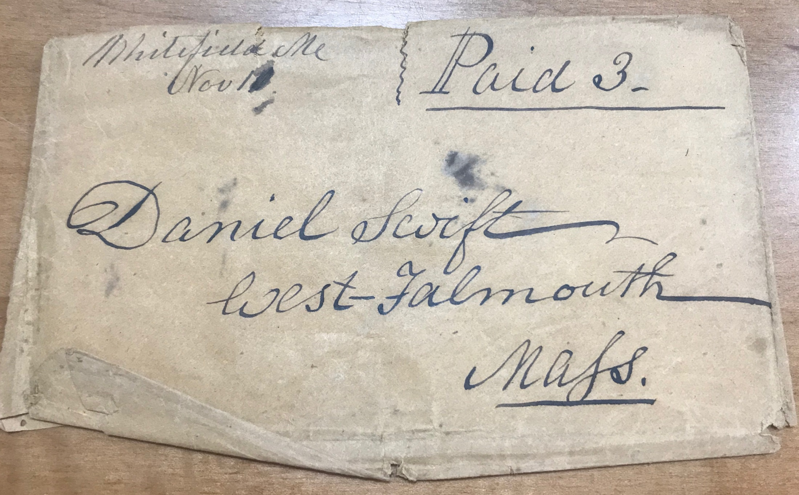
It used to be so easy to receive mail in West Falmouth;
no zip code or address needed.

Slide 47
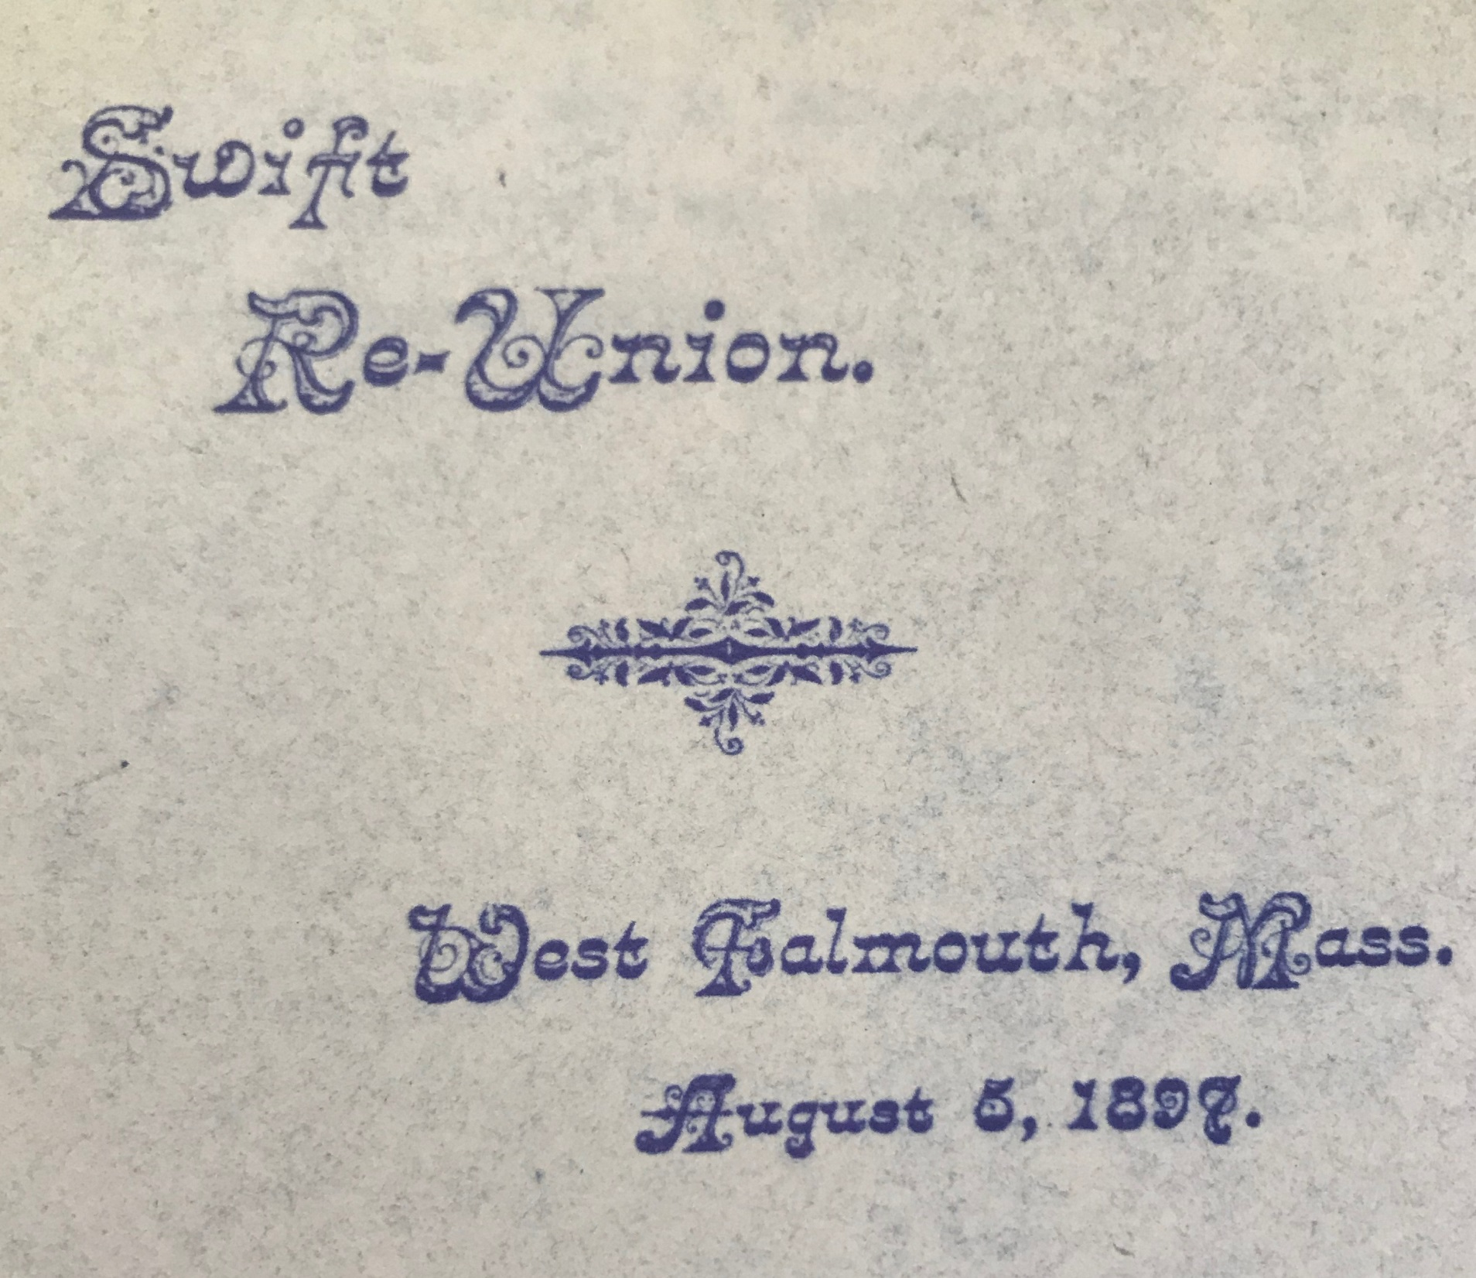
Notes:
The year the current library building opened.

Slide 48
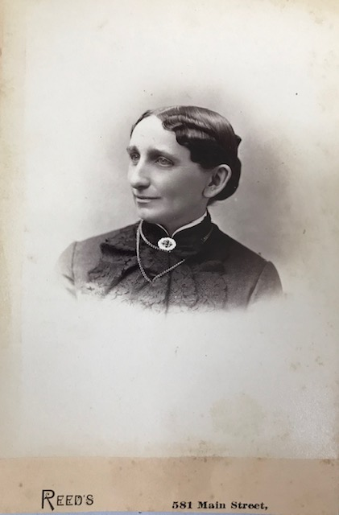
Sarah Jane Gifford
Swift
b.1846.
The reverse of the photograph reads Sarah wife of D. Wheeler Swift.

Slide 49
Sarah Jane Gifford Swift b.1846 Wife of D. Wheeler Swift
Falmouth Enterprise, Friday, November 27, 1942; Page: 9 Long life Marked By Benefactions Mrs. D. Wheeler Swift Was Contributor to Quaker Schools and Philanthropies Funeral services were held at 10:30 AM Monday for Mrs. Sarah Jane Swift of Worcester, a former West Falmouth resident, at the Friends' meeting house in Worcester. Mrs. Swift died last Friday at the age of 96.
Funeral services were held at 10:30 AM Monday for Mrs. Sarah Jane Swift of Worcester, a former West Falmouth resident, at the Friends' meeting house in Worcester.
Mrs. Swift died last Friday at the age of 96. The Rev. Oliver R. Frazer officiated at the service. Also taking part were the Rev. Gren O Pierrel of Providence, R.I., and the Rev. Leslie Barrett of Arlington both former pastors of Friends' meetings. Many other officials of the New England- Friends' Society were present. A special committal service was held at the Friends' burial ground in West Falmouth Monday afternoon. Mr. Frazer again officiated.

Slide 50
Mrs. Swift has long been a summer resident of West Falmouth. In 1904 she and her husband built a large home on Main street. Granite for the foundation and architectural decorations were taken from the West Falmouth hills. Her nephew, Willard E. Swift, and his family still have a home in West Falmouth where they live part of the year. Mr. Swift is president of the American Envelope company in Worcester. Mrs. Swift was born in North Dartmouth on November 16, 1846. She was the daughter of Isaac R. and Phoebe Rushmore Gifford. She was educated at the District School and at Moses Brown School in Providence, R.I. (at that time school was coeducational and called "Friends School"). She served as a member of the Committee of the New England Yearly Meeting of Friends in charge of this school from June 1898 until the time of her decease.

Slide 51
On December 26, 1872, she was married in Friends Meeting House at Smiths Mills (near New Bedford) to D. Wheeler Swift, formerly of West Falmouth, who came to Worcester, as a pioneer in the envelope industry in 1864. He died June 10, 1910.
Both her father and mother came from long lines of New England Quaker parentage. Her father died at 91. Her mother lived to be over one hundred years old. The Gifford family (her father's people) were substantially interested for many years in the shipping and whaling industry, and her father and his brother William were owners of whale ships of New Bedford. This industry suffered severely during the War of 1812 when British cruisers took a heavy toll of New England whaling interests. Later, at the time of the Civil War, ships fitted out in British ports preyed upon the whalemen of New Bedford; Nantucket, and other New England ports.

Slide 52
Sarah Swift maintained the traditions of the many generations of her Quaker ancestors, taking through her life an active part in the work of the Society of Friends, both in United States and abroad. She maintained vigorously throughout her long life the traditions of the Quakers against war as a means of settling international differences, believing that if a fraction of the effort and resources drained by war could be devoted to the cause of international conciliation and an endeavor to remove the causes of war, wars themselves would cease to exist.
Sarah Swift was a member of Permanent Board of Yearly Meeting of Friends for New England, which is a part of the Five Years Meeting—the governing body of the Society of Friends of America. She was one of the Elders in the Worcester Friends Meeting and served on the Finance Committee, Cemetery Committee, Committee on General Care; at one time was Clerk of the Monthly Meeting; member of Building Committee for the present church, and contributed to the American Friends Service Committee

Slide 53
Her interests extended to educational work, in this country and in foreign lands. She was a benefactor of educational institutions and many struggling young scholars and ministers preparing for their life work. For many years she was a substantial contributor to the educational and religious work of the Friends' Mission on the Island of Jamaica, B. W. I., and the Friends' Ramallah Mission School in Syria.
Sarah Swift's gifts to, and Interests in this institution, supervised by the New England Friends' Yearly Meeting, have contributed immeasurably to efficiency and effectiveness of the Mission schools. With it all, she realized the necessity and importance of maintaining efforts of welfare and charity in Worcester, the city where she had made her home. For many years she was a member of the Board of Directors of Worcester Children's Friend Society. Many civic organizations were recipients of her generosity and her helpful deeds, almost without number, were inconspicuously accomplished. Early in life she was imbued with the ideals of frugality and thrift, with a tendency approaching self-denial, feeling that by so doing others in heed might receive more.
Her joy was in helping others.

Slide 54
It has been well said that some lives, between the beginning and the end, consist mainly of length; others are of greater breadth although the length may be less. Her life, happily, was one of unusual length and breadth as well, and the hundreds who came within the space of its length and breadth were made happier and more useful and effective as a result of her interest. *
*Falmouth Enterprise, November 27, 1842

Slide 55
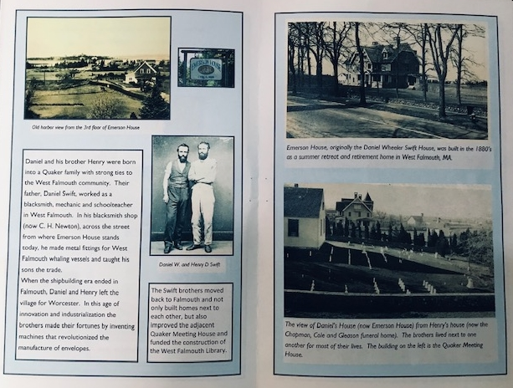
Notes:
Thank you to June for loaning this document to the library for the presentation. These pages are from a This p This pamphlet was prepared by the “Emerson House Friends” (no date). Note the images of D. Wheeler’s summer residence on the right; and the open view to the water on the left.

Slide 56
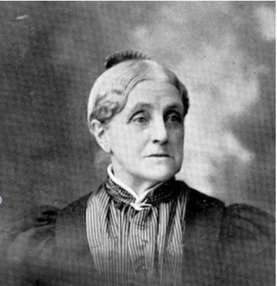
Abby Swift
Mendenhall b.1832 was the
daughter of Silas Swift, sea captain (b.1795) and Chloe Bowerman Swift (b.1796).
Siblings include
Rhoda Bowerman Swift (b.1818), Phebe A. Swift (b.1821),
Harriet G. Swift Green (b.1825) and
Sarah C. Swift (b.1829).
She donated the land for the West Falmouth Library.

Slide 57
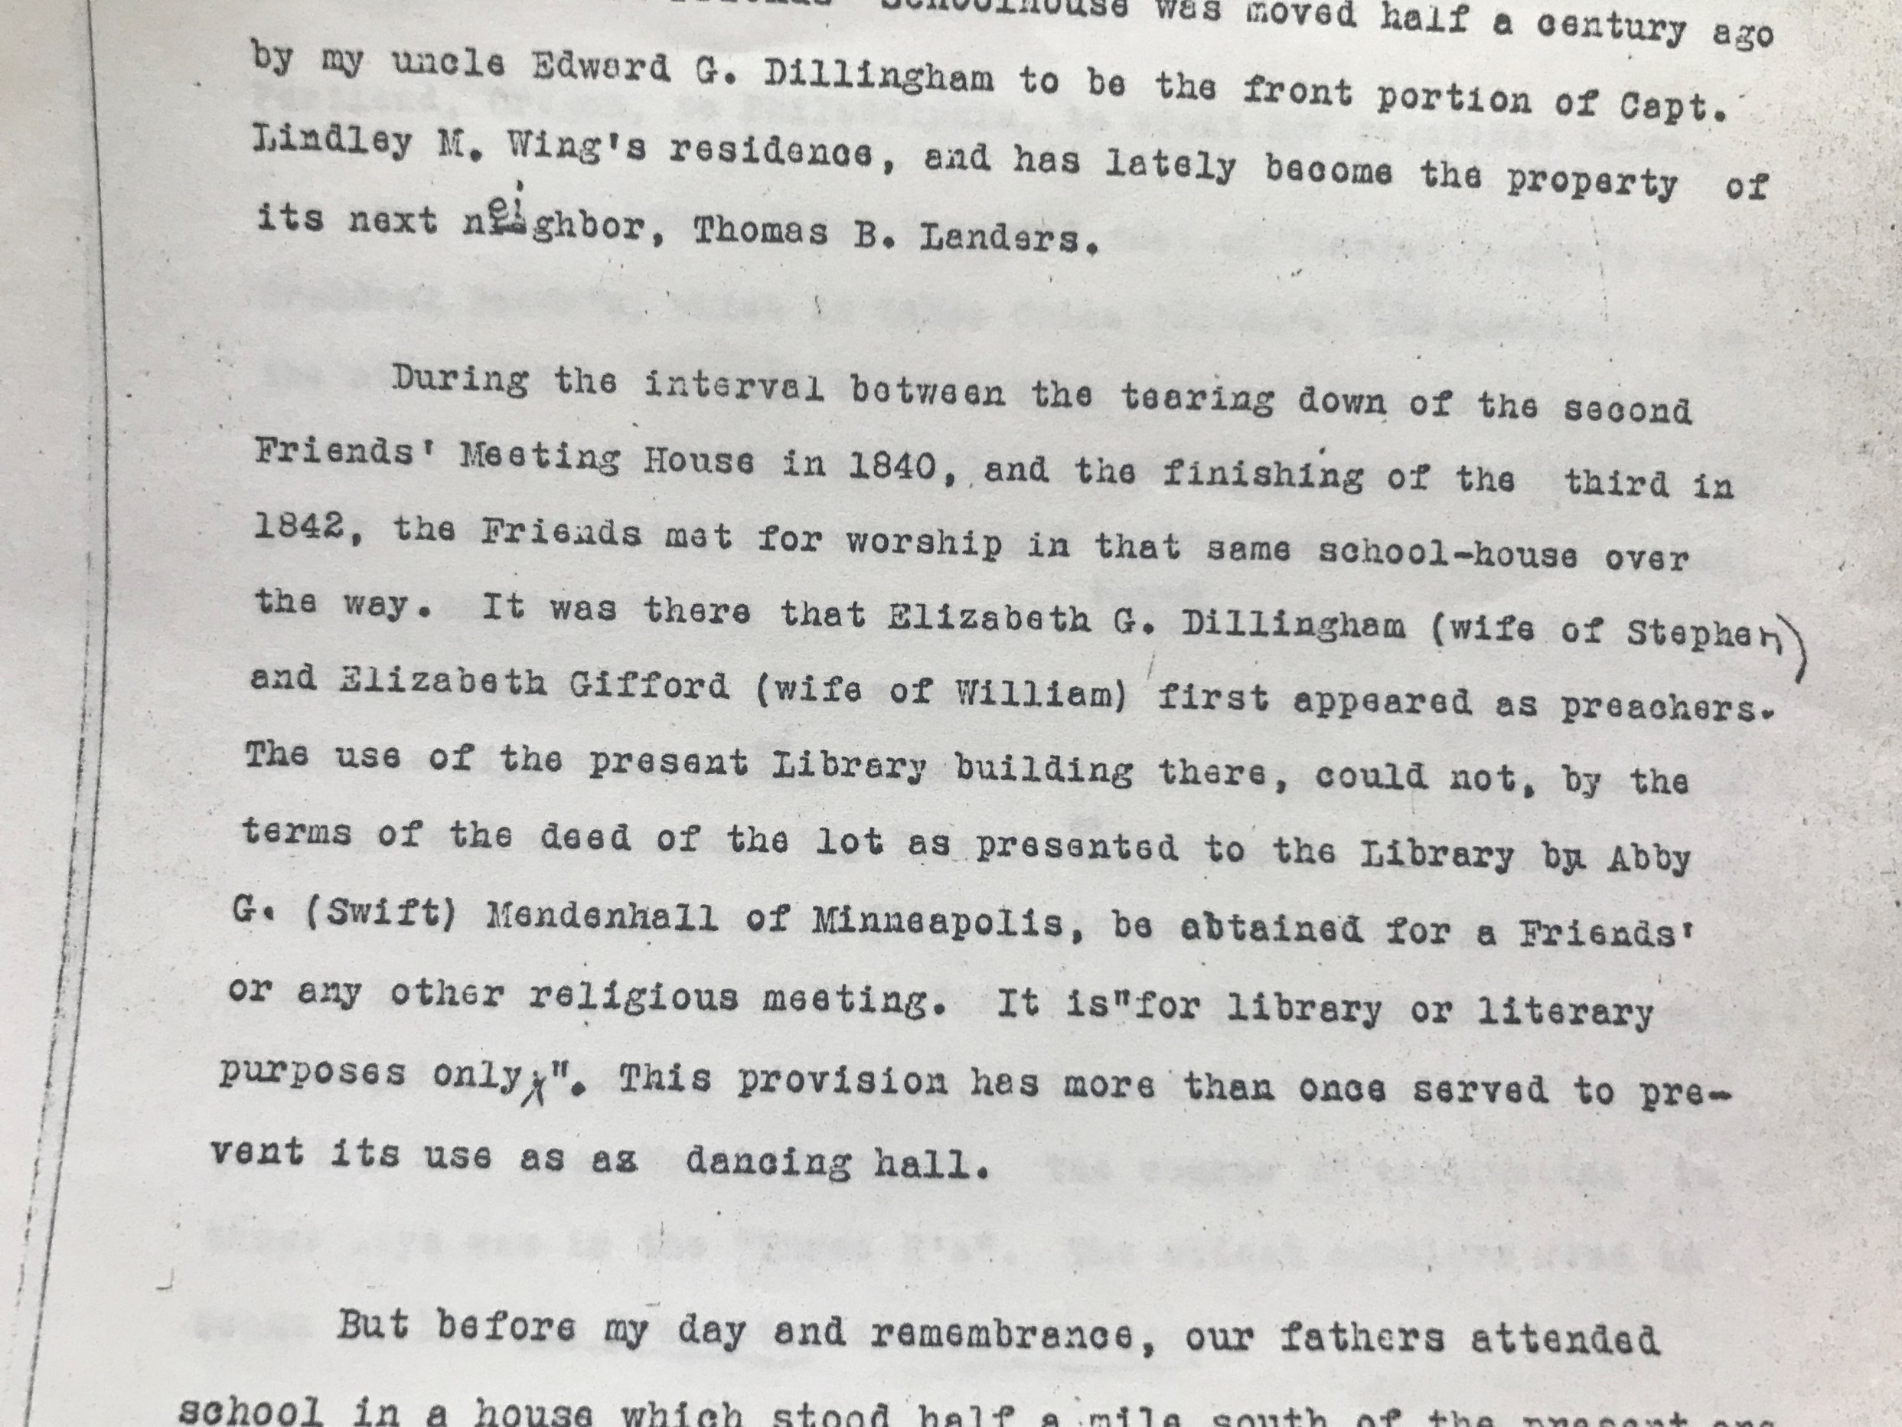
Notes:
Note that the two preachers in 1841 were women. Also mentioned are the stipulations for the deed of the lot as presented to the Library by Abby G. (Swift) Mendenhall of Minneapolis, which states the use of the Library is “for library or literary purposes only.” The last sentence reads. “This provision has more than once served to prevent is use as a dancing hall.

Slide 58
Abby G. Mendenhall
(from a published biography on the findagrave.com site)
Abby G. was the daughter of Captain Silas Swift, a merchant sailor of West Falmouth, and was born Aug. 19, 1832. She was descended from a long line of Quaker sailors who had always been connected with the charitable associations of the Society of Friends.
She was married to R. J. Mendenhall of North Carolina, Feb. 11th, 1858, and in April the young couple came to Minneapolis. From the pioneer days Mrs. Mendenhall has always been a friend to those needing help, and her interest and influence is seen today in the charitable institutions of the city,
She was one of the four women who were instrumental in the organization of Bethany Home and its work has always been very near her heart. She served as treasurer for twenty-three years, and for one term acted as secretary.
Notes:
The four women who started Bethany home were:

Slide 59
She was also prominently identified with the Northwestern Hospital, and was a member of the board of directors for thirteen years and for six years held the office of vice president.
The Friends' Society of Minneapolis counted her as one of its efficient members and she represented it at the national meetings an several occasions.
Without children of her own, Mrs. Mendenhall became by sympathy and choice mother to the unfortunate. Many of these have been inmates of her own family, from which they have gone to illustrate in their own households the virtues of Christian motherhood.
Mrs. Mendenhall's mother, Mrs. Chloe Swift, was a member of her family in Minneapolis until her death in 1891, at the age of ninety-five. Mrs. Mendenhall died at her home in Minneapolis January 11, 1900.

Slide 60
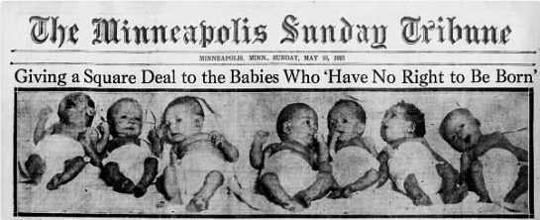
A Headline in the Minneapolis Tribune, date ? “Giving a Square Deal to the Babies Who “Have No Right to Be Born”.” The Minneapolis Sunday Tribune, May 15, 1921. (A Special Archival Report)
Mendenhall, Abby G. “Bethany Home for Unwed Mothers.” The Quaker Writing. Accessed February 27, 2019. http://www.qhpress.org/quakerpages/qwhp/bethany.htm.
Perlman, Tamatha. “Where Are the Men Who Make These Girls What They Are?” The Historyapolis Project. March 11, 2014. Accessed March 6, 2019. http://historyapolis.com/blog/2014/03/11/where-are-the-men-who-make-these-girls-what-they-are/.

Slide 61
The Bethany Home: Fighting for the “Fallen”.—from the Hennepin History Museum (no date; probably late 1800s-Abby died in 1900)
In celebration of International Women’s Month it seems appropriate to explore one of the many untold stories surrounding the women of Hennepin County. Being a woman, much less a mother, in the late 19th and early 20th centuries was no easy feat. Women were confined to the private sphere and expected to be homemakers who reared the children. However, all too often, this idyllic vision of family-life created harmful stereotypes and devastating consequences for women who became pregnant out of wedlock. These mothers were shunned and at times completely exiled from their communities and families. In the 19th century they were called “fallen women.” Under Christian religious doctrine, it was believed these women had fallen from grace after losing their purity and would not enter heaven. This stigma perpetuated the myth that the female sex was promiscuous and untrustworthy.. This often led to incidents of domestic abuse and the separation of mothers from their children so they would not “corrupt” them. However, during this dark period of women’s history, some women in positions of power and privilege took a stand.

Slide 62
In July 1876, in Minneapolis, a small group of upper-class women, known as the Sisterhood of the Bethany, a Quaker religious society, joined together to establish the Bethany Home for Fallen Women, with the hope of giving unwed mothers a second chance.
(Abigail Grant Swift Mendenhall and Charlotte Van Cleve were founders)
Abigail Grant Swift was born on August 19, 1832, in West Falmouth, Massachusetts. As the daughter of a highly-regarded father, Capt. Silas Swift, she received a fairly comprehensive education, a privilege not offered to most girls at the time. On February 11, 1858, Abby married Richard Junius Mendenhall, a wealthy plantation owner from South Carolina. The newlywed couple moved to Minneapolis, arriving on April 25, 1858. Abby recounts her daily life and activist work in her diary, now kept in the archives at Hennepin History Museum, (a copy is also available in the West Falmouth Library archives) which dates from her first arrival in Minneapolis until her death in 1900. Abby acted as the first treasurer of the Bethany Home, serving in her role for 23 years.

Slide 63
The first mention of the Bethany Home in Abby’s diary is on July 24, 1876. She writes, “Went to St. Paul to find a matron for our Bethany Home (Magdelene work) as it is now. Did not succeed.” This pattern of employment and financial troubles plagued the early years of the Bethany Home. In these formative years Abby and Charlotte made great sacrifices in their personal lives which culminated in the official incorporation of the Bethany Home on March 21, 1879, exactly 140 years ago during this 2019 International Women’s Month.
The basic premise of the Bethany Home was to help women who had become pregnant out of wedlock, whether through sex work or by failed relationships. Upon entering the home, they signed a contract for a year and agreed to obey the house rules, although there was no security and the “inmates” could leave if they so choose. Once their infants were born, every mother was given the choice to keep their child with assistance from staff at the home for the next three to four months or to place their child up for adoption. Most women entered the home under aliases to protect their identities wither from disapproving families or male superiors seeking to return them to prostitution.

Slide 64
Over the next decade, the Bethany Home became a pillar of the women’s community of Minneapolis. Charlotte Van Cleve and Abby Mendenhall began targeting the powerful men running the sex industry, rather than blaming the young women who had been coerced into the profession. Once, when interviewed by a newspaper regarding the integrity of the “fallen women,” Charlotte memorably remarked, “Where are the men who make these girls what they are? Go find them in our business marts, drawing rooms, and churches…Men are getting rich on the toil and tears of famishing women and children.” With the mindset of targeting the source of illegitimate births, Charlotte and Abby took advantage of the already established laws and turned them in their favor.
In the 1880s, the City of Minneapolis enacted fines against known houses of prostitution and brothels within city limits. This meant that these locales had to pay monthly fines to the city to continue operation. With money always being in short supply at the Bethany Home, the women set about to turn the tables on the stigma of “fallen women.” Charlotte and Abby convinced the city to give them two-thirds of the monthly collected fines to help fund the Bethany Home, directly supporting the women who were victims of the industry. With a solid budgetary plan and a persuasive argument, the women were victorious and acquired funding for years to come much to the dismay of some of the male council members.

Slide 65
The Emerson House in 1908. Today, the campus includes the Emerson House Cottage where those same services that Abby G. Swift Mendenhall felt were so important in 1880 are offered to young single mothers
who need help caring for and supporting a family.

Slide 66
The Emerson House Cottage
Pregnant women and mothers with infants reside in a home adjacent to the Main House. Child care is provided to allow women to attend groups and recreational activities. Case management and counseling staff ensure that you will get the prenatal care required for you and your baby. Appointments can be made with local midwives, ob-gyn doctors, and pediatricians as soon as necessary.
Lactation consultation is available to assist women about breast-feeding issues. Counseling and medical staffs work together to insure an appropriate pace of activities. Postpartum support groups and family planning services are available at the Faxon Women’s Center of Falmouth Hospital.
Emerson House prioritizes the mother’s relationship with her children. The program will assist you in setting up visits with your other children. This includes activity planning, dealing with separations, and maintaining the connection during the separation. Emerson House works with DCF to arrange for reunification.

Slide 67
The Library and Quaker Meetinghouse researchers are attempting to solve a mystery concerning Benjamin Swift who was the first Swift to settle in West Falmouth. Unfortunately, as was the custom, families in the 1600s-1800s often passed down family names (sometimes in an organized fashion; but often haphazardly as well). We are trying to determine which of two Benjamin Swifts of Sandwich were the actual ancestor of the West Falmouth Swift families. If you have information to add or share, please contact Renee Voorhees,
West Falmouth Library at:
rlvoorhees@clamsnet.org
Thank you.

Slide 68
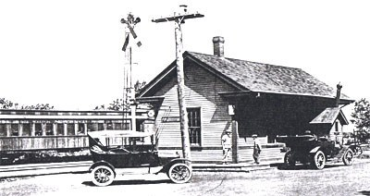
QUESTIONS, COMMENTS, INTRODUCTIONS?
To find slides and videos for all historical presentations visit the West Falmouth Library home page at:
www.westfalmouthlibrary.org
West Falmouth History and Heritage
rlvoorhees@clamsnet.org
Renee Voorhees
(To be continued after the Meetinghouse Tour. Please come back to meet family, guests, staff, and friends from 8-9:30.)

