Slide 1

VETERANS’ CELEBRATION
NOVEMBER 3, 2019
WEST FALMOUTH LIBRARY IN COOPERATION WITH JOE Q. VETERAN COFFEE GROUP AND FALMOUTH TOGETHER WE CAN
CONCERT BY: TOAST AND JAM
POTLUCK DINNER DONATED BY AREA RESTAURANTS PHOTOS: SANDY MCARA AND LOREN HUTNER

Slide 2
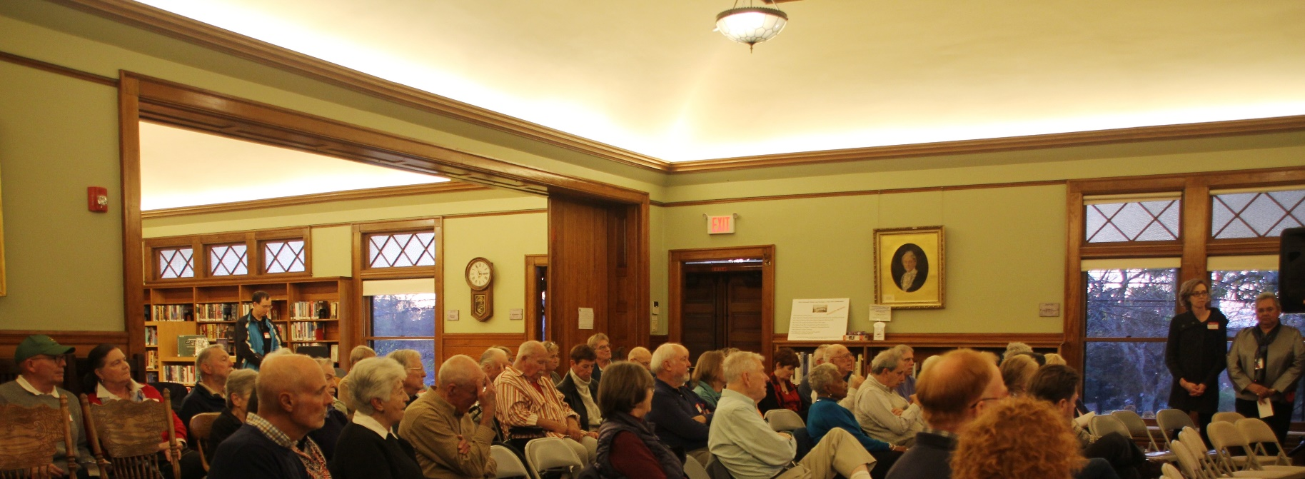



This event was made possible with funds from the Institute of Museum and Library Services Administered by the Massachusetts Board of Library Commissioners.

Slide 3
We sincerely thank the restaurants who donated to the potluck dinner
Epic Oyster
Bucatino Restaurant and Wine Bar
Silver Beach Pizza & Seafood
Silver Lounge
North Falmouth Cheese Shop
Crabapples
Jack in the Beanstalk
Windfall Market
The 99
DJs Famous Wings
Slice of Italy, Inc.

Slide 4
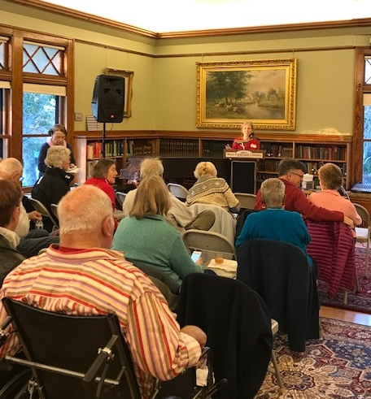
Renee Voorhees, West Falmouth Library, welcomes the crowd with the announcement that the water to the building is back on and that bathrooms are open.

Slide 5
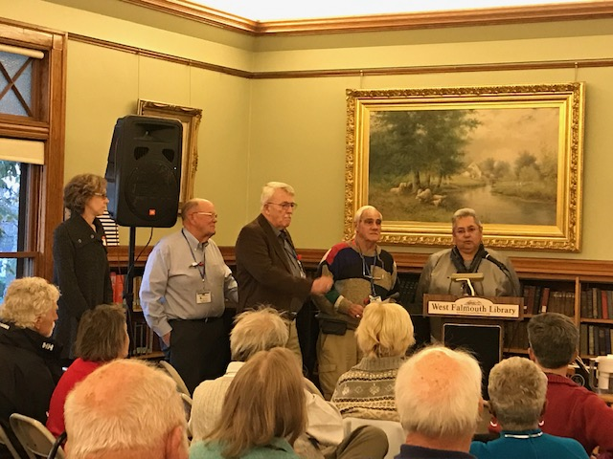
Members of the Joe Q. Veteran Coffee Break Group Advisory Board

Slide 6
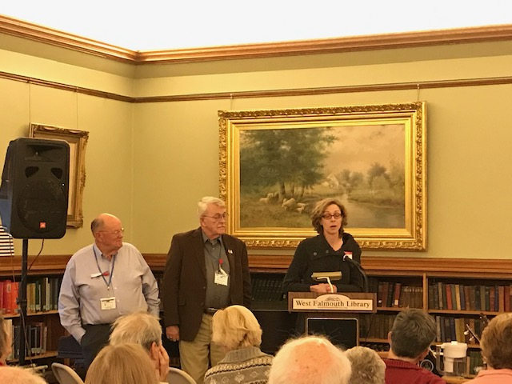
Planning Committee: Allen Wilson, Alan Driscoll, and Kate Prophett (not pictured Clara Hennessey Gilbert and Renee Voorhees)

Slide 7
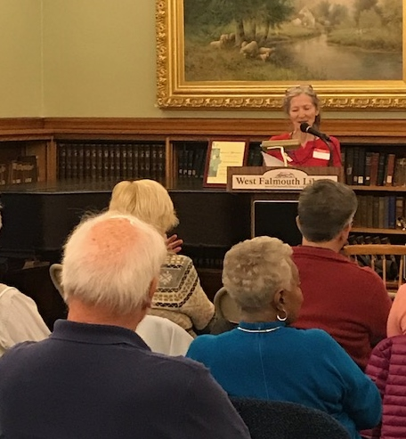
Renee reads a tribute written by Clara Hennessey Gilbert in honor of her brother Arthur H. Hennessey Jr., who was the first soldier from Cape Cod to die in the Vietnam War. The tribute included a story that made the front page of the Falmouth Enterprise. Alan Fraser, age 14, Jerry Roderick and Robert Tait, age 13, Arthur age 11, and Charles Smith age 10 were swept into Buzzards Bay in a 110 boat in winds moving at 28 knots. They stayed afloat and made it to Marion, where they were picked up by Alan’s mom. Bob Bowman, veteran and West Falmouth resident, spoke from the audience to say he missed the boat by 5 minutes because he got out of work at the market late.
The Coast Guard at Cleveland’s Ledge were watching the boys with binoculars. When a call for rescue came in, they replied they were watching, and that when they could not count 5 heads, they would commence a rescue. Bob Bowman claimed he was still sorry he missed this adventure.

Slide 8
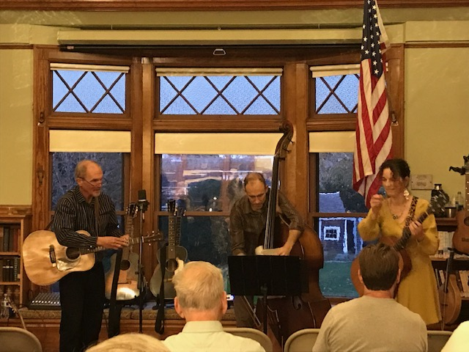
The Concert Band-Toast and Jam

Slide 9
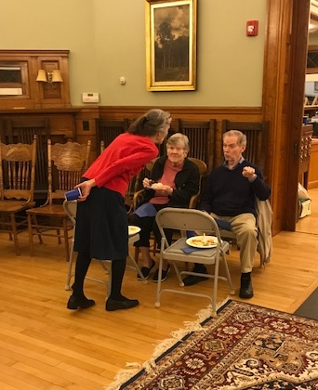
Renee leans in to hear about another veteran’s war experiences.

Slide 10
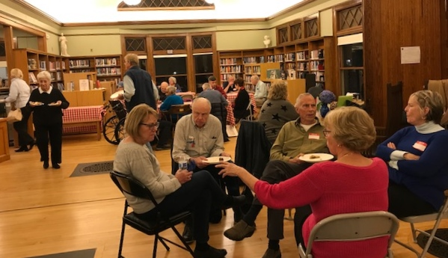
Vietnam veterans, Paul Rogers and Dave Crichton, enjoy dessert with Candice St. Martin, Karen Crichton and Carolyn Ryczek.

Slide 11
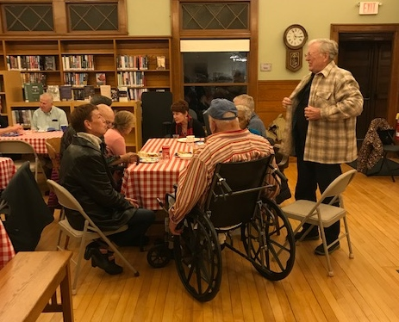
Raine Gilbert shares stories with Bob Bowman and family.

Slide 12
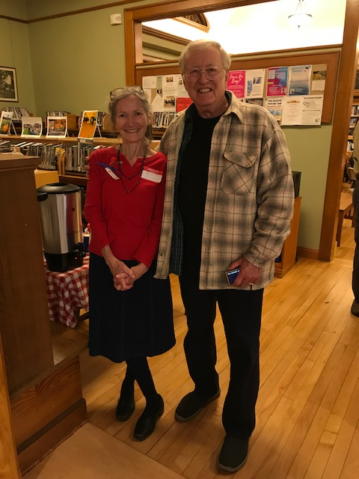
Raine (filling in for Clara) and Renee share a laugh.

Slide 13
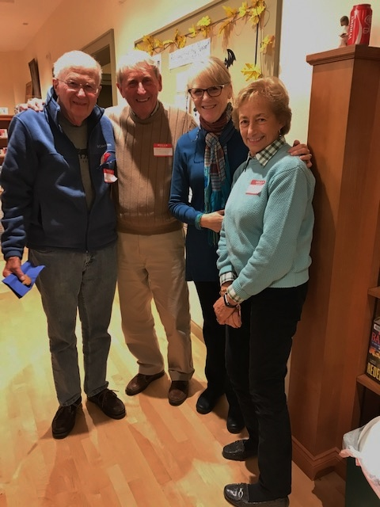
Long time library volunteers, Milt Williamson, John Swirbliss, Melinda McAra, and Carol Swirbliss strike a pose.

Slide 14
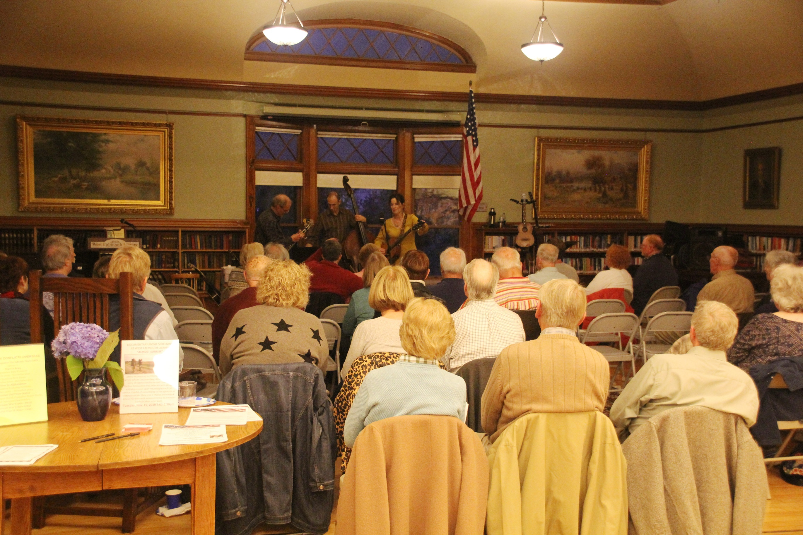

Seventy attendees enjoyed music, dinner, dessert and conversation.

Slide 15
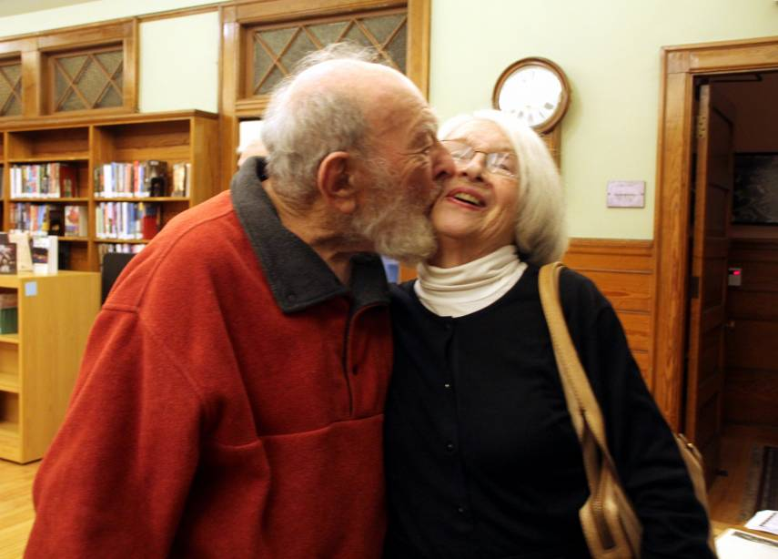
Joel Weinstein and wife, Barbara, ham it up for the audience.

Slide 16
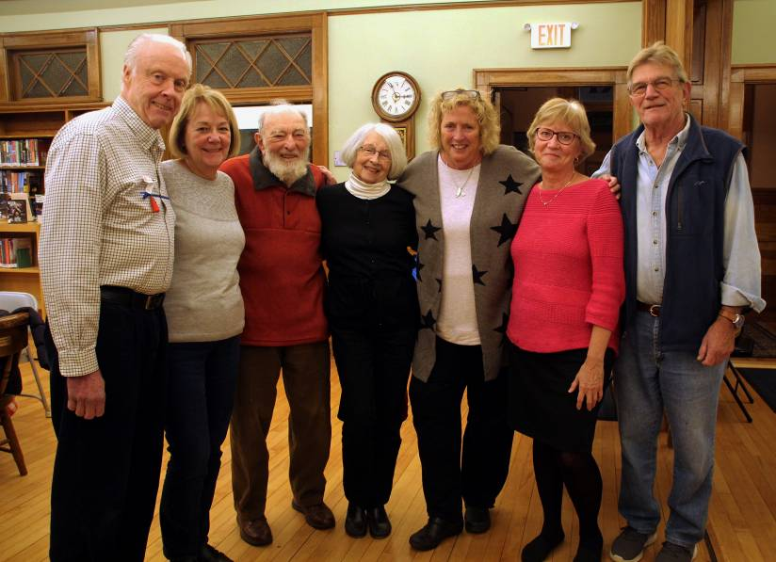
Paul Rogers, Candice St. Martin, Joel Weinstein, Barbara Weinstein, Karin Benedict, Carolyn Ryczek and Todd Benedict share a group hug.

Slide 17
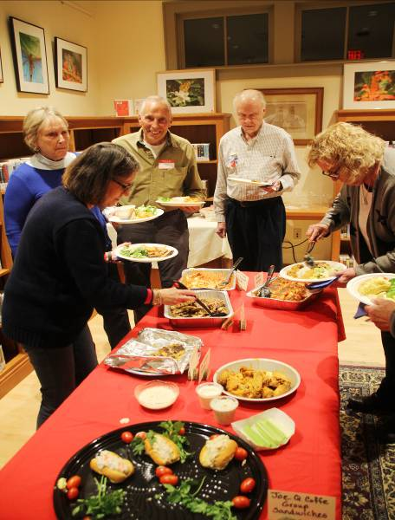
Eleven local restaurants donated to the potluck dinner. Thank you!

Slide 18
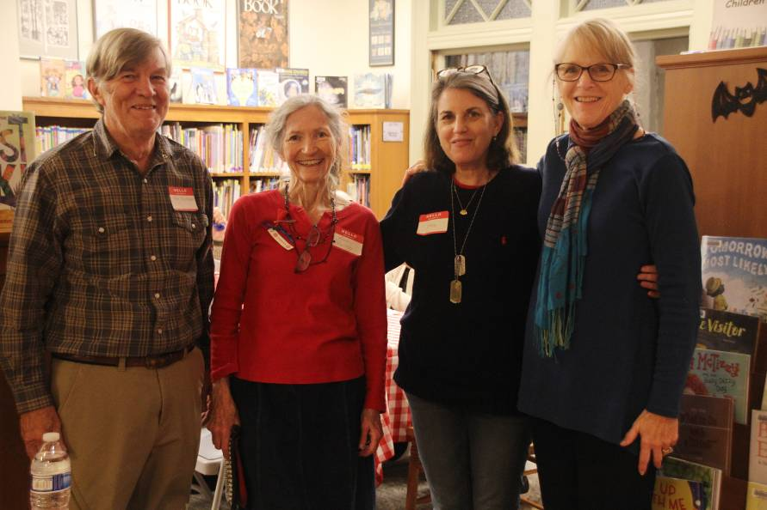
The work crew: Ken Voorhees (Vietnam), Renee Voorhees, Loren Hutner (with her father’s WWII dog tags) and Melinda McAra.

Slide 19
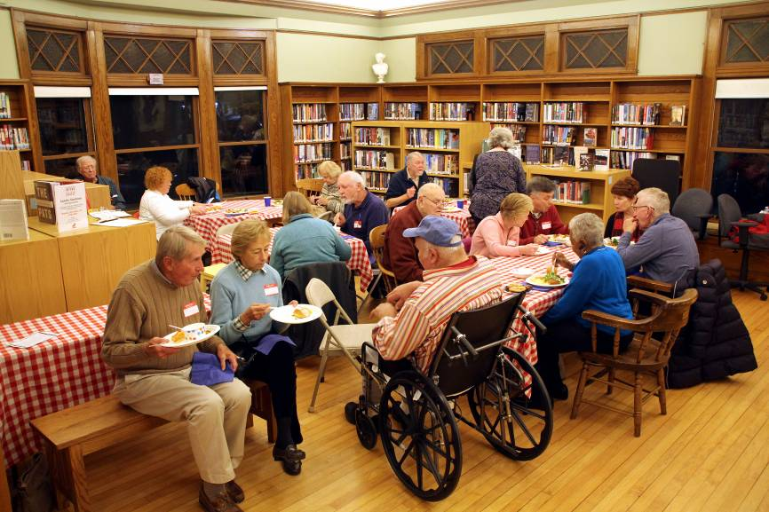
Shelves were rolled to the side and tables set up all over the Library.

Slide 20
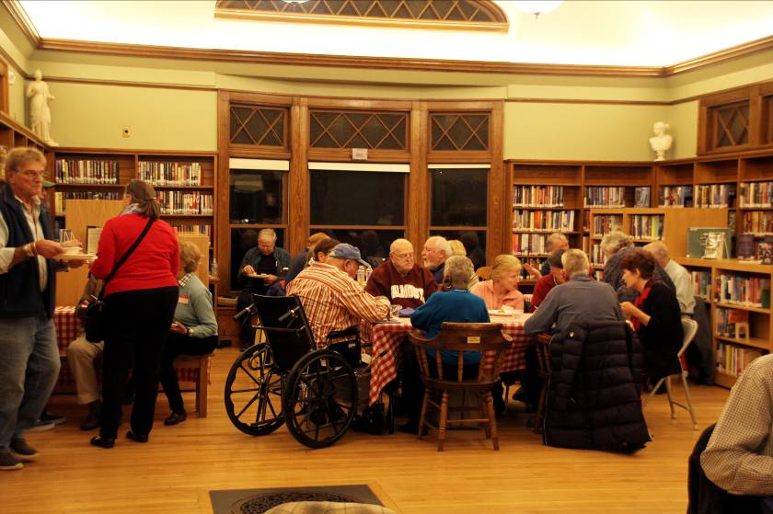
Enjoying food and friendship with neighbors, friends and veterans and their families.

Slide 21
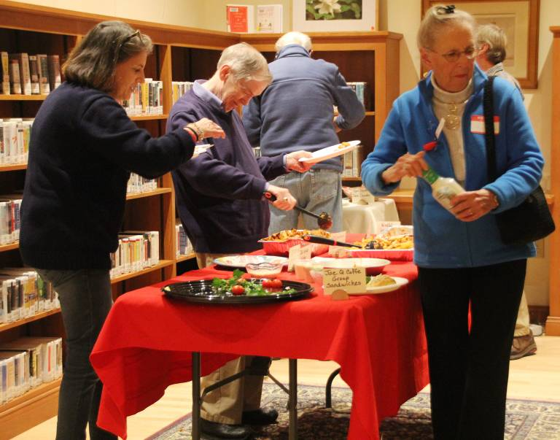
Foods included clam chowder, pasta, salads, chicken cutlets, wings, chicken parmesan, brownies, apple crisp, ice cream, coffee and mulled cider.

Slide 22
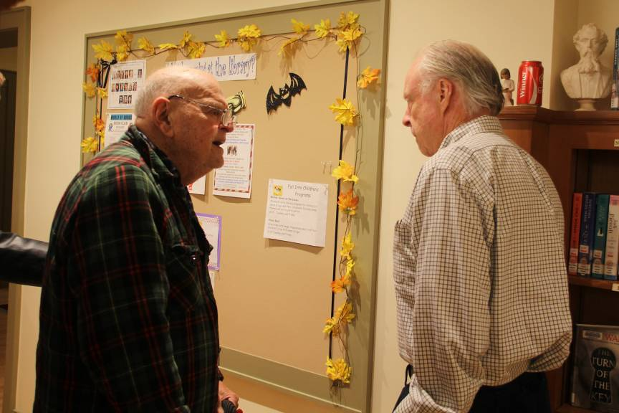
A final conversation with a World War II veteran, Fred?, who treated us to a beautiful song, a tribute to his Italian mother, sung in Italian.

Slide 23
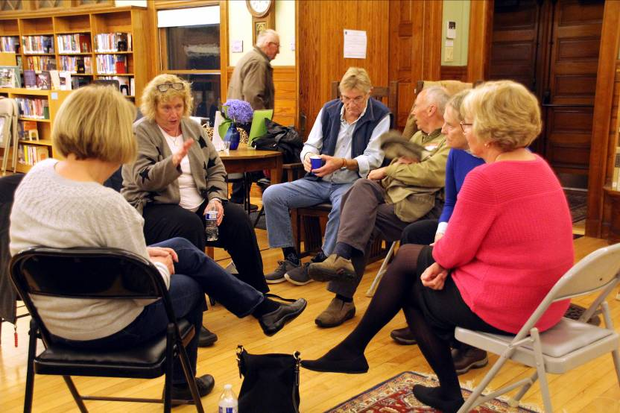
Karin Benedict gets in one last word or two before the evening ends.

Slide 24
I would like to thank Clara Hennessey Gilbert and Raine Gilbert for loaning personal items and photographs for the library display honoring Clara’s brother, Arthur F. Hennessy Jr., who was the first Cape Cod soldier to lose his life in Vietnam. The family also established the Arthur F. Hennessey Jr. Scholarship awarded yearly by the West Falmouth Library to a deserving Falmouth senior.
Thanks also to Allen Wilson, Kate Prophett, and Claire Hennessey Gilbert for ideas, plans, and collaboration.
I would also like to thank the staff and friends of the West Falmouth Library for their assistance and support for this event. Loren Banker-Johnson for leading us in The Pledge of Allegiance; Melinda McAra, Loren Hutner, and Ken Voorhees for assisting with dinner; and Loren Hutner and Sandy McAra for taking photographs.
I look forward to seeing you all again next year for our second annual Veterans’ Celebration. Renee Voorhees

