Slide 1


West Falmouth
Economy 1800s– Part I
SATURDAY, JANUARY 26, 2019 – 10:30AM
POSTERS AND SLIDE SHOW Funded with a grant from the institute for museum and library services
administered by the Massachusetts board of library commissioners

Slide 2
Thank you to the following contributors:
Historians:
Deyo, Simeon-The History of Barnstable County, Massachusetts, 1620-1637-1686-1890
Jenkins, Charles W-Three lectures on the early history of the town of Falmouth : covering the time from its settlement to 1812
Jenkins, Candace-Between the Forest and the Bay: A History of West Falmouth as revealed in Its Historic Buildings and Landscapes
Dillingham, John Hoag-Lectures About Life in West Falmouth in the 1800s
Local researchers:
Susan Meyers-John Hoag Dillingham lectures
Linda Ohkagawa-Sheep Farming (also presenting today)
Milt Williamson-Pink Granite
Tim Jackson and family-Videography

Slide 3
The 19th Century |  | The 19th Century
United States Events |  | World Events
1803-Louisiana Purchase |  | 1804-Napolean becomes Emperor of France
1812-War of 1812 |  | 1815-Napolean Defeated at Waterloo
1820-Missouri Compromise |  | 1822-Liberia Established as Free Slave Colony
1835-1838-Trail of Tears |  | 1837-Opium Wars
1846-Mexican American War |  | 1846-Great Potato Famine
1850-Fugitive Slave Law |  | 1859-Darwin's Origin of Species
1861-Civil War |  | 1867-Britain Quits Sending Convicts to Aus.
1876-Bell invents the Telephone |  | 1879-Zulu War in South Africa
1886-All U.S. Indians on Reservations |  | 1883-Krakatoa Erupts
1896-Klondike Gold Rush |  | 1893-New Zealand Gives Women Right to Vote

Slide 4
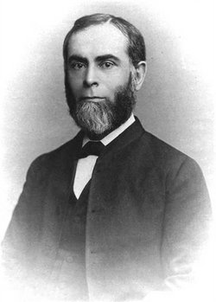
John Hoag Dillingham 1839-1910
John served as village storyteller and historian. Many of his stories about living in West Falmouth in the 1800s were written in 1909.
When he was12 , he walked from West Falmouth to his lessons at Lawrence Academy in Falmouth.
At 16, he taught school at a district In Falmouth called Ashumet, which he later termed a "rude, uncivilized district in the woods." At 19 he entered Harvard. He graduated in 1862. Soon after he was teaching Latin and Greek at Haverford College. In 1878 he became principal of the Friends' Select School for Boys in Philadelphia. From 1883 to 1889 he was an elder of the Quaker Church. In 1891 he became a minister.
The family were Quakers for generations.

Slide 5
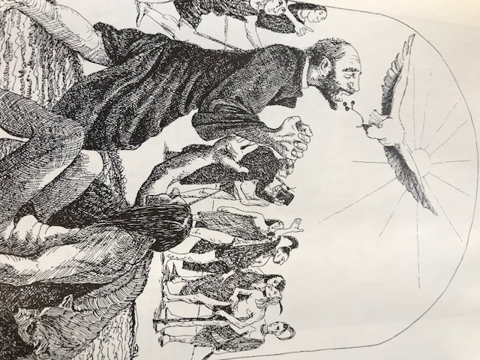
Cranberries-Legend
Cranberries are indigenous to the Cape and valued by Native Americans for centuries as a pemmican, dye, and wound poultice. “The Pilgrims found the berry “excellent against the Scurvy...and to allay the fervour of Hot diseases”. (Deyo)
Henry Hall of Dennis first attempted to cultivate cranberries in 1816 on a low swampy area of public land. In 1820, Hall’s cranberry bog produced between 70 and 100 bushels of crop, which he sent to New York to sell.
The photo illustrates a legend about a curse put on Richard Bourne, a Christian missionary, by a local medicine man. The curse mired Bourne in quicksand. If Bourne survived, the medicine man would serve him.
The cranberry saved Bourne, and the medicine man converted to Christianity.

Slide 6
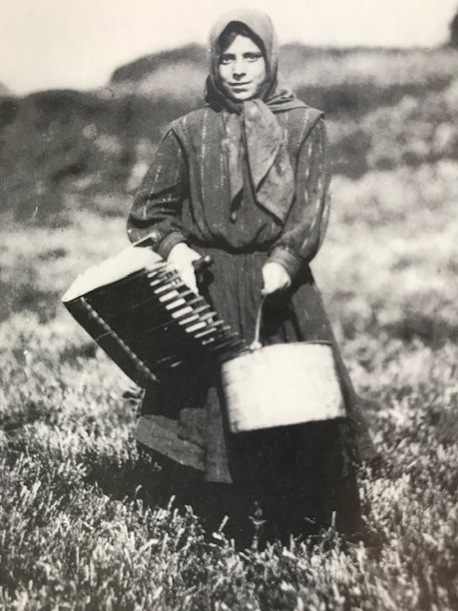
Cranberries-Cape Cod
Cranberries became a primary crop on Cape Cod in the mid 1800s. The first official census of cranberry land took place in 1854. 197 cultivated acres were reported. The top three producers were: Dennis with 50, Barnstable with 33 and Falmouth with 26. By the late 1800s, there was a total of 1,074 cultivated acres. During the Civil War, cranberries sold for $10-$20 a barrel. By 1895 Falmouth was exporting 15,000 barrels a year.
Falmouth by the Sea
The photo is of Carrie Medeiros, age 12, during her second year of picking cranberries. Swift's Bog, East Falmouth. 1911. Falmouth Historical Society.

Slide 7
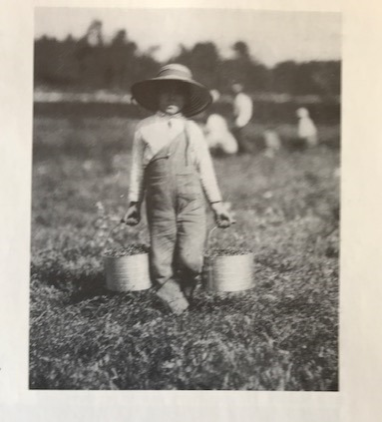
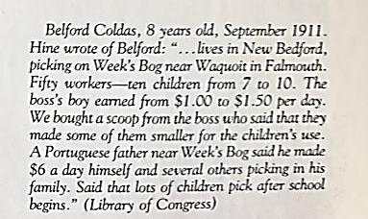
Cranberries-Child Labor

Slide 8
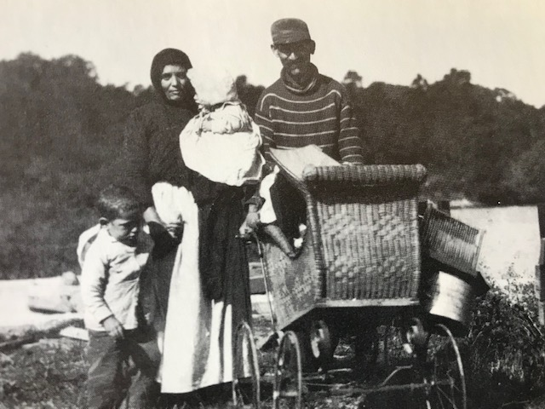
Cranberries-Swifts’ Bogs E. Falmouth
After the mill on the Moonakis River burned in 1894, the property was sold to the Swift brothers. Three Swift brothers of Sandwich and later Waquoit, took a Boston investor fishing along streams above the abandoned mill ponds on the Coonamesset River to persuaded him to back their plan of converting the ponds and bordering swamps to cranberry bogs. In 1894 the brothers hired Finns and Russians from New York City to drain the pond, to clear the swamps of trees and stumps, to ditch and dike, and to plant 25 acres of bogs. Cranberry owners continued to hire migrant and
immigrant laborers. There were no
child labor laws until 1938.
A Serbian family on Swifts’ Bog c. 1910. Housing was usually a one room shanty or communal bunk lodging built on the bog.

Slide 9
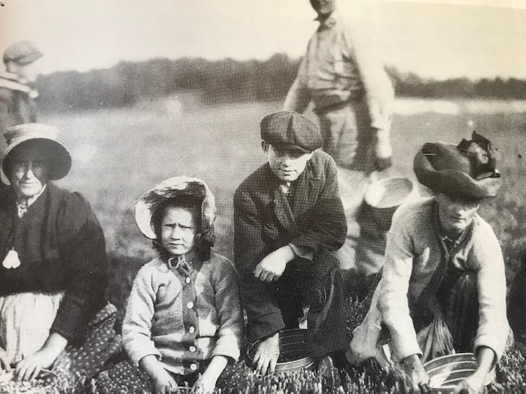
Cranberries-West Falmouth
In I860 Dr. Lewis Miller laid out one of the earliest ditched and managed bogs in a marsh behind his house on the West/North Falmouth border.
In the early years of his bog he probably shipped the barrels of cranberries on schooners that docked at the pier in West Falmouth. In I895 he shipped out 800 barrels. The bog is still operating today just below Wlng’s Pond.

Slide 10
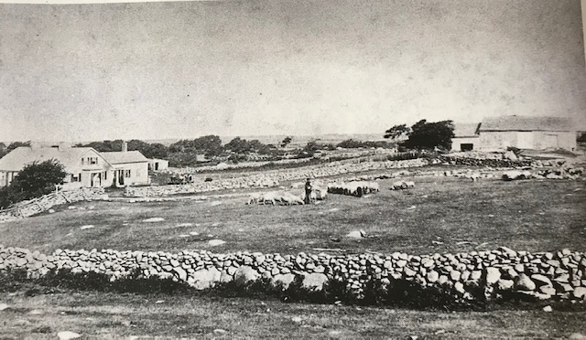
Historic View of the Bowerman Homestead
West Falmouth Library Archives
The Bowerman Homestead defined the southern edge of the Village in the 1800s. The house was built in the late 1600s, and some of the original house still stands.
The property remained in the Bowerman family until Virtue Bowerman married Arnold Joseph Gifford in 1897. When Virtue died in 1981, the house was sold to a private buyer.
Jenkins

Slide 11
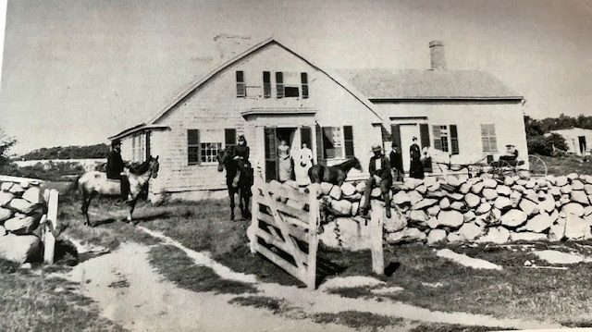
Historic View of the Bowerman Homestead
West Falmouth Library
Archives
c. 1887-1889
“Daniel Bowerman called the farm “Poverty Hollow” Chloe Bowerman Hatch called it “Valley Farm” or “Rock Valley.”
(Daniel’s name might be a reflection of the sinking agriculture economy in the late 1800s).
Jenkins

Slide 12
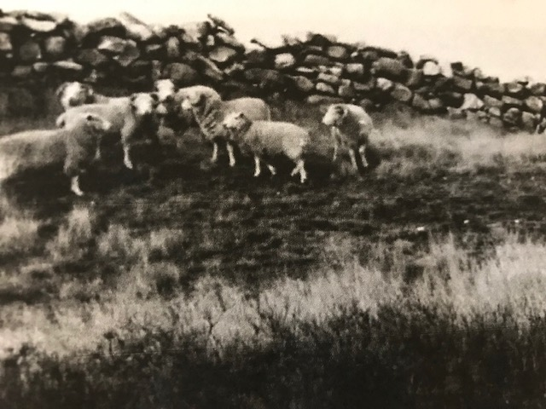
Sheep Farming
From the early settlement of West Falmouth to 1840 sheep dominated the landscape and the economy.
By 1831 Falmouth was the leading sheep raising town in the county with 2,974 animals;
most of those in West Falmouth.
By 1840 West Falmouth saw the numbers of sheep and the numbers of farms decrease, as farmers looked to other means of economic support.
Merino sheep dominated the landscape.

Slide 13
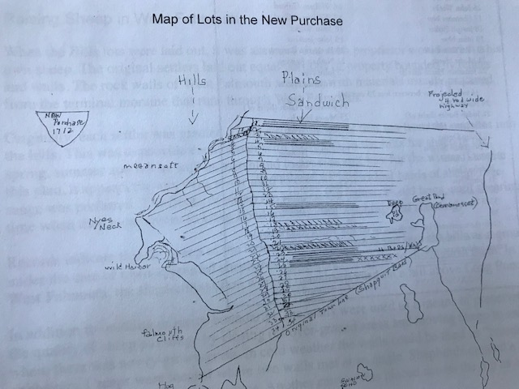
Proprietors and farmland
Land in West Falmouth was laid out in a series of transactions that began with the purchase of land from the Native Americans which was approved by the Colony Court. Each proprietor was awarded land on the hillside for pasture and wood and land along the bay for farming.
18th Century Deeds by Dorothy S. Svenning, (Archivest at the Falmouth Historical Society) Spritsail Vol15 #2 Summer 2001.

Slide 14
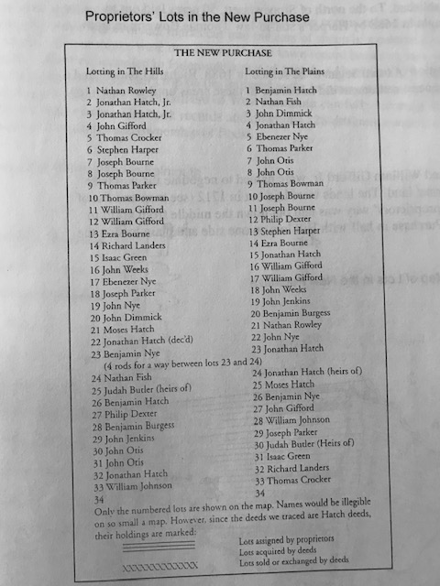
West Falmouth
Proprietors
Town appointed shepherds cared for groups of sheep in the hills east of the village. Remnants of a sheep yard can still be seen on a hill above Long Pond. Walls were built so that sheep could be moved from over grazed areas to areas with fresh grass. Free ranging sheep led to the creation of a number of town paid positions, including Fence Viewer, Pound Keeper, and Field Driver.
18th Century Deeds by Dorothy S. Svenning, (Archivest at the Falmouth Historical Society) Spritsail Vol15 #2 Summer 2001
Reprinted in
Sheep and Wool in Nineteenth-Century Falmouth, MA: Examining the Collapse of a Cape Cod Industry
Leo Patrick Ledwell University of Massachusetts Boston

Slide 15
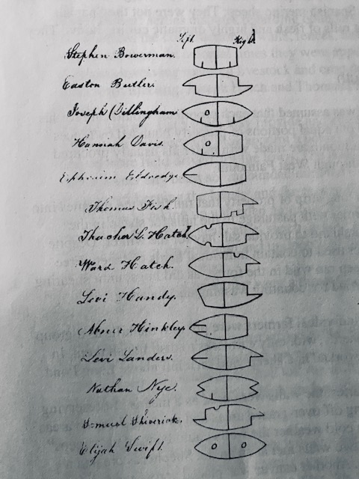
Ear Marks Distinguished
Roaming Sheep
In the 1700s wolves were especially troublesome in Falmouth, so the town approved paying an additional 5 pounds over the price of twenty schillings for every wolf killed.
Farmers had to rely on itinerant sheep shearers to prepare the wool for home production or market.
While wool was the primary product, farmers also sold or traded mutton.
Woolens Industry by Jennifer Stone Gaines Spritsail
http://woodsholemuseum.org/oldpages/sprtsl/v21n1-Wool.pdf

Slide 16
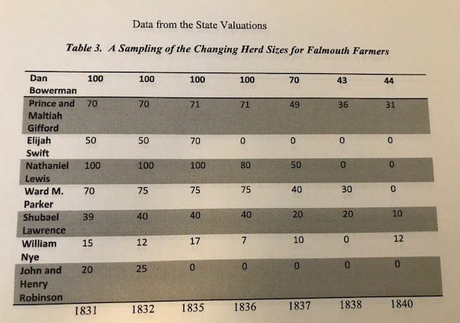
Sheep in decline
Table 3. A Sampling of the Changing Herd Sizes forFalmouth Farmers
Prior to 1830 there was a market for small sheep farmers. After 1830, mills chose to look to Naushon Island for wool, as it was easier to contract with one herd of 1,000 sheep, than it was to do business with multiple small farmers.
Sheep and Wool in Nineteenth-Century Falmouth, MA: Examining the Collapse of a Cape Cod Industry
Leo Patrick Ledwell University of Massachusetts Boston

Slide 17
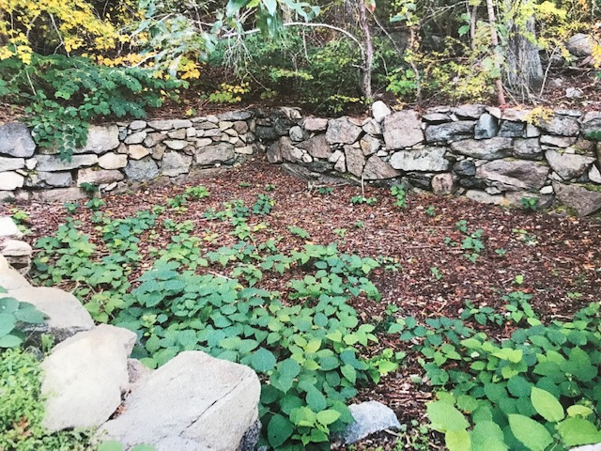
West Falmouth Town Pound
Hidden behind brambles and trees at 825 West Falmouth Highway are rocks that are steeped in colonial history. The rocks are what remain of the West Falmouth Pound, a livestock shelter.
Historic Home For Wayward Sheep Gets Sheared
By Amanda Haines
Falmouth Enterprise
Oct 26, 2018

Slide 18
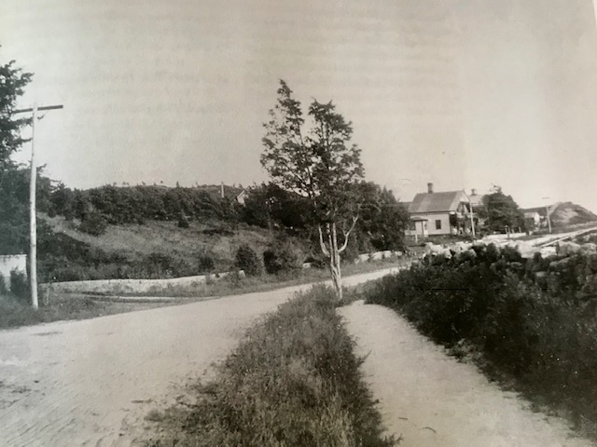
Farming and the Village Landscape
Photo
H.G. Curless c. 1897
This picture of the Seth Allen Homestead (looking south towards the village) shows the rural landscape of West Falmouth in the late 1800s. Seth Allen was a mariner, like his father, Captain Seth Allen. In 1837 he married Christina Hamblin, sister of Captain John C. Hamblin. When Seth returned to port in the 1850s he needed a vocation, so he took up farming, and he and
Christina took in boarders to make ends meet.
Jenkins

Slide 19
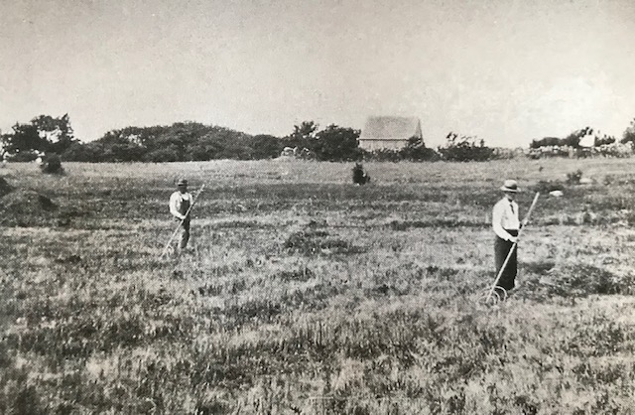
Salt Marsh Hay
West Falmouth Library
Archives
Photo c. 1896 by
H. G. Curless
Gathering salt marsh hay on the Great Sippewissett Marsh. The hay was hand-raked into piles called staddles.
Staddles were raked onto sledges and pulled from the marsh to the farm by horses or oxen.
Jenkins

Slide 20
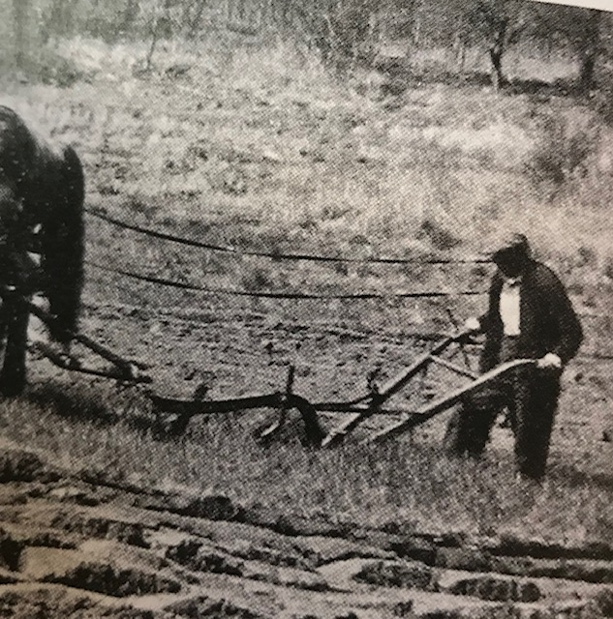
Land Cultivation
West Falmouth Library
Archives
Hand plowing the open fields was time consuming and exhausting, but farmers in the 19th century needed to harvest any resource to provide for their families. The major agricultural product was livestock, particularly merino sheep. Most farms raised cattle, hogs, horses, grains, vegetables, and fruit. Most of the Bowerman homestead was sold during the early1900s to developers of Saconesset Hills.

Slide 21
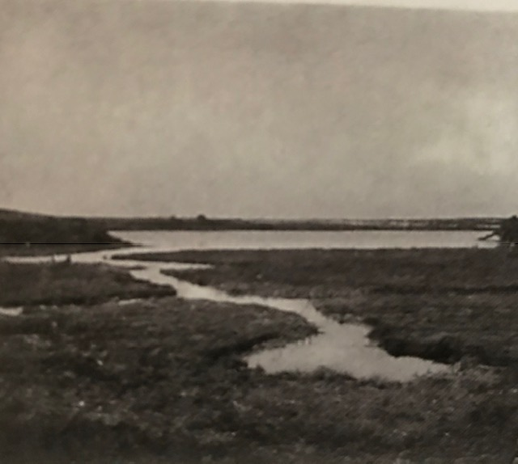
Historic View of the Oyster Pond
West Falmouth Library
Archives
Photo by H. G. Curless c. 1896
Oysters were important as a food source and as a bartering resource for both the Native Americans and the colonists.
Stephen Diliingham and William Gifford formed the Oyster Pond River Company in the 1800s in order to control the harvesting of oysters and herring in the ponds and rivers of West Falmouth.

Slide 22
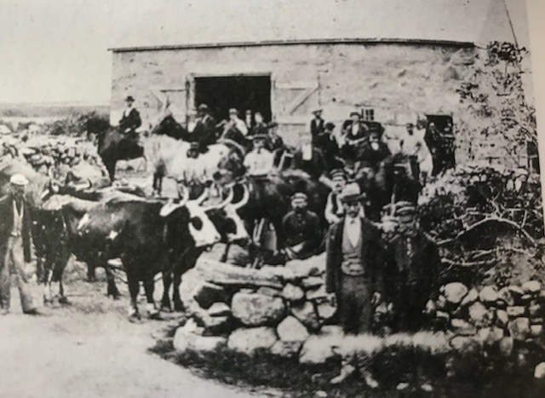
Farmstead-William Gifford IV
West Falmouth Library
Archives
William Gifford of Sandwich was the first to settle in Suckanessett. His family became very prosperous.
This picture shows the farmstead in the mid 1800s on land inherited by William Gifford IV. Note the pink granite barn in the background and the animals gathered in front. This view appears to show the farmstead as the staging area for the railroad, which was built through West Falmouth in 1871.
Jenkins

Slide 23
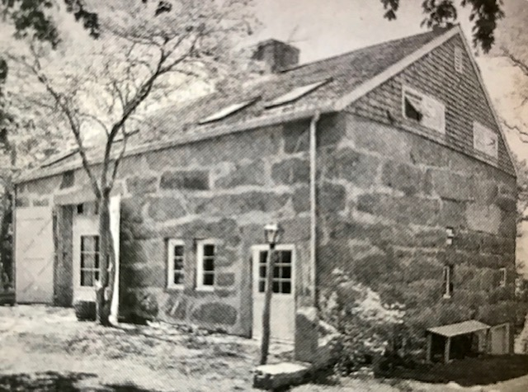
Pink Granite-William Gifford IV
Photo
James Higgins 1998
William Gifford IV used pink granite to build this barn on the Gifford homestead in the mid 1800s. Pink granite is found all over the world. The concentration of pink granite along the glacial moraine in West and North Falmouth is significant.
The barn stands today, but it has been converted into a private dwelling.
Jenkins

Slide 24
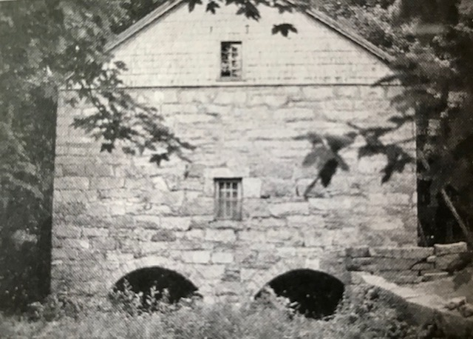
Pink Granite-George and Daniel Weeks
Photo
Peter Stott c. 1989
George and Daniel Weeks were both stone masons. George built his house in 1828, using pink granite as the foundation. He began building the barn in the mid 1800s but died before it was completed. His son, Daniel, inherited the property and completed the barn, which still stands.
Jenkins

Slide 25
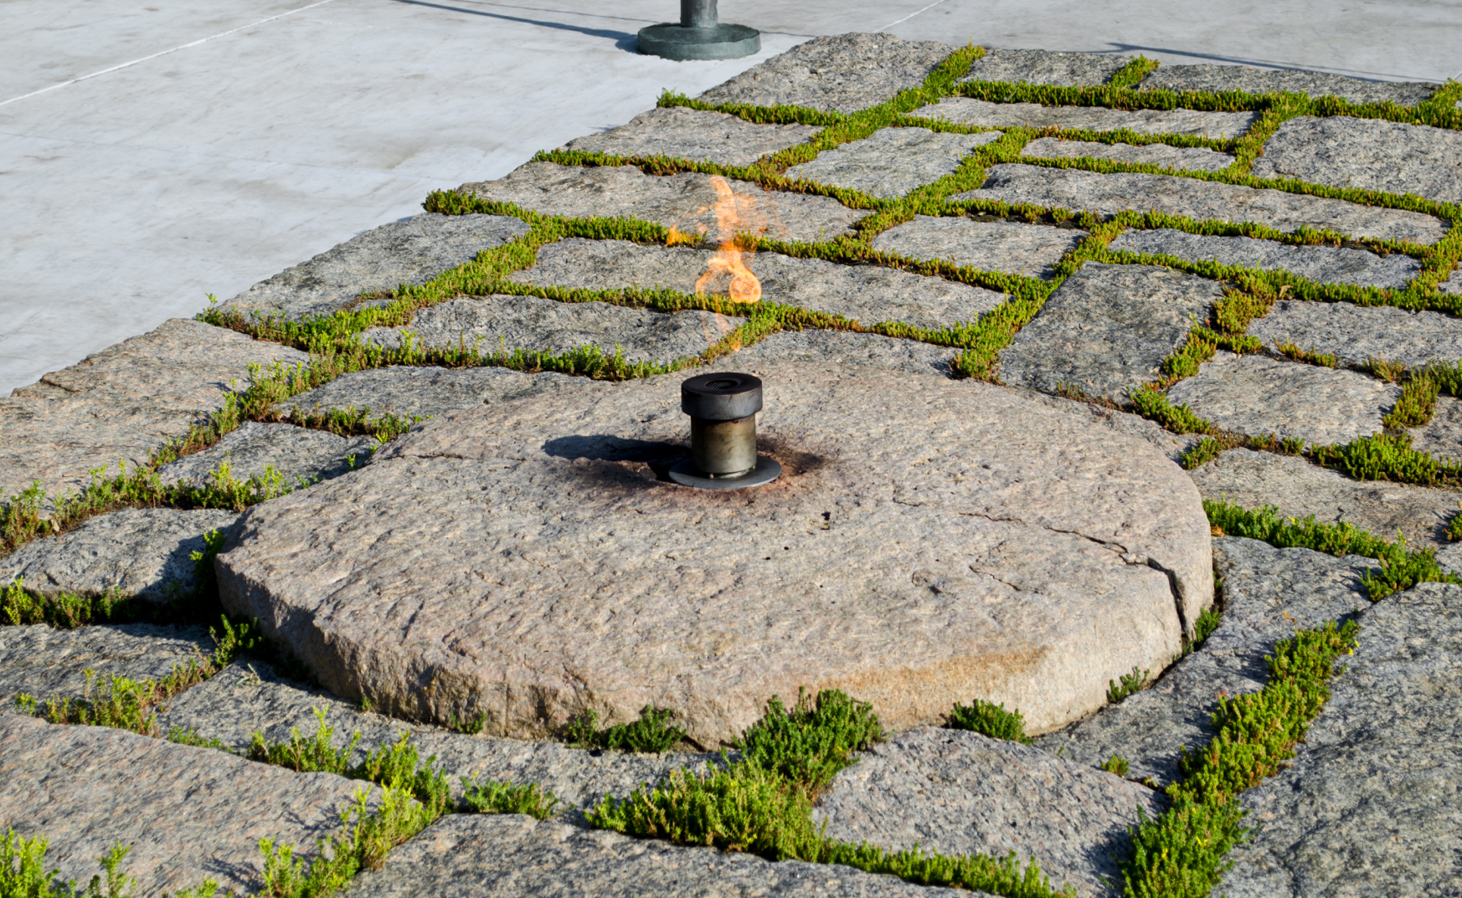
Pink Granite-The Eternal Flame
Arlington Cemetery
The Eternal Flame
The 3.2-acre Kennedy gravesite is flanked by pink granite stones quarried in West and North Falmouth about
150 years ago.
In 1967 Jackie Kennedy sent Rufus O. D Garland, a Falmouth antiques dealer and Antiquarian store owner, to find pink granite for the site. He traveled from his store on Palmer Ave to the Baker Monument Company on Jones Road to find the granite she desired.

Slide 26
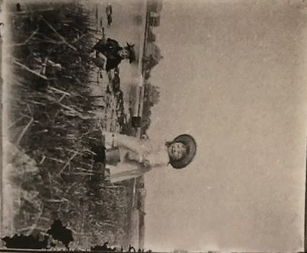
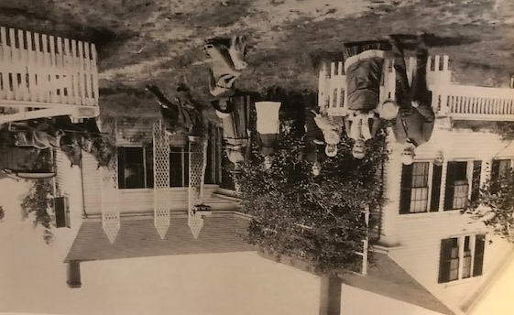
Mostly work but some play
Two young girls playing in Sippewissett Marsh.
The Browning Swift house in the late 1890s. Family and friends.

