Slide 1
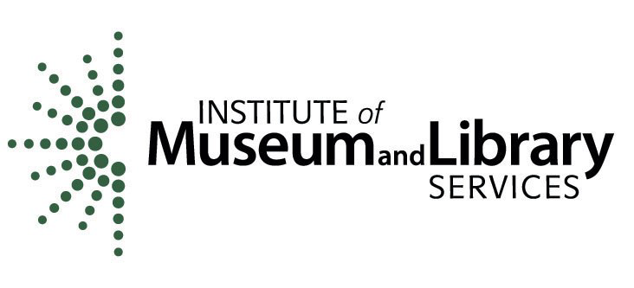
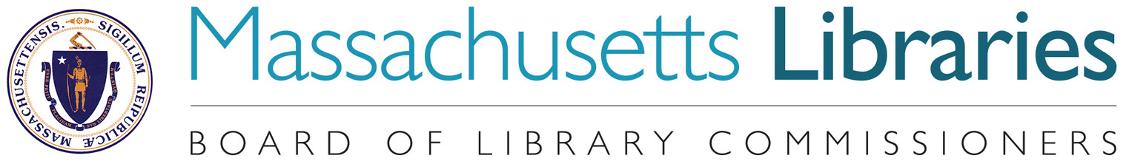
West Falmouth
Economy 1800s– Part II
SATURDAY, February 23 – 10:30AM
POSTERS AND SLIDE SHOW Funded with a grant from the institute for museum and library services
administered by the Massachusetts board of library commissioners

Slide 2
Thank you to the following contributors:
Historians:
Deyo, Simeon-The History of Barnstable County, Massachusetts, 1620-1637-1686-1890
Jenkins, Charles W-Three lectures on the early history of the town of Falmouth : covering the time from its settlement to 1812
Jenkins, Candace-Between the Forest and the Bay: A History of West Falmouth as revealed in Its Historic Buildings and Landscapes
Smith, Mary Lou ed.-The Book of Falmouth: A Tricentennial Celebration 1686-1986. Published by the Falmouth Historical Commission.
Local researchers:
Susan Carliss (presenting today)
Lois Hiller, Susan Meyers, Linda Okagawa, Milt Williamson
Tim Jackson and family-Videography

Slide 3
1850-1900 |  | 1850-1900
West Falmouth |  | Falmouth and The Cape
1842-Third Meeting House Opens |  | 1826-Sandwich Glass Factory Built (Closes 1888)
1854-Moses Swift opens Union Store |  | 1849-Henry David Thoreau Walks Cape Cod
1857-First Methodist Church Built |  | 1863-Pacific Guano Works Opens (Closes 1889)
1859-Mrs. Gilbert Boyce Runs Tag Factory |  | 1870-Highfield Hall and Tanglewood Built
1871-Bertha Goes Whaling |  | 1871-Last of 42 Salt Works Torn Down (F&WF)
1872 Railroad Extends through WF |  | 1873-Land Purchased for Heights Development
1872-Hog Island Purchased for Development |  | 1886-Falmouth Celebrates Bicentennial 3,000 attend
1902-Bourne’s Market Opens |  | 1890-Pres. Grover Cleveland Summers in Bourne

Slide 4
USA Events
1848-1855 California Gold Rush – Over 300,000 Rush to California
1852 Harriet Beecher Stowe Publishes Uncle Tom’s Cabin
Abraham Lincoln is Elected President – South Carolina Secedes
1861 Confederate States of America is Established – Jefferson Davis Elected President
Civil War is Declared
1863 The Emancipation Proclamation is Issued
1863 Homestead Act Passed – Settlers Can Own 160 Acres after 5 Years of Residency
13th Amendment Prohibits Slavery – Lincoln Re-Elected
Alaska is Purchased from Russia
1869 Central Pacific and Union Railroads Meet
Chicago Fire Kills 300 and Leaves 90,000 Homeless
1885-1920 Cranberries Become Major Industry – Hundreds of Families Migrate Here
1890 Elizabeth Cady Stanton Forms National American Women’s Suffrage Association
1899 Klondike Gold Rush – Over 100,000 Rush to Alaska

Slide 5
Occupations 1800-1880
Wagon, carriage, coach and sleigh builders, carpenters,
tin smithers, brick makers, harness makers, coopers, tanners, gas and oil light makers, gristmill operators, quarry excavators and cutters, traveling salesmen, teachers, and preachers, sailing packet agents and operators, stone cutters, ship builders, riggers, sail makers, milliners, gardeners, farmers, fulling millers, salt workers, investors, candlestick makers, oil cloth producers, photographers, lecturers, tag stringers, store owners, traders, building designers and builders, land developers, train agents and dispatchers, telegraph operators, carriage operators, sailors.

Slide 6
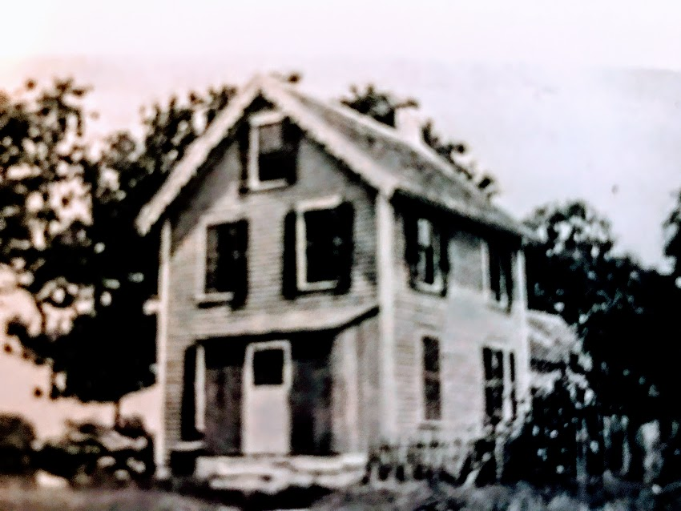
Tag Factory 1859-1916
The Tag Factory resulted from the
marriage of George Swift (WF)
to Matilda Dennison.
Aaron Dennison, Matilda’s brother,
designed fine watches in Boston.
Unsatisfied with available shipping boxes, he enlisted the family to help build new boxes, eventually designing the first box cutting machine in 1844. He sold the business to his son Eliphalet Whorf (E.W.) Dennison in 1855. E.W. Dennison invented a shipping tag with a washer that reinforced the hole to help guarantee the tag
would arrive with its product.
He patented the tag in 1863.

Slide 7
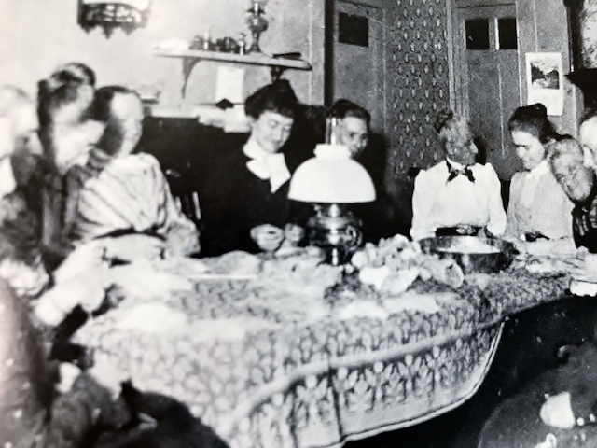
Tag Factory 1859-1916
The Tag Factory spanned four decades. Mrs. Gilbert (Annie R.) Boyce managed the business for more than thirty years,
initially out of her home.
By1879 several hundred people were employed (mostly women).
Those tying tags were paid
12 to 17 cents for a thousand tags.
In 1887 The Falmouth Local credited a Davisville woman with tying 6,000 tags in one day.
At its peak, payroll was
$12,000 a year.

Slide 8
Shipbuilding and Coastal Trading

Slide 9
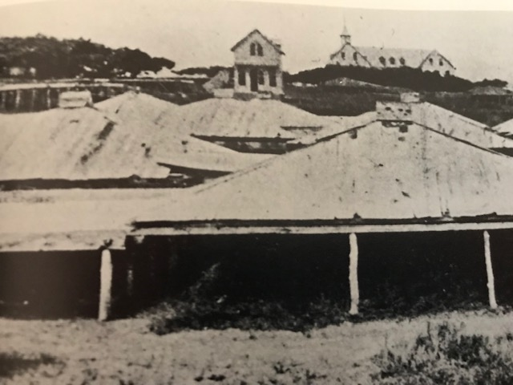
Salt Works-Falmouth
By 1830 there were 42 individual salt manufacturers in greater Falmouth producing 24,000-35,000
bushels of salt per year.
Salt was one of many cargos carried on coastal schooners and sloops that sailed out of the harbors of Waquoit, Woods Hole, Quissett, and West Falmouth.
An embargo placed on foreign goods (to punish Britain in the War of 1812 for aggressive acts) drove the price for Cape Cod salt to $1.25 a bushel.

Slide 10
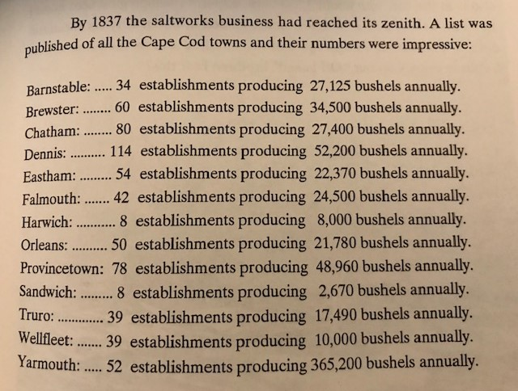
Salt Works-Production
This chart shows 658 establishments producing 662,195 bushels of salt in 1837. By 1877 salt deposits were discovered in upstate New York.
The Erie Canal was completed in 1825.
New York salt was shipped via the Canal to major East coast markets.
The demand for salt as a preservative
on whaling ships decreased.
When the Embargo of 1812 was lifted, the price of salt dropped to 40 cents per bushel. Salt works on the Cape were abandoned by 1880.

Slide 11
Salt Production
Sea water was pumped by windmills through wooden pipes to rooms or vats.
The brine was left to concentrate for five weeks.
Brine was floated to “pickle rooms” to crystallize.
Partially crystallized salt was moved to salt rooms or vats to dry further.
The bitter water that was extracted was used to make Epsom salts.
Glauber’s salts (the end of the process) were used in glass making, hide tanning and textile production.
The final residue water was turned to cement for cornices and filigree work.
350 gallons of sea water produced one bushel of salt. Producers had difficulty finding workers (who were not at sea) to watch the vats
to make certain they were covered in case of rain.
http://woodsholemuseum.org/spritsail/saltworks.pdf

Slide 12
Salt Works-West Falmouth
The hurricane of 1815 destroyed many of the salt works, but there was so much money to be made that most were rebuilt. The Cape Cod salt industry continued to grow until it reached its peak between 1830 and 1840.
Nearly every West Falmouth household manufactured salt in some fashion, including Daniel Bowerman, William and Theophilus Gifford,
Ephraim Sanford, Marcus and George W. Wicks, Adrian Davis,
James and Silas Gifford, Joseph and Stephen Dillingham, Elijah, Seth, Daniel, Joseph, Silas and Moses Swift, Benjamin Crowell, Walter Davis and Zebulon Bowman. The last West Falmouth salt works was operated by
Nathaniel Eldred, a. retired sea captain, who sold his plant
to S. F. Swift, who discontinued it in 1871.

Slide 13
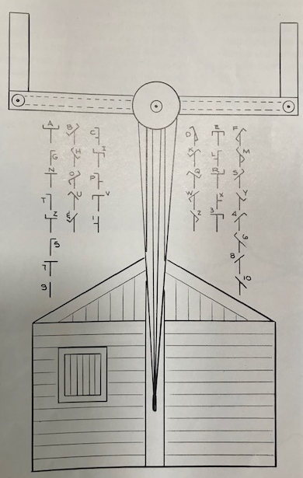
Telegraph Hill (off Blacksmith Shop Rd.)
A semaphore telegraph machine was put in service on Telegraph Hill in the 1840s, replacing a Revolutionary War system which used a series of flags. Signals were sent from the Vineyard to Boston to announce the location of ships making their way through Vineyard Sound. Semaphores were located on six hilltops between Falmouth and Boston; the sites for each were named Telegraph Hill. The mainland station was located in Quissett. This system is considered to be the oldest telegraph system in the United States. Messages from Quissett to Boston (70 miles) were conveyed in 12 minutes. One man, based in the hut, pulled ropes to operate the arms.
“Boston’s First ‘Wireless’ Telegraph Brought News From Vineyard in180,.” Boston Sunday Globe, April 29,1929.

Slide 14
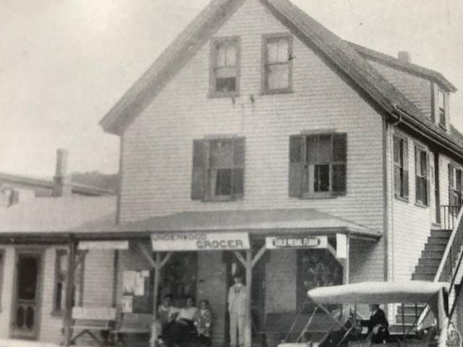
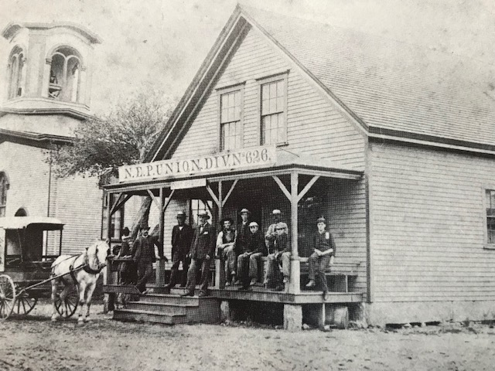
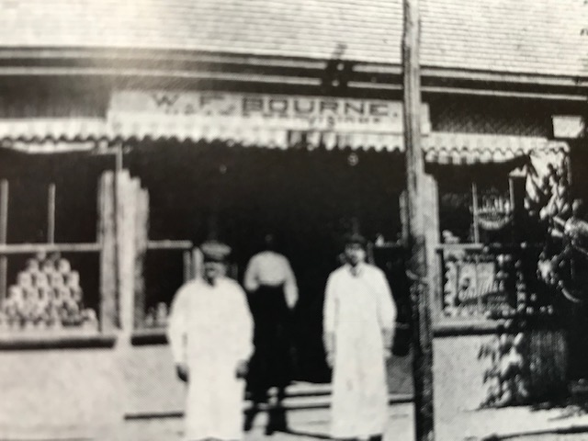
West Falmouth Stores
The Union Store moved and became the Underwood & Bemis store in 1895.
Bourne’s Market opened in 1902.
The Market offered fresh meat, dry goods and grocery delivery, besides selling storage
space to summer visitors.
The Union Store was organized by Moses Swift
In 1854. It was resident owned with profit sharing.

Slide 15
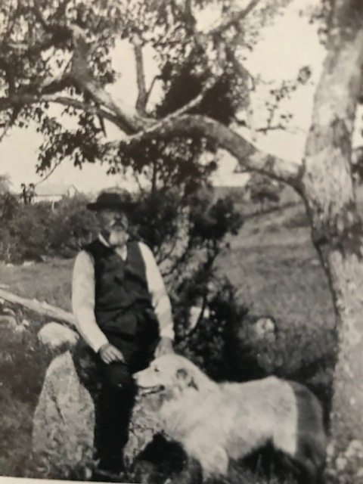
Brick Kiln-Buried Under Route 28
Colonel Edward H. Thompson, son of Josiah, in a lecture at the Falmouth Library told the story about his father, “who one day while hunting and trouting, stumbled upon a bed of clay
off Brick Kiln Road”.
Josiah bought the land and hired a carpenter from Worcester, his home area, to build a shed and barracks.
The kiln operated until 1897, producing scouring brick, a molded mass of abrasive earth used for scouring steel knives and bright metal surfaces.
Colonel Edward Thompson served 25 years as U. S. Consul in Yucatan. He left the post in 1891 to devote
his time to archaeology. https://www.nytimes.com/1964/09/27/archives/yucatans-sacred-well-remains-unfathomable.html

Slide 16
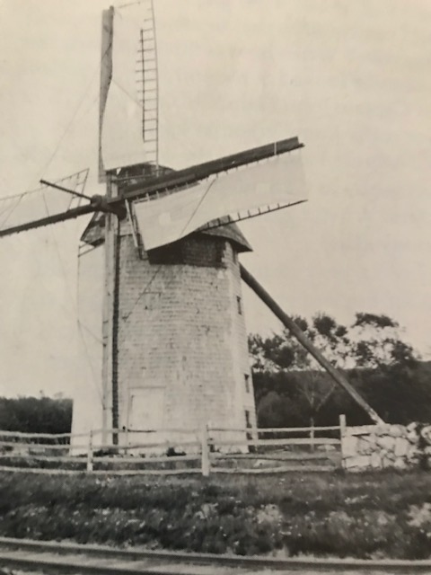
The Historic Windmill
Nothing quite captures the spirit of West Falmouth better than the turbulent history of the windmill. The windmill was built by Jesse Gifford in 1787 for investors: Joseph Bowerman, Stephen Dillingham, and Richard Lake. By 1887 the windmill was owned by Silas Swift (also an agent for the Old Colony Railroad). Silas arranged for carloads of grain to be unloaded in Wareham and trucked to West Falmouth for grinding, “because it did not pay him to grind less than 10 bushels at a time.”
When reliance on agriculture declined in the late 1800s, the windmill sat unused and in disrepair.
In 1922 it was sold to Dutchland Farms Ice Cream Company and moved to Brockton, where it burned down in 1924.

Slide 17
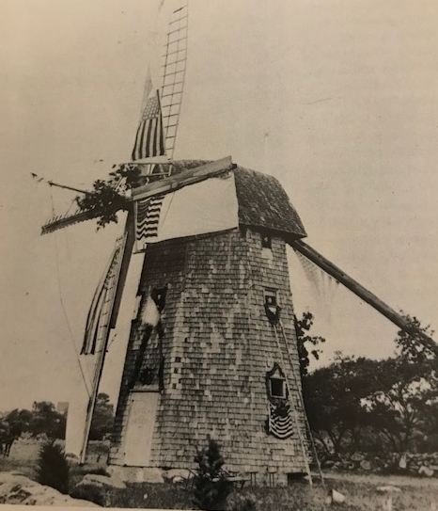
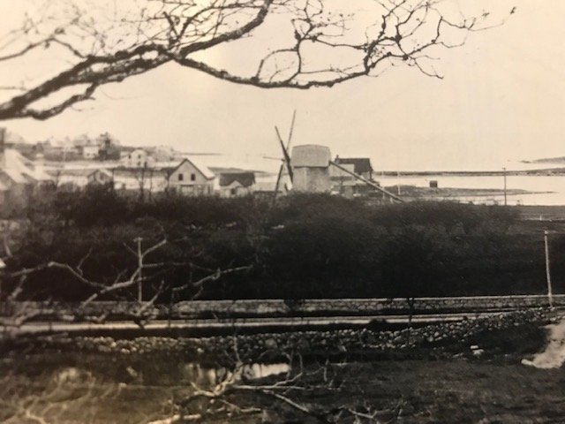
The Historic Windmill-Two Views
Looking across the Harbor towards Chapoquoit Island and Little Island Road
Decorated for the 1886 Centennial

Slide 18
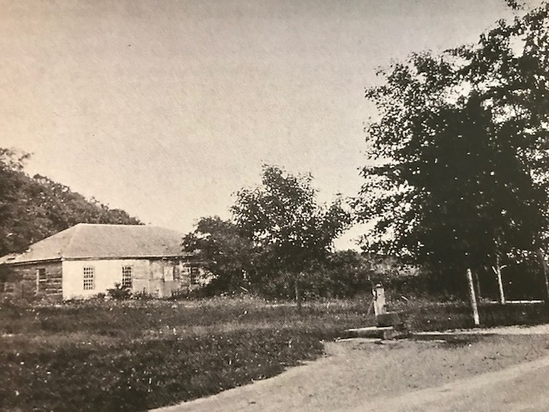
Village Blacksmith
The job of village blacksmith was essential to the local economy.
The blacksmith fashioned and repaired tools and hardware for agriculture, building trades, marine industries, and home businesses.
Richard Lake was the first village blacksmith, arriving from Rhode Island in 1778.
In 1790 Richard sold 150 acres of land and buildings to Abial Swift. Abial’s sons, Seth and Daniel, continued the business through the end of the century, adding a shipbuilding yard, a salt store, and a village general store. Providing goods and service to coastal traders who stopped at
Silas Swift’s waterfront dock.
Photo: H. G. Curliss 1897
The pink granite building survives today behind C. H. Newton on Blacksmith Shop Road.

Slide 19
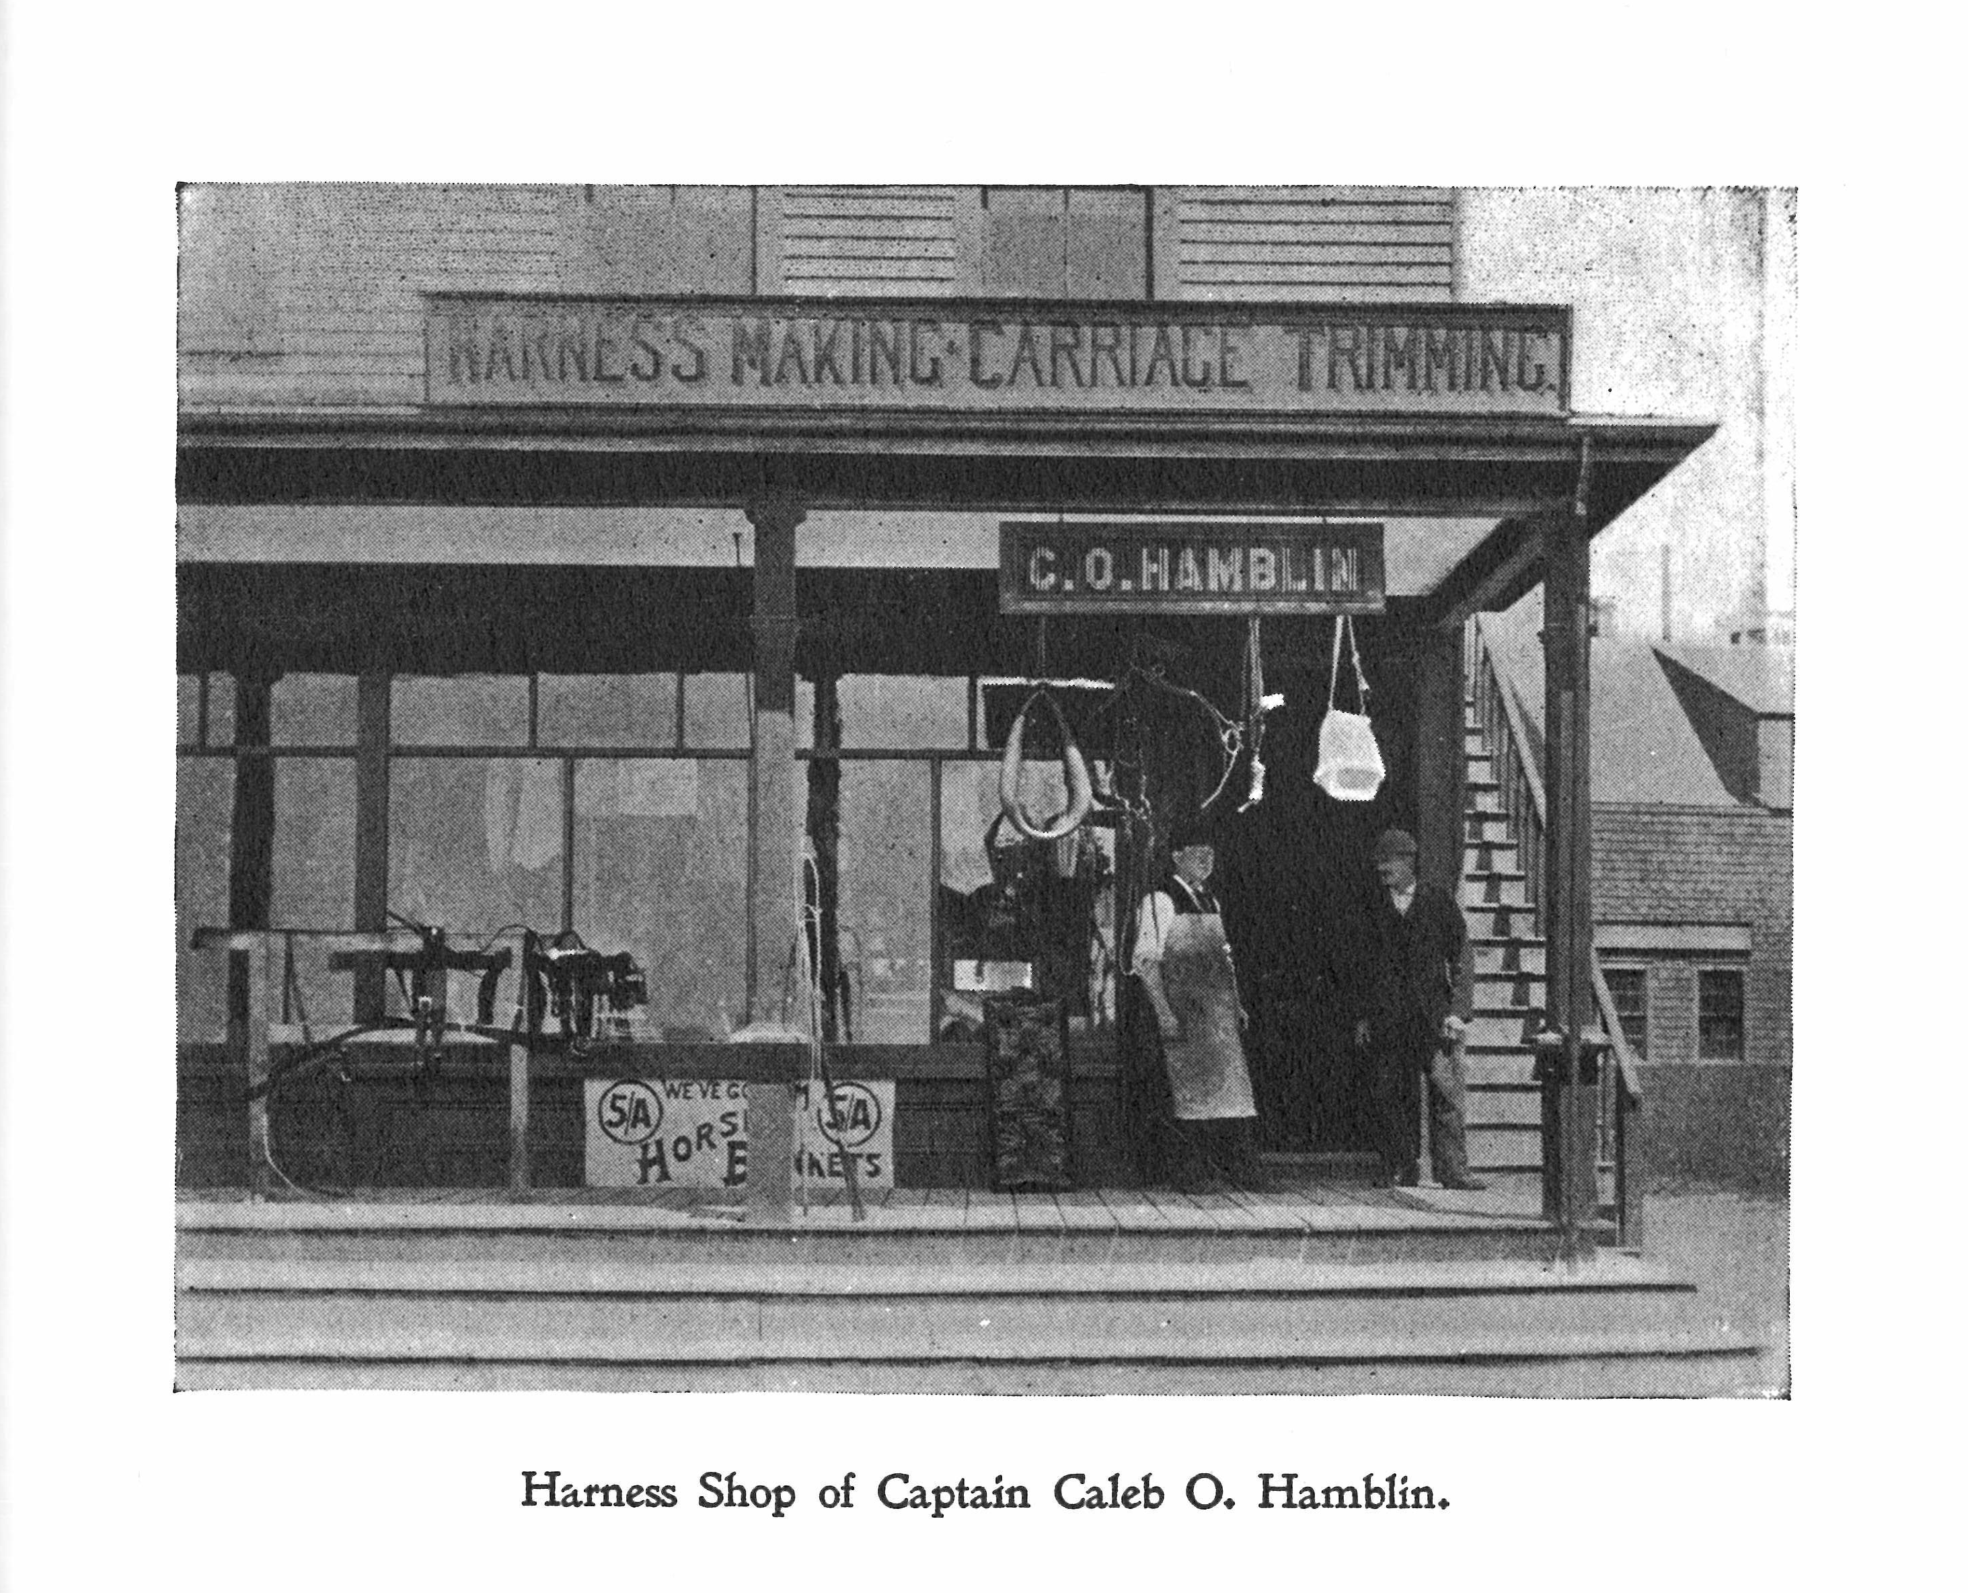
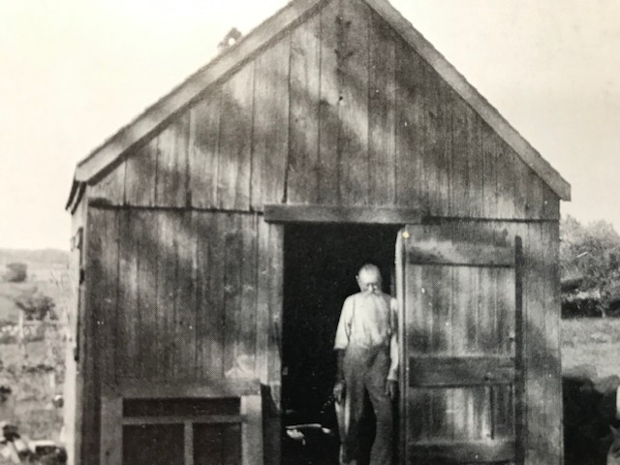
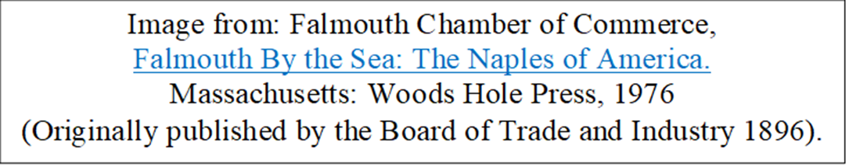
Trades - Harness Shop, Carpenter
Uncle Silas, the village carpenter
Smith, Mary Lou ed.-The Book of Falmouth: A Tricentennial Celebration 1686-1986. Published by the Falmouth Historical Commission.

Slide 20
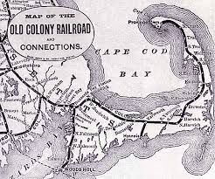
Cape Cod – Old Colony Railroad
In 1848, the Cape Cod Branch Railroad laid the first railroad tracks from Middleboro to Sandwich to serve the glass factory. In 1854 the Cape Cod Branch Railroad became the Cape Cod Railroad. By1865, The Cape Cod Railroad laid tracks to Orleans.
In 1872 tracks were laid to Woods Hole (to serve the guano factory)
and finally to Provincetown.
In 1872 Cape Cod Railroad merged
with Old Colony and Newport to become the Old Colony Railroad.
As rail service increased in the mid-1800s, the use of sailing packets and stage coaches declined.

Slide 21
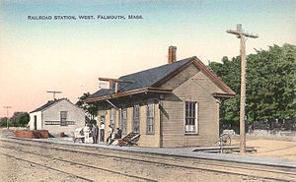
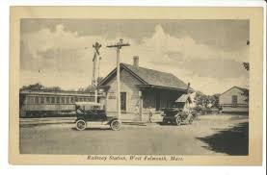
West Falmouth Station
falmouthpubliclibrary.org
The railroad station also served as a telegraph and post office. Silas Swift was station agent and telegraph operator for many years. He also served as the village miller.
The Village Depot was built at the head of West Falmouth Harbor.
Mail was dropped off twice a day.

Slide 22
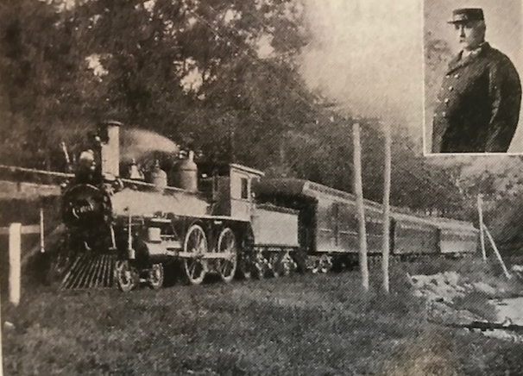
The Dude Train
For 33 summers, from 1884 to 1916, the “Dude Train” carried travelers from
Boston to Woods Hole
Wealthy Bostonians had to buy memberships to ride. Families were assessed $100 per person,
about $2,500 in today’s currency, plus regular rail fare each way.
The original make-up of the train included a combination baggage-smoking car and two drawing-room cars, named Naushon, after the Forbes’ island, and the Mayflower.
Augustus S. Messer, long time conductor
http://www.mvmagazine.com/news/2017/07/01/riding-dude

Slide 23
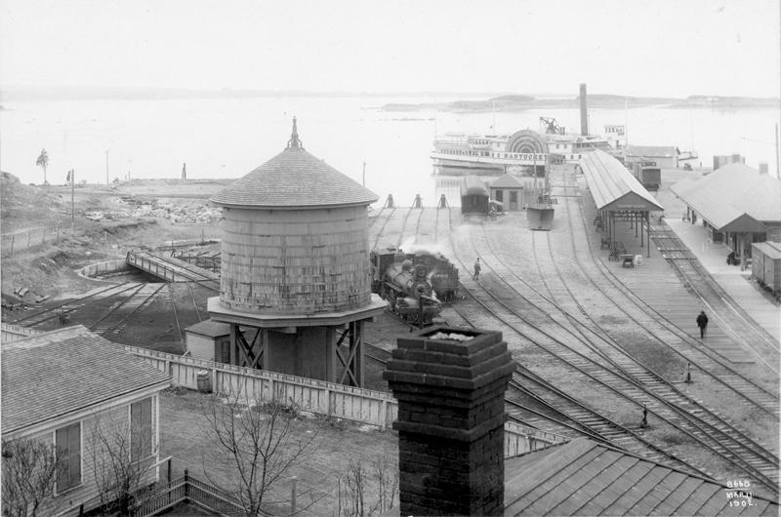
Woods Hole Terminal in 1902
WOODS HOLE HISTORICAL MUSEUM ARCHIVES http://www.mvmagazine.com/news/2017/07/01/riding-dude

Slide 24
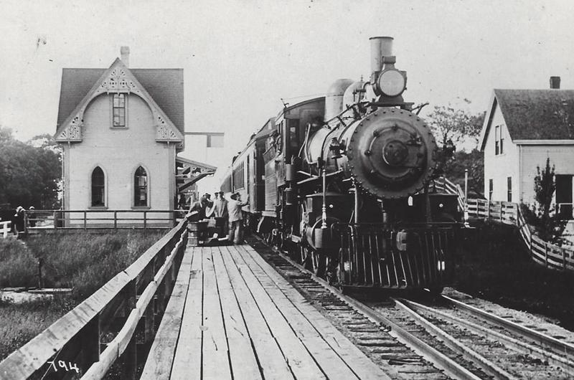
Cataumet Station
Courtesy: Bourne Historical Society http://www.mvmagazine.com/news/2017/07/01/riding-dude

Slide 25
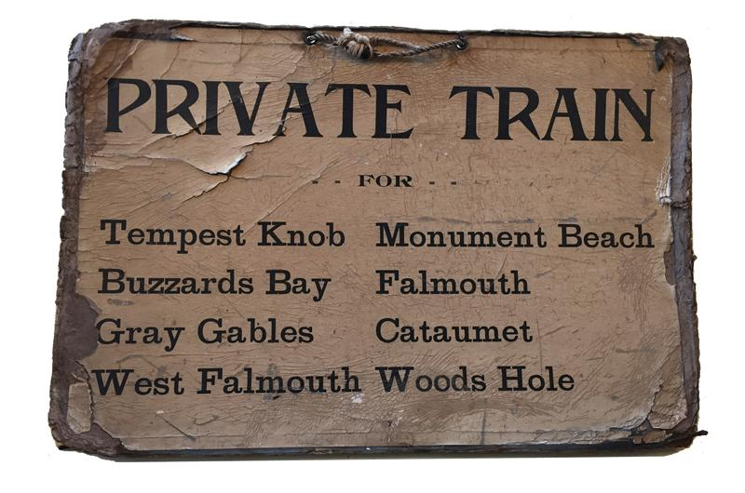
Sign at Boston Kneeland Street Station
Courtesy: Bourne Historical Society
http://www.mvmagazine.com/news/2017/07/01/riding-dude

Slide 26
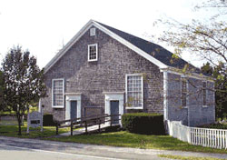
Religion-Society of Friends Preparatory Meeting House
Village residents identified primarily as Quakers or Methodists in the 1800s.
Both groups kept local trades persons busy building churches, meeting houses, schools, storefronts, and homes for residents and tourists.
The Quaker Meeting House was built three times
(in 1720 on the Old West Falmouth Highway; again in 1770, and expanded in 1794, at its present location; and razed and rebuilt in 1841 at the present location).
Photo: http://www.capecodquakers.org/falmouth.html

Slide 27
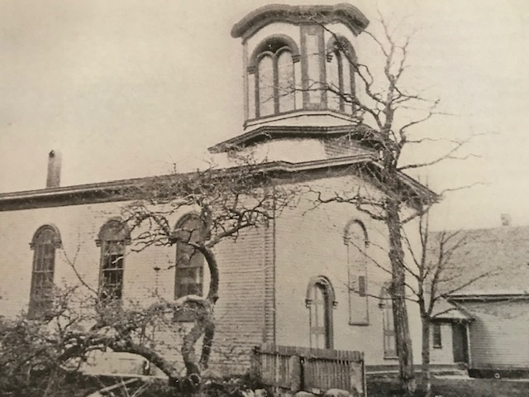
Religion-Methodist Church
The first Methodist church was built in 1857 on land donated by Silas Eldred. Alvin Crowell managed construction, and Rev. Charles A. Carter was named pastor. In 1900 the existing church was deemed irreparable and a new church was built directly across the road by Fred. N. Bowman and crews from the village. Pews were sold to parishioners to raise money to fund the church, and residents canvased the area to raise funds to pay off the mortgage in 1907.

Slide 28
Methodist Preachers
Both the Meeting House and the Methodist Church relied on traveling itinerant preachers or shared preachers/leaders for leading services. Deyo provides this list of pastors who served the Methodist parishioners:
Rev. R. H. Dorr, A. S. Edgerly, S. Hamilton Day, Moses Brown, Mr. Roach and Mr. Stephenson; student Rev. J. S. Davis was a supply for two years prior to April 1, 1881; E. H. Hatfield succeeded for two years; and J. O. Dening, George M. Meese, William H. Sommers, J. C. Bell and Fred. L. followed.
Many of the preachers who have supplied this pulpit have been students at the time, and a salary of three to four hundred dollars has been paid each year.”
Virginia Landers, Church Historian provided this story:
“A number of student pastors filled our pulpit in the early 1900 and in 1919, one young man was unfortunate that when he spoke his teeth did not show. Following the service one morning, one of the kind-hearted summer friends said to him, “Brother don’t you think you could speak better if you had teeth?” and he offered to buy him some only to find out that it wasn’t necessary.”

Slide 29
Quaker Leaders and Preachers
“Quakers believe that we all share responsibility for the practical spiritual work of caring for our faith community.” https://neym.org/learn/faq#organizing
This concept of equality extended to the idea that both sexes were equal in spiritual matters. Early Quakers believed that women had the same authority to preach in meeting as men did; and, like their male counterparts, women often traveled in their ministry.
In the 1800s women participated fully in meetings and their decisions and participation were considered equal to the men’s governance.
https://philadelphiaencyclopedia.org/archive/religious-society-of-friends-quakers/
By the end of the 19th century, West Falmouth was no longer a Quaker enclave. In 1902 , the Swift brothers, concerned about low attendance, recruited a Quaker preacher, Elam Henderson to lead the Meeting. He remained 15 years. After he left, the Meeting was held only during the summer. Dr. Elihu Grant, a professor of Biblical History and Literature at Haverford College, lectured and drew Quakers and other residents to meeting.

Slide 30
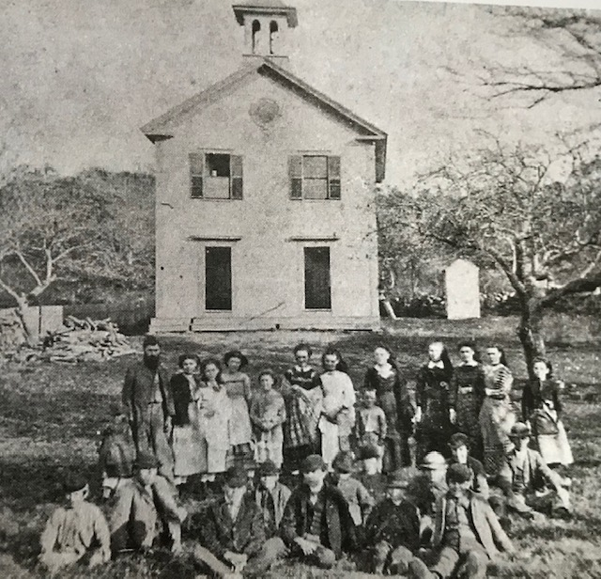
Village Schools
By 1850 there were nine district schools in Falmouth. West Falmouth built five schools in the 1800s. District School #5, was built in the southern half of the village circa 1810.
(721 WF Highway) and District School #6 was built in the northern half of the village circa 1810 (737 WF Highway.) The Friends built a school in 1831 on the site of the West Falmouth Library.
All three schools combined in the mid 1850s in a new building located in the village center, the corner of Blacksmith Shop Road and WF Highway. This school was replaced with a modern building in 1887.
The modern building (indoor plumbing). Courtesy of Cecilia Fuglister and the Falmouth Historical Society.

Slide 31
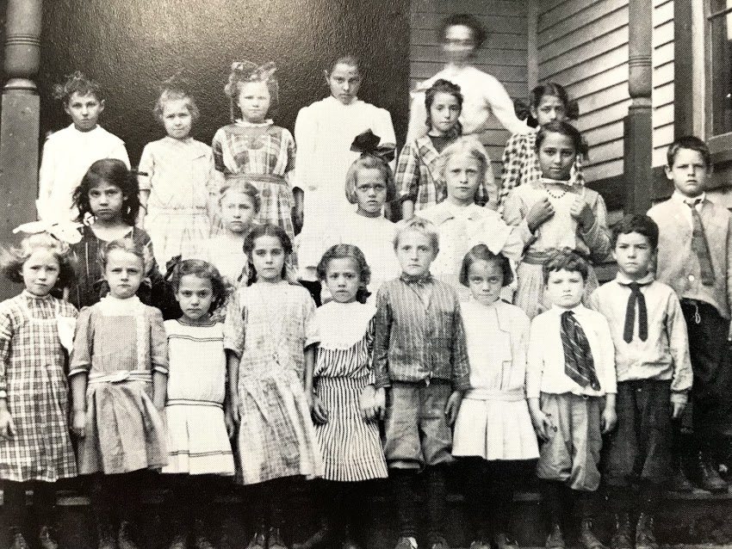
Village School
Falmouth Town Report 1873
“Mr. J . F. Davis, a teacher of long experience and uniform success (assisted by Mrs. J. F. Davis) was paid $185.00 for teaching 12 weeks in the spring and $81.00 for 3 weeks in the fall. The primary Department was taught by Miss H. A. Small of North Truro. Miss Small has proved herself to be a first class disciplinarian, and an excellent teacher.”
Photo was taken in 1910.

Slide 32
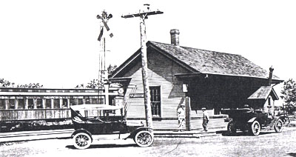
Transportation, Trade, and Tourists
“With the train (in 1872) came the curious, the adventurous and the investors.”
Villages grew, services evolved, and construction boomed. Tourists arrived. Homes became boarding houses, inns and storefronts. New streets were laid out to connect summer colonies to the village.
“It was a time of livery and delivery.”
Carts, wagons, and the stagecoach met trains to transport tourists and to pick up deliveries. Local businesses thrived.
“Tourism and the train” by Leslie McDonald, Falmouth Preservation Alliance
falmouthpreservationalliance.org

Slide 33
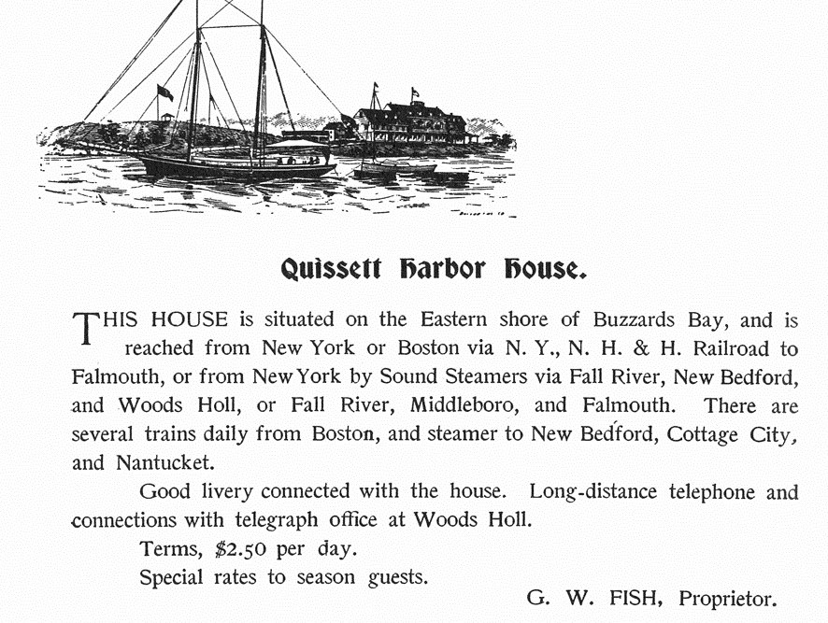
Quissett Harbor House-The First Hotel ?
During the 1860s, and increasingly after the railroad came to Woods Hole in 1872, summer visitors came to stay as guests of the owners of the farm houses on
the Neck at Quissett.
In 1874, Colonel Lewis, from Arkansas, purchased 47 acres and the family home from Susan Eldred Jenkins (Smith). He also bought the Hammond home and began running the Jenkins and Hammond houses as a hotel. Stephen Carey purchased the Quissett Harbor House in 1881 from Jane W. Lewis. The Carey family eventually deeded the property and management to the Quissett Harbor House Land Trust, Inc. and the Salt Pond Area Bird Sanctuaries.

Slide 34
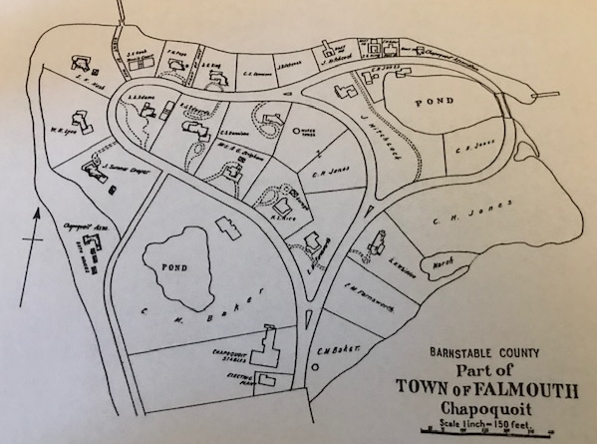
Summer Resort Development
Land development in West Falmouth was led by outside investors and summer residents. West Falmouth’s first planned summer resort was Chapoquoit Island.
In 1872 Franklin King,
a Dorchester druggist, teamed with Falmouth native William Coleman to buy Hog Island from farmers Joshua and Daniel Bowerman.
After the economic panic of 1873, Coleman sold his share to
Charles H. Jones of Whitman.

Slide 35
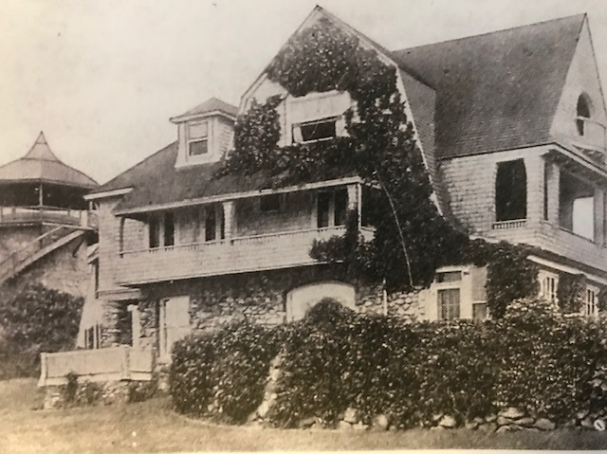
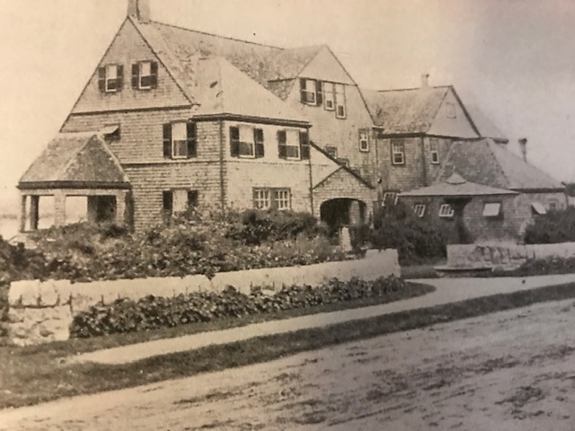
Chapoquoit Homes
Charles H. Jones House 1891.
Photo: Courtesy Nina Heald Weber Collection
Samuel G. King House, 1892.
Sketch: Perry, “A Trip Around Cape Cod 1898.

Slide 36
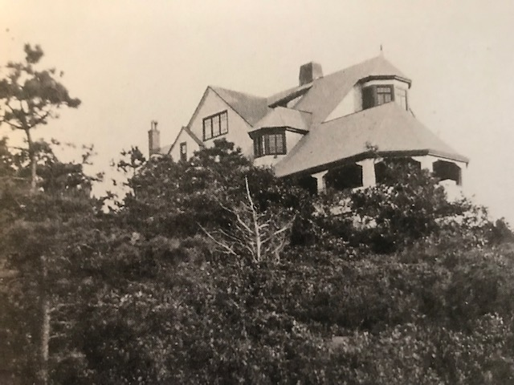
The Frazar House
Recognizing that he could not purchase property on Chapoquoit,
Evertt Edward Frazar, president of the Fall River Steamship Line, built his grand house on the glacial moraine with a view over the bay in 1880.
The house once served as a clubhouse for a group of Falmouth residents who purchased the house and properties in the 1920s and laid out a golf course in 1929. The golf course never materialized. The land was subdivided, and the house returned to use as a private home.

Slide 37
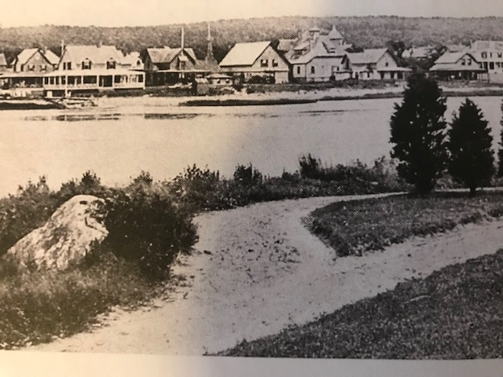
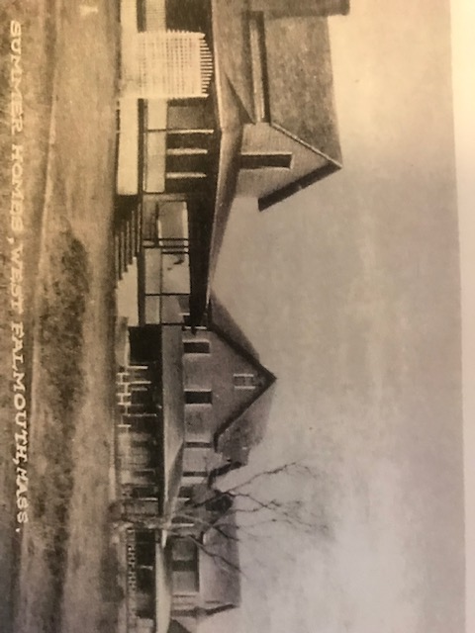
Silas Swift Harbor Lots
10 of 11 lots were developed by 1908
Photo: Courtesy Nina Heald Webber Collection
The View across the water from Long Point
Photo: Courtesy Nina Heald Webber Collection

Slide 38
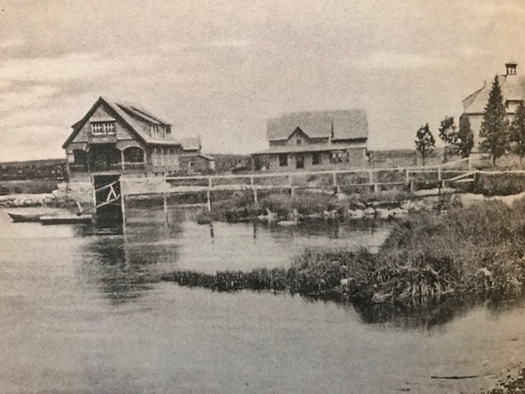
Henry M. Kingman Estate
Henry Kingman, a Brockton shoe manufacturer, built this house in the early 1890s. He purchased the land from local resident Silas Swift, who owned most of the land from the Highway to the Harbor. Silas Swift operated the village mill. He also served as telegraph operator
railroad station master,
and ran a small inn for travelers.
The photo depicts the
Kingman boathouse
and the back of the house.
Photo: Courtesy Nina Heald Webber Collection

Slide 39
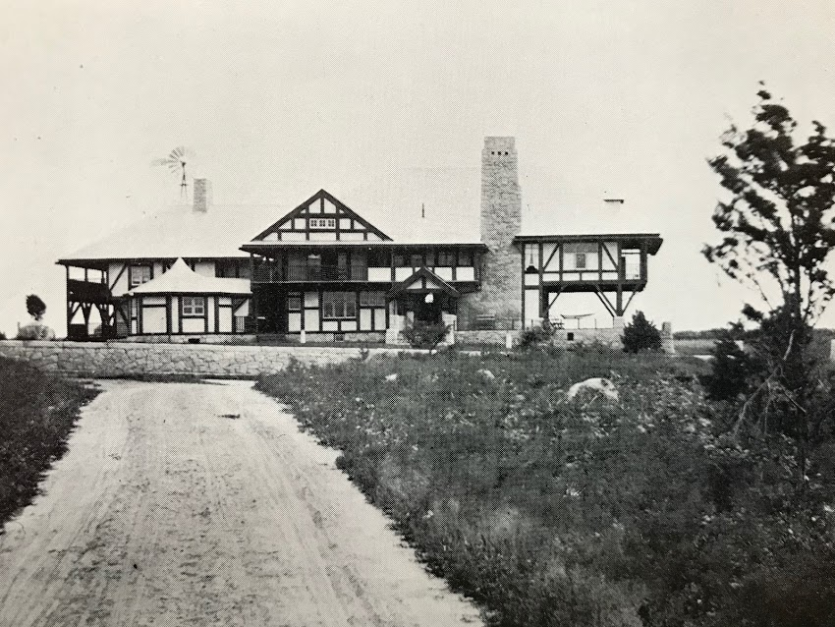
Sara Scull House
Scull House was designed in 1895 by Boston Architect J. William Beal for Philadelphia Quakers Sara M. and William J. Scull. It was sold first in 1911 to a group of Harvard professors, who sold it to Mrs. William Montgomery. She converted it to a boarding house known as Ridgefield Hall, and later simply as “The Inn.” In the 1970s Josiah K. Lilly III purchased the property to serve as the home of the College Light Opera Company.

Slide 40
Whaling

Slide 41
The Methodist Church Opening-A Reflection by John Hoag Dillingham, Quaker
“Some of us were present at the dedication of the first Methodist Meeting House in West Falmouth in the year 1857 and heard the thrilling sermon of the minister and the poem of the men who presented the clock.
The Friends' seemed to welcome the upbuilding of the new church here,
that those who were not in the habit of attending any meeting might have increased gospel privileges.
The relations of the two religious Societies have been every amicable.
A separate paper could well be written of the history of that church, which has been a marked blessing to the place. We remember how devotedly good old Capt. Asa Tobey spent his means and was spent in the service of that church; and the revivals which cheered the heart of Father Brown, Brother Carter, Brother Curless and others whose reward is imperishable.”

